Slide 1
Reading on the Screen
Emily Rozmus, Senior Instructional Speciliast
Notes:
Introduce myself, Lori and Sarah

Slide 2
Notes:
INFOHio is Ohio’s PreK-12 Digital Library. We license digital resources and provide web tools at no cost to Ohio’s students, teachers, and parents. We also provide training and professional development and support many of Ohio’s school libraries.

Slide 3
Vision
Mission
Each Ohio PreK-12 student has equal access to high quality digital resources for a successful education and future.
INFOhio transforms student learning by providing equitable access to quality resources and cost-effective instructional and technical support for each student, educator, and parent in Ohio.
Notes:
If you are introducing INFOhio, or refreshing the audience, you can include this slide. It is not mandatory.

Slide 4
Digital Natives
Notes:
We’re going to start off today by talking about digital natives. This term was coined in 2001 by Mark Prensky to describe those students who were "native speakers" of the language of technology - computers, video games, cell phones, and the Internet. I am going to guess that most of us here are older than 19 years old, and most of us can remember a time before there were pocket-sized computers and something called the WWW. We watched three channels and we liked it! Others will not be able to find a memory of a time when there wasn’t information accessible with a few keystrokes. But I want us to think more about the digital natives in your classrooms today. We are going to start by doing an empathy map for our students. This exercise is intended to help us think like a kid, if only for a little while!

Slide 5
Empathy maps help us learn more about others by putting our understanding of who they are into words.
In each of the boxes below, write what your digital native students might say, think, do, or feel about reading on a screen.
Consider your students’
influences
current technology practice in the classroom and at home
your observations of their practice and behavior
https://bit.ly/EmpathyMapMRESC
Notes:
https://docs.google.com/document/d/1VY_KVZoqlq25vgqHvgQdJyMgwCdXF1ihQy5FpnNKiqE/edit?usp=sharing
We will take three minutes to complete this activity. Use the link provided and type in the boxes what you think your students will say, think, feel, or do when they read text on a screen. Use your observations in the past, the students’ levels of tech practice, and the daily influences to help you complete the map.
Share screen to show progress? Discuss results? How does this influence how we help students read deeply for meaning?

Slide 6
“Kids know everything about technology! My son is only 5 and he knows more that I do!”
Myth #1
“Kids are proficient when using technology for entertainment and social interaction. They still need adults to model and supervise, to help with evaluation and application of appropriate actions. Tech comfy is not tech savvy.”
Notes:
How many of you have heard this from someone? What are your thoughts or reactions when you hear this? Do you have an answer?
<click>Angela Maiers - Watching my 3-year-old niece navigate her way around the screen confirms what my friend, Chris Lehman, has proclaimed for some time; technology is like oxygen for these kids. Their ease with the web is simply amazing.
Being tech-comfy, however, does not guarantee their proficiencies automatically grow into new and sophisticated literacies or on line competenciesas info-sumers, critical thinkers, and savvy participants in a digital space. For many youth, their motto seems to be, “In Google We Trust”, or so says a new studycoming out of Northwestern University; exploring the savvy web skills (or lack thereof) of college students, especially as it relates to search strategies and ability to determine the credibility of search results.

Slide 7
“Print will eventually be extinct. People read everything on devices now.”
Myth #2
“Most people still read print books and will choose print over digital if given a choice.”
Notes:
Scholastic reading report – 65% of kids ages 6-14 will always want to read print.
Mizrachi study – 72% of college kids want the print textbook
2019 Pew Internet Research – 65% of adults who read regularly prefer print.

Slide 8
“Reading on a screen is the same as reading print.”
Myth #3
“When we read online, typical reading processes and practices shift.”
Notes:
Maria Konnikova – Being a Better Online Reader
more skimming behavior: when we scroll, we tend to read more quickly (and less deeply) than when we move sequentially from page to page.
we read more quickly to compensate.
people tended to browse and scan, to look for keywords, and to read in a less linear, more selective fashion.
We become tired from the constant need to filter out hyperlinks and possible distractions. And our eyes themselves may grow fatigued from the constantly shifting screens, layouts, colors, and contrasts, an effect that holds for e-readers as well as computers.

Slide 9
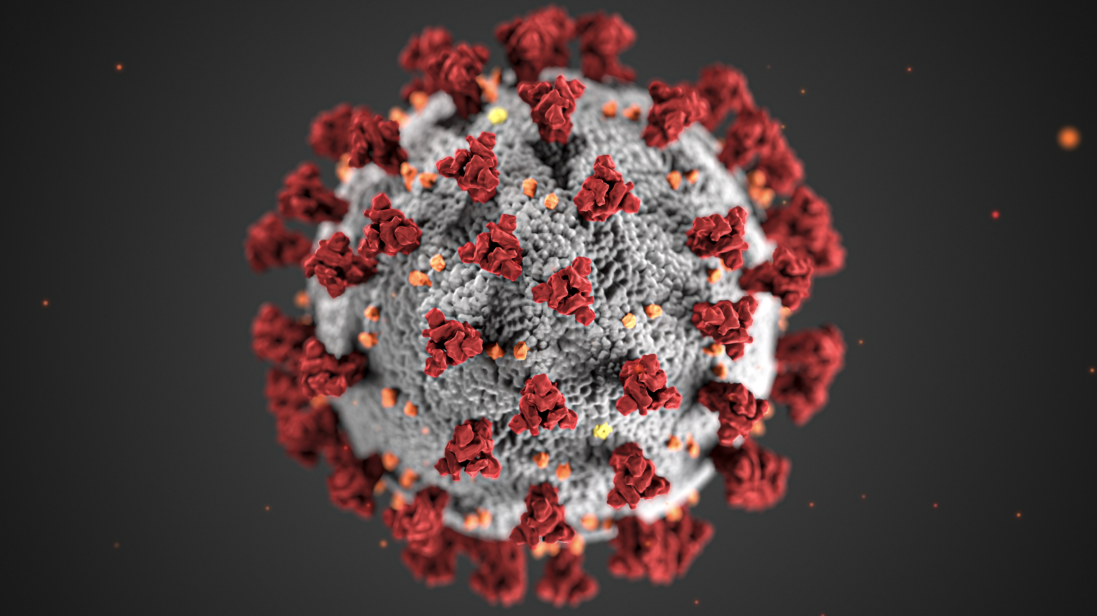
Notes:
Before the pandemic hit, students were already asked to read on a screen for high-priority tasks. Online testing was on the rise, and students with little or no experience reading text on a screen are at a severe disadvantage. Truly, any student who isn’t getting explicit instruction on reading digital text is lacking the necessary skills needed to comprehend, analyze, and synthesize text they are reading on a phone, computer or other screen. The summer slide isn’t our only worry for students; now we need to take into consideration the COVID slide – just how much are our students losing from the cognitive overload of adapting to new learning environments, inconsistent deliveries and approaches, and the inevitable anxiety and stress?

Slide 10
Notes:
Our ultimate goal is to create life-long learners who can read text in any format or consume media and successfully evaluate it to determine whether it is reliable, accurate, and factual. I call this reading in the digital wilderness. Before we send any students into the wilderness, we need to prepare them – our digital natives – the right tools and skills to be successful.

Slide 11
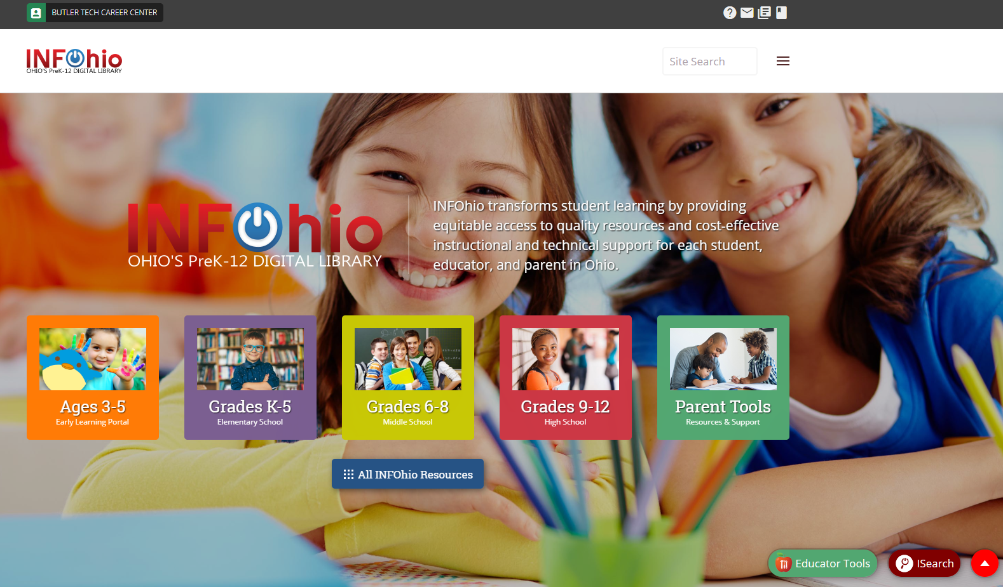
www.infohio.org

Slide 12
INFOhio Campus
How do you do PD?
From your couch, office, carpool, or classroom,
do PD your way with INFOhio Campus.
www.infohio.org/campus
Notes:
This slide, and accompanying notes, needs to be in all presentations.
INFOhio gets it. You need professional development that is flexible, personalized, and lets you show what you know with contact hours, graduate credit, or badging. With INFOhio Campus, you get it all.
INFOhio Campus meets your needs with free access to high-quality PD focused on collaboration and reflection. When you do PD with INFOhio Campus, you learn how to use and integrate INFOhio's digital content and web tools in your classroom. Visit INFOhio Campus today to get started!

Slide 13
Here’s how #INFOhioWorks for me!
Tell us your story so we can share it with legislators:
https://www.surveymonkey.com/r/INFOhioWorks
Notes:
This slide needs to be in all presentations.
A big thank you to those of you who have emailed, sent postcards, and contacted your legislator in past years to help INFOhio secure the funding that allows us to bring high-quality digital resources to you and your students each year. Thank you for your support, we couldn’t do it with out you!
Now more than ever, INFOhio remains committed to our vision to transform student learning by providing equitable access to high-quality resources and cost-effective instructional and technical support for each student, educator, and parent in Ohio.
Are you growing the use of digital resources in your school or classroom with INFOhio? We want to hear from you! We like to spotlight teachers and school librarians using INFOhio resources in schools across Ohio. Share your story for a chance to be featured on our website, or in biannual newsletters to our valued partners. Follow the link to complete the survey https://www.surveymonkey.com/r/INFOhioWorks
Thank you for your support and we look forward to learning more about how #INFOhioWorks for you your students, and your children.

Slide 14
Share the name of your favorite resource and what you and your students like about it.
Use hashtags to promote awareness.
Tag a teacher, school librarian, or your state legislators.
Follow us on social media!
#INFOhioWorks
Notes:
Follow us on social media!
Add a picture from your classroom or school library showcasing students using INFOhio digital resources.
Catch up on INFOhio’s news items, blogs, and webinars sent straight to your feed.
Get the latest updates on INFOhio’s digital tools and resources.
Join the community of INFOhio supporters.

Slide 15
Need more information?
We’d love to help!
Contact us at
support.infohio.org.
INFOhio is Optimized by the Management Council
Notes:
Use this slide as your ending slide.

