Slide 1


Early Learning Portal
A Training Guide for Navigating INFOhio Resources and
Tools
INFOhio is Optimized by the Management Council

Slide 2
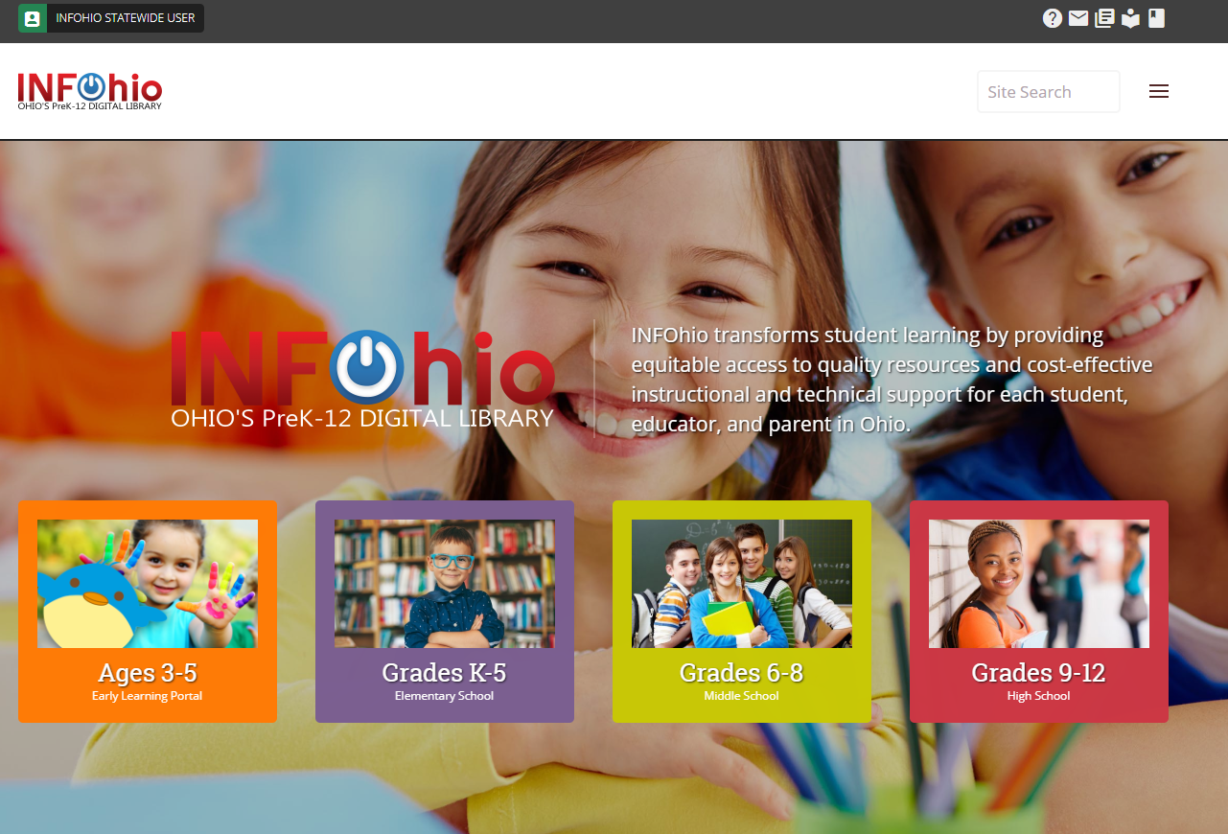
www.infohio.org
Notes:
You can access the INFOhio Early Learning Portal at www.infohio.org. Click on the orange PreK button.

Slide 3
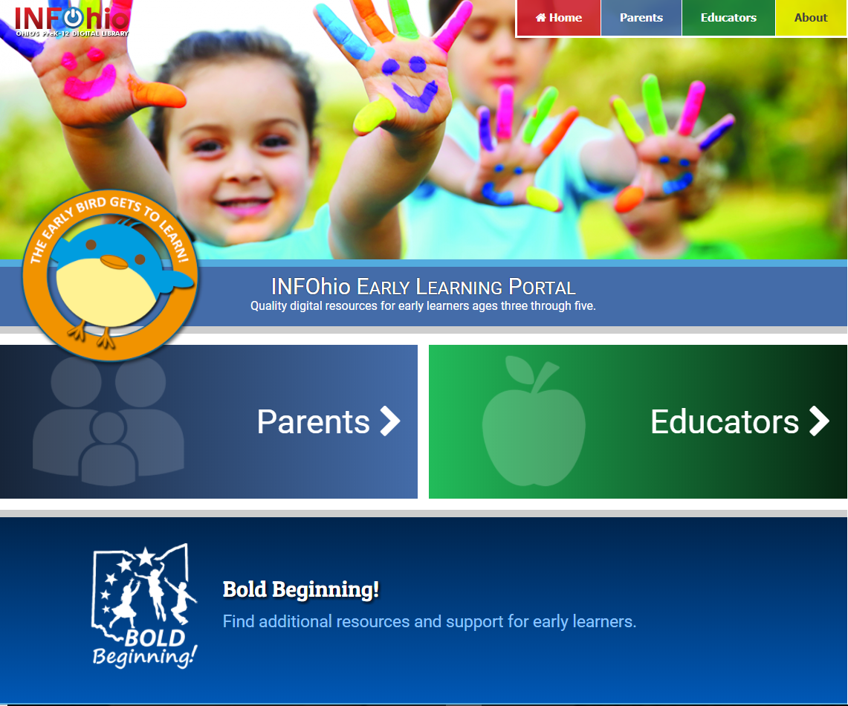
S
early.infohio.org
Notes:
The url for the INFOhio Early Learning Portal is early.infohio.org.

Slide 4

Hello! My name is Early Bird. You can click on me to learn more about me and my site.
Notes:
The home page offers many options of where to start, but Early Bird invites you to click on him to learn more about him and the site.

Slide 5
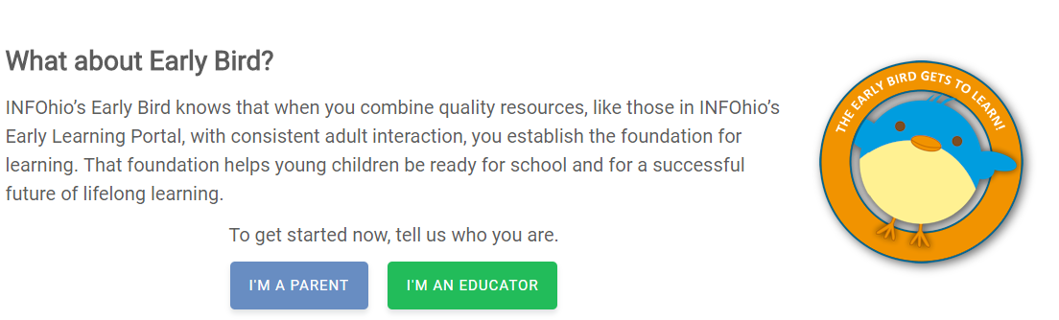
Who is Early Bird?
Notes:
The early bird gets to learn! The INFOhio Early Learning Portal was created for educators and parents of children ages 3-5. Early Bird reminds us that adult interaction and quality digital resources can be a foundation for school readiness and a lifetime of learning. Early Bird appears on many pages within the site to remind parents and educators how to help children develop, engage, interact, and learn as they use the digital resources.

Slide 6

For parents and educators of children ages 3-5
To prepare Ohio’s early learners for school and their future
Evaluated by librarians and educators using a rubric
All resources align with the Ohio Early Learning Standards
About
Notes:
The INFOhio Early Learning Portal is the result of a partnership of key agencies who serve families and early learners ages 3 through 5. The Ohio Department of Education, The Ohio Department of Job and Family Services, and the Office of Governor John Kasich partnered with INFOhio, Ohio's PreK-12 Digital Library to create a collection of free and affordable digital resources aligned to Ohio’s Early Learning Standards. It is a companion site to Bold Beginning! A website which combines information and services for early childhood from 6 government agencies.

Slide 7
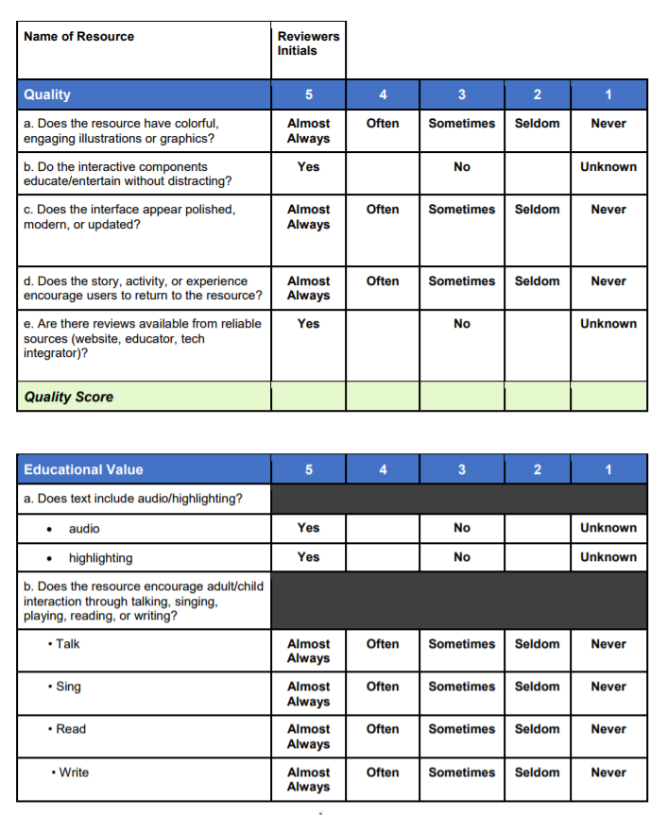
Quality
Educational Value
Message/Mentor
Safety/Privacy
Sales/Marketing
Usability
Age Appropriate
Support
Rubric
Notes:
Over 50 quality resources are featured on the portal. These resources were chosen and evaluated by educators and librarians who have experience in the early learning field. INFOhio and the Ohio Department of Education developed this rubric to evaluate over 100 resources. It is available for download on the About page of the portal. The categories used for evaluation are listed on the slide.

Slide 8
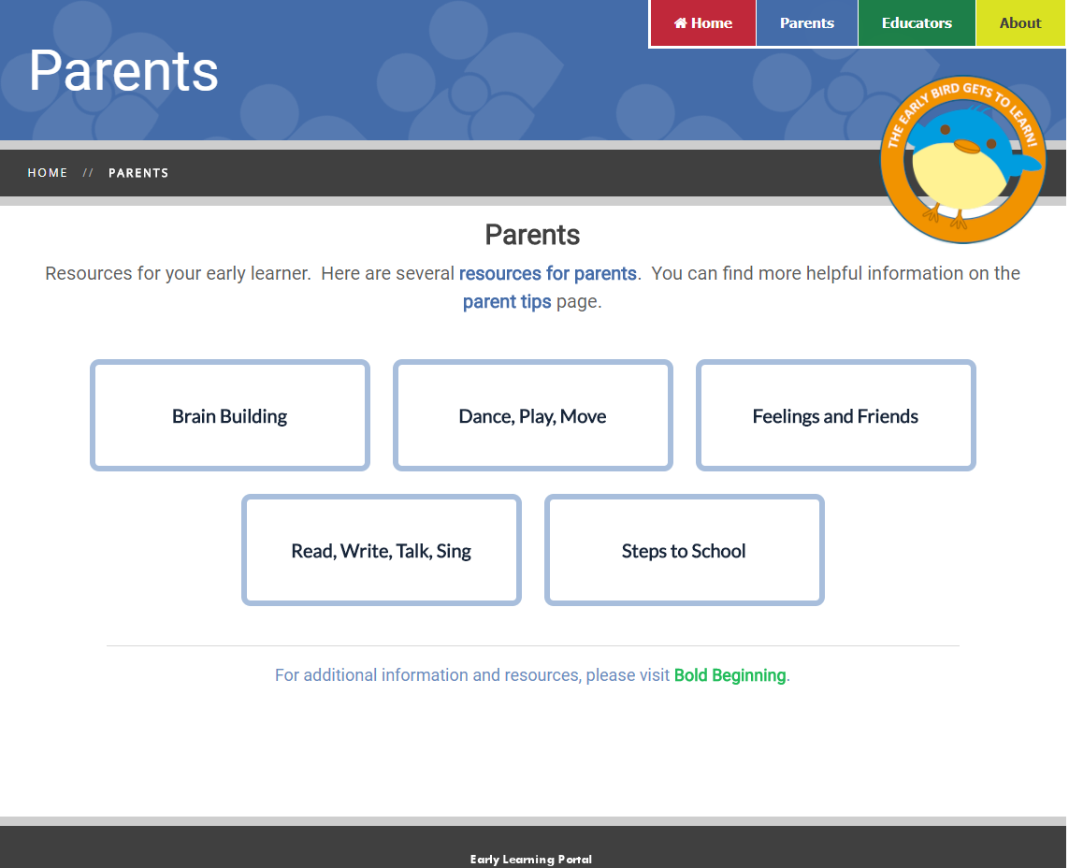
"Play games with your child. “
- Early Bird
Parents
Notes:
The Parent Home page features five categories, each with a number of resources available. Parents can choose the category they wish to help their child with. On the Parent homepage, Early Bird gives simple, easy tips to maximize learning. The list of tips is available for parents on the Parent Tips page.

Slide 9

Play games with your child.
Read and listen to eBooks with your child – and print books, too!
Talk to your child. Ask questions. Point out what you like or find funny. Chat about what he learned.
Sing songs and dance with your child. Create song and dance routines or make it up as you go along!
You can find more tips on the Early Learning Portal!
Parent Tips
Notes:
Each tip is based on research and work done with digital resources and early learners. The Parent Tip page also provides parents with books and websites that are helpful for learning with technology as well.

Slide 10

Notes:
On the Parent Home page, a link is available for resources for parents where they can find additional resources to use with their children.

Slide 11
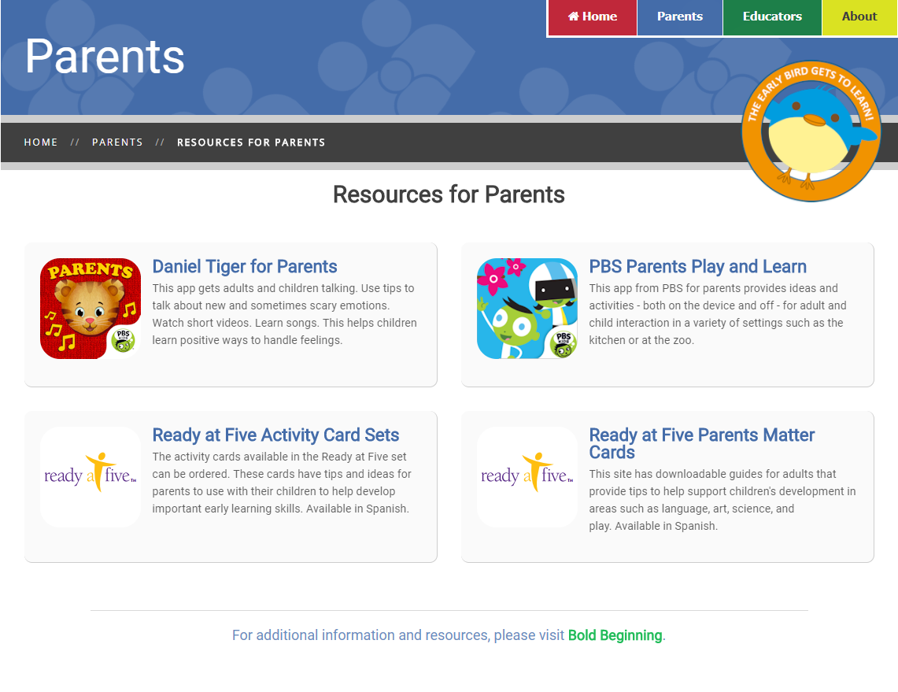
Parent Resources
Notes:
These resources are intended for adult use. Each one offers daily support using tips, videos, handouts, and activities to use with children.

Slide 12
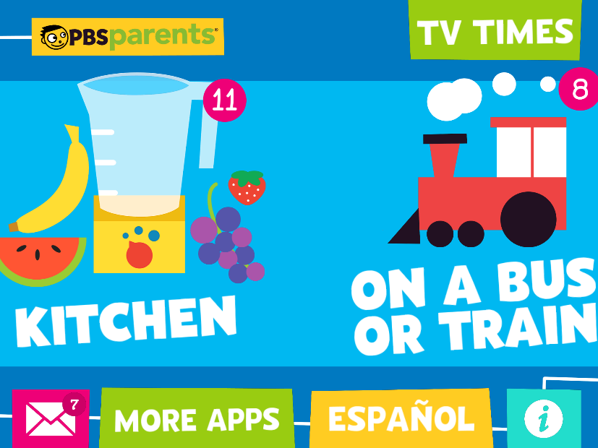
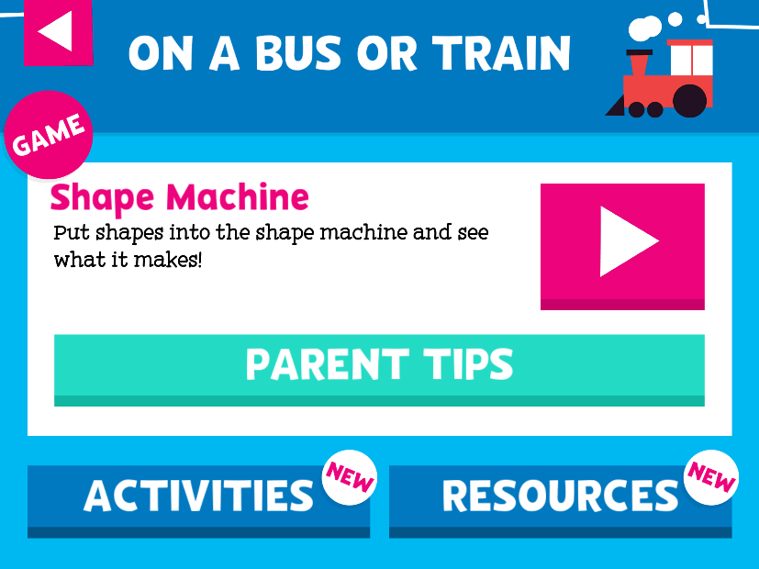
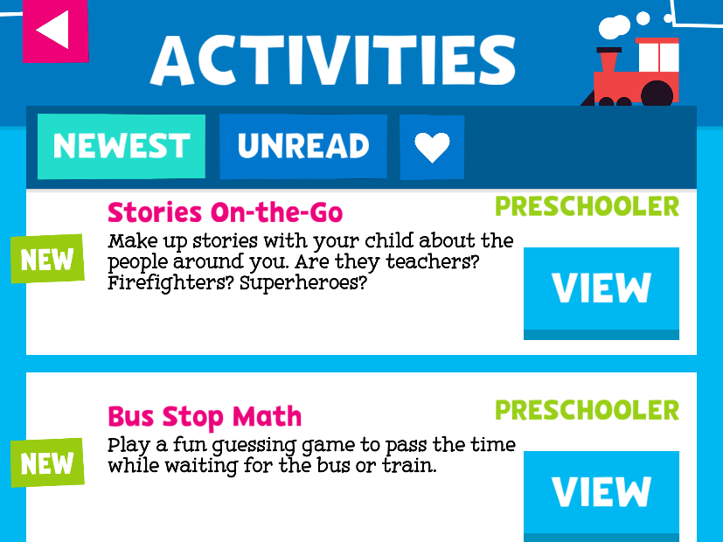
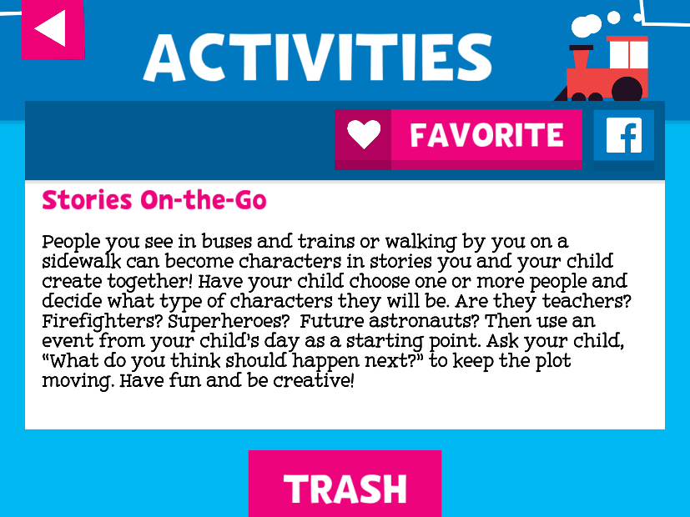
Resource Overview
Notes:
PBS Parents Play and Learn is one of the resources for parents. This app allows parents to choose an activity to do with their child based on where they are and what they are doing. The example shows two options – Kitchen or On a Bus or Train. Choosing On a Bus or Train provides parents with three choices of ways to interact with their child: a digital game with tips that provide helpful ideas to maximize learning, activities which may be online or using real objects and settings, and resources such as printable activity sheets or games. The activity chosen in this example is one that prompts parents to interact with their child while traveling, engaging them in talk, creativity, and problem solving. The app updates with new elements frequently.

Slide 13

Notes:
To access the resources for students use the bread crumbs in the upper black bar. Once you are back on the parent home page, you will see the five categories to choose from again. One of the categories to choose is Brain Building.

Slide 14
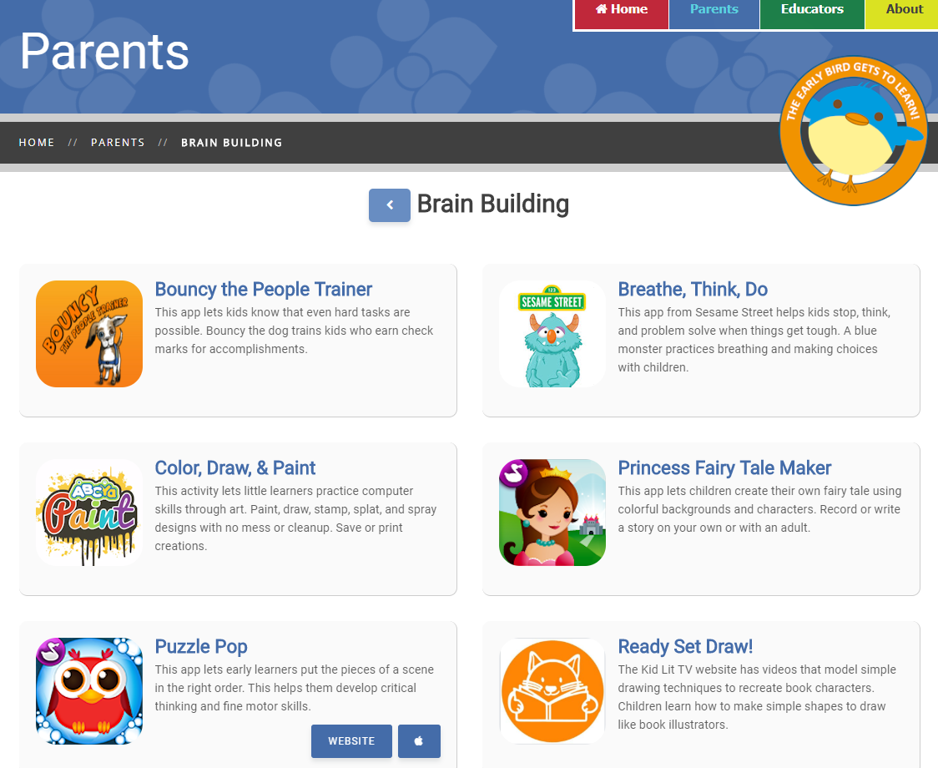
"Sing songs and dance with your child!“
- Early Bird
Resources for Kids
Notes:
Back on the Parent pages, choosing one of the categories takes parents to resources for early learners. These are resources for children, but the best learning happens when children interact with adults or each other while playing the games, watching videos, creating artwork, or dancing and singing. And, Early Bird is here to help! Mouse over each resource to find links to the website or app on the app store.

Slide 15
Notes:
Mouse over each resource to find links to the website or app on the app store. Click on it to go to the website, or download the app to your device. All resources will have a website listed for additional information, whether or not it is available as a website or not. Make sure to read the description of the resource to know for sure what platform the resource is. Breathe, Think, Do is a good example of this. It is an app, but the website is listed with additional information about the resource.

Slide 16
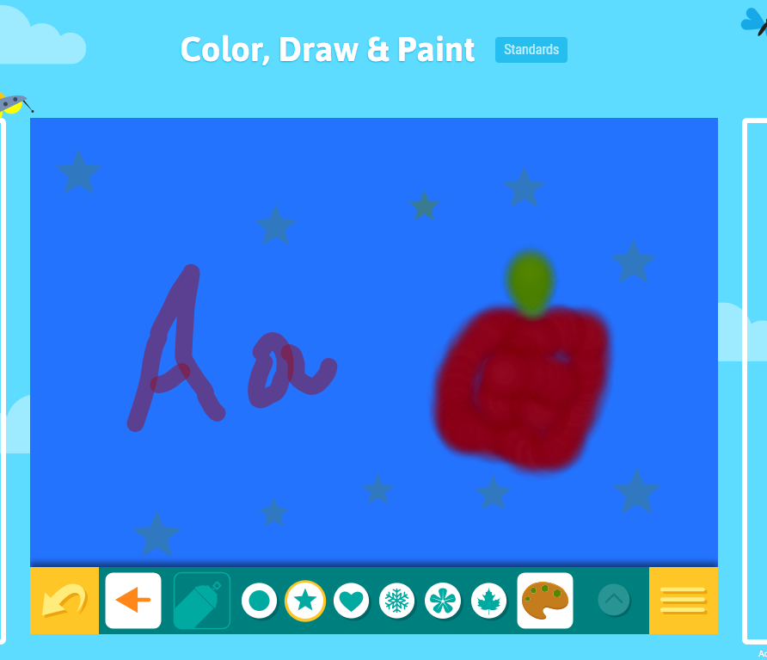
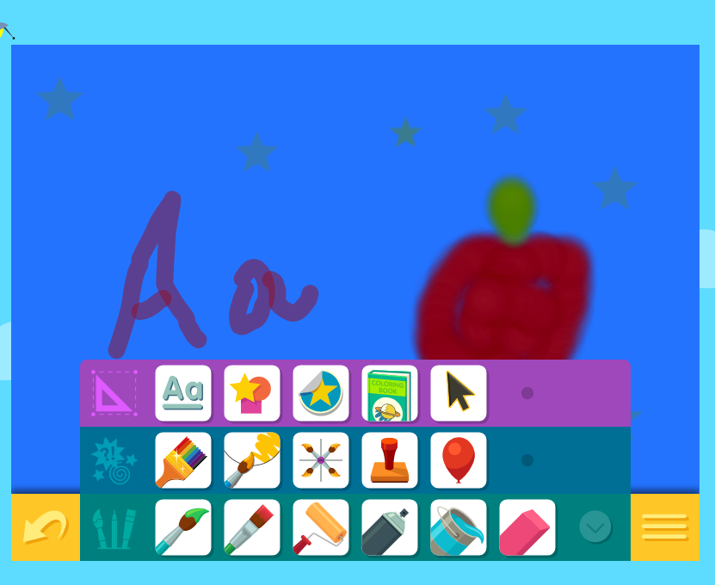
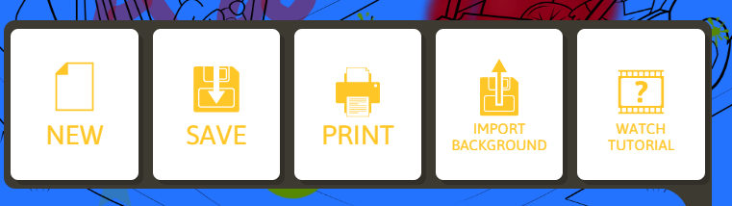
Resource Overview
Notes:
Color, Draw, and Paint is a website where little learners can create their own designs, color pictures, and practice early writing skills. A variety of tools are available to help expand a child’s creative talents, and help strengthen fine motor skills. Parents can print the designs or save them on their computer to share with family and friends.

Slide 17
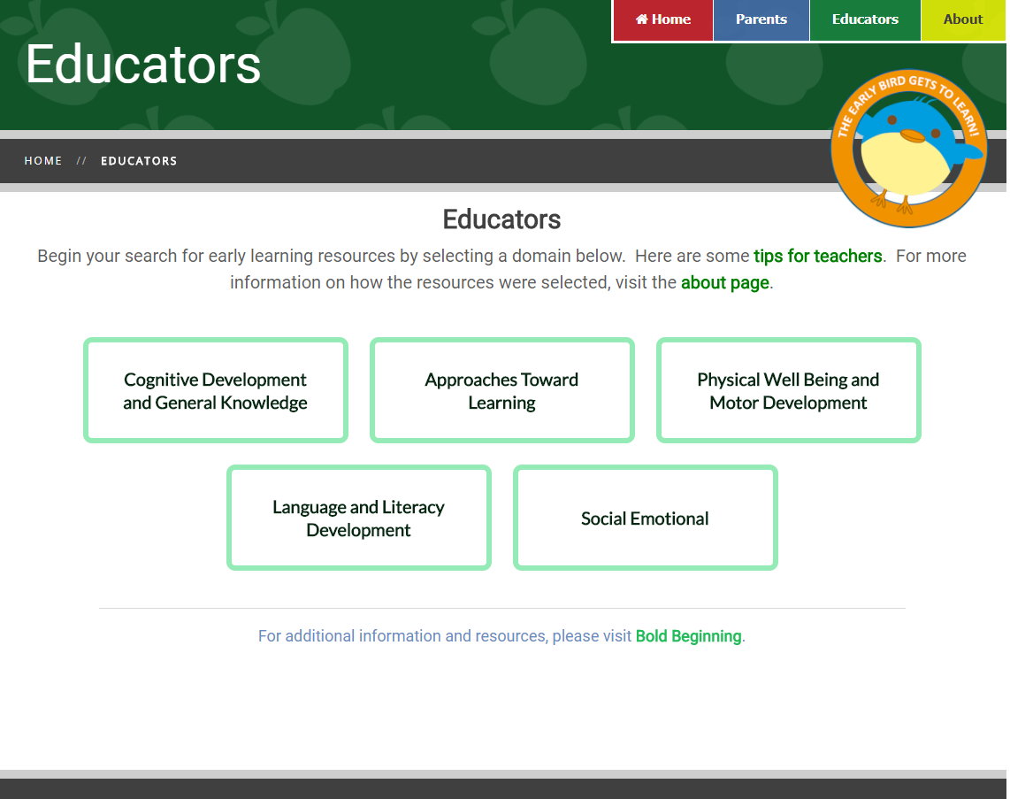
"Model how to use the resource.“
- Early Bird
Notes:
The Educator Home page also offers categories, but these use the domain language from Ohio’s Early Learning Standards. There are tips for teachers linked here, and Early Bird is happy to offer suggestions as well.

Slide 18
Test the resource before you use it with students
Use the resources in a whole group
Model the use of the technology
Check out the INFOhio Best Practices for Reading Online
Share the resources with parents using this handout
You can find more tips on the Early Learning Portal!
Educator Tips
Notes:
Within the tips for educators, there are several helpful tools that enhance the user experience with the INFOhio Early Learning Portal. One of those is the Best Practices for Reading Online.

Slide 19
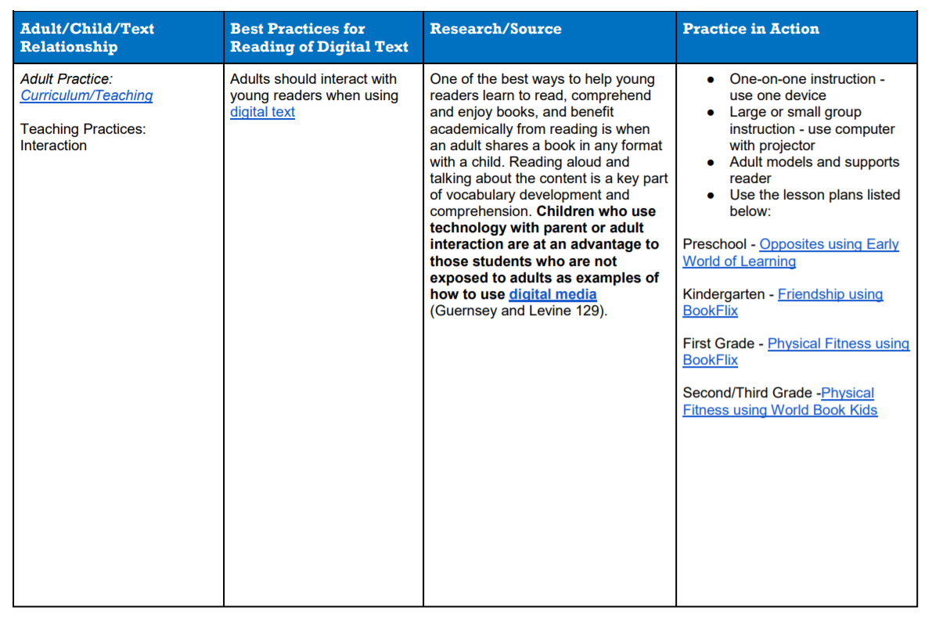
Best Practices for Reading Online
Notes:
This document highlights best practices for helping students read, analyze, and comprehend text on a screen (linked). These research-based best practices offer teachers ideas to help improve even beginning readers’ interaction with digital text. There are also lesson plans which integrate the best practices with INFOhio’s vetted quality resources, including BookFlix, and Early World of Learning. Both of these resources were evaluated using the rubric for the INFOhio Early Learning Portal, and both were chosen to be included in the list of resources.

Slide 20
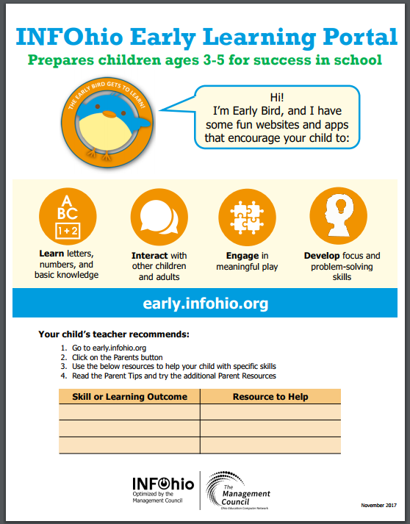
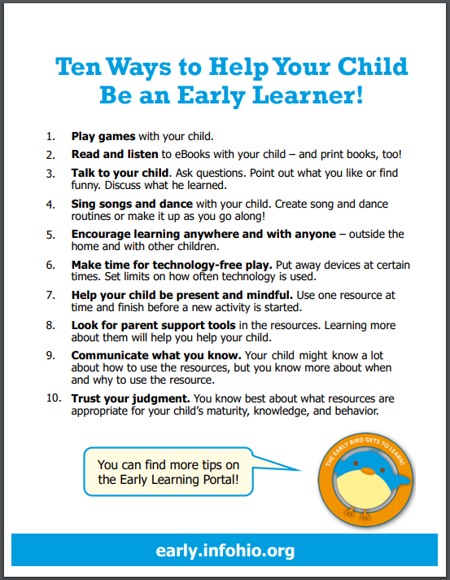
Parent Handout
Notes:
A second tool available for educators on the Educator Tips page is the parent handout. This handout provides an overview of the Early Learning Portal, and offers a customizable space where an individual child’s needs can be written, as well as the resources that will help the child practice and develop those needed skills. There is also a version of the handout that is pre-filled with literacy resources. This is convenient for the busy educator to send home for every child to practice letter recognition, fluency, and early reading.

Slide 21
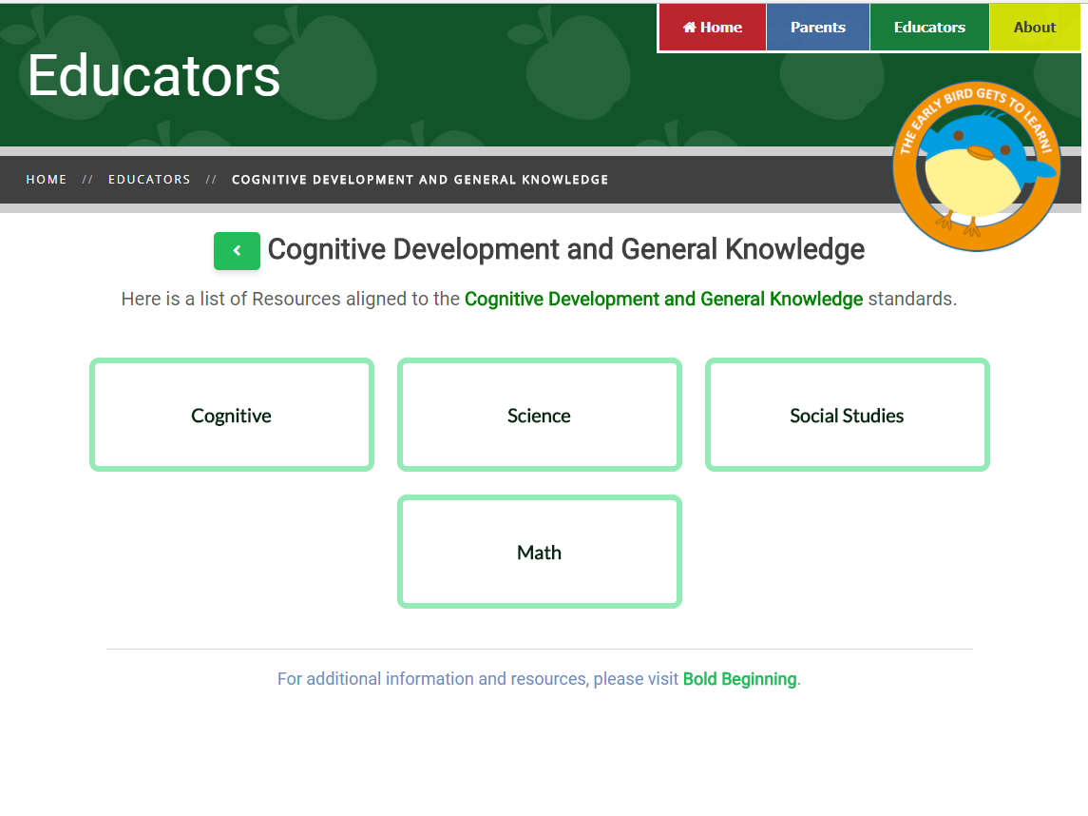
Notes:
There is a detailed list of resources aligned to Ohio’s Early Learning Standards. To support intervention and personalized learning, each standard is paired with at least one of the resources from the Early Learning Portal. Often, a specific component of the resource, like a BookFlix eBook, is given to support the learning outcome. A link to the detailed list is available for each domain on its homepage.

Slide 22
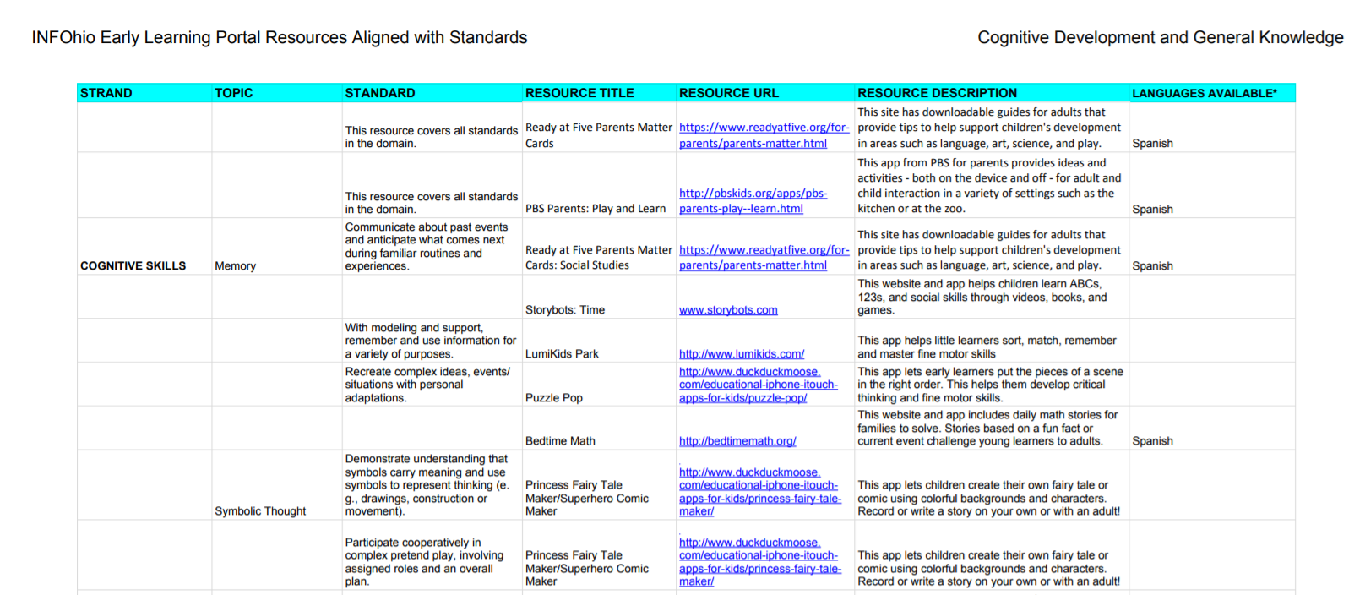
Ohio Early Learning Standards
Notes:
Here is the Cognitive Development and General Knowledge list (linked). Using the exact language as the standards, this document makes it possible for educators to personalize learning for a child based on his needs or strengths. For example, a child who struggles with time or routine could be directed to watch a video on Storybots which is about time. A catchy song is fun to sing, but adult interaction will make the words mean something to the little learner.

Slide 23
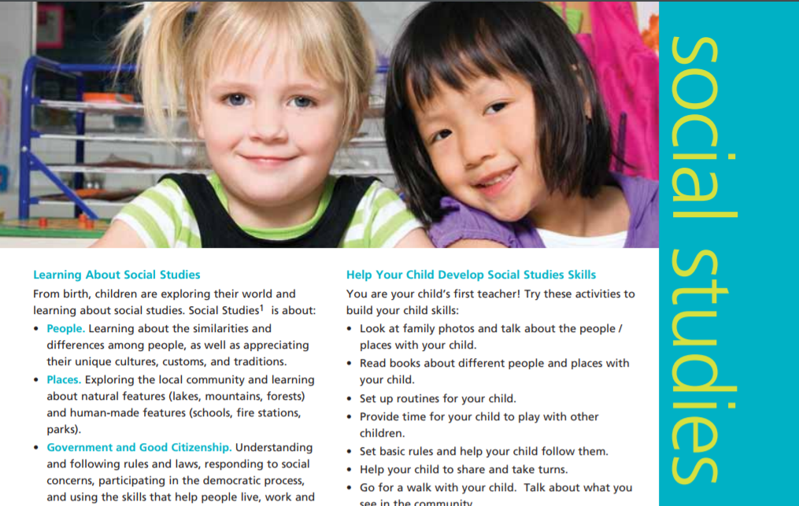
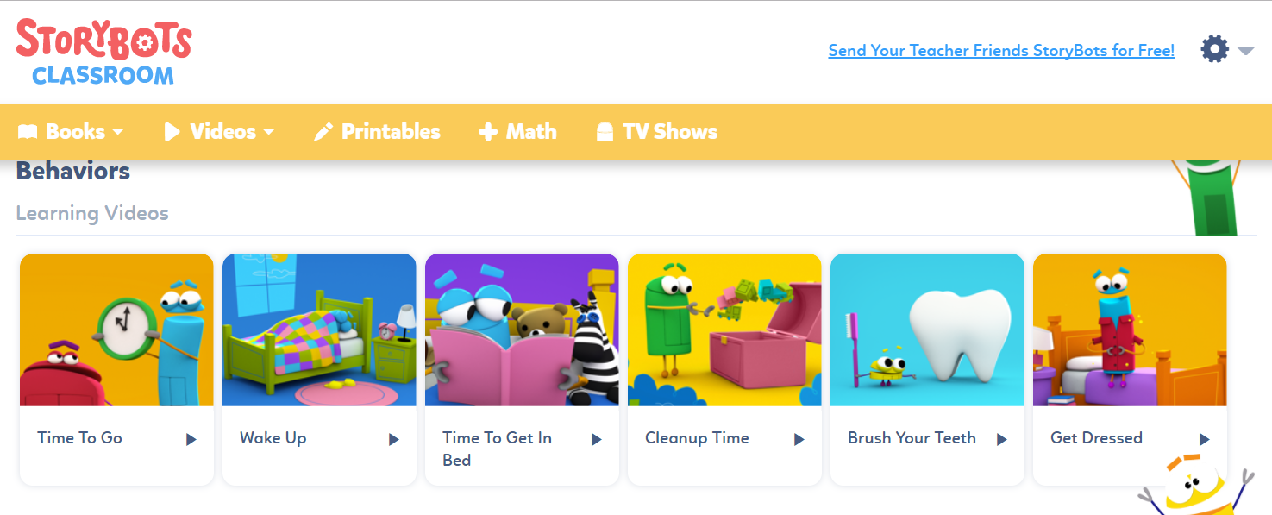
Standard: Communicate about past events and anticipate what comes next during familiar routines and experiences.
Notes:
For example, the Cognitve Skills standard for memory suggests two resources that can help early learners. Ready at Five’s downloadable tip sheet offers ideas for parents to help their children learn about routines and talk about the past as a reference. Storybots has a series of videos about daily routines. They also have videos about time in their collection. It is important to know that educators must create an account to use the content on Storybots, but it is free. There are many resources that, while free, still require adults to create an account.

Slide 24
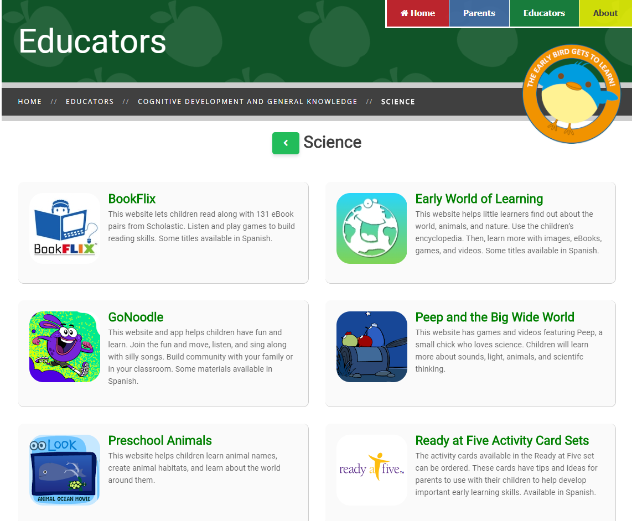
"Use the resources with a whole group of students."- Early Bird
Notes:
One of the strands from Cognitive Development is Science. There are many resources that will support the standards for this topic. One of these resources is GoNoodle.

Slide 25
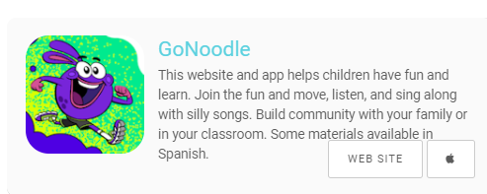
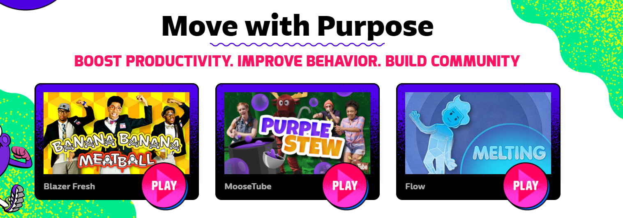
Touches several standards
Available as an app or website
Fun for kids and adults
Works for classrooms or at home
Resource Overview
Notes:
GoNoodle is a free resource available as an app or a website. It has videos that will not only get learners moving, but will also provide lessons on topics such as science, math, and mindfulness. Banana Banana Meatball is about patterns, Purple Stew will create a dance party in the classroom, and Melting is a destressing, relaxation video for wind-down time.

Slide 26
"Use the resources with a whole group of students."- Early Bird
Notes:
The Early Learning Portal also has two resources provided by INFOhio—BookFlix and Early World of Learning.

Slide 27
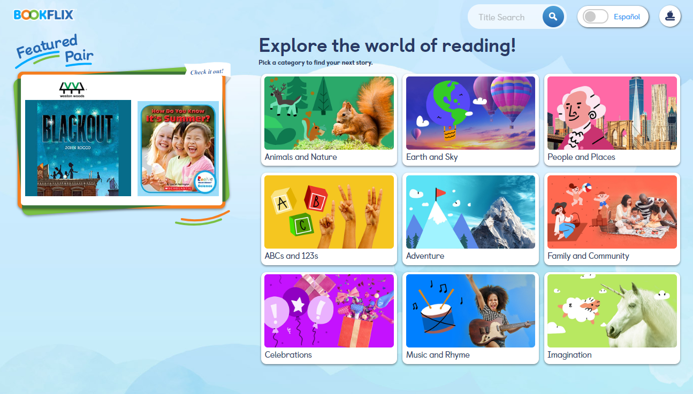
Resource Overview
Notes:
BookFlix is a Scholastic product that offers fiction and nonfiction pairs of popular titles for early learners.

Slide 28
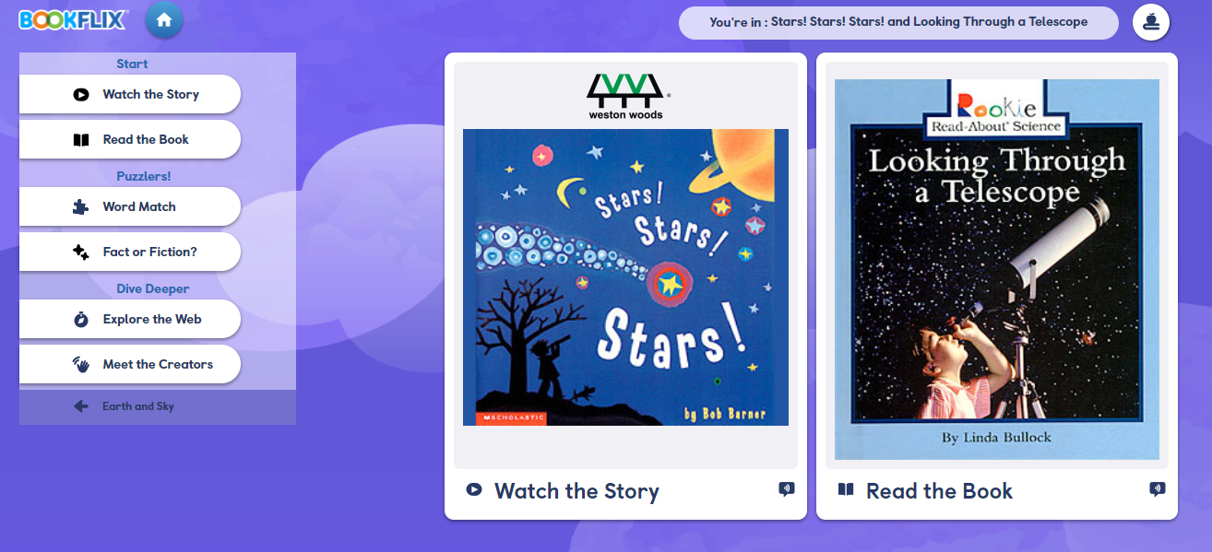
Check out the lesson plans for each pair!
Notes:
Fiction books are presented as Weston Woods videos. Each bookflix has the text of the book on the screen, highlighted and read aloud. Nonfiction titles are more traditional ebooks but also include the option for highlighted and read aloud as needed. Each pair has a lesson plan, and puzzlers – games – which reinforce the difference between fact and fiction, sequencing, and vocabulary. There are other links with appropriate websites, and author information.
What is great about BookFlix is that the resource supports not only literacy standards, but also other areas, such as Science as seen in the titles on the screen, as well as Social Emotional and even Physical Development!

Slide 29
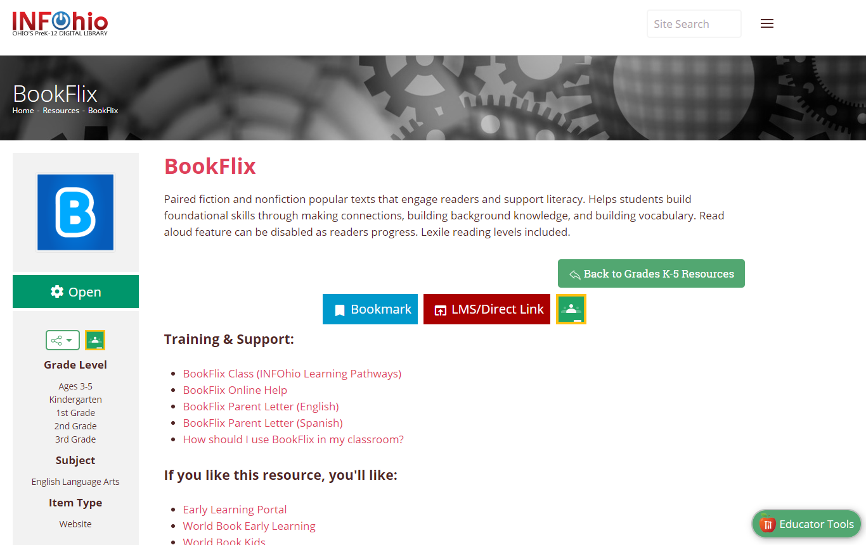
Notes:
There are many supports for using BookFlix in the classroom.. When you choose BookFlix on the Early Learning Portal, you will land on this screen first. Make sure to use these helpful integration supports!

Slide 30
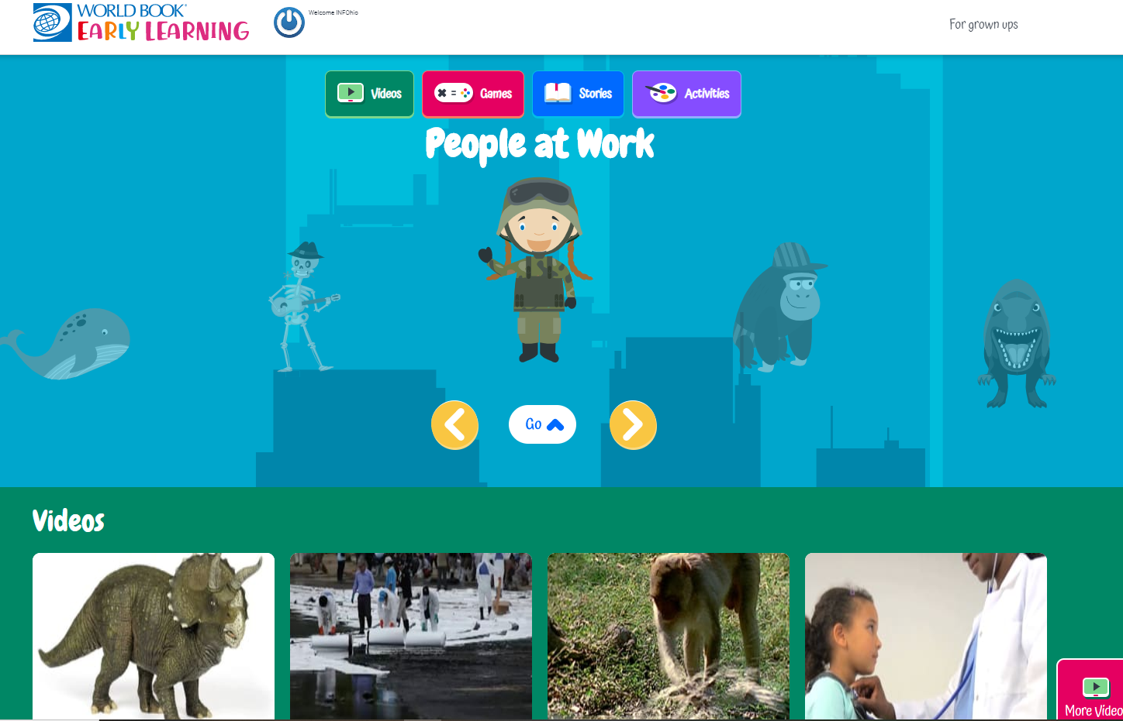

Notes:
World Book Early Learning product that has a beginning reader leveled ebooks, games, short videos, and printable activities to reinforce learning. The stories include timeless fairy tales, nursery rhymes, and songs.

Slide 31
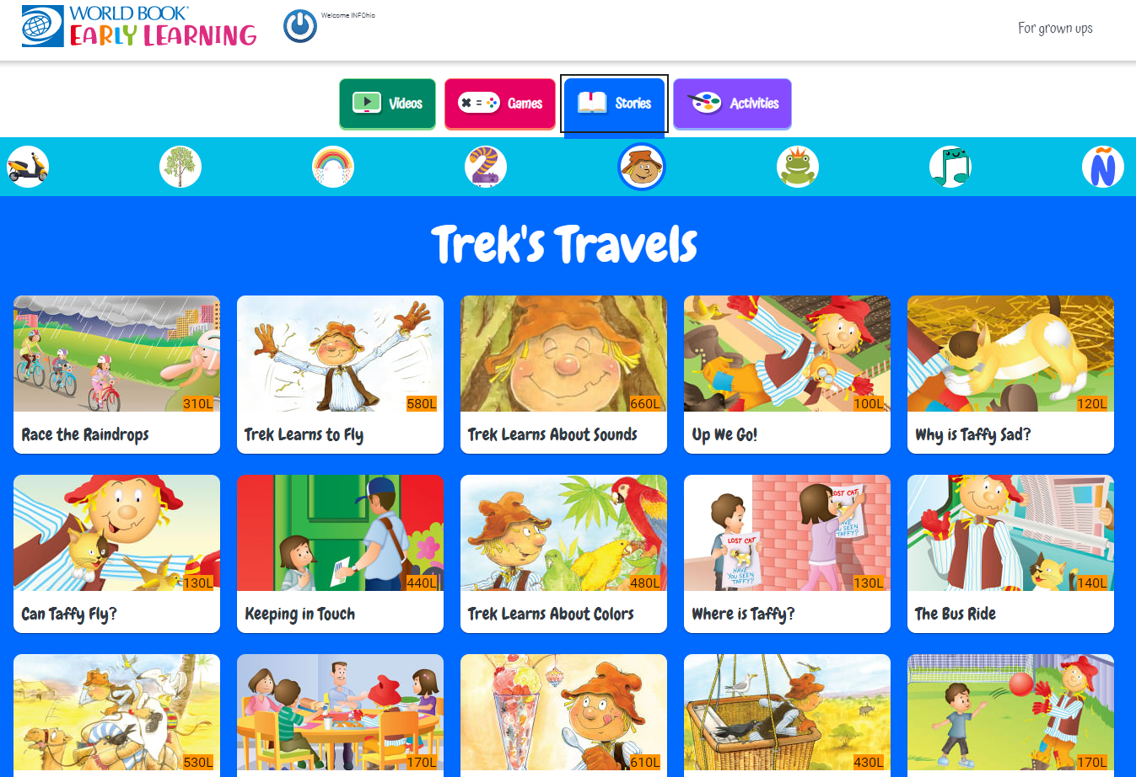
Notes:
There are eBooks that use bi-modal text and provide little learners with printable books to take home and share. Click “For Grownups” to find the book that accompanies the eBook!

Slide 32
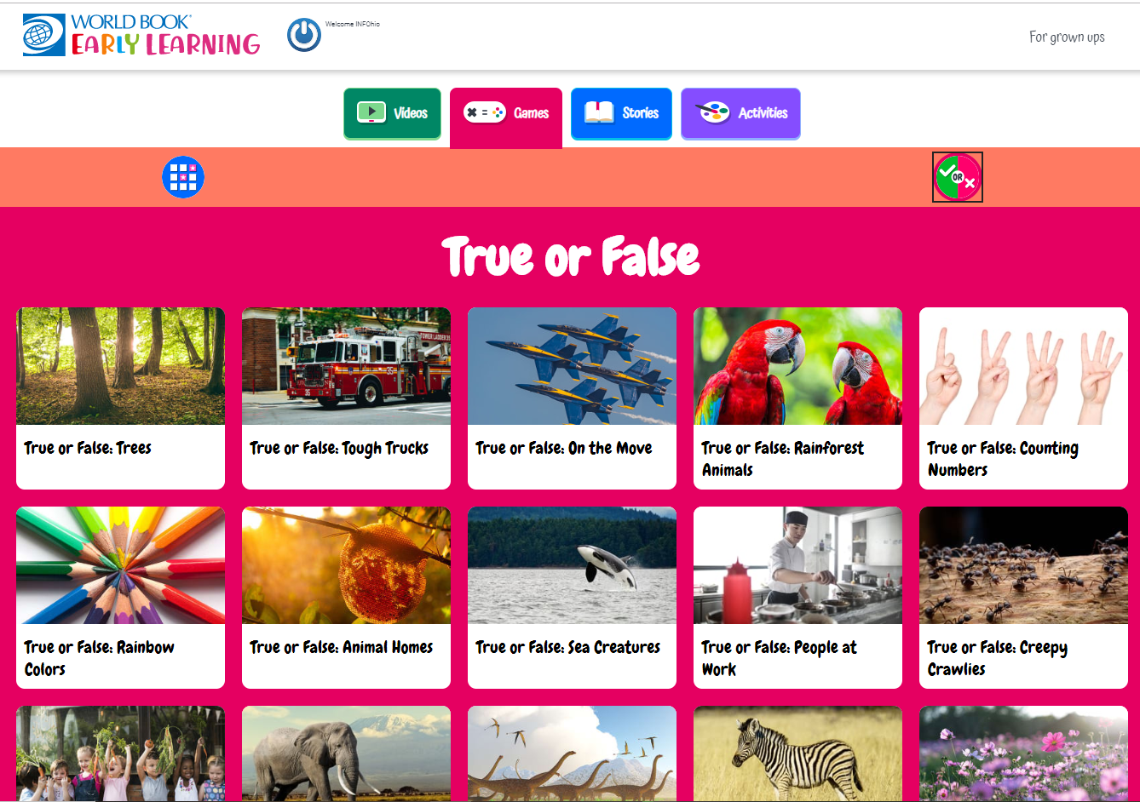
Notes:
Games include concentration and True/False. The questions check basic comprehension for the eBooks.

Slide 33
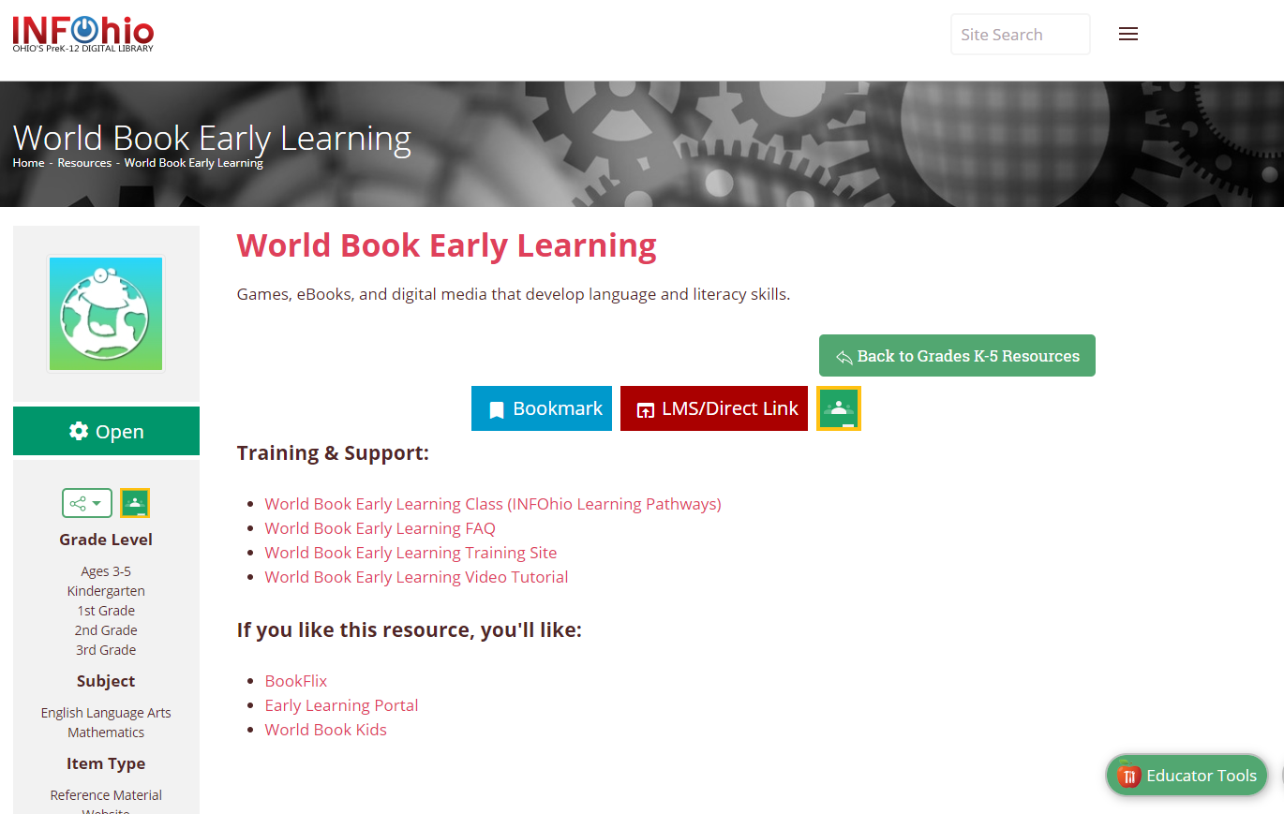
Notes:
For more information on World Book Early Learning, visit the I page on INFOhio. You can link the resource to your LMS or Google Classroom.

Slide 34


Find more information at
www.infohio.org
http://education.ohio.gov/Topics/Early-Learning
http://boldbeginning.ohio.gov/
Need help with the Early Learning Portal? Contact us at
support.infohio.org.
INFOhio is Optimized by the Management Council

