Slide 4
Notes:
Similar to goodreads, yet less focus on social networking. LibraryThing could be useful for a library that wishes to showcase their new books visually to students, by creating book lists and linking to them on social media or even printing them. This is a nice way to browse the collection. It could also be useful for teachers that have a small class library, and wish to keep track of their collection.

Slide 5
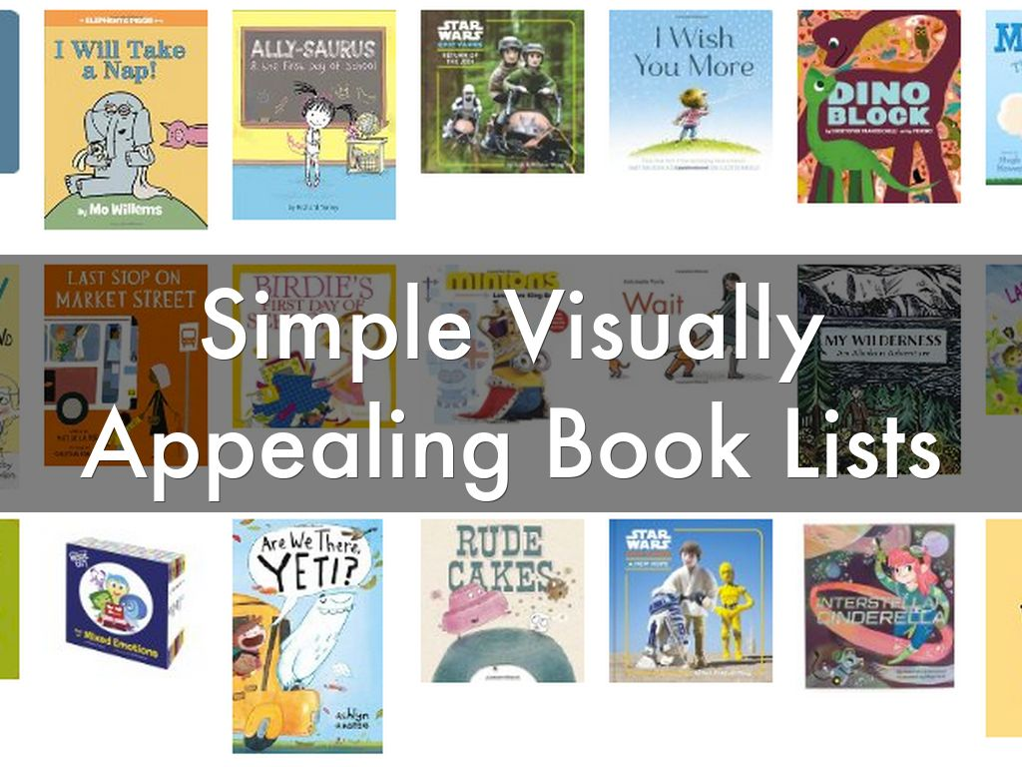

Slide 6
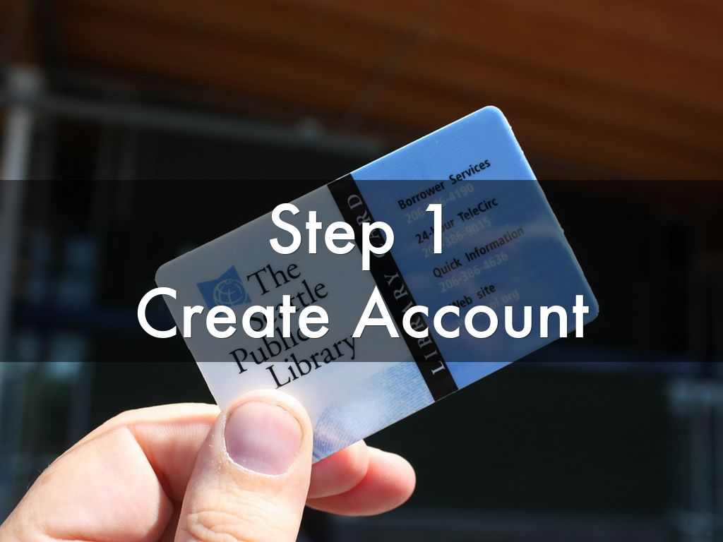

Slide 7
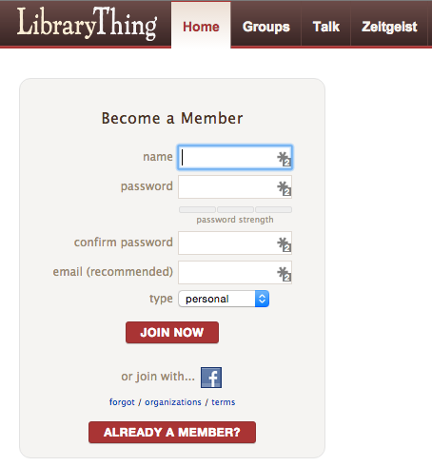
Notes:
It doesn’t matter if you choose personal or organization, you will still have a set limit of 200 books. However, you can upgrade to a premium account for as little as $1.00 per year, or $19.00 for a lifetime. You can catalog as many as you want. If students wish to follow your account, they will need to be 13 or older (due to COPPA.)

Slide 9
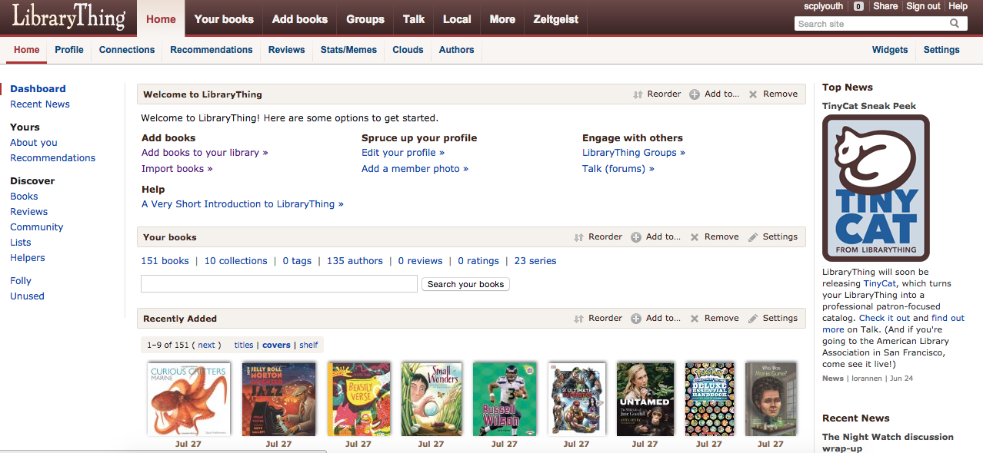
Notes:
Once you have created your account – click “Add Books” or “Add books to your library.” Both will take you to the same place.

Slide 10
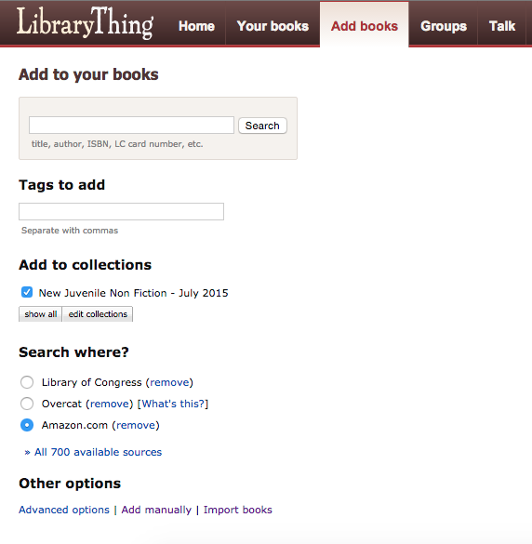
Notes:
Before starting your search, look under Add to collections.” Click “edit collections.”

Slide 11
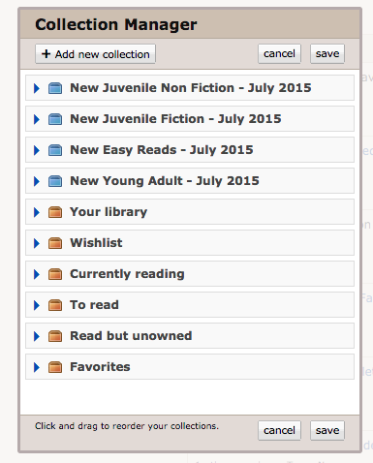

Slide 12
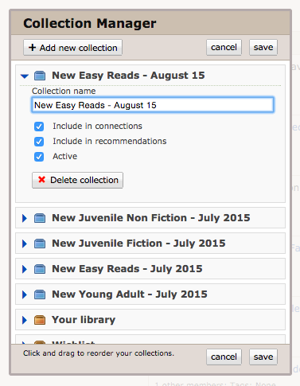
Notes:
You should now see the “Collection Manager.” Select “Add new collection,” and then proceed to naming your collection. I normally label them by month, or you could name them by order. Example: “1/14” or “Winter Order.” Click save, and your new collection should appear! Your new collection should also be check marked. Also, go ahead and check mark “Your library.” This will enable any new books to be added to both collections, and will create a better browsing experience for yourself as well as your patrons.

Slide 13
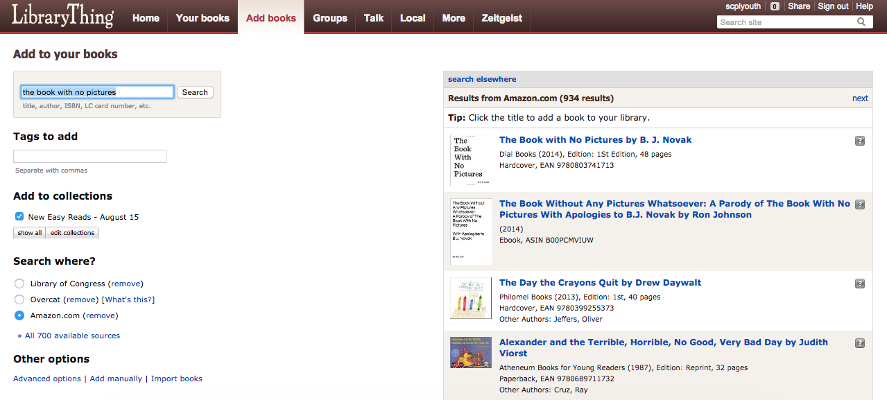
Notes:
Now we are ready to search/add new books to our collections! You can search by title, author, isbn, etc…Your selected book will appear on the right. Just select it, and it will appear in your new collection. If you would like to batch import books, which is what I do. Select import books.

Slide 14
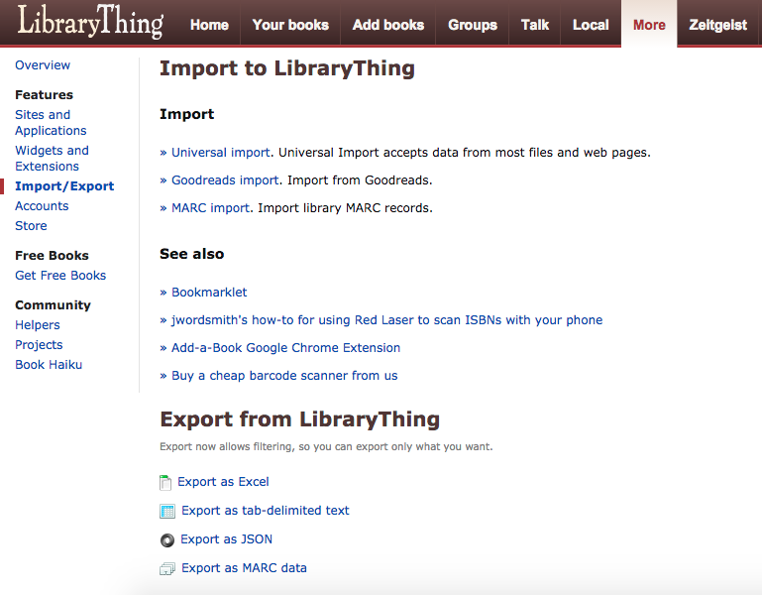
Notes:
Select universal import.

Slide 15
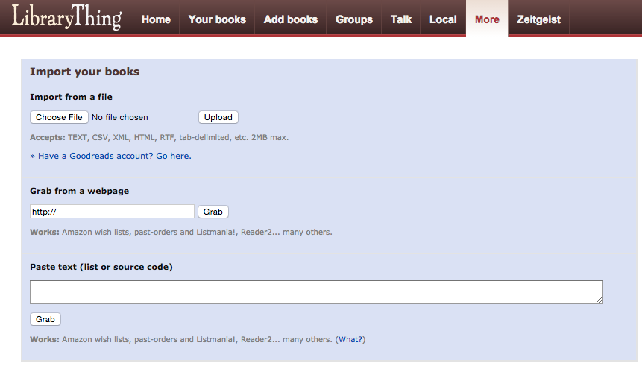
Notes:
You can choose most types of files. I download a CSV from Ingram ipage, and just upload it. After your books have uploaded. Select your books and you can see your new collection.

Slide 16
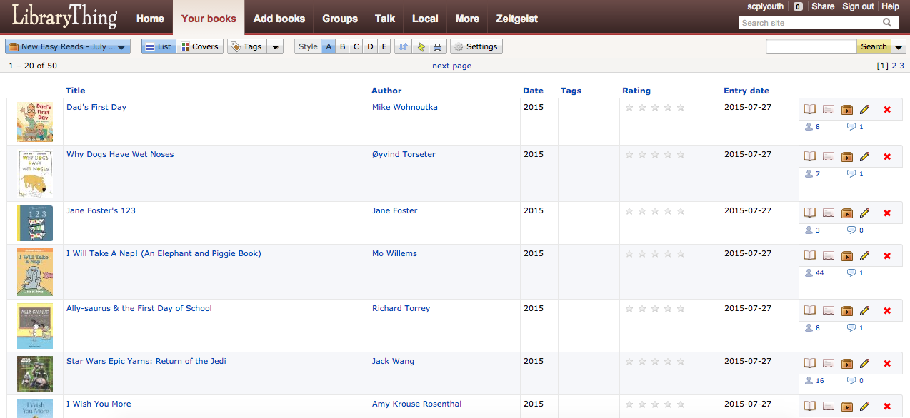
1
2
Notes:
From here you will see the list view. Select covers, and you will see a nice cover flow view.

Slide 17
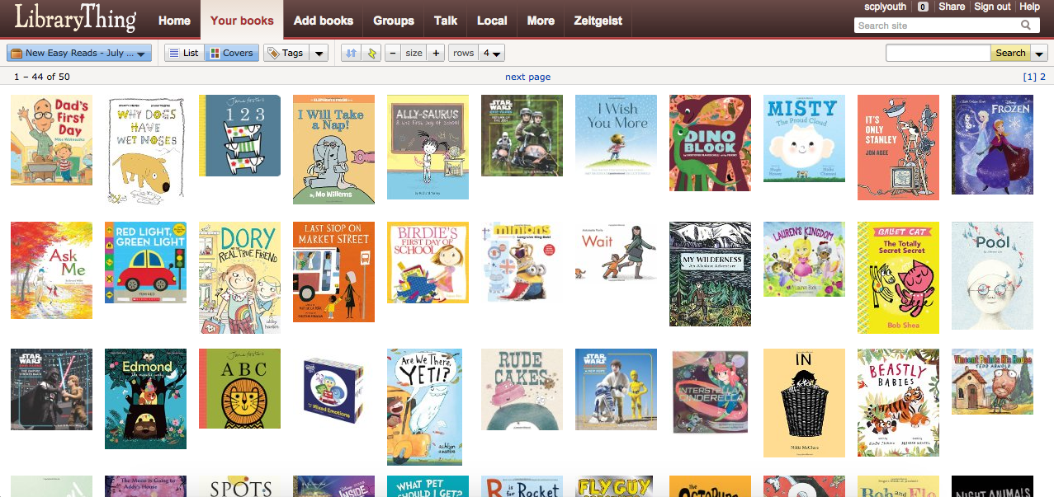
Notes:
Ta da!

Slide 18
Notes:
Now we are going to create a link to share on social media, your website, wherever you want!

Slide 19
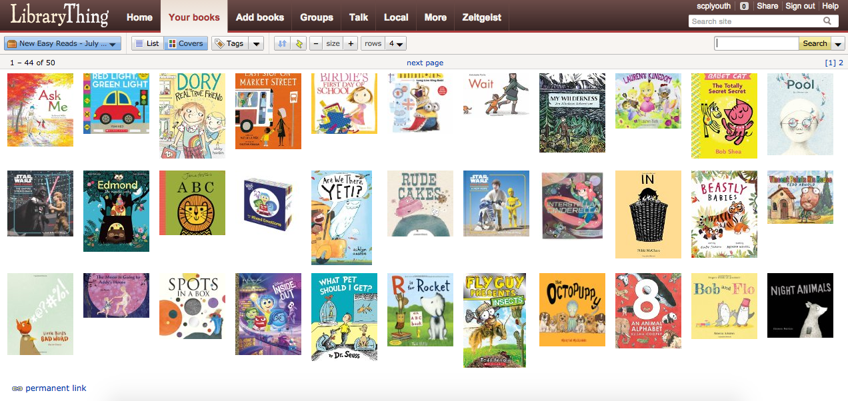
Notes:
You must select permanent link. The default link will not link to your collection. Also, you can link to each individual collection. I usually post a link on social media, so our patrons can easily see what we’ve added.

Slide 20
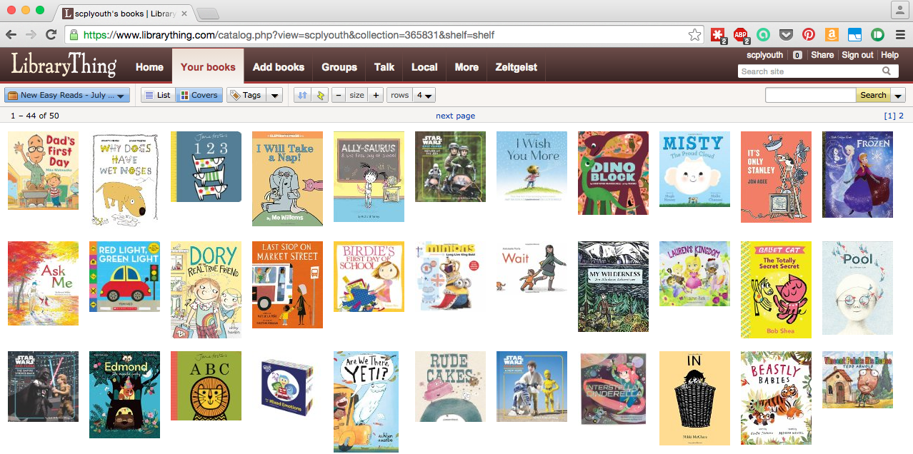
Notes:
Copy the link and post it to the website of your choice. You can also print these for your physical book list, or make a mosaic out of them.

