Slide 1
Transforming Instruction ● Impacting Learning
What is INFOhio?
For Ohio’s Parents & Families
INFOhio is Optimized by the Management Council

Slide 2
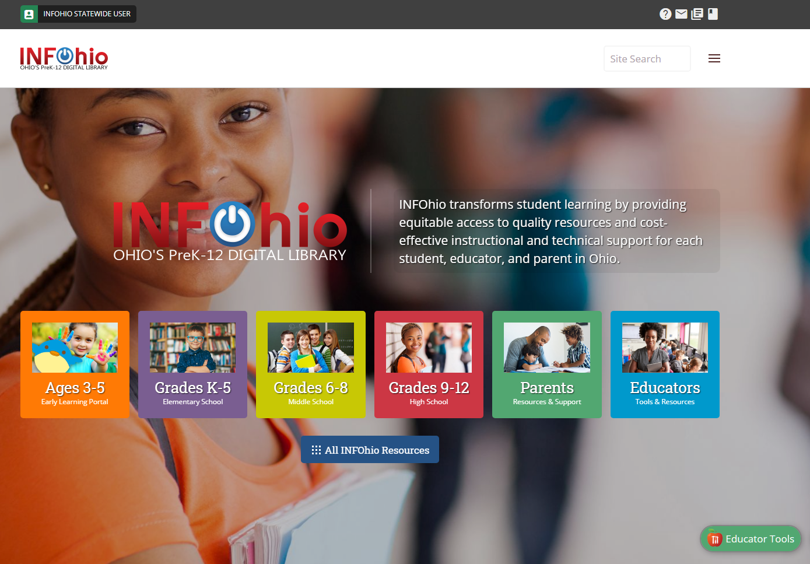
www.infohio.org
Notes:
Each Ohio PreK-12 student has equal access to high-quality digital resources for a successful education and future. INFOhio transforms student learning by providing equitable access to quality resources and cost-effective instructional and technical support for each student, educator, and parent in Ohio.
Find everything at www.infohio.org

Slide 3
Notes:
When your children are at school, they are automatically logged in to use INFOhio. In the upper corner they’ll see their school or district name.

Slide 4
Notes:
To keep our digital content for Ohio residents only, we use layers of authentication that will log most users in automatically.
Most districts and many private school systems have their own username and password that’s easy for the students to remember and use when they are at home. You can click at the top on Switch login, and use the Find Password button to log in as your child’s school or district.

Slide 5
Notes:
Resources are organized by grade levels. Choose the level that is right for your child. You can also access the Parent Tools page from this menu. Let’s take a look at the Parent Tools page.

Slide 6
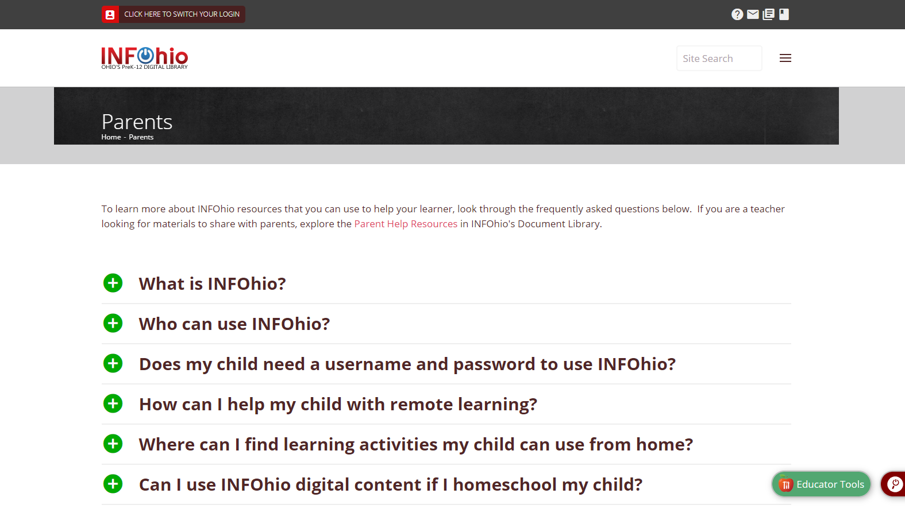
Notes:
If you need additional help with logging into INFOhio, there is a link to a short video tutorial. It will show you the steps to making sure you are correctly logged in to INFOhio.

Slide 7
Notes:
This page also provides more information on the resources and services from INFOhio. Find the answers to common questions and links to helpful webpages and resources. For more information about supporting your child with reading choose “How can I help my child learn to read?”

Slide 8
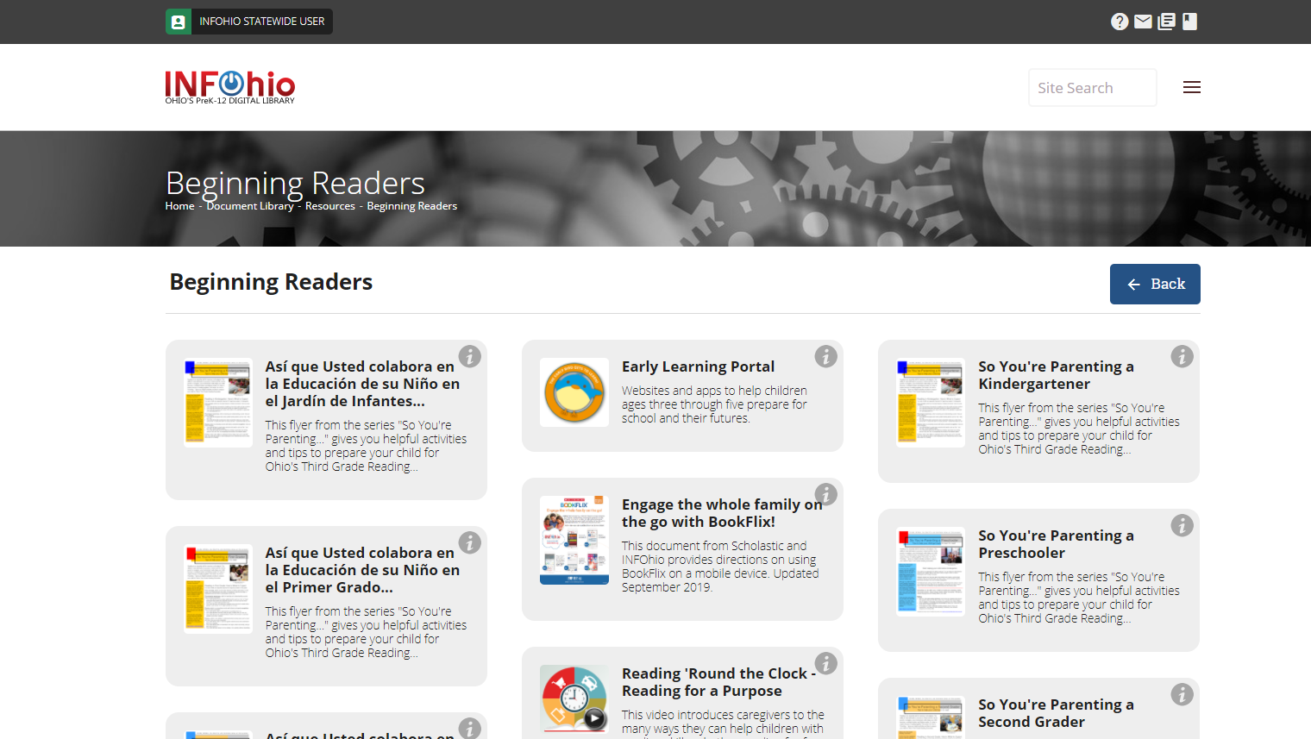
Notes:
From there you will find a link to our Beginning Readers page.
There you’ll find flyers and videos with great ideas for working reading practice into everyday activities, as well as engaging and interactive resources.

Slide 9
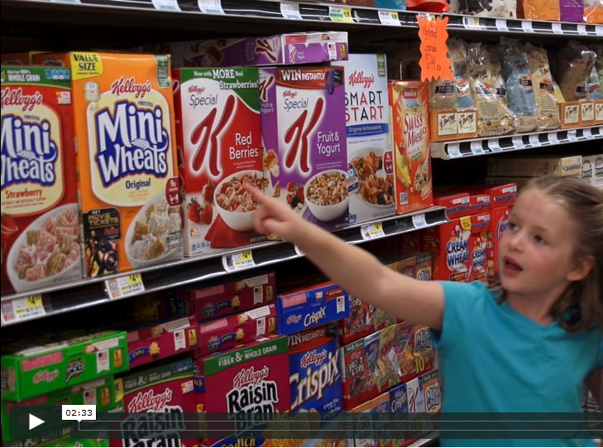
Reading on the Go!
Parent Videos
Notes:
One of the resources are these Reading ‘Round the Clock videos and flyers. INFOhio created these in partnership with the State Library of Ohio, Ohio Educational Library Media Association, and the Ohio PTA.
First came a series of flyers for PreK-3 families. The flyers are available in English and Spanish. There is one flyer for each grade level, PreK through 3. Each gives many ideas for working reading practice into your daily lives.
Then the partners followed up with a series of videos. This scene is from Reading on the Go! The other two are Reading for a Purpose Reading on the Screen. They are short, less than five minutes each. And the Reading on the Screen video gives some helpful tips for using devices for education and not just entertainment.

Slide 10
Notes:
By clicking a grade band you will open up a list of available resources from INFOhio.
Remember that these resources are open to you not just during the school year or during the school day, but after school and during the summer as well.
Let’s highlight some of the resources that families find very useful.

Slide 11
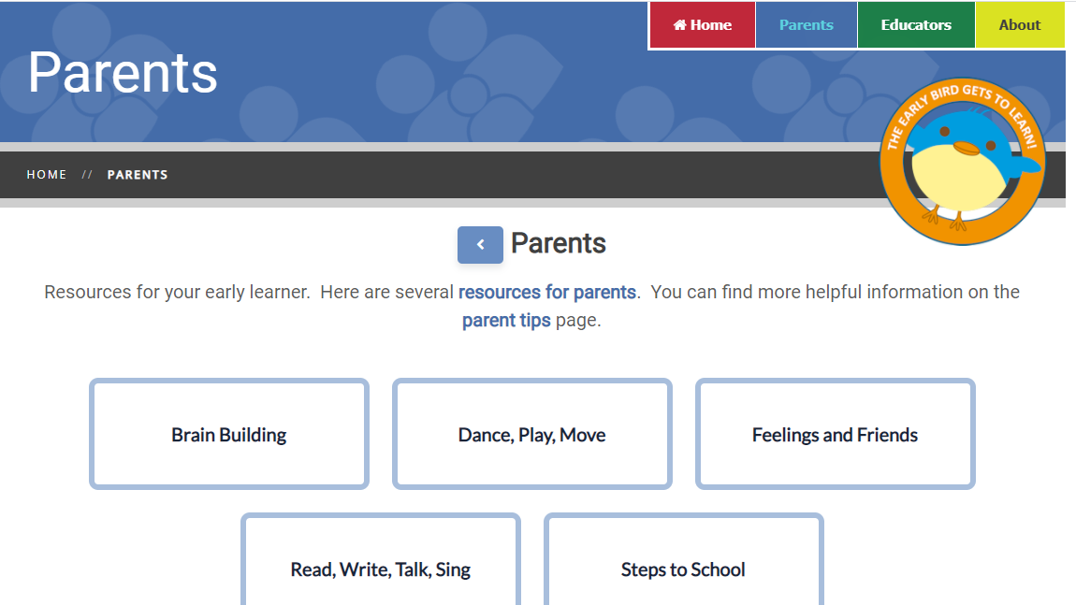
Notes:
INFOhio supports learners at all levels. If you have preschool students at home, be sure to click Ages 3-5 to access the INFOhio Early Learning Portal. This collection of over free 50 apps and websites supports families using Ohio's Early Learning Standards. The INFOhio Early Learning Portal is designed for adults to use with children, the key to successful technology integration for preschool.

Slide 12
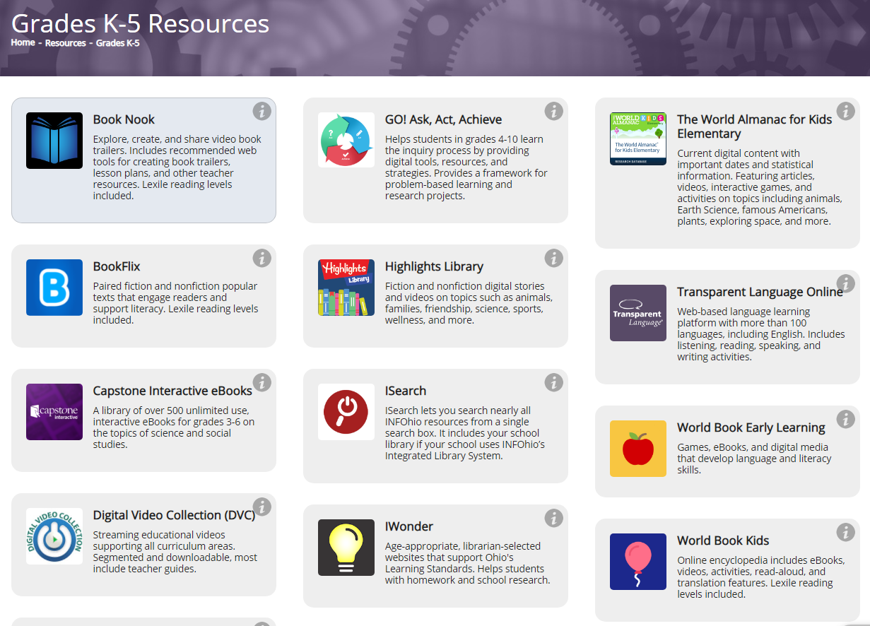
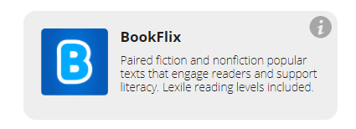
Notes:
To find resources for primary grade students, click grades K-5. One resource that’s very popular with our students is BookFlix.
BookFlix is for PreK-3 students.
Paired fiction and nonfiction popular titles are perfect for a family read-aloud.

Slide 13
Notes:
Another great resource for students in grades PreK-5 is World Book. World Book Kids includes videos, images, maps and more. Learn about people, places, animals and more. Students can even choose to hear the text read aloud.

Slide 14
Notes:
World Book Kids has all kinds of activities that students can use by clicking the icons along the bottom of the screen.
Students can do Science Projects with step-by-step directions, compare and read about animals in World of Animals or try activities like decoding their name, solving a logic problem, or even making a musical instrument.

Slide 15
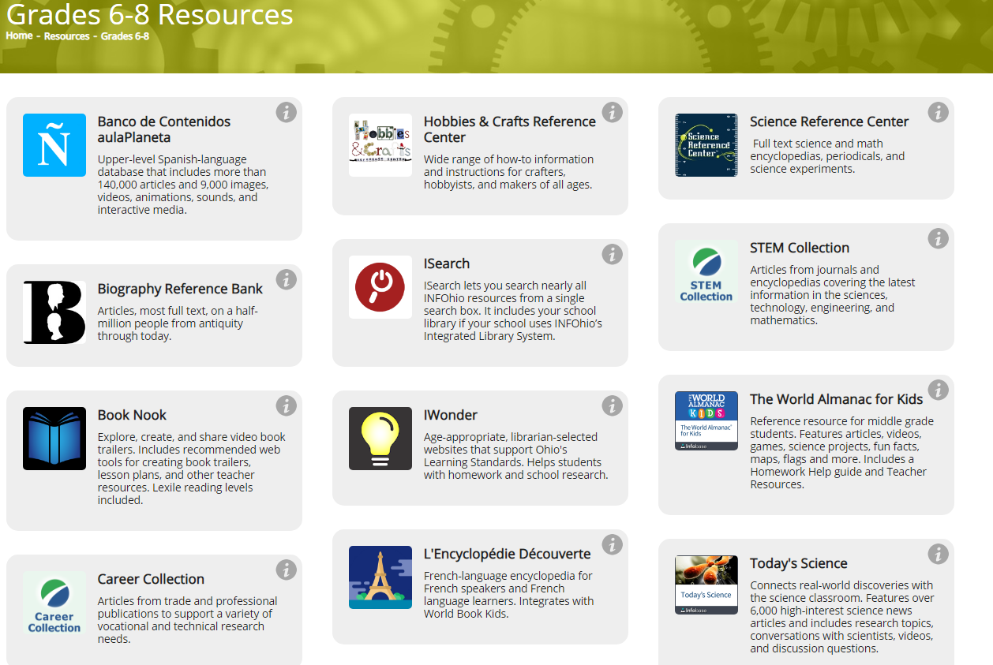
Notes:
INFOhio has many resources for middle and high school students from biographies and health to science and current events. Sources include magazine and journal articles, videos, e-books and more.

Slide 16
Notes:
Helping your children evaluate information is important. Points of View Reference Center is a resource that supports students when they are asked to analyze information and present arguments that they can support with evidence.

Slide 17
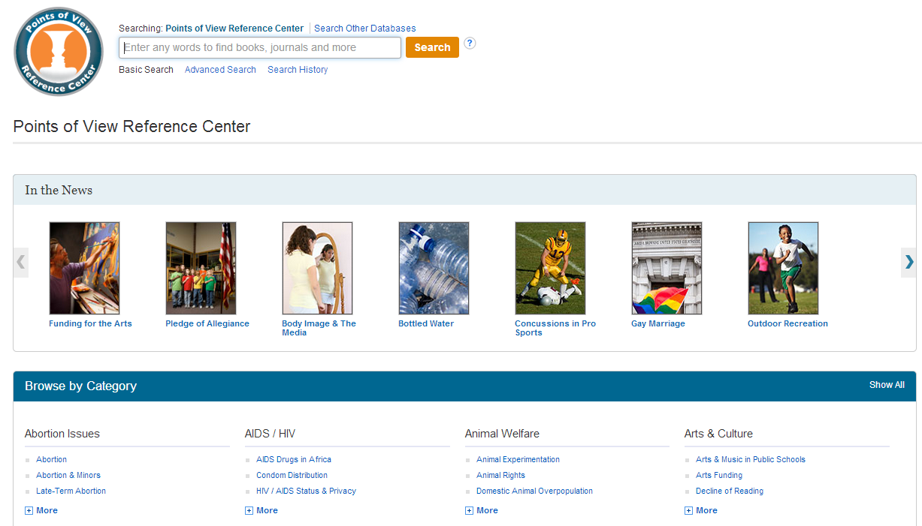
Notes:
Each topic covered in Points of View—and there are more than 300 of them--includes a Point and Counterpoint article so that students are introduced to both sides of an issue.
And each article includes a Ponder This section with additional questions for class discussion that helps students learn how to delve into an issue and answer the questions, “how do you know that,” or “why do you think that” which are key questions they need to be able to answer to meet the new standards.
POV is also a great place to turn when your child has to choose a research topic. Sometimes it’s helpful for children to see a list of possibilities, and POV provides that.

Slide 18
Notes:
Another resource that’s great for middle and high school students is Science Online

Slide 19
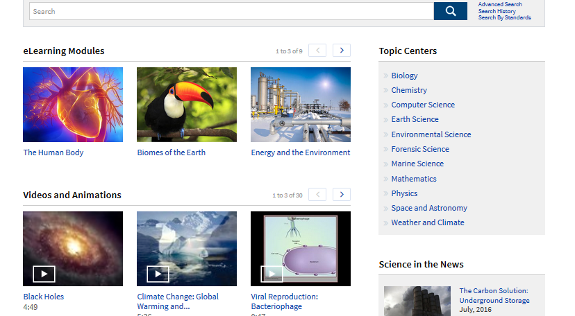
Notes:
The topic centers are an wasy way to find information about science and mathematics as well as links to current science in the news. The news articles are updated frequently, so keep checking back to see what’s new.

Slide 20
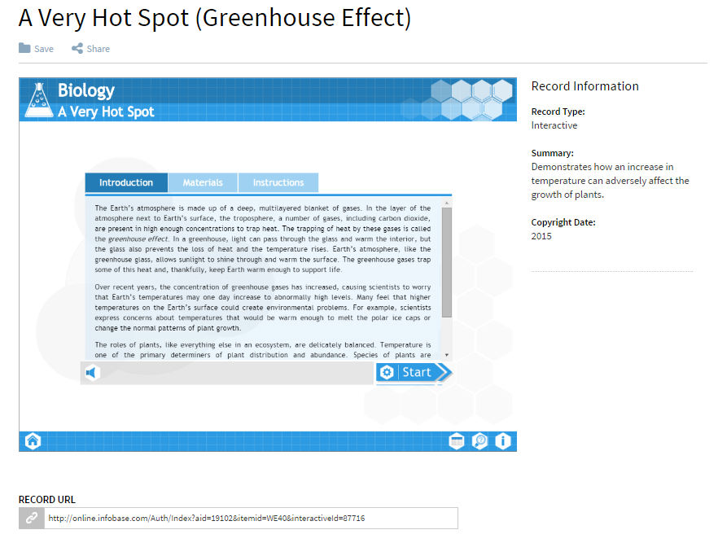
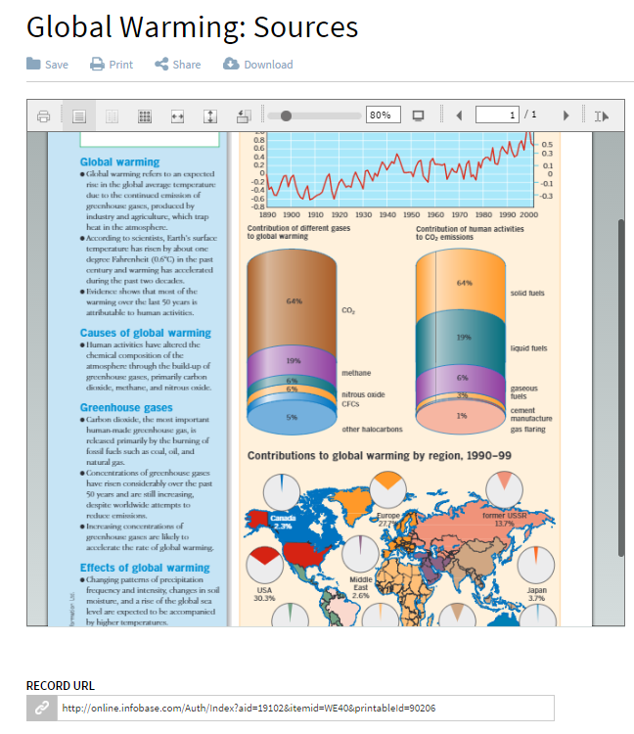
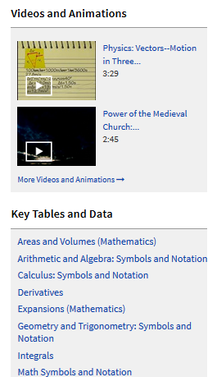
Science Online:
Interactive Experiments
Diagrams
Science Online:
Mathematics
Notes:
There are also interactive experiments with step-by-step directions, and colorful diagrams that provide an in-depth look at a topic. Under mathematics there are overviews of algebra, statistics, geometry and other math subjects. There are even videos and animations and links to tables and data for math courses. Try Science Online when your child needs homework support.

Slide 21
Notes:
The Digital Video Collection or DVC is INFOhio’s streaming video library. It includes videos for students in all grade levels that can be used in the classroom or at home. Bill Nye videos are a popular choice no matter what age the learners in your home! Just do a search for "Bill Nye" to find those entertaining and educational videos.

Slide 22
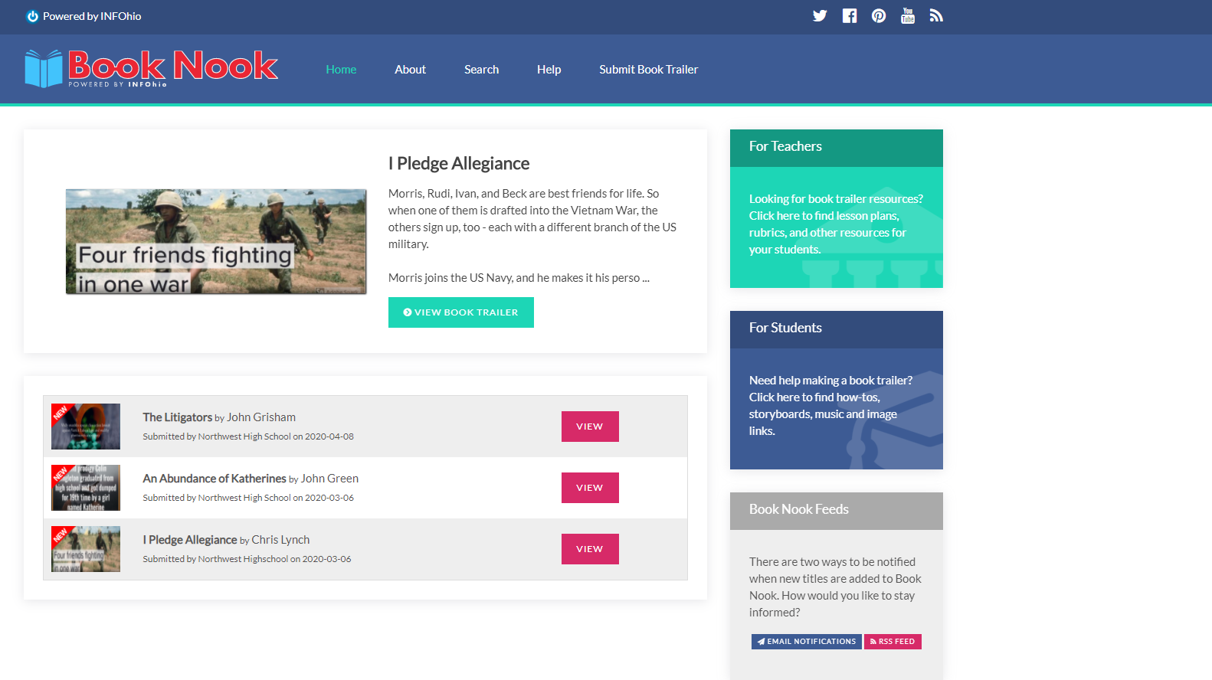
Notes:
INFOHio also has tools which support inquiry and students as creators. Book Nook allows Students to create their own book trailers, like movie trailers but for books, at home or at school and send them to INFOhio to be included in Book Nook. It’s a great way to help students think carefully about what they’re reading, share what they’re reading with their friends, and express themselves creatively. Your child can also search or browse to find their next read!

Slide 23
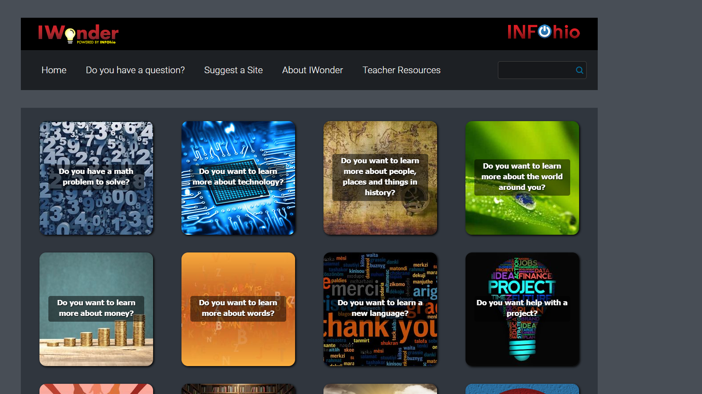
Notes:
Want to encourage curiousity? Consider INFOhio's tool IWonder, :
IWonder includes the “best of the best” websites handpicked for students in grades 3-9.
IWonder is a great place for kids to start when they need help with homework, a fun way to practice skills such as vocabulary or math, or to explore a topic that interests them. They can choose a question to learn more about that topic.

Slide 24
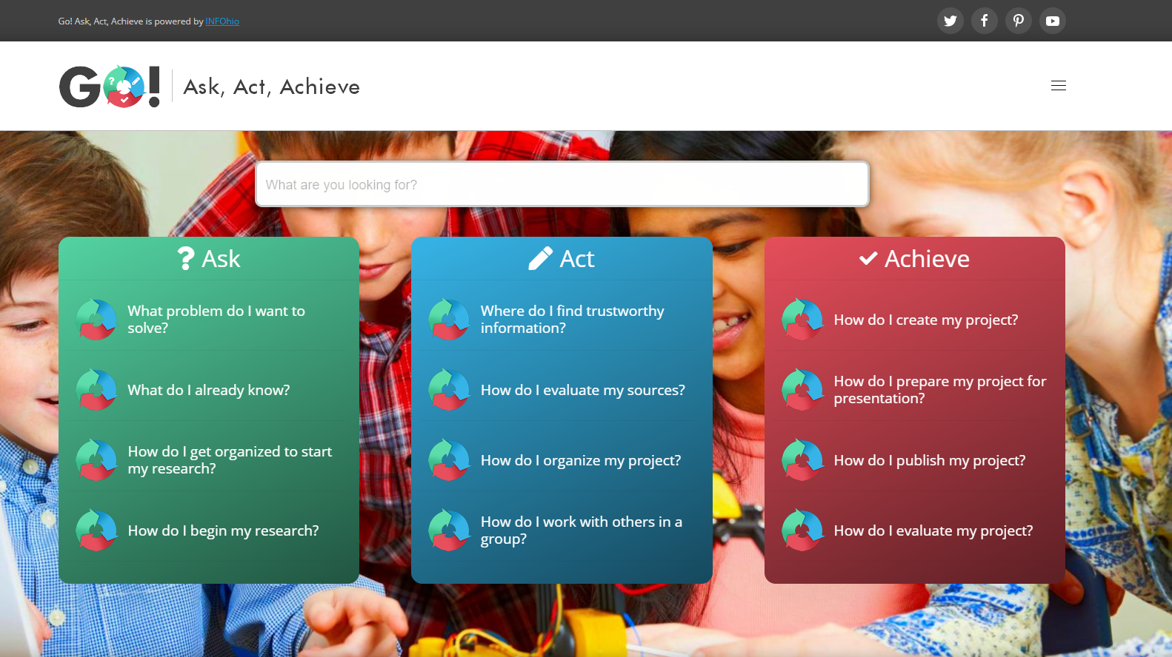
Notes:
Next you’ll see our inquiry tool Go! Ask, Act, Achieve
GO! splits a big project, which can be intimidating, into smaller, manageable steps so students won’t be overwhelmed.
There are three major sections—Ask, Act, and Achieve.
Then it further separates each of those sections into steps. Each step contains links to several different resources to help with that part of the inquiry or research process.
The next time your child has a research or science fair project and is having trouble finding or narrowing a topic, finding reliable research resources, or coming up with a creative way to present a topic, try GO!

Slide 25
Notes:
Finally, let’s explore Research 4 Success.
Research 4 Success is a tool for high school or college credit plus students. Teachers use R4S to help students learn how to do rigorous research. This tool is perfect for College Credit Plus students and those who are moving on to college after graduation.

Slide 26
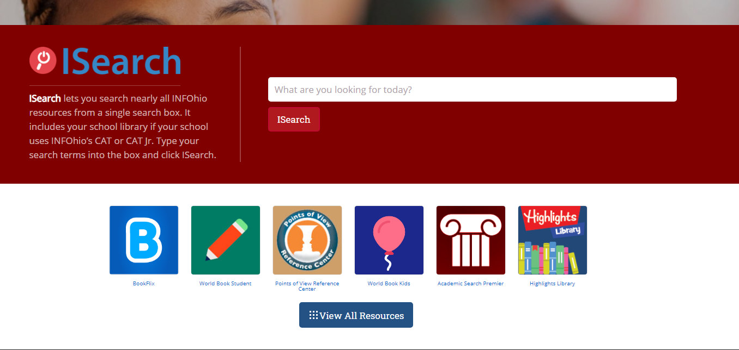
Notes:
In the old days, students had to search each INFOhio resource one by one—more than two dozen of them—to find information.
Then ISearch was released. Many Ohio schools use INFOhio's library automation software to catalog books in their school library including eBooks. ISearch allows you to search this content when you are logged in using your district username and password. You can find these titles under the My Library tab.
It also allows students (and teachers and parents) to search almost all INFOhio resources at one time using a Google like search. With one search, students can now find encyclopedia articles, magazine and journal articles, primary sources, educational videos, and eBooks.

Slide 27
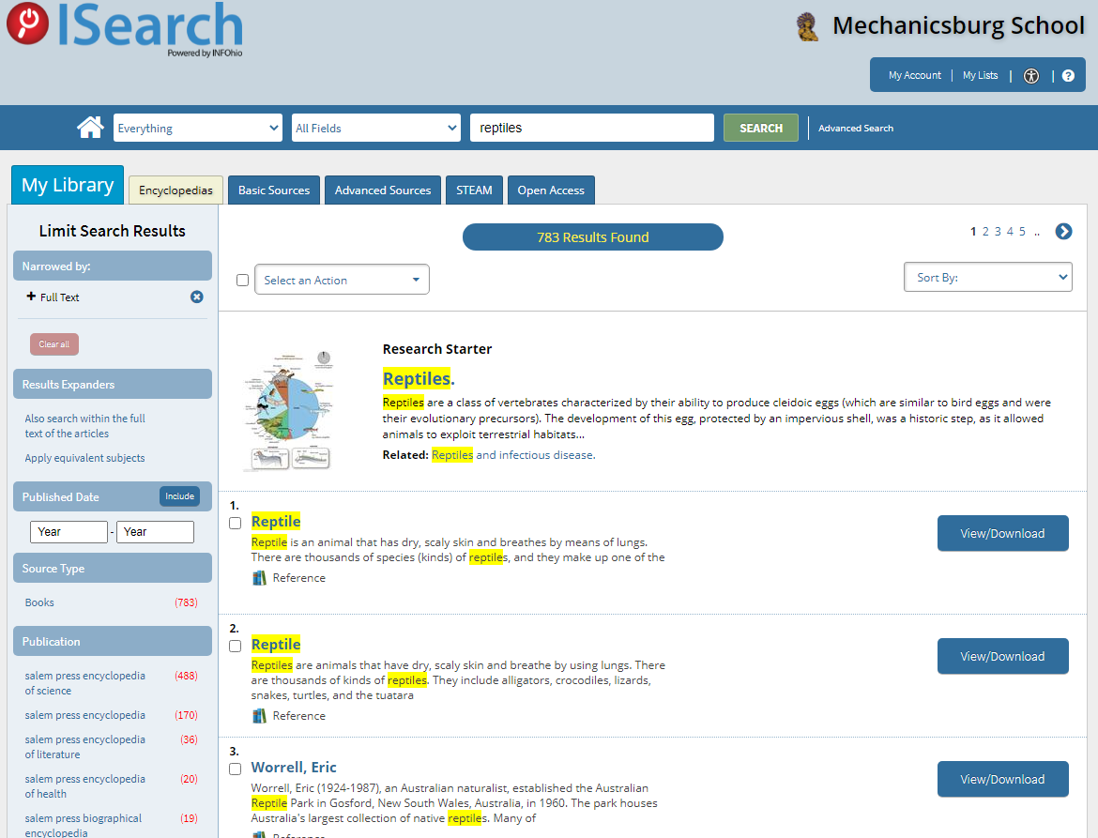
Notes:
ISearch is a search tool that helps students be college and career ready because it’s a search tool like those used in most colleges and public libraries in Ohio. Teachers and students can use the tabs at the top of the ISearch results screens to find the right resource at the right level for them.

Slide 28
Notes:
As you can see, INFOhio has a wealth of resources that can help your children with their schoolwork or just to learn more about their favorite topics. Our vision is: Each Ohio PreK-12 student has equal access to high-quality digital resources for a successful education and future.

