Slide 1



FREE STEM/CS/CTE
Career Exploration Resources for OH
Sign up for your FREE account at www.learningblade.com/OH
Provided by:

Slide 2
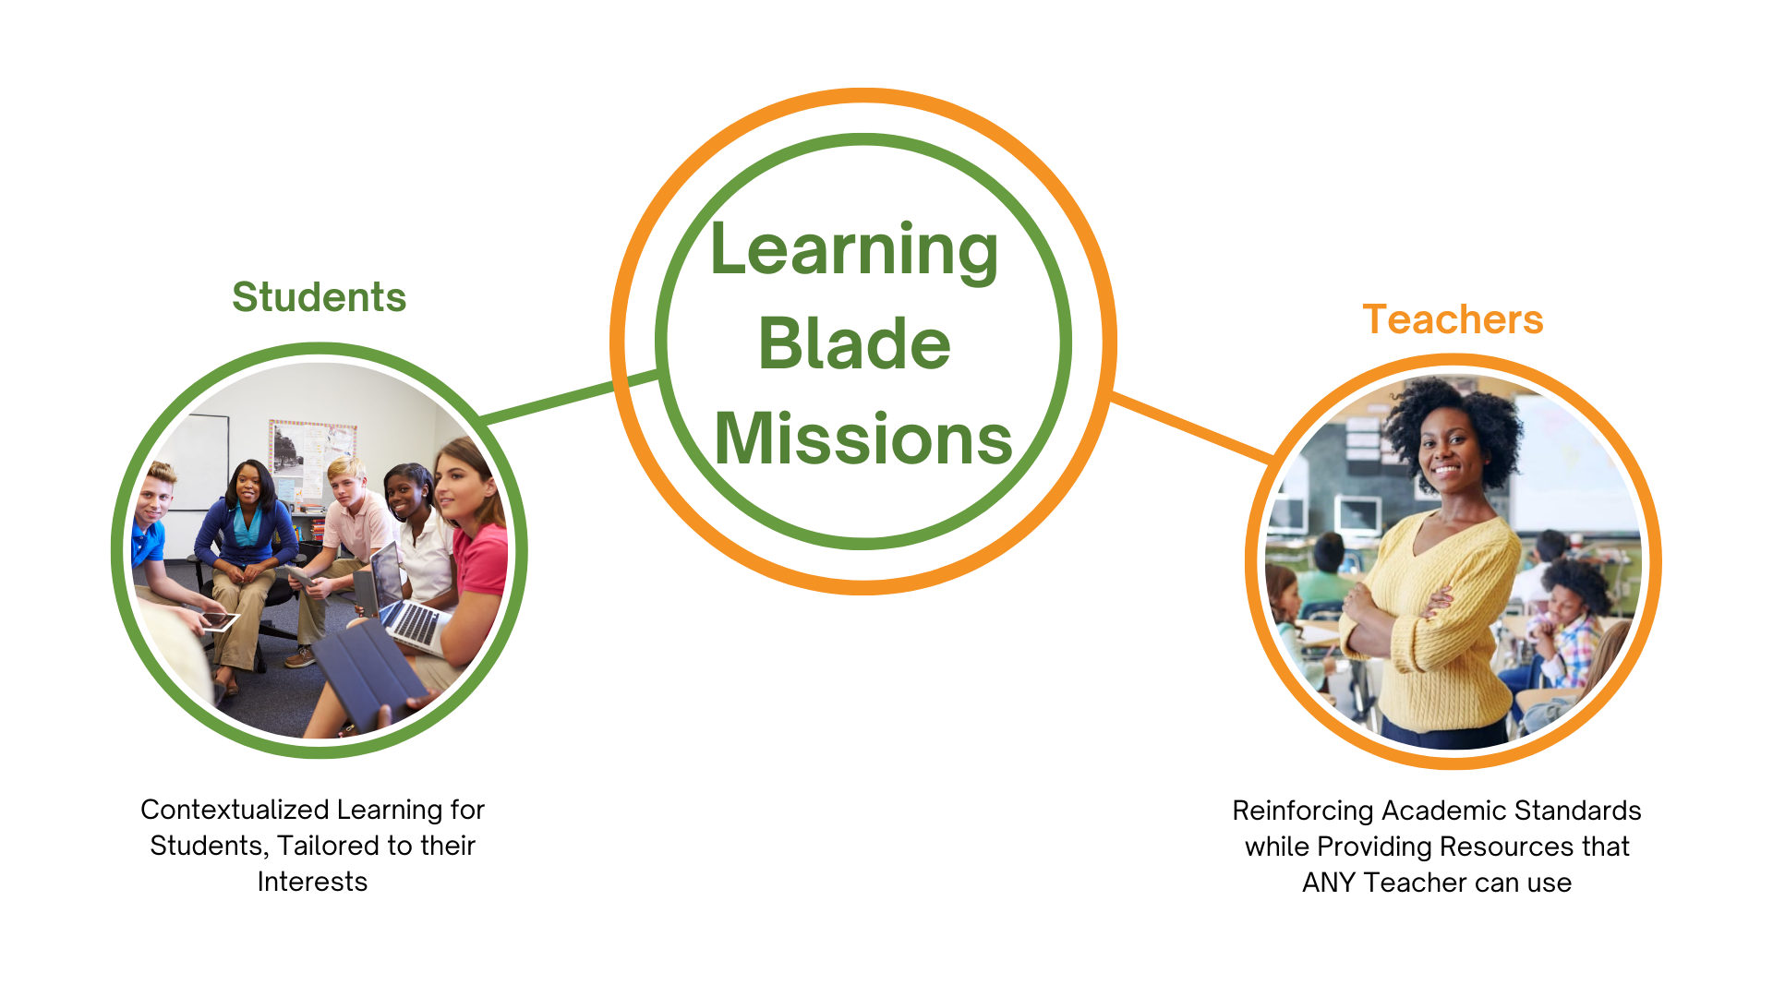
We introduce students to CS and STEM Careers through “Missions”.

Slide 3
“Missions” involve a societal challenge that interests students
Mission Challenge Career Clusters
12
Car Manufacturing | Use modern manufacturing techniques to design and build a new concept car | Advanced Manufacturing
Dolphin Rescue | Help rescue rehabilitate an injured dolphin, including creating an artificial prosthetic tail | Biomedicine, Marine Science
Energy Sources | Evaluate alternative or upgraded energy sources for a city that currently has an old coal-fired power plant | Energy Production, Environment
Entrepreneurship | Set up a new business with a focus on entrepreneurship | Finance, Business
Flu Outbreak | How health and IT professionals can use data warehousing and analysis to predict flu outbreaks using GIS and social media data | Information Technology
Fresh Food | Consider methods to increase production of local foods in a community | Agriculture
Hack Attack | Learn about methods to create and protect website, apps and social media after a school’s website and media are hacked | Computer Science
Haiti Orphanage | Design and build an environmentally-sound orphanage for children left homeless by an earthquake in Haiti | Construction, Sustainability
Heart Surgery | Conduct heart surgery and therapy for a child with a heart defect; evaluate the use of artificial hearts or heart components | Medicine
Lightweight Aircraft | Design a lightweight and easily maintained aircraft for distant missions | Lightweight Metals Manufacturing
Rescue Robots | Explore technology used for robotics design, such as sensors, electrical circuits, industrial design and computers | Electronics, Computer Science
Transportation Congestion | Evaluate new transportation methods for a city that has a traffic congestion problem | Transportation
“Missions” that engage all students

Slide 4
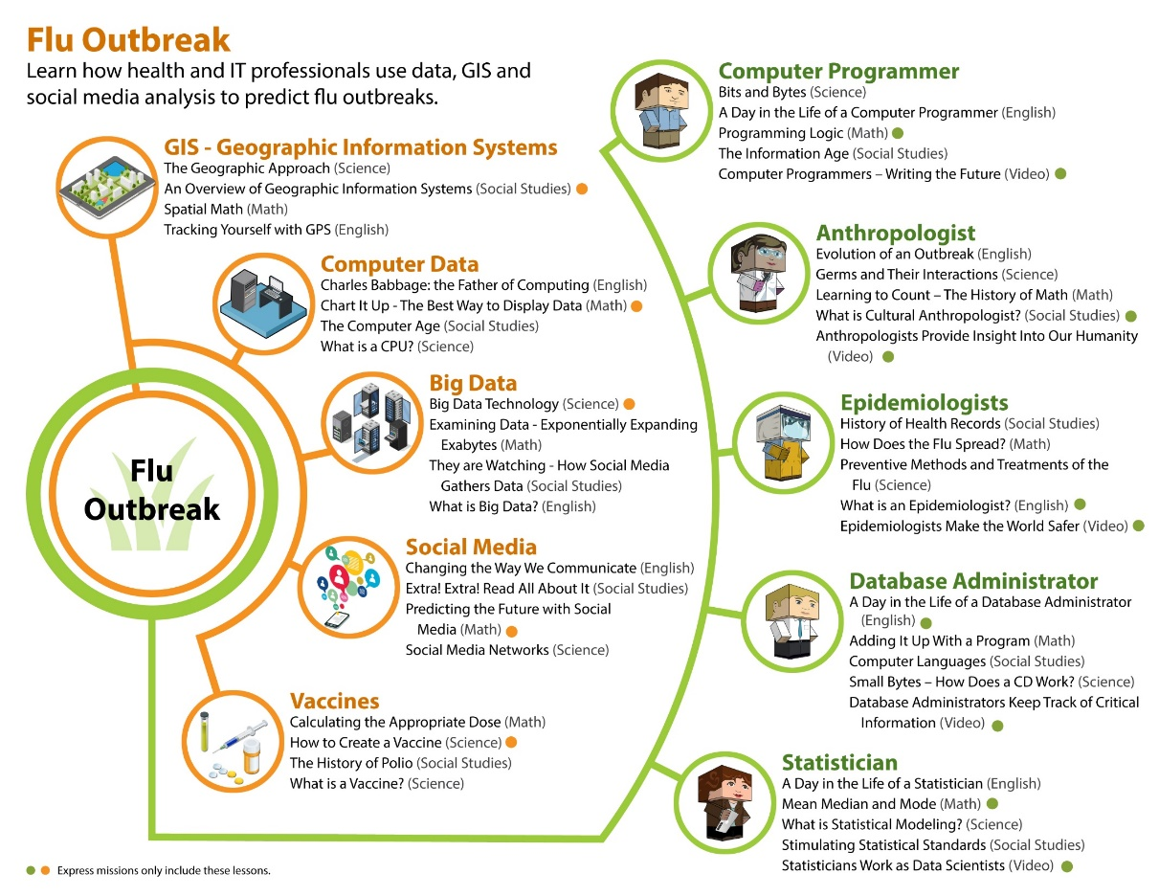
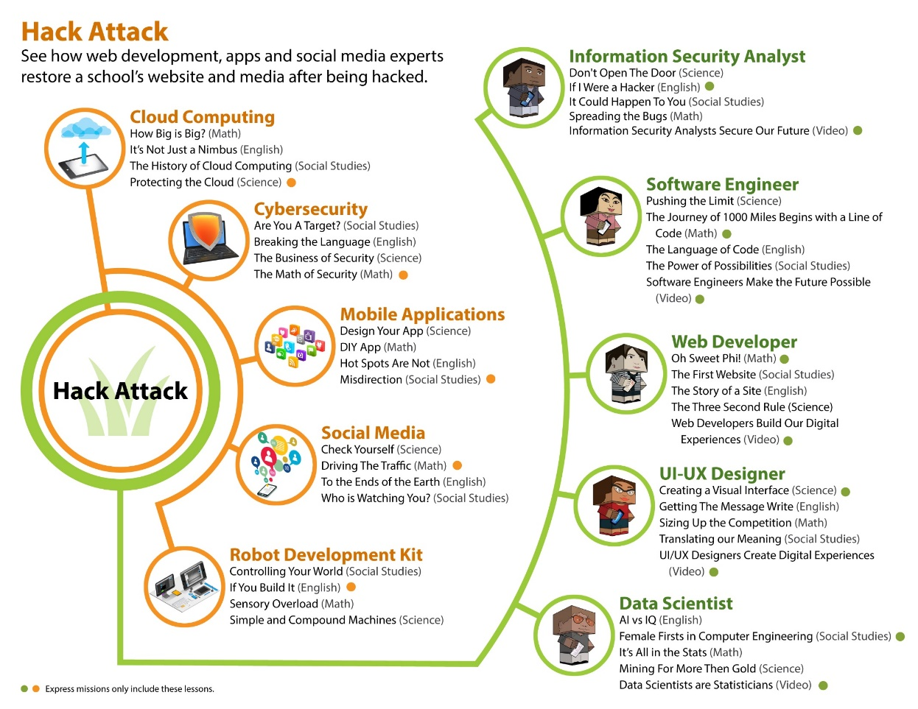
LB contains over 100 careers and technologies, 400 lessons in the specific contexts of science, math, English and social studies.
Tools
Teammates
Sample mission outlines showing Science, Math, English and Social Studies lessons for each career and technology

Slide 5
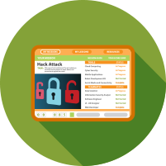







Each Mission includes an interactive toolbox of lessons and activities.
Interactive online lessons, ready-to-use lesson plans and activities for middle and high school students.
Can be used by any teacher, anywhere. Validated and proven to increase STEM/CS/CTE career interest.
Interactive Lessons
Hands-On Projects
Design Thinking
Parent Discussions
Over 400 online lessons tied to academic standards
Mission challenges are project-based lessons using common materials
Solve complex problems with the 5-step creative thinking process
Handouts and easy experiments for at-home discussions
Career Videos
3D Printing Activities
Intro to Coding
Papercraft Figures
Introduce over 50 careers with real-life people
Create objects that demonstrate science principles
20-hour middle school course providing robust coding experiences
Students make origami-type figures
of 100 careers and technologies

Slide 6
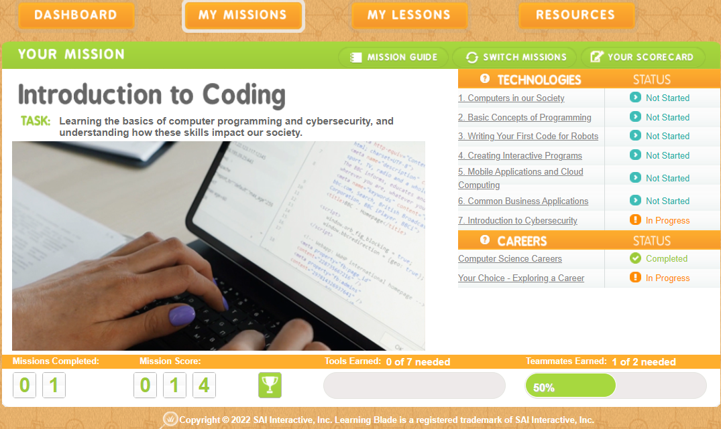
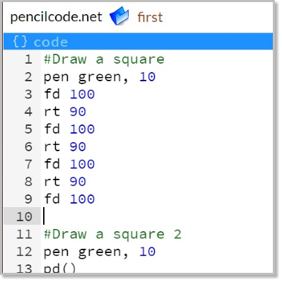
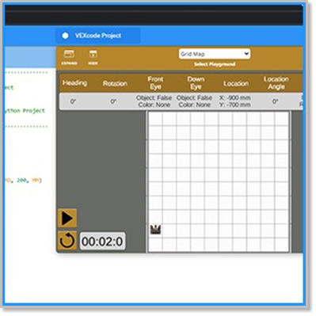
This 20-hour course provides everything you need to introduce students to computer science and real, text-based computer programming for MIDDLE SCHOOL!
Includes online lessons, group classroom activities, and complete lesson plans for guiding students through authentic coding experiences. Topics include:
20-Hour Introduction to Coding Course
Computer hardware and software
Simple algorithms and common statements
Offline algorithm games
Beginning programming
Creating a simulated mobile app
Concepts of cybersecurity and personal security
Exploring common IT careers
Notes:
Arkansas Requested an Intro to Coding course

Slide 7

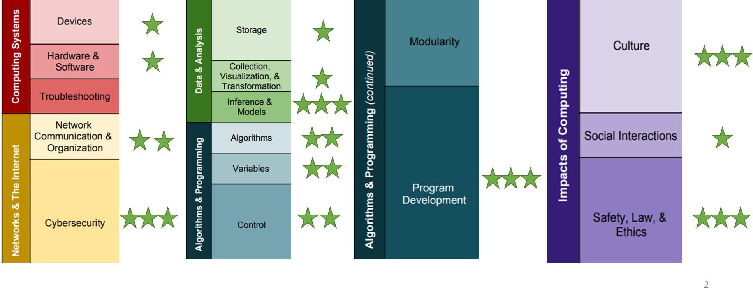
Approved CSTA Quality PD
Learning Blade - Intro to Coding PD is accredited by CSTA for quality PD .
An independent committee of experts evaluates the indicators of quality computer science PD and elements of effective teacher PD including the following:
Content Focus
Inclusivity
Active Learning
Collaboration
Differentiation
Models & Modeling
Accessibility
Feedback & Reflection
Efficacy
Ongoing Support
Learning Blade Aligns with CSTA Level 2 Standards for Middle Grades

Slide 8
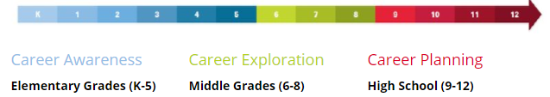
OH Career Connections Framework
Learning Blade curriculum is aligned to middle school standards while exploring 100 STEM careers and technologies:
Grades 6-8: identify interests, develop self-awareness, determine personal motivations related to work and income
Accountant | Environmental Engineer | Nuclear Engineer
Agricultural Engineer | Environmental Protection Specialist | Nurse
Agronomist | Epidemiologists | Paramedic
Anthropologists | Food Assurance Technician | Power Engineer
Architect | Industrial Designer | Safety Administrator
Automotive & Engineer Technician | Industrial Engineer | SCUBA Diver
Automotive Designer | Information Security Analyst | Software Engineer
Biomedical Engineer | Investor | Statistician
Business Consultant | Logistics Engineer | Therapist
Civil Engineer | Machinist | Transportation Engineer
Computer Programming | Manufacturing Technician | Transportation Planner
Data Scientist | Marine Biologist | UI/UX Designer
Database Administrator | Mechanic | Veterinarians
Doctor | Mechanical Drafter | Web Developer
Electrical Technician | Mechanical Engineer | Welder
Electrician | Microbiologist
8

Slide 9
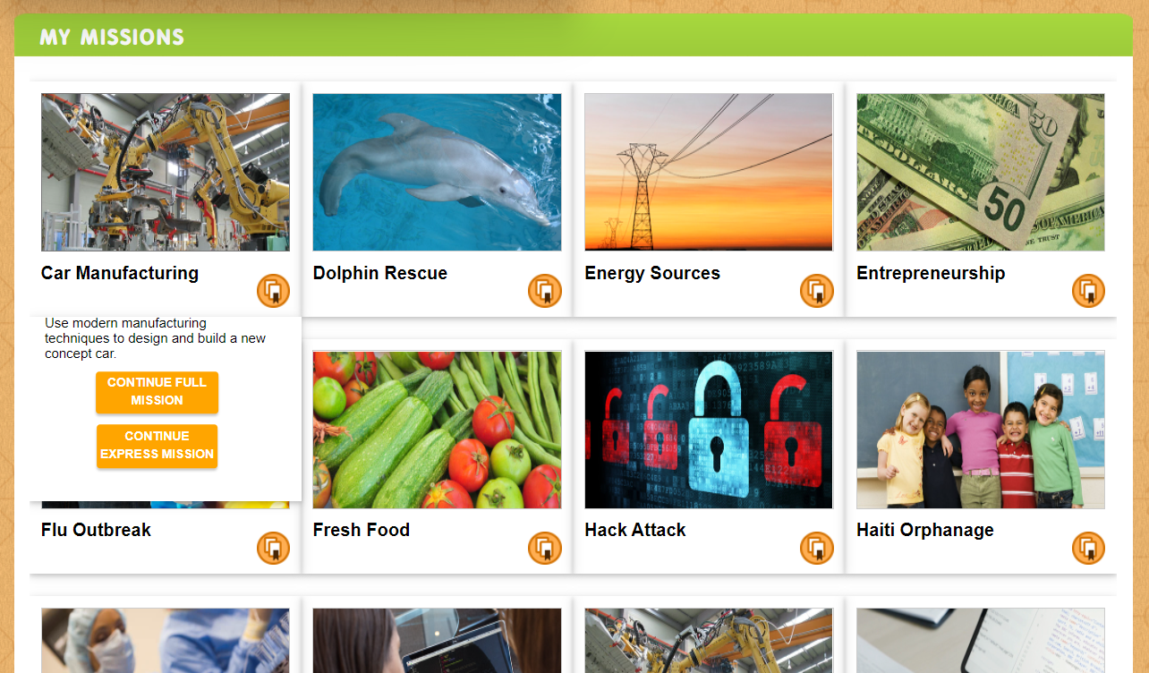

Students Can select a Mission, or teachers can assign specific Missions.

Slide 10
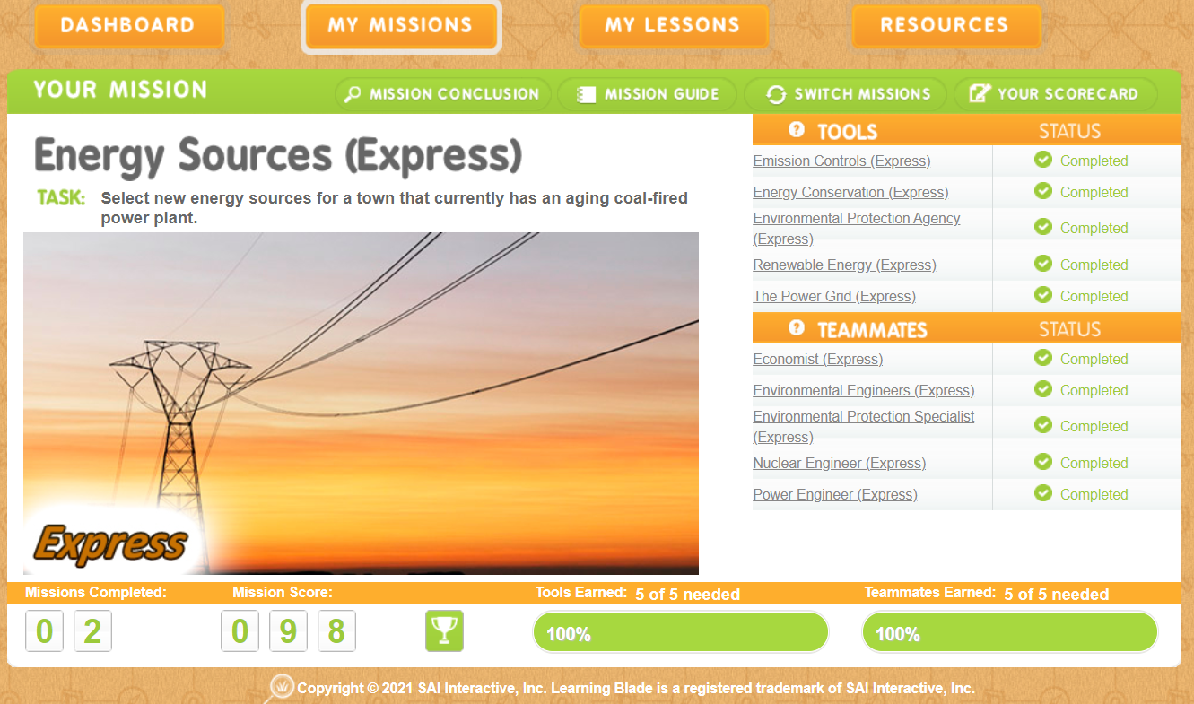
Students operate missions from a mission dashboard.

Slide 11
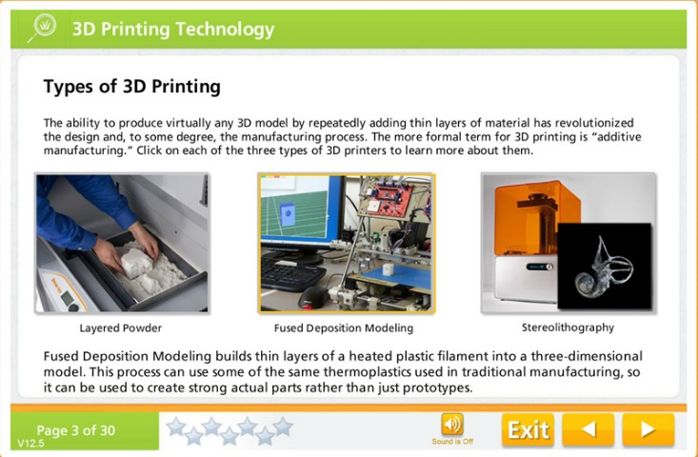
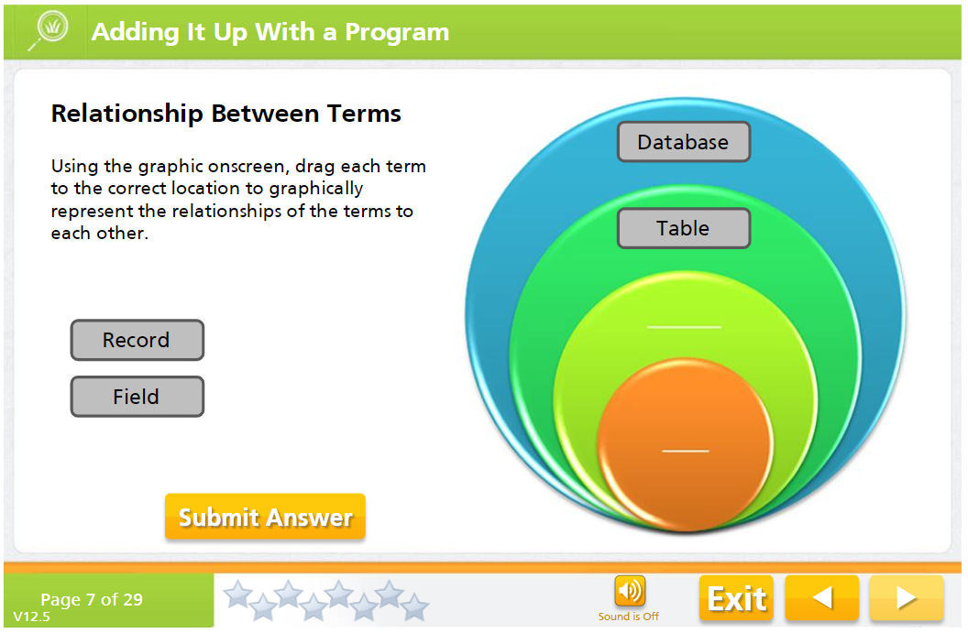
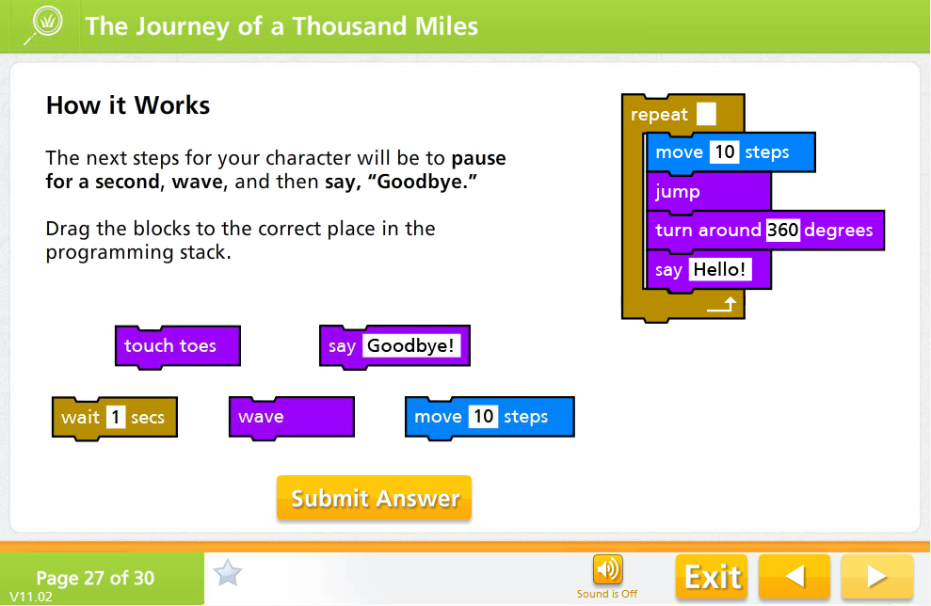
LB interactive lessons introduce careers while reviewing academics.

Slide 12
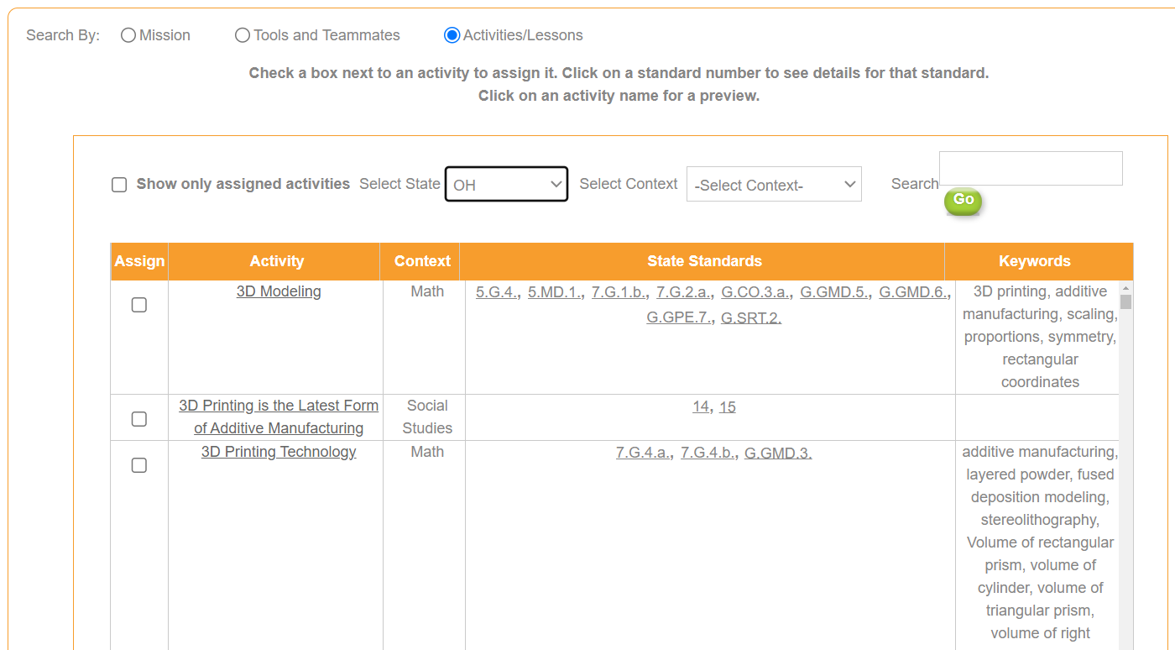
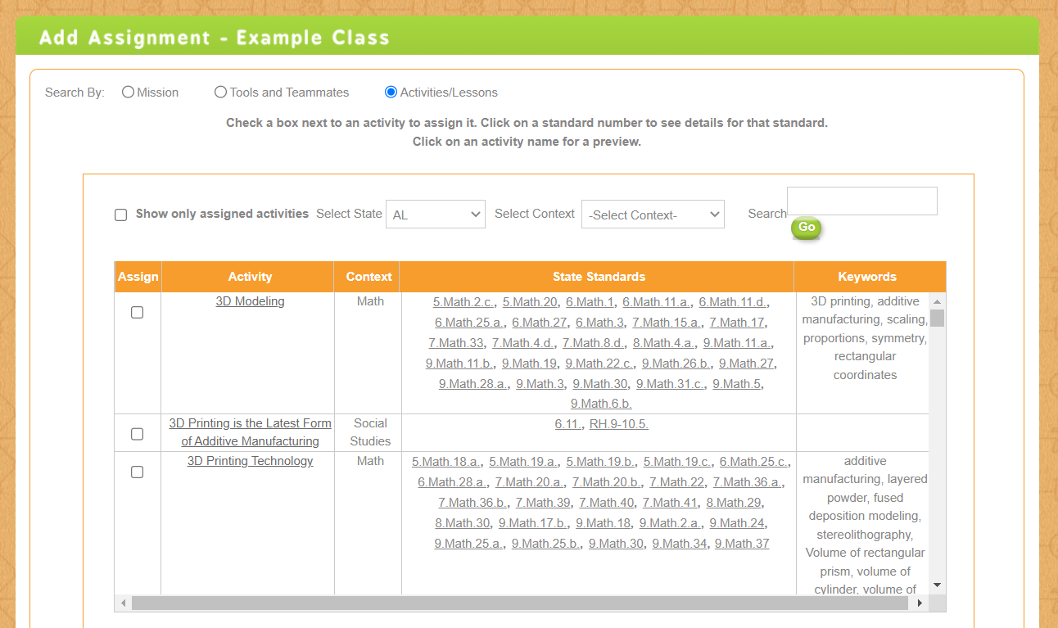
Lessons are specifically aligned to OH academic standards.

Slide 13
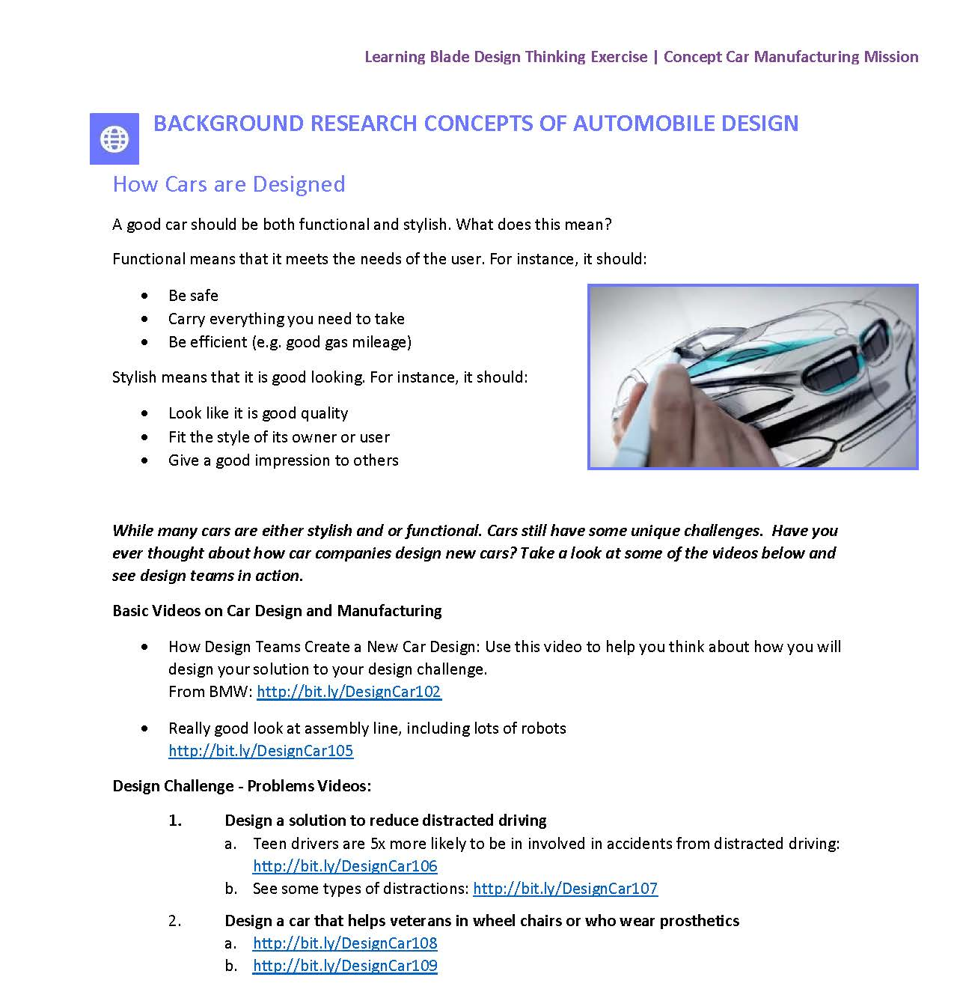
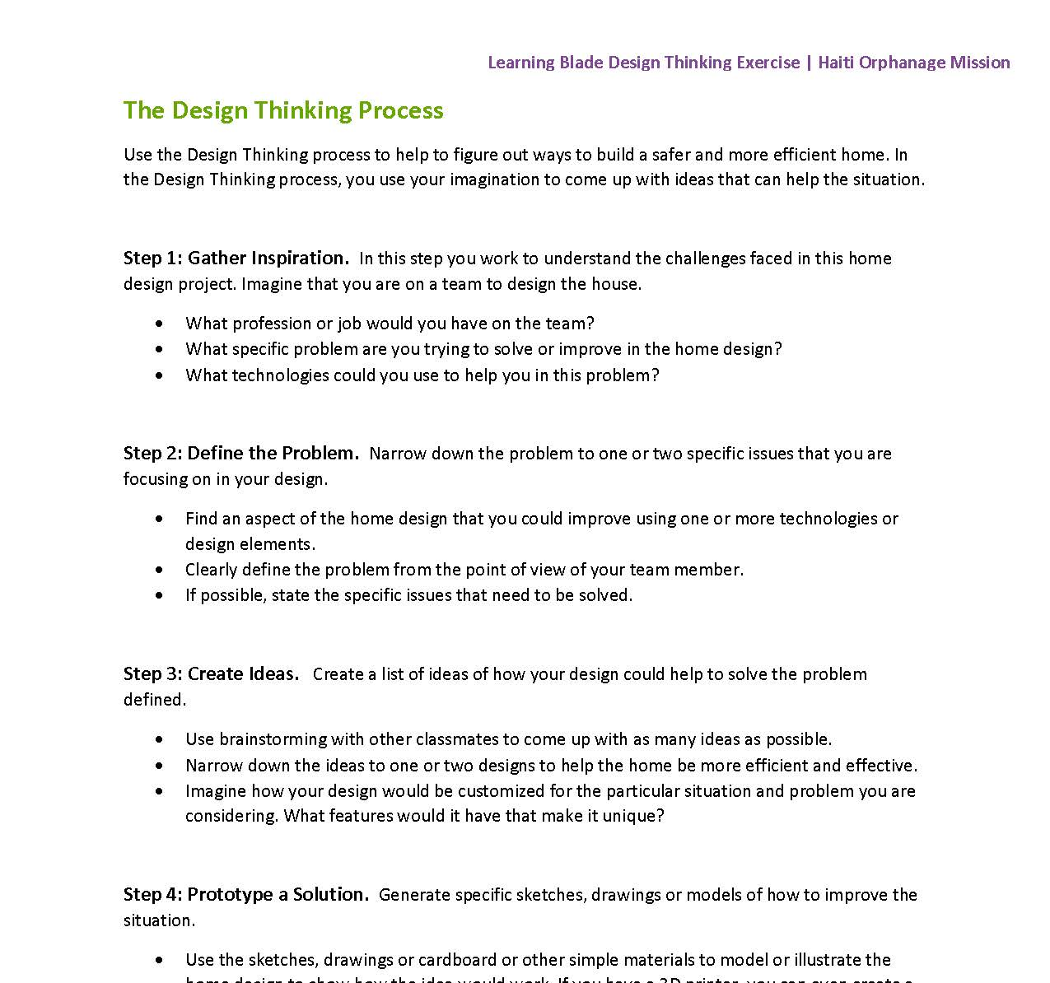
Design Thinking lessons let students create a solution to the Mission.
Design Thinking
New Design Thinking lessons encourage students to explore their own solutions to the problems related to each the mission, and to present their ideas in front of other students.
Each lesson includes:
Background research information
Suggestions for problem statements
Five-step design thinking process guides
Standards alignment
Teacher rubric
13

Slide 14
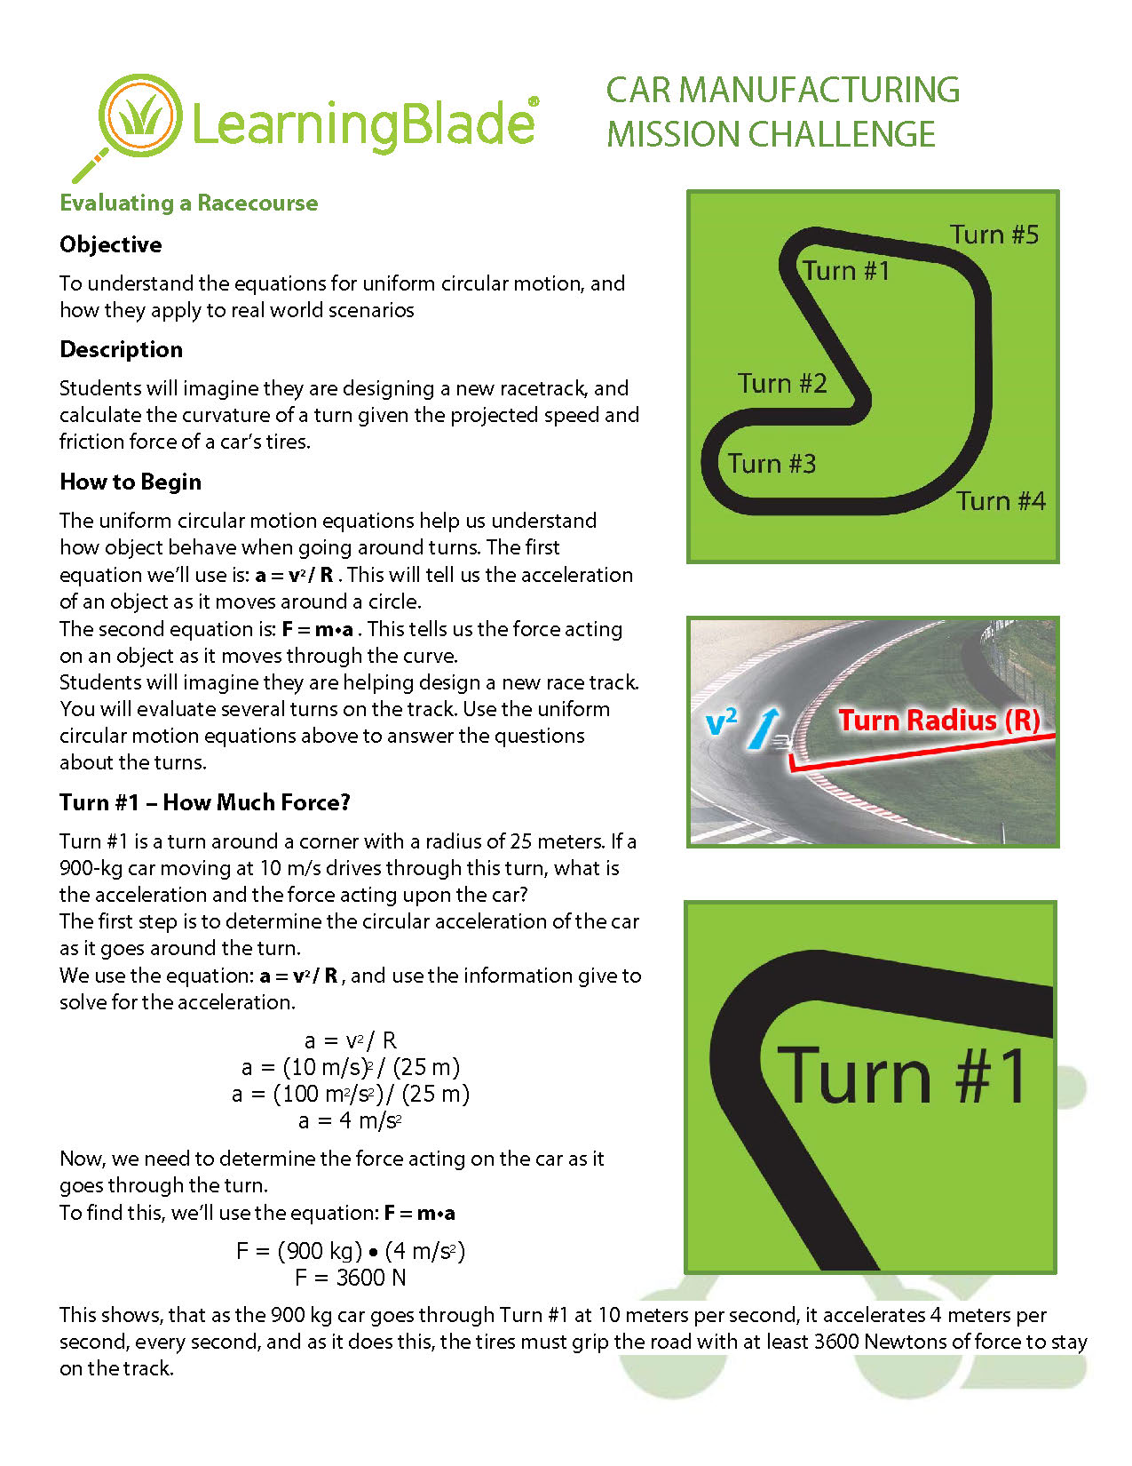
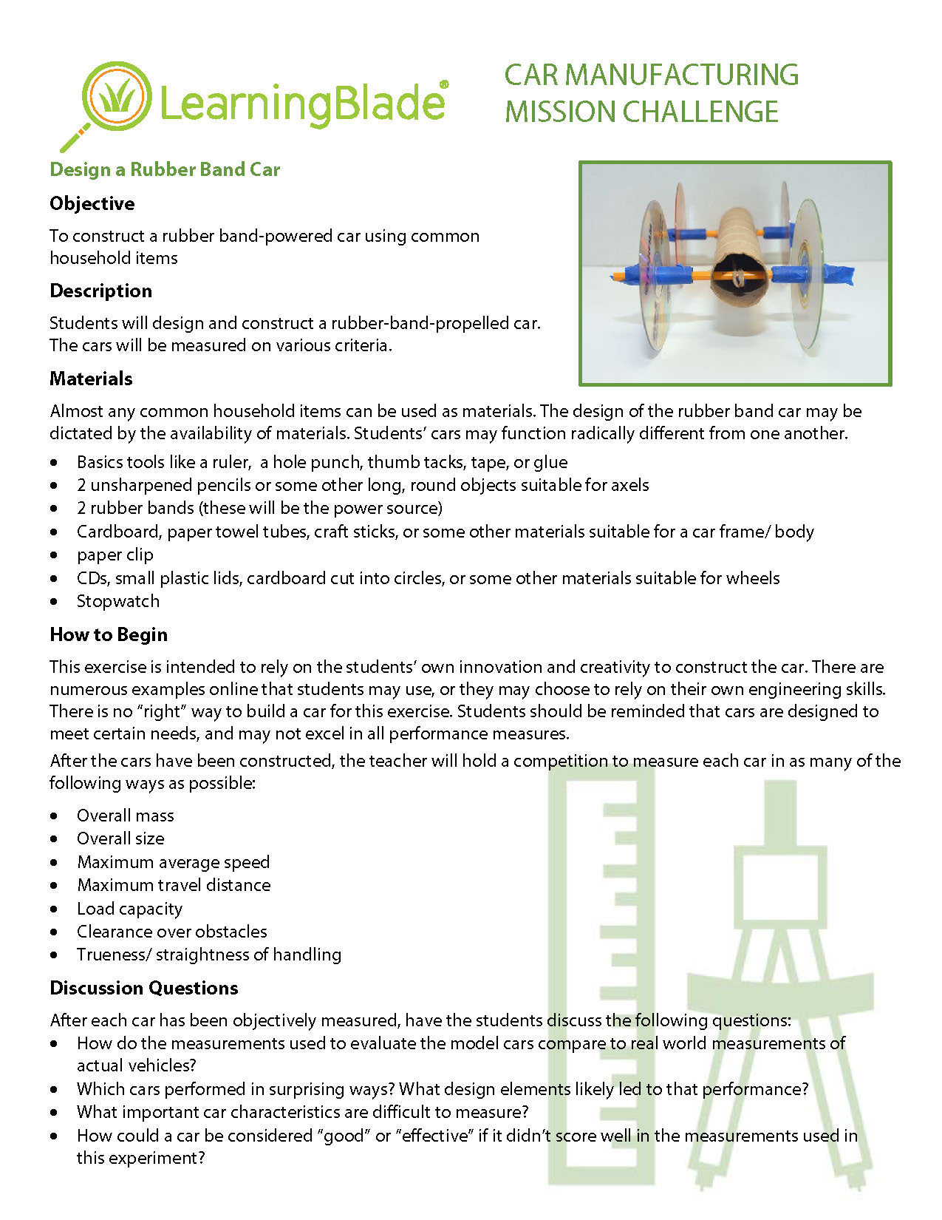
Mission Challenges include experiments, projects and presentations.
Mission Challenges
Each lesson includes:
Writing prompt
Presentation prompt
Manipulatives using common household or classroom materials
14

Slide 15
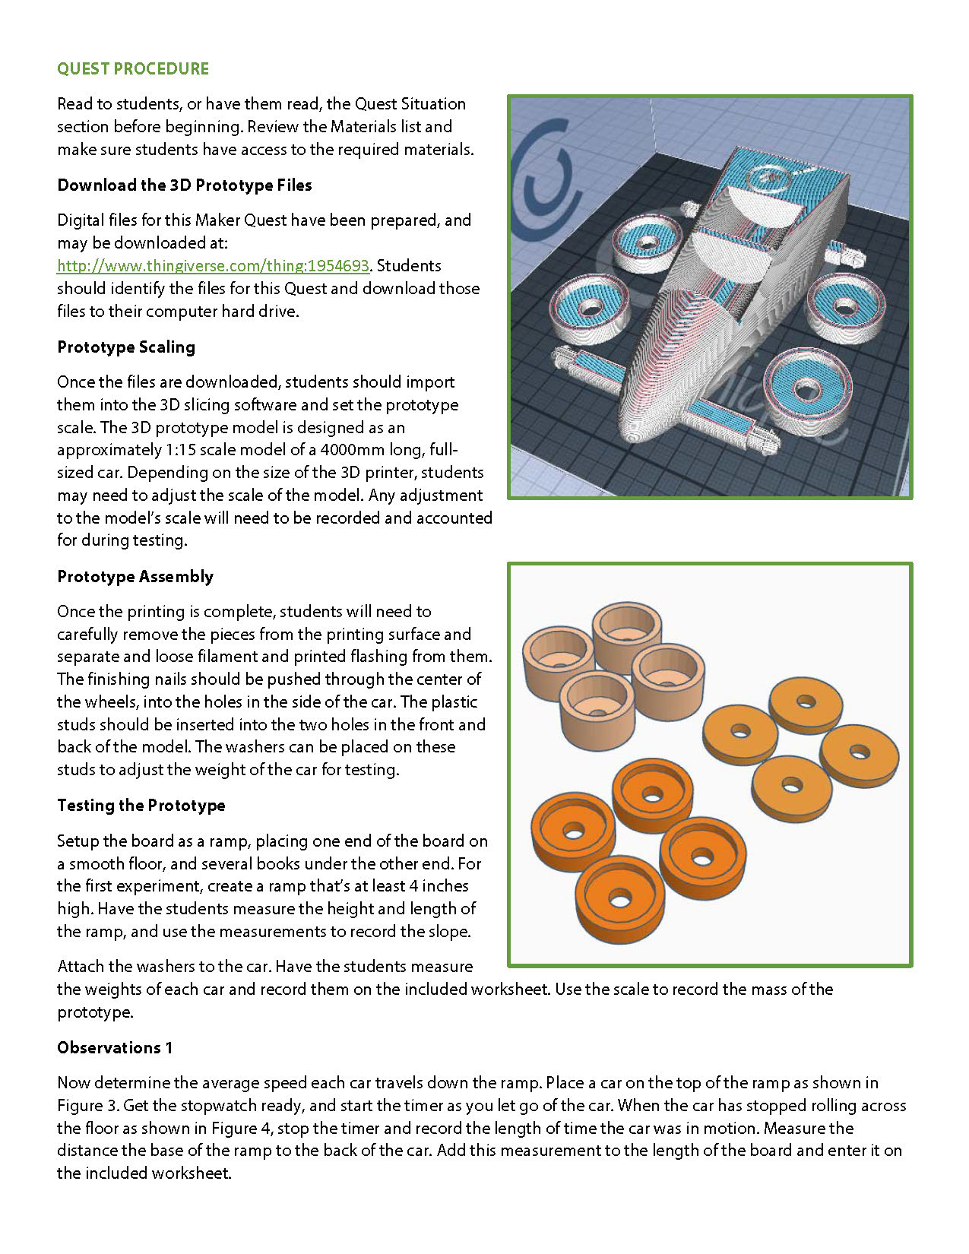
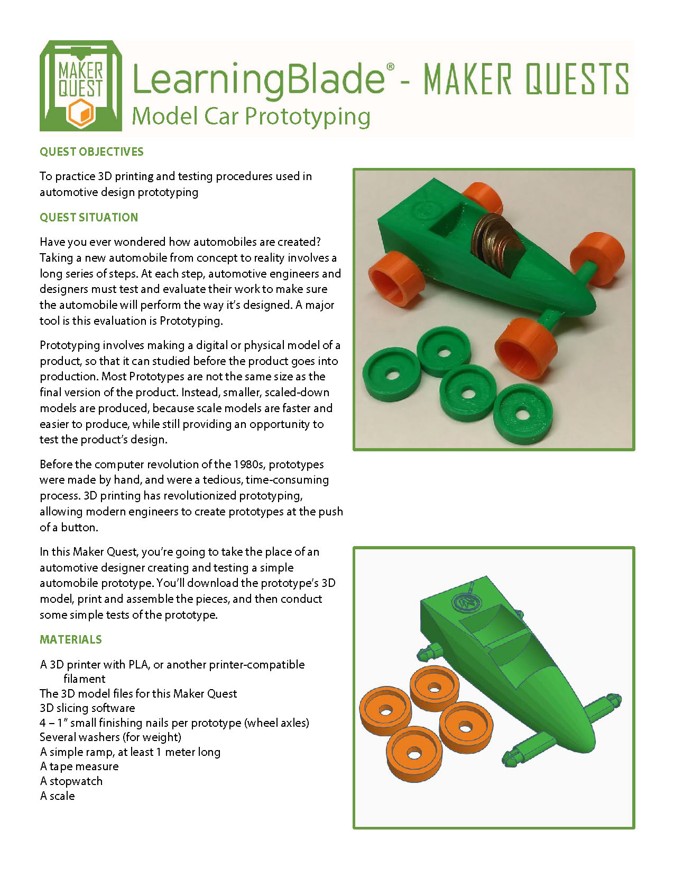
3D Printing lessons let students design objects and then do experiments.
3D Printing projects
Each lesson includes:
Downloadable 3D design models
Ability to modify the model online
Instructions for activities that use the object after printing to illustrate science concepts
15

Slide 16

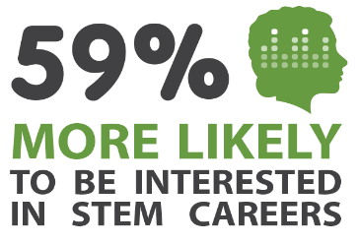
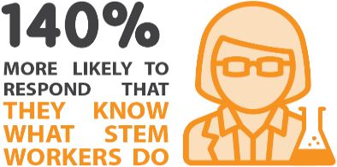
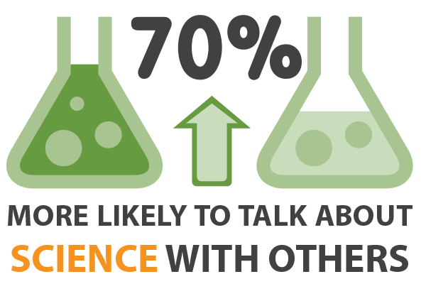
Our results have been independently validated.
Student Survey Results Validated by Battelle:
55% Increase in students who strongly agree that they are interested in a career in Computer Sci.
Doubling the # of students interested in becoming an engineer and/or scientist
79% Increase in students recognizing “Math is helpful when solving interesting problems.”
69% Increase in students recognizing “What I learn in school will be useful later in life.”
56% Increase in students interested in taking advanced math classes in high school.
Independent Ed.D. Research Results: Katherine Kendall, 2017. All items p<.001, N=276
Learning Blade users were more likely to intend to pursue STEM careers:
59% more likely to be interested in a STEM career
84% more likely to want a job that designs or builds things
140% more likely to respond that they knew what STEM workers do
70% more likely to be willing to like to talk about science with others
Selected as “Accomplished” in STEMworks database by WestEd by
meeting rigorous design principles and evaluation by independent reviewers
Learn more at http://link.learningblade.com/results
Results from Student Surveys

Slide 17
Teachers Feel Confident With Learning Blade
Teacher Survey Data
92% is Easy to Use
91% helps students visualize themselves in STEM career paths.
93% helps students understand how STEM careers solve real-world problems
93% provides students practical examples of the application of science concepts
92% Provides practical examples of the application of math skills
80% provides useful hands-on lesson plans
"I like Learning Blade because it is user-friendly, allows for student self-paced, self-guided lessons that focus on career exploration. It is a great tool to have in my back pocket!“
Career Exploration Teacher, Louisiana

Slide 18

Ohio Pilot
Springboro Middle School
5+ Years using Learning Blade
1,579 Students Impacted
78,000+ Online STEM Lessons Completed
10,000 Downloads
Lori Langdon, Technology Teacher, Springboro Middle School
"Learning Blade is innovative, it's exciting, it's new, it's interesting for the kids, the kids love it. It's interactive and students are drawn in. The fact that it's so geared toward their interests and relates to a 12 year-old, yet it introduces things that I don't even know about.”
Chad Lensman, Principal, Graham Middle School.
As a rural school, we don't have a lot of access to manufacturing your different careers within our own backyards, …, this really levels the playing field.“
Dan Leffingwell, Superintendent, Noble Local Schools
"A great supplement to any curriculum! Making the connection between curriculum and future career opportunities help students identify their 'why' and increases the course 'relevance'."

Slide 19
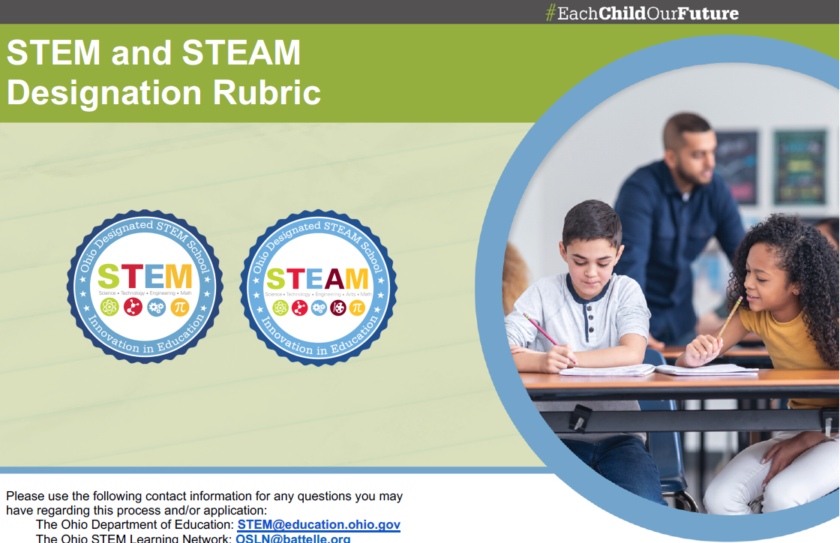
Learning Blade Aligns with Domain Two of OH STEM Designation Rubric
Instructional Design Supports Domain Two of the Ohio STEM Designation rubric
Integrating Academics - All academic disciplines and multiple content skills are combined into designing solutions to big future issues
Learning Approach - Students engage in project-based Missions that include design thinking about real-world issues
Computation Thinking - Algorithmic logic included in multiple missions, and added new Introduction to Coding course to provide true coding experiences
Dynamic Assessment – A toolbox of lesson plans for each
mission includes multiple opportunities for student
expression of Mission objectives

Slide 20
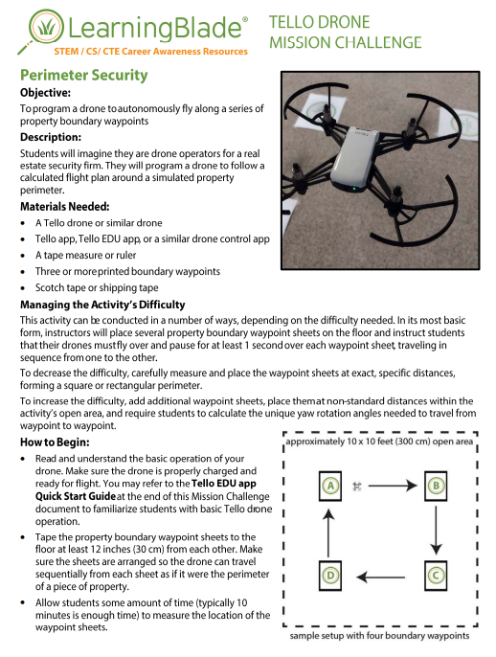
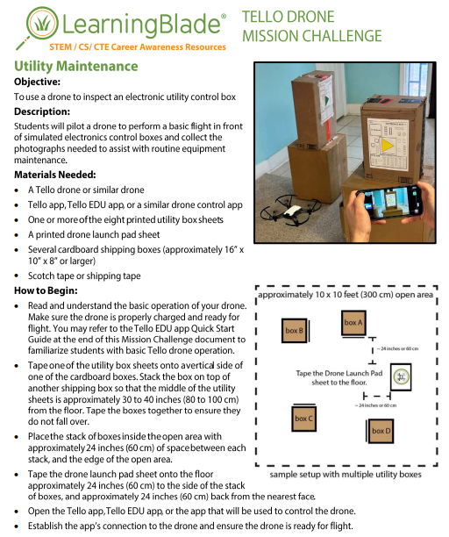

Win a Drone
Learning Blade will be awarding “TELLO DRONES" to our most active schools.
Schools that complete 5,000 online lessons during the 2023-2024 academic year will win.
Learning Blade includes lessons for programming drones and exploring the career of a Drone Operator.

Slide 21

Our accomplishments are nationally recognized.
Validation from Battelle
Learning Blade has been validated as a supplemental tool for increasing STEM career awareness and interest by Battelle.
Selected as an “Accomplished” solution in
the STEMworks database by WestEd
by meeting rigorous design principles,
and evaluation by independent reviewers.
Recognized by NREA as an effective means for bringing STEM career awareness and interest to rural schools.

Slide 22

Schedule Professional Development
Schedule professional development during your next planning period- now using Calendly!
https://calendly.com/d/g4x-2t9-sqv
Notes:
https://calendly.com/d/g4x-2t9-sqv

Slide 23
Thank you!
Sign up for your free account at:
www.LearningBlade.com/OH
For more information email us at:
info@LearningBlade.com

