Slide 1
Enrich your Teaching with Treasures from EDSITEment!
EDSITEment Project Specialists:
Joe Phelan, History and Social Studies
Shelley NiTuama, Literature and Language

Slide 2
What is EDSITEment?
We represent the highest quality digital humanities content designed to foster exploration and discovery in communities of learners
What does EDSITEment offer?
We offer a virtual treasure trove for teachers, students, and parents searching for high-quality material to enrich student learning at all levels.

Slide 3
Poll Question 1.
How many of you know that the National Endowment for the Humanities serves the k-12 community of teachers?
Please click on the little guy at the top of your screen to raise your hand

Slide 4
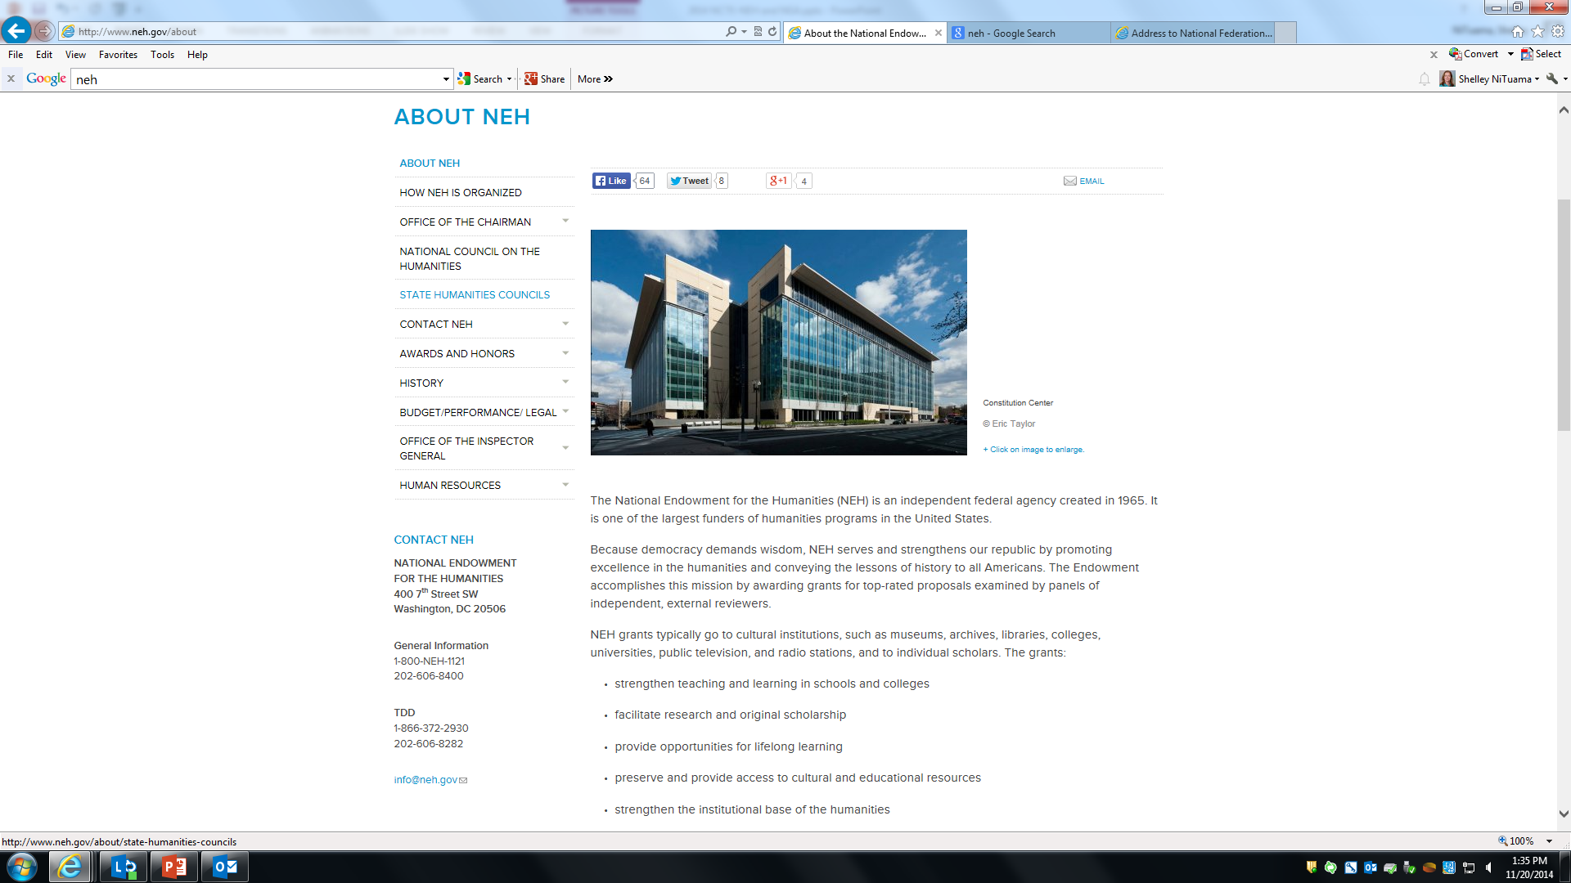

Slide 5
National Endowment for the Humanities Programs A few examples of current offerings for teachers:
Humanities magazine articles
Back When Everyone Knew How You Voted The secret ballot seems fundamental to democracy, and yet we did not always vote in private.
Professional development opportunities - Summer 2017
Summer Seminars and Institutes for School Teachers Attendees spend between two to five weeks on in-depth study of a humanities topic.
Landmarks of American History and Culture Workshops for School Teachers These one-week programs give participants direct experiences in the interpretation of significant historical and cultural sites and the use of archival and other primary evidence.
Public Programs
National exhibitions: Shakespeare’s First Folio tour
Educational documentaries: “Created Equal” - Freedom Summer
Educational repositories: Chronicling America Historic American Newspapers
Educational games: Mission US; Walden, a game

Slide 6
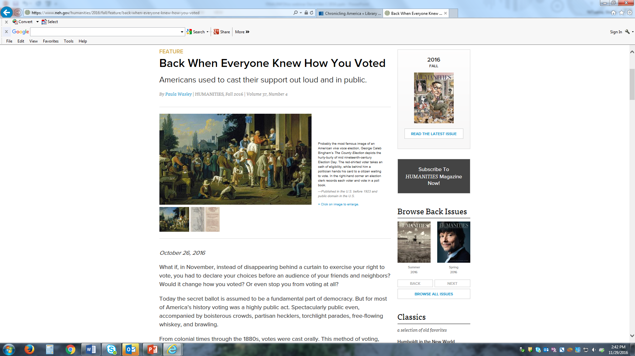

Slide 7
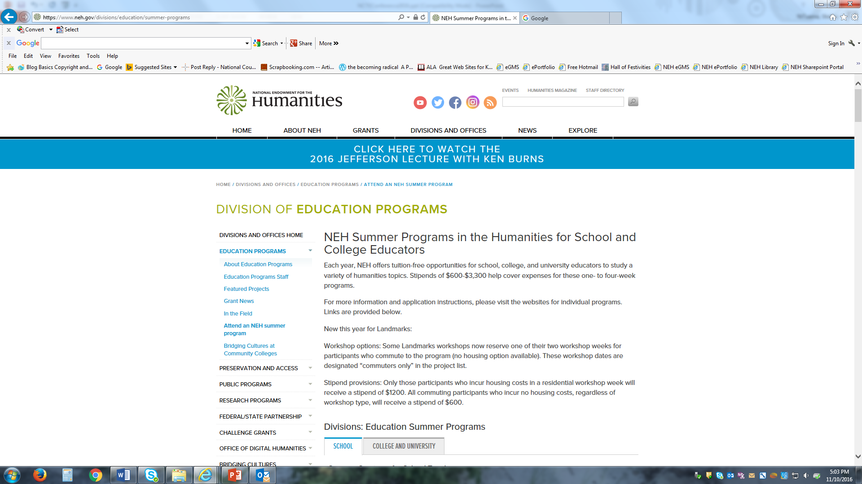

Slide 8
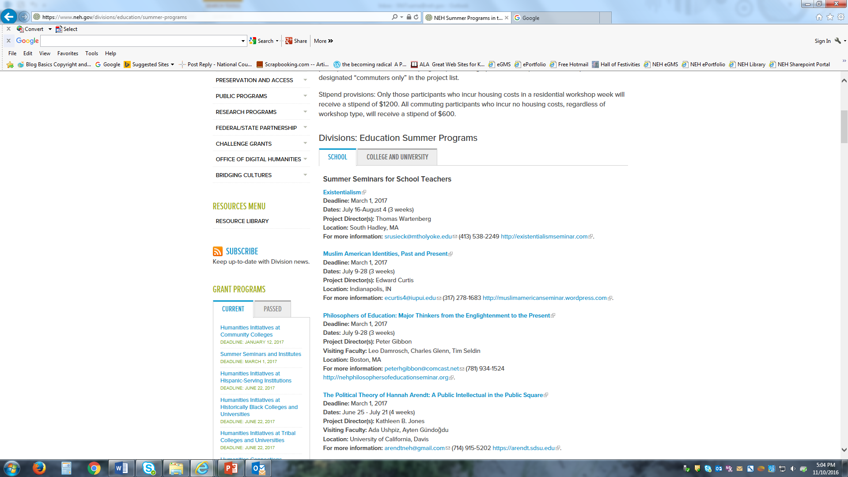

Slide 13
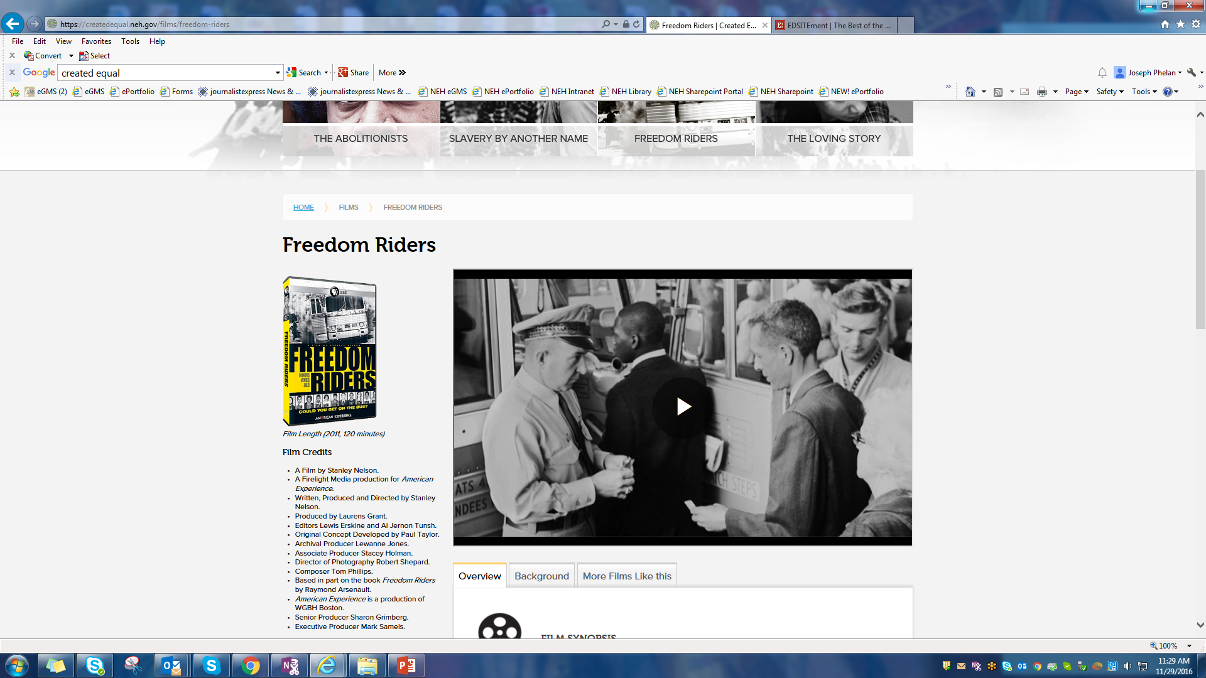

Slide 14
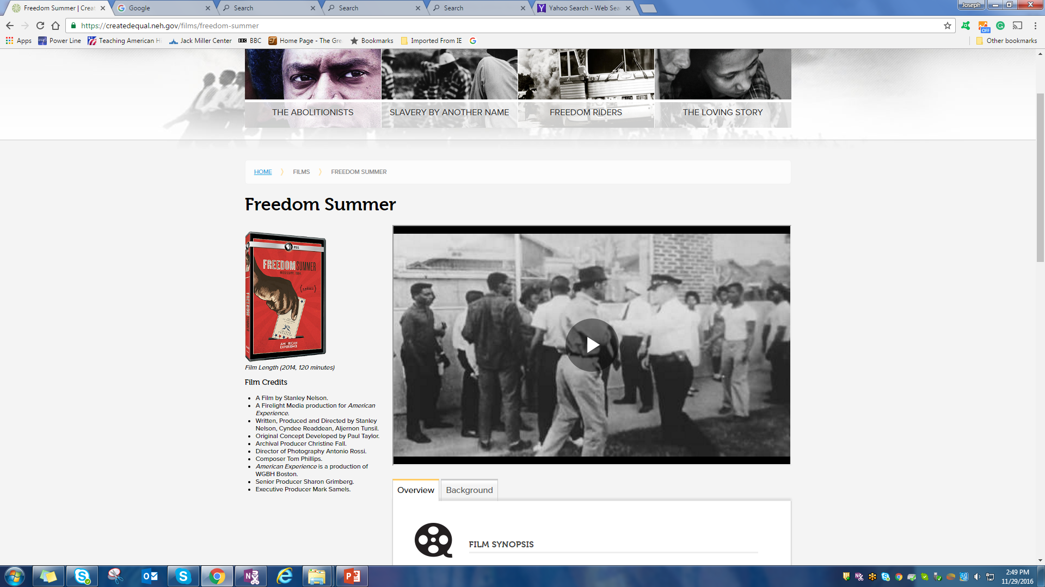

Slide 16
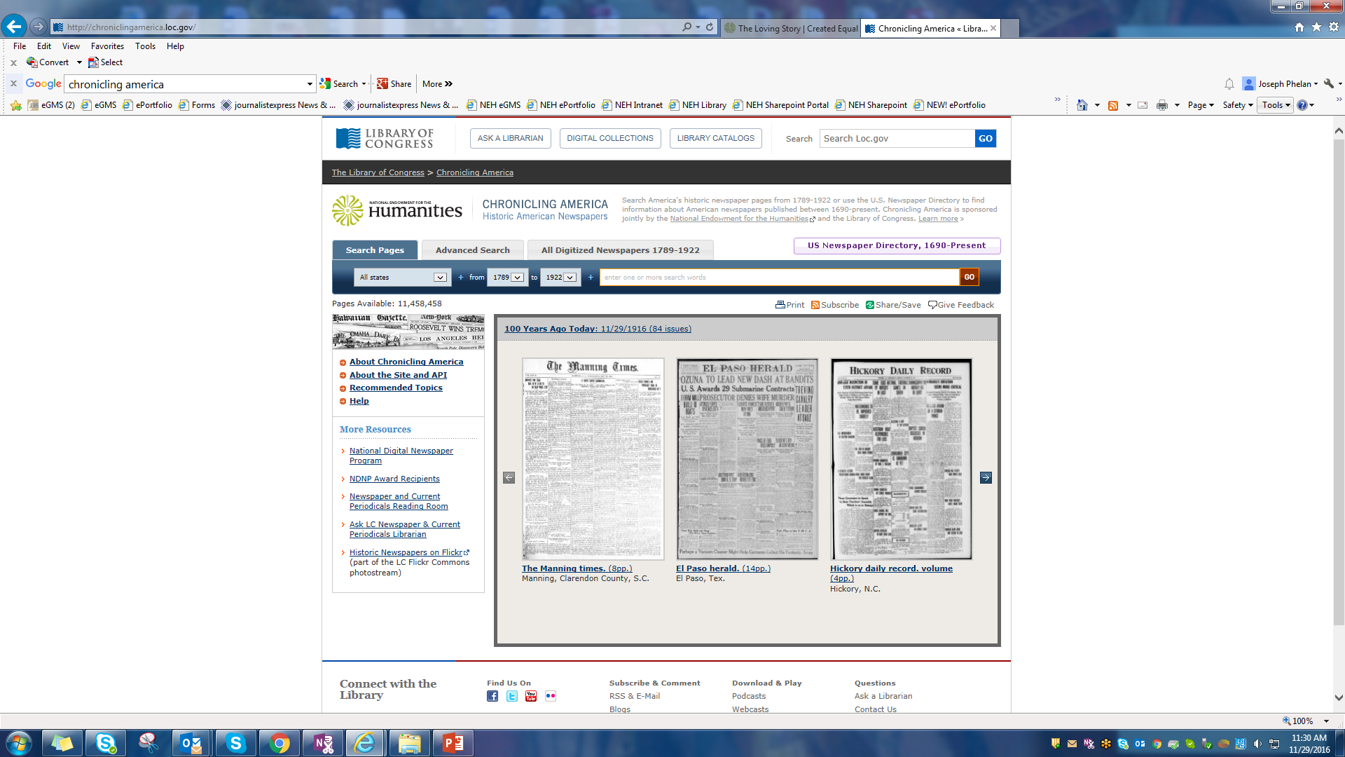

Slide 17
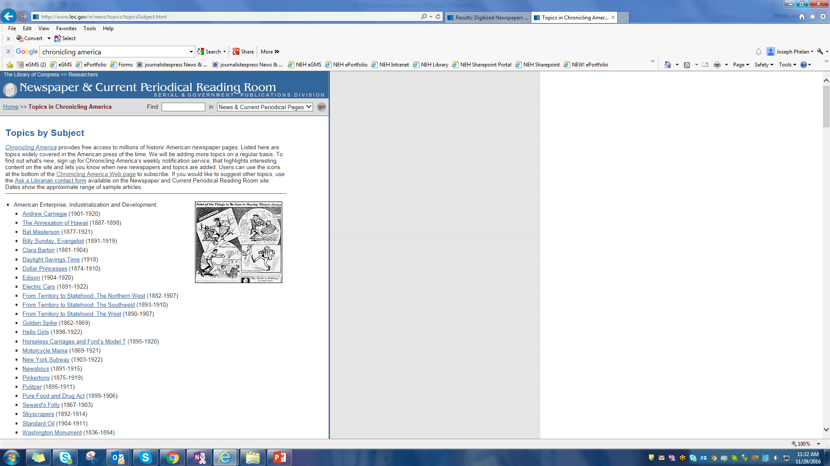

Slide 18
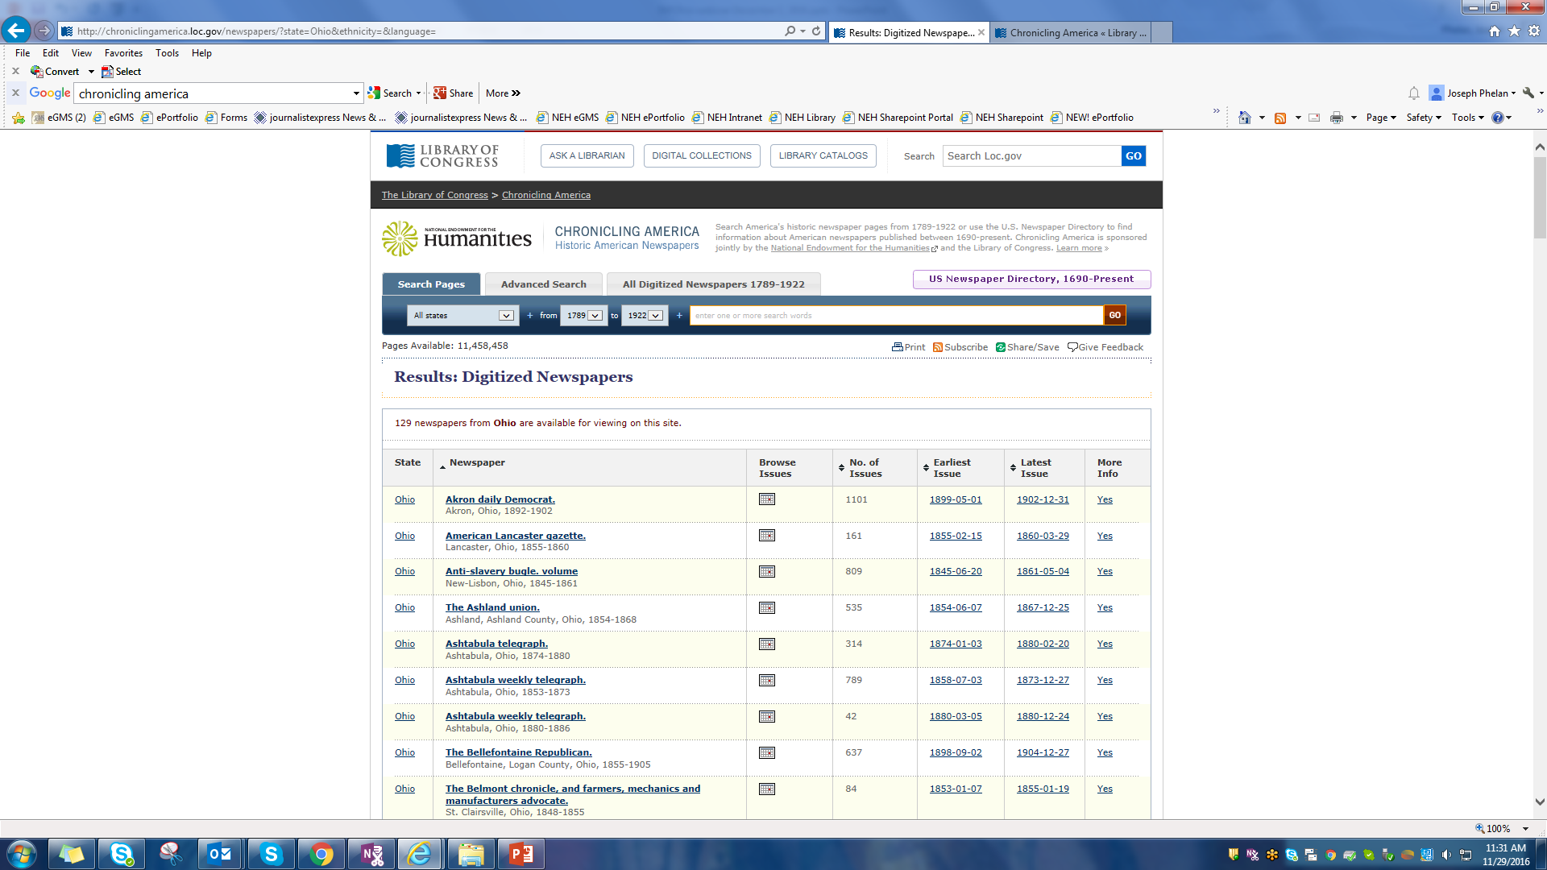

Slide 19
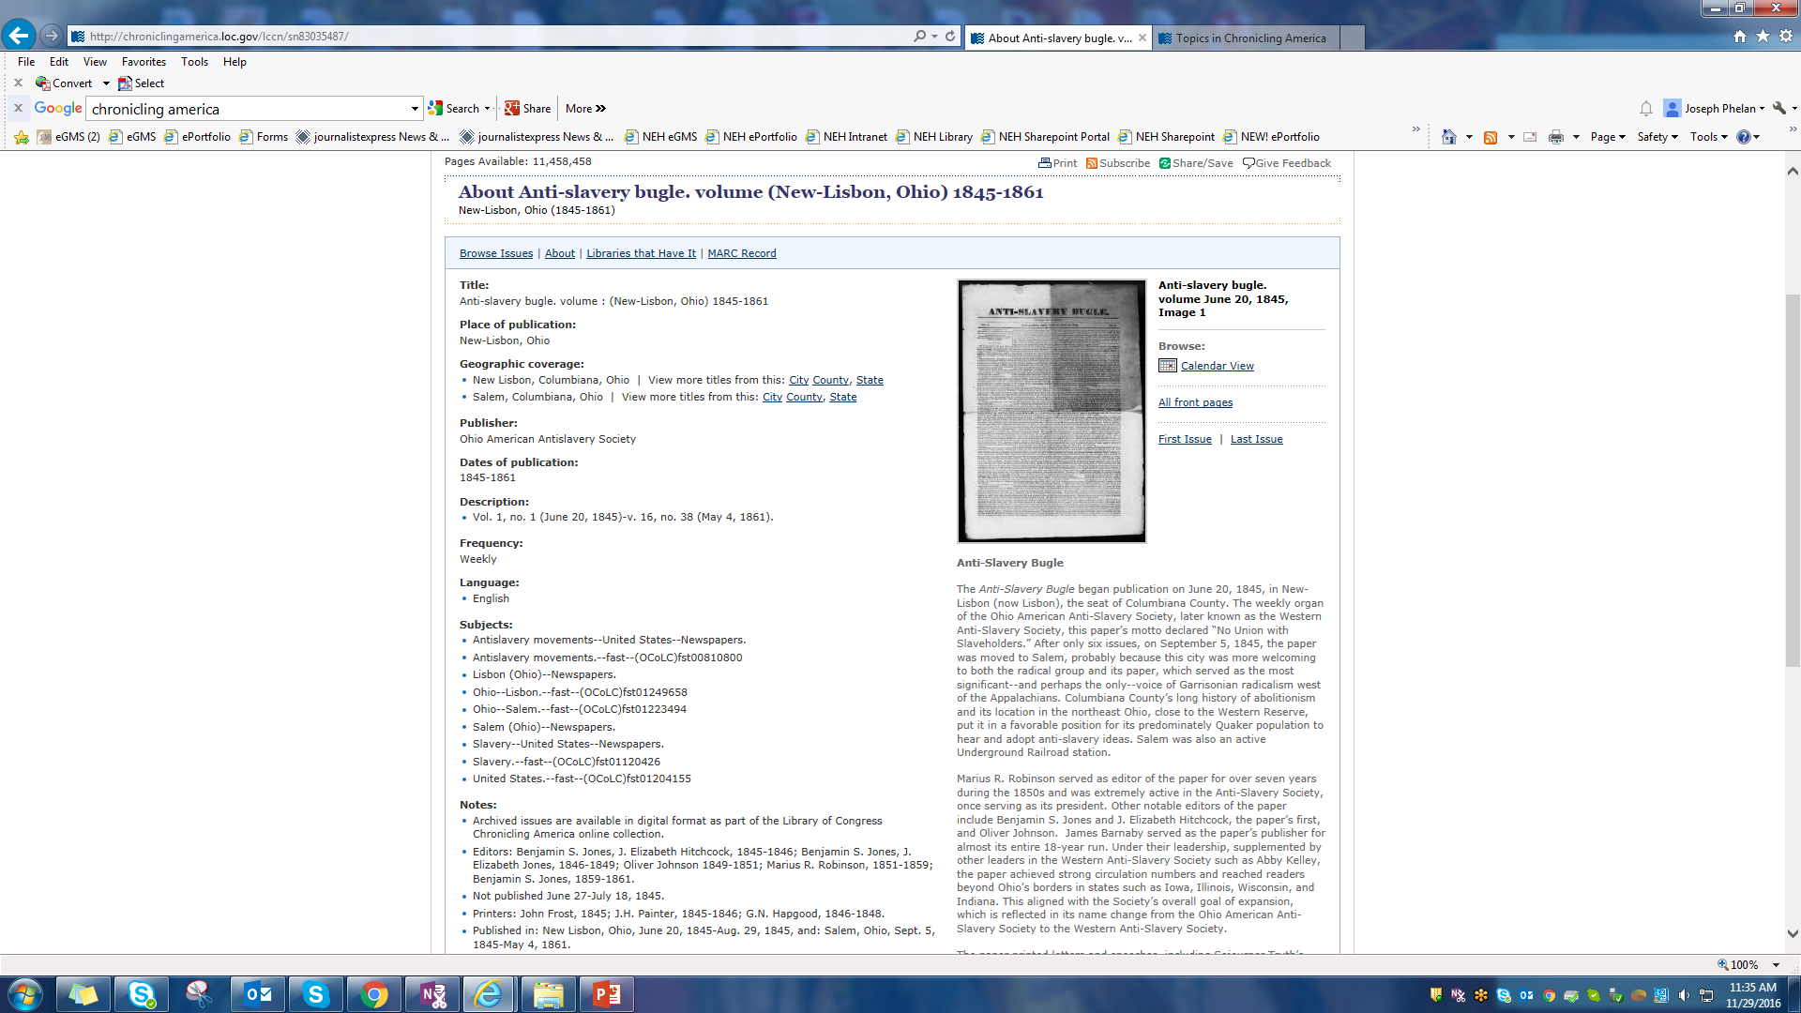

Slide 20
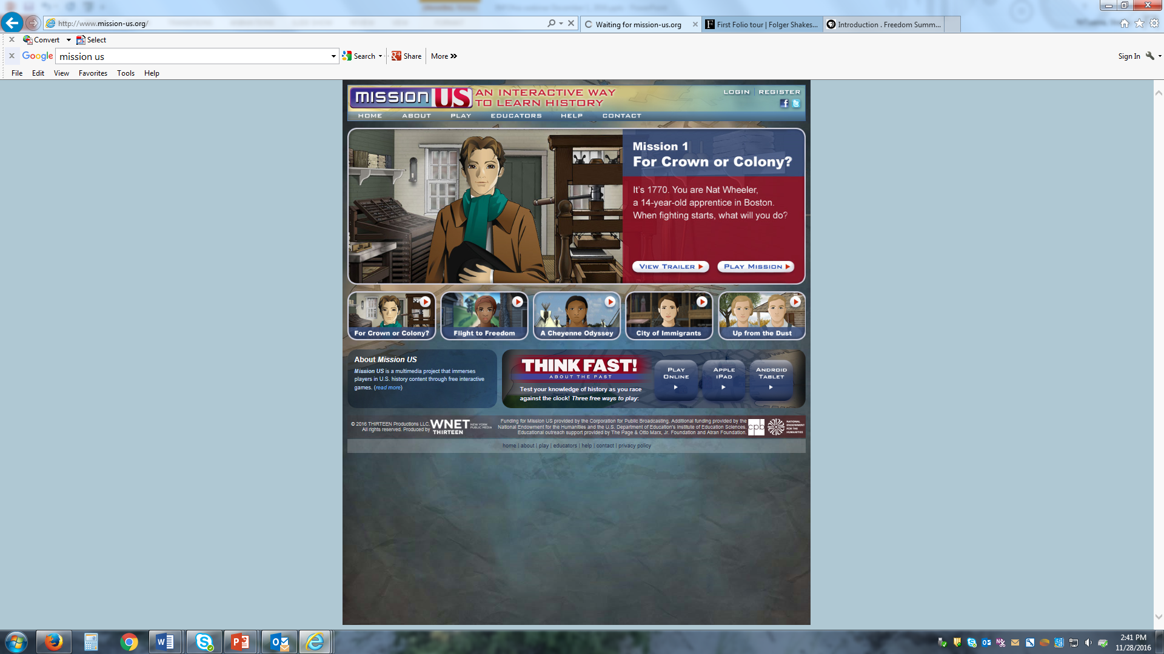

Slide 21
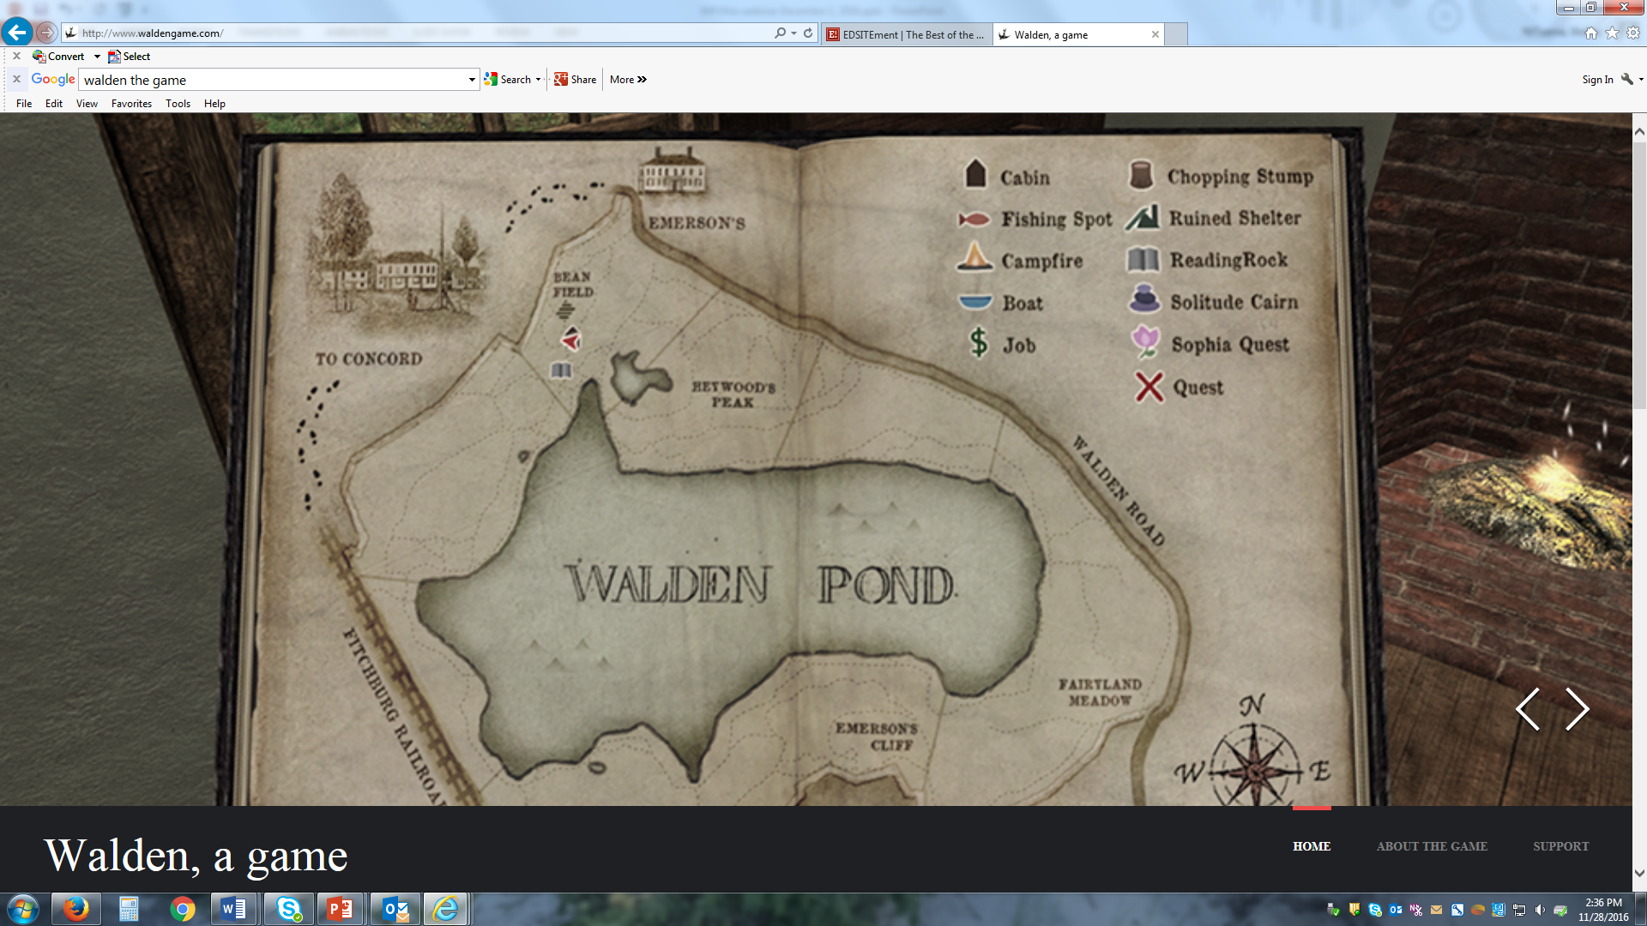

Slide 22
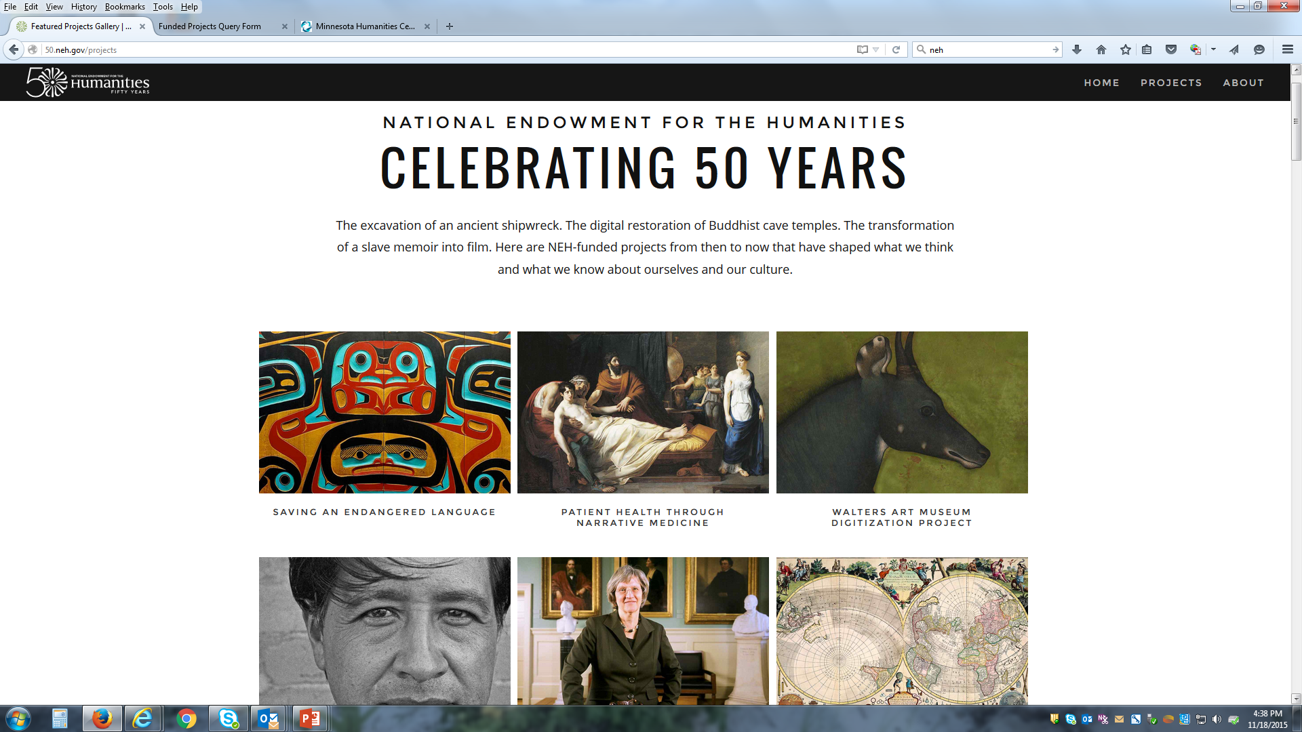

Slide 24
Poll Question 2.
Are you are familiar with the EDSITEment website? Please click on the little guy at the top of your screen and choose the green (yes) or red (no) circle.

Slide 25
NEH’s EDSITEment is …
Presented by:
Presented by:
a 18-year-old, award-winning website of the National Endowment for the Humanities edsitement.neh.gov
a dynamic resource for teachers, librarians, students, and life-long learners
a repository of over 500 lessons, 400+ websites vetted for classroom excellence, all aligned with the Common Core State Standards
a resource filled with timely ideas accessible through multiple platforms, including a monthly newsletter, Face Book, Twitter, and a Closer Readings+ blog edsitement.neh.gov/blog
with over 2.5 million visits per year and over 14 thousand per day during periods of peak educational use

Slide 26
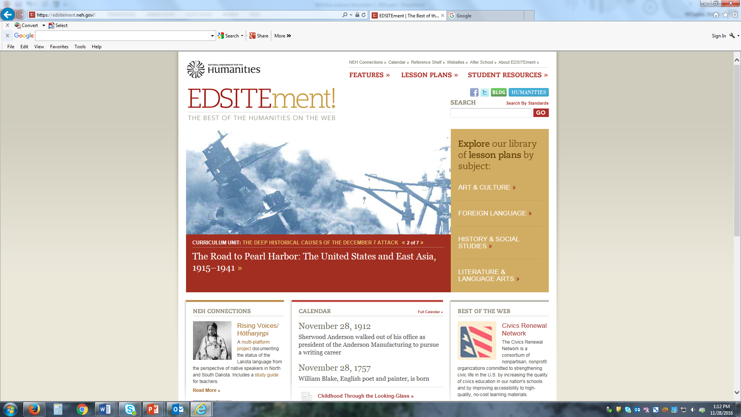

Slide 27
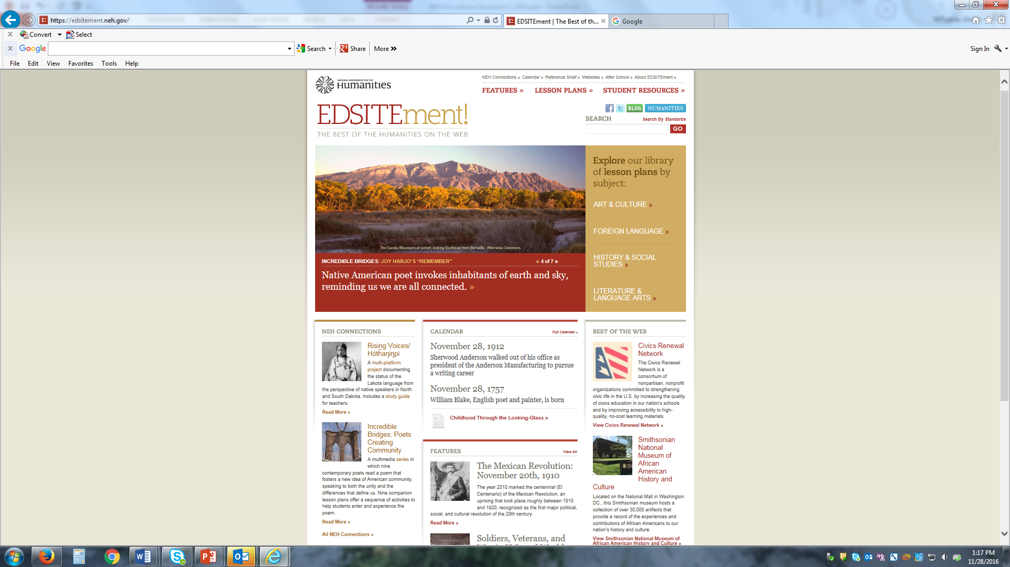

Slide 28
Poll Question 3.
How many of you are finding it a challenge to meet the Common Core State Standards?

Slide 29
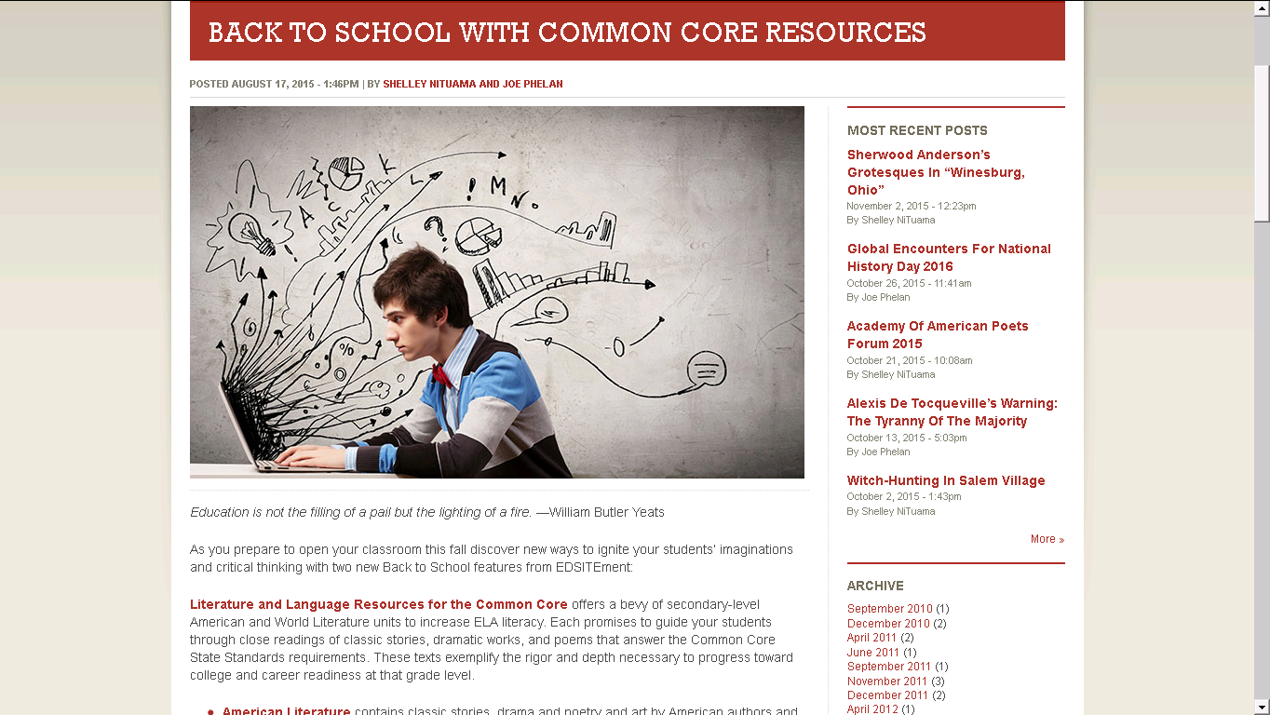

Slide 30
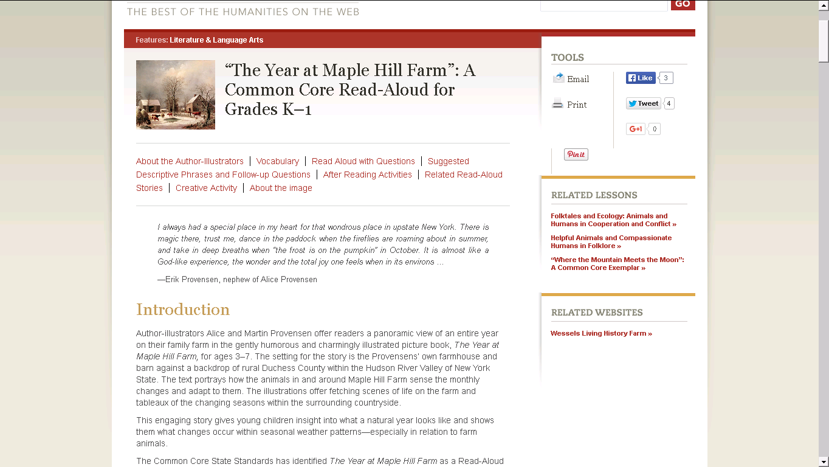

Slide 33
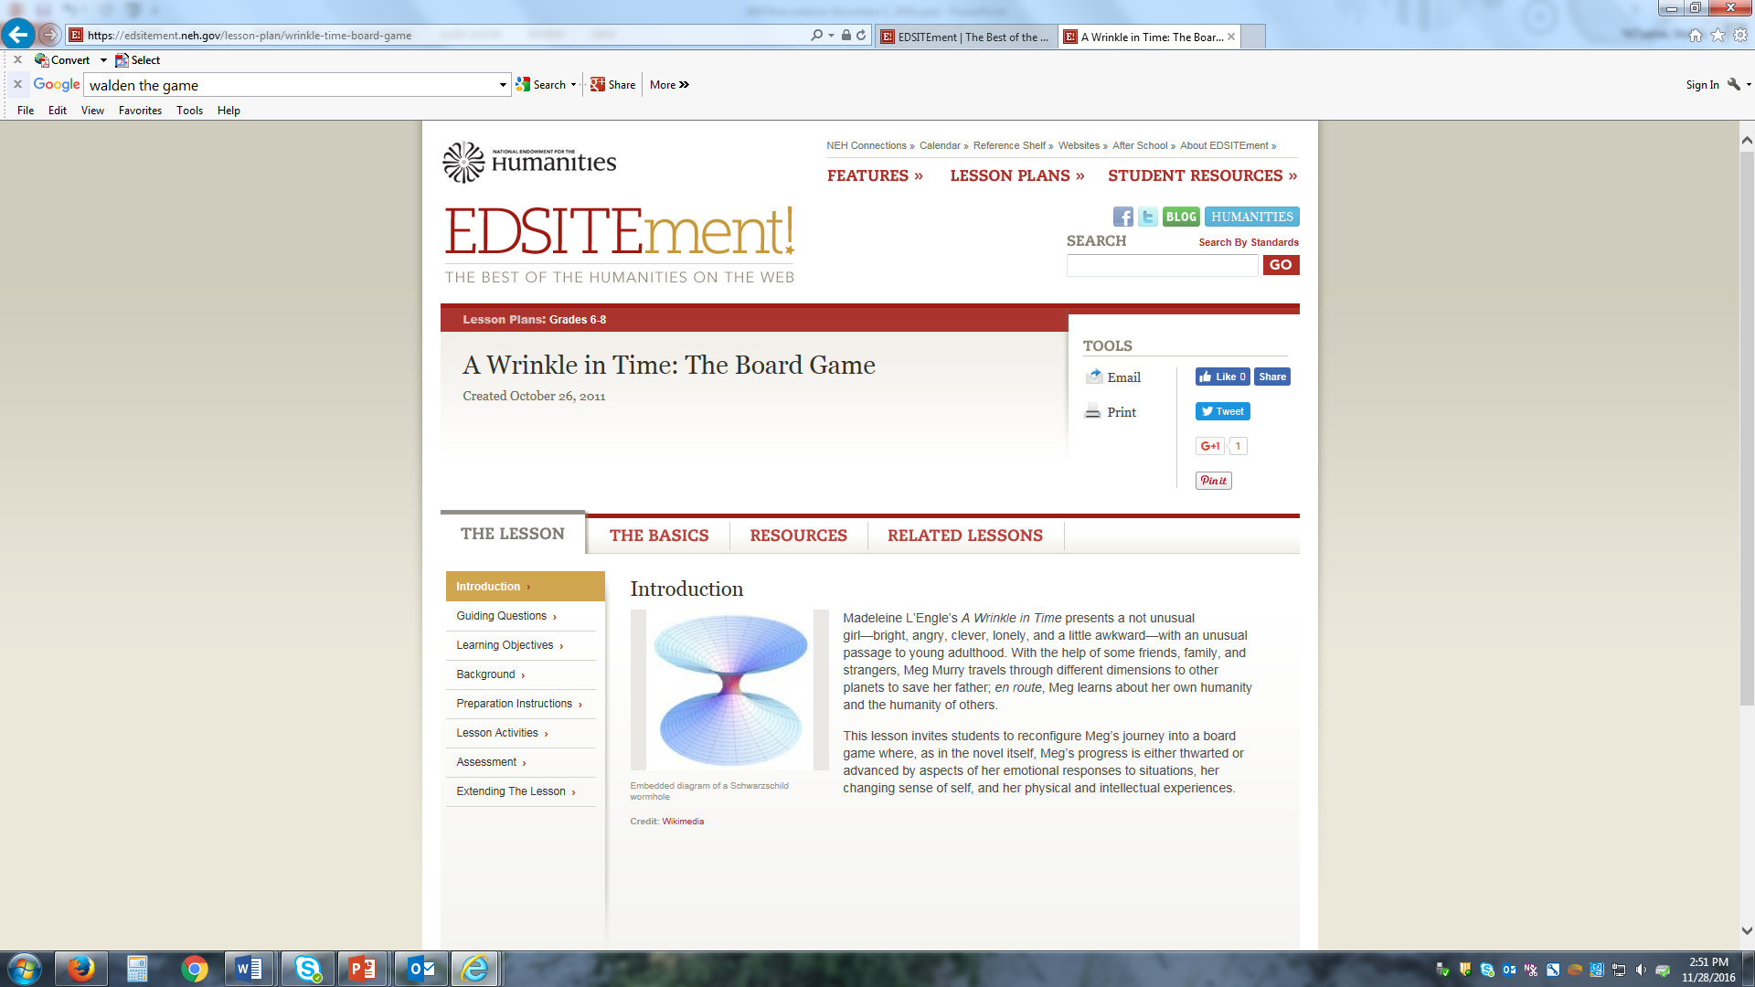

Slide 34
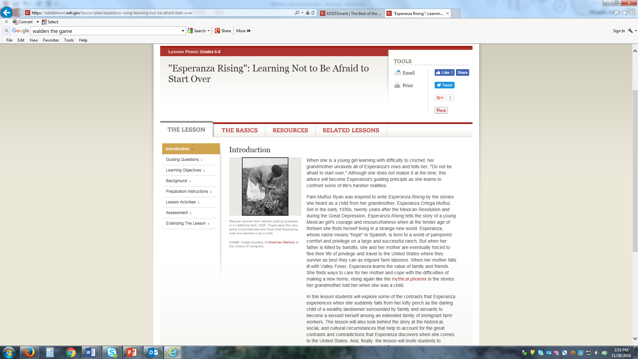

Slide 35
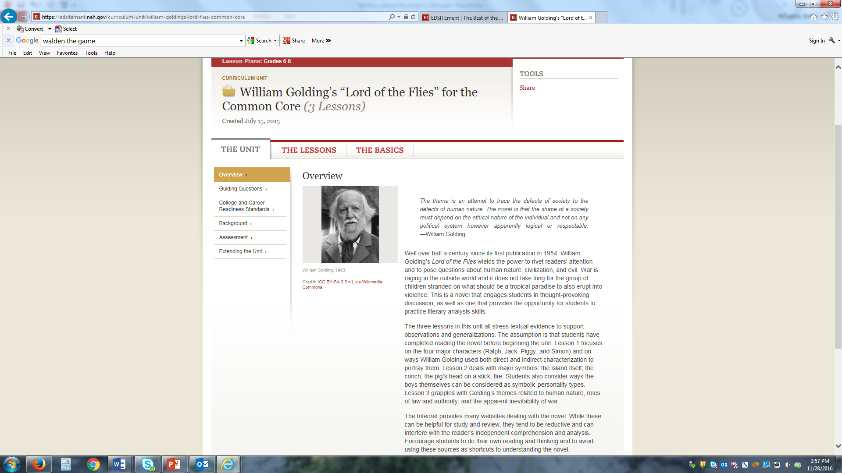

Slide 36
Poll Question 4
How many of you integrate poetry into your classroom teaching?

Slide 38
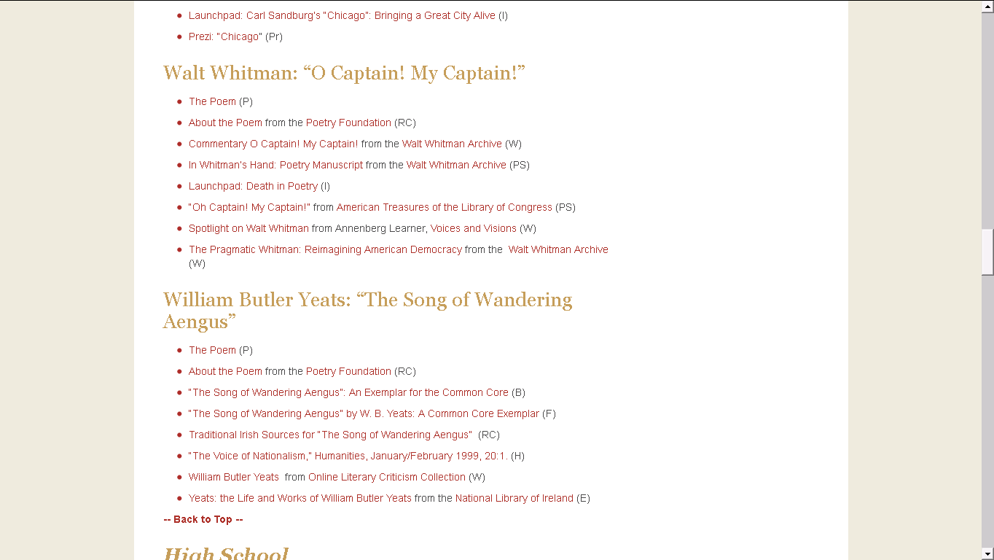

Slide 42
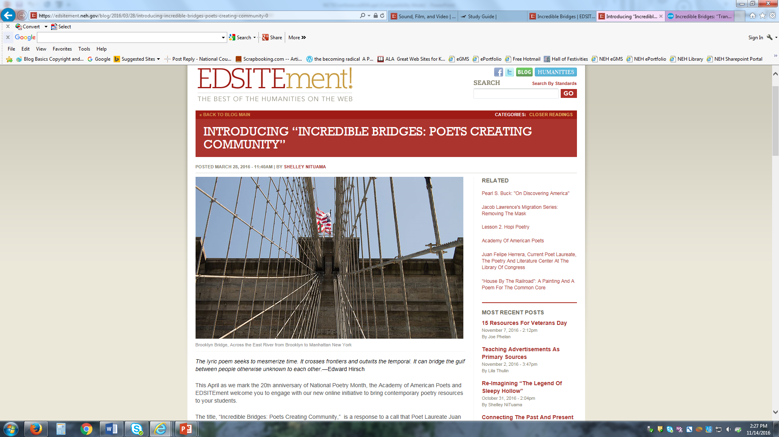

Slide 43
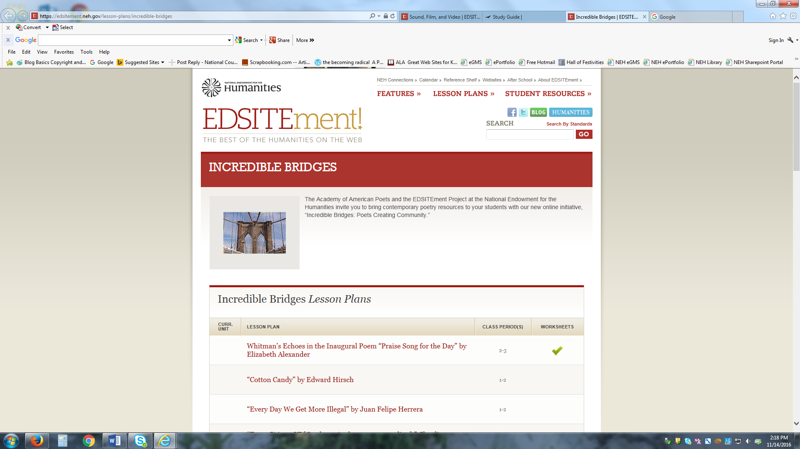

Slide 44
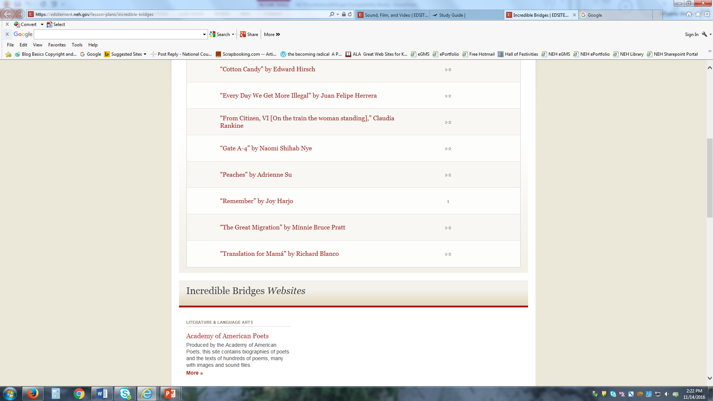

Slide 45
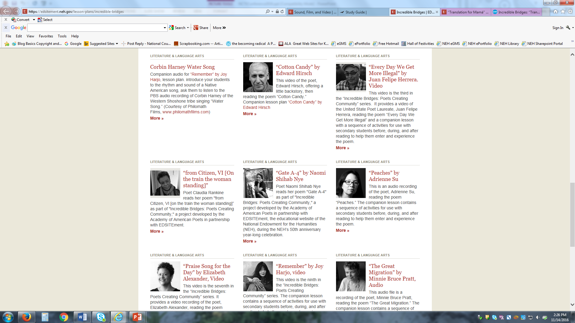

Slide 46
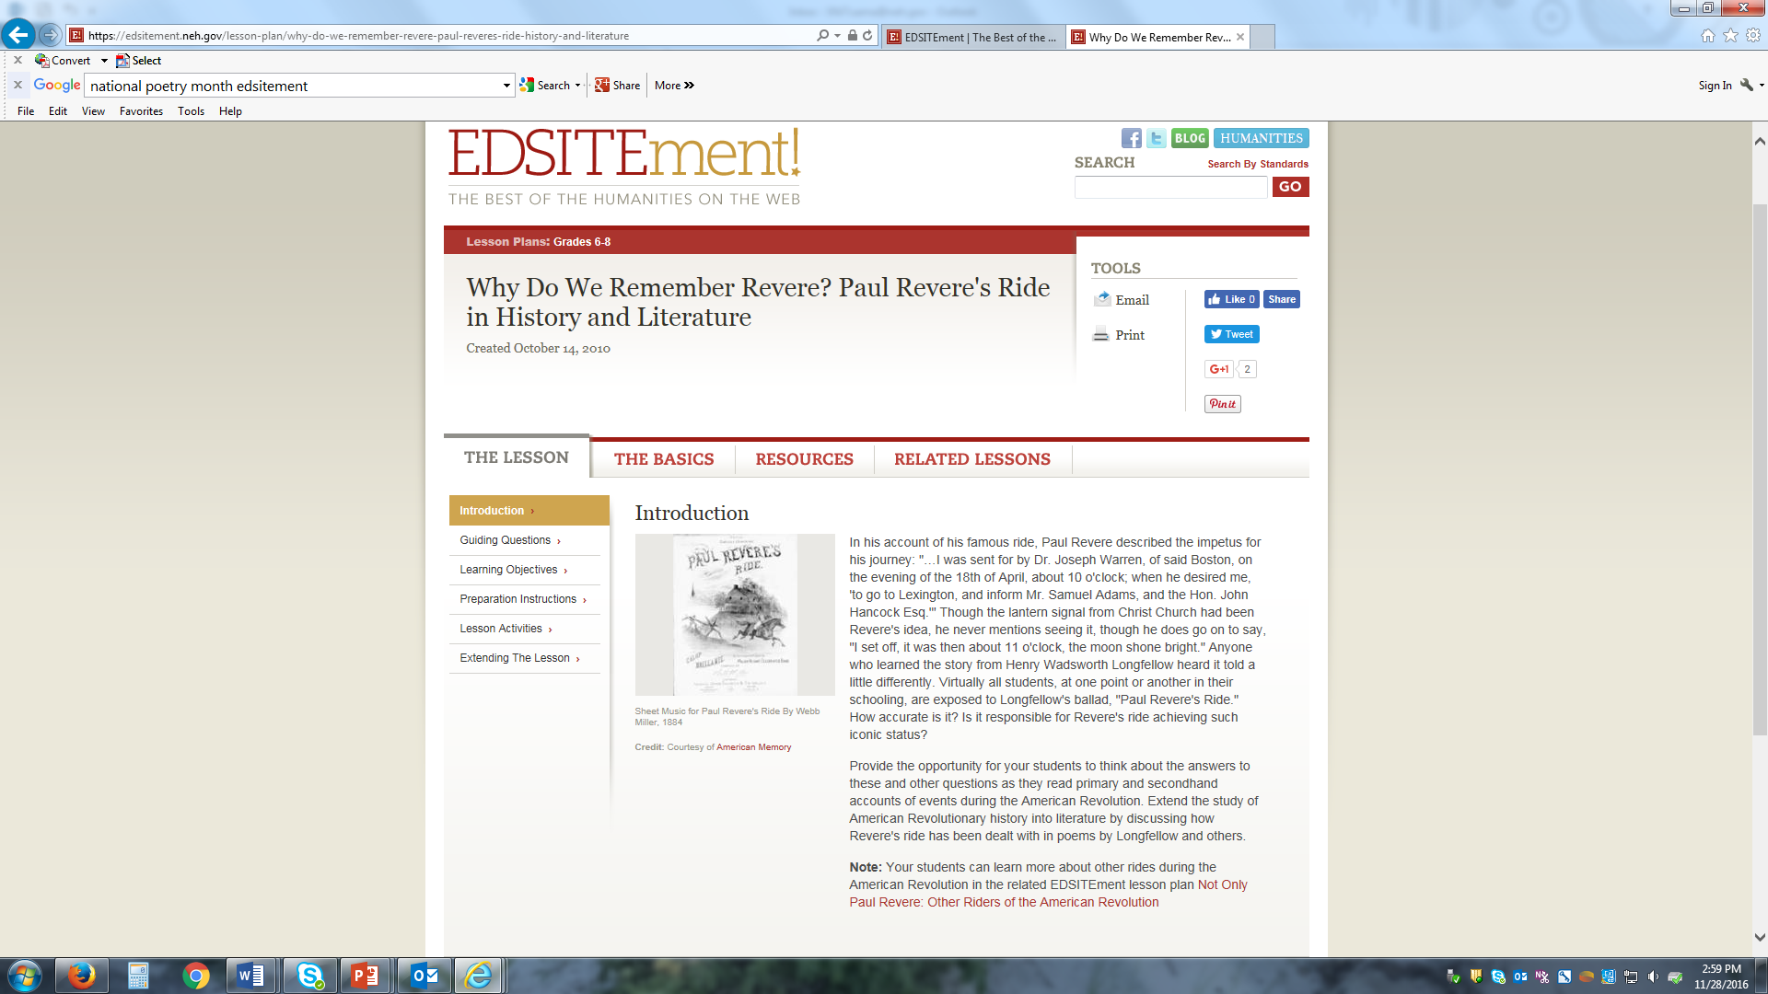

Slide 47
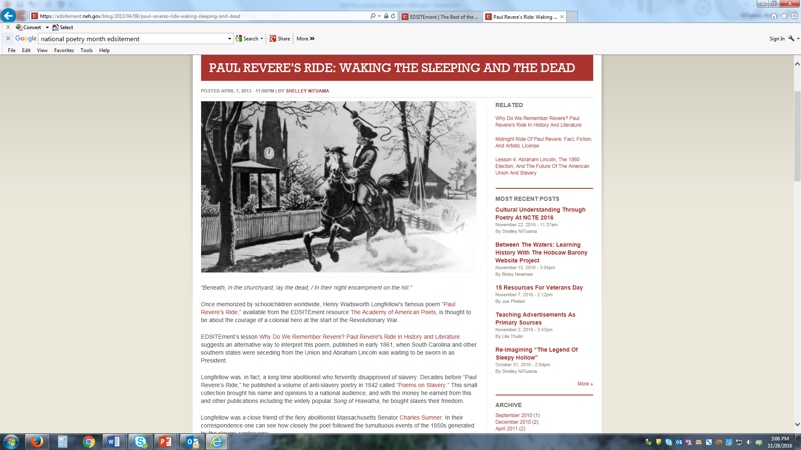

Slide 48
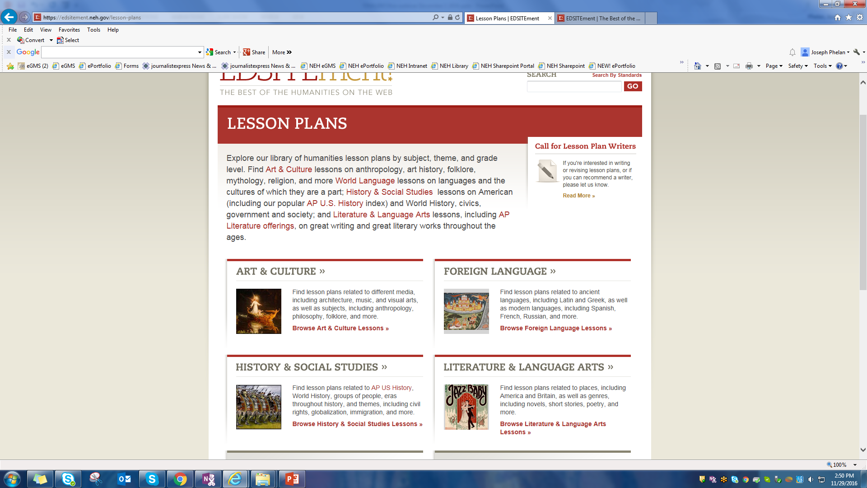

Slide 49
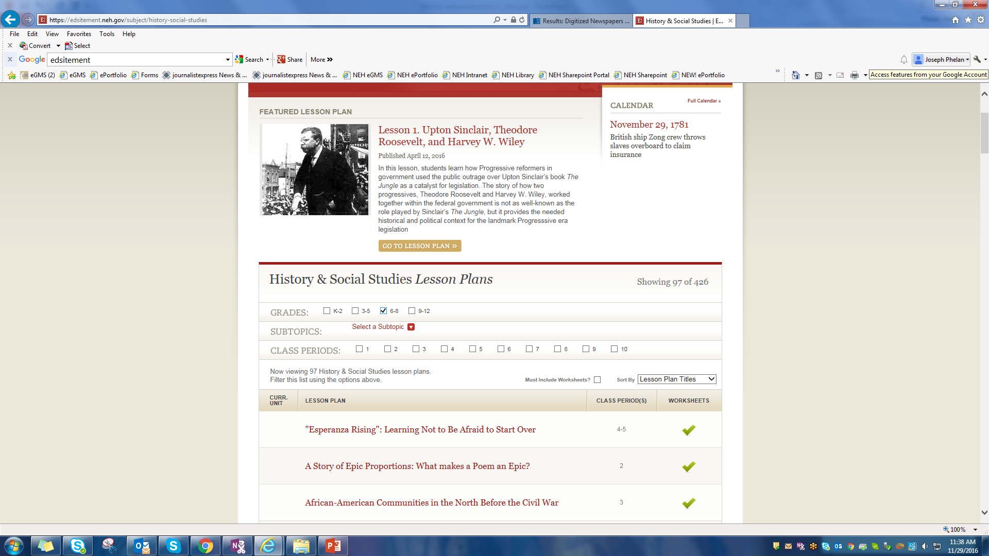

Slide 50
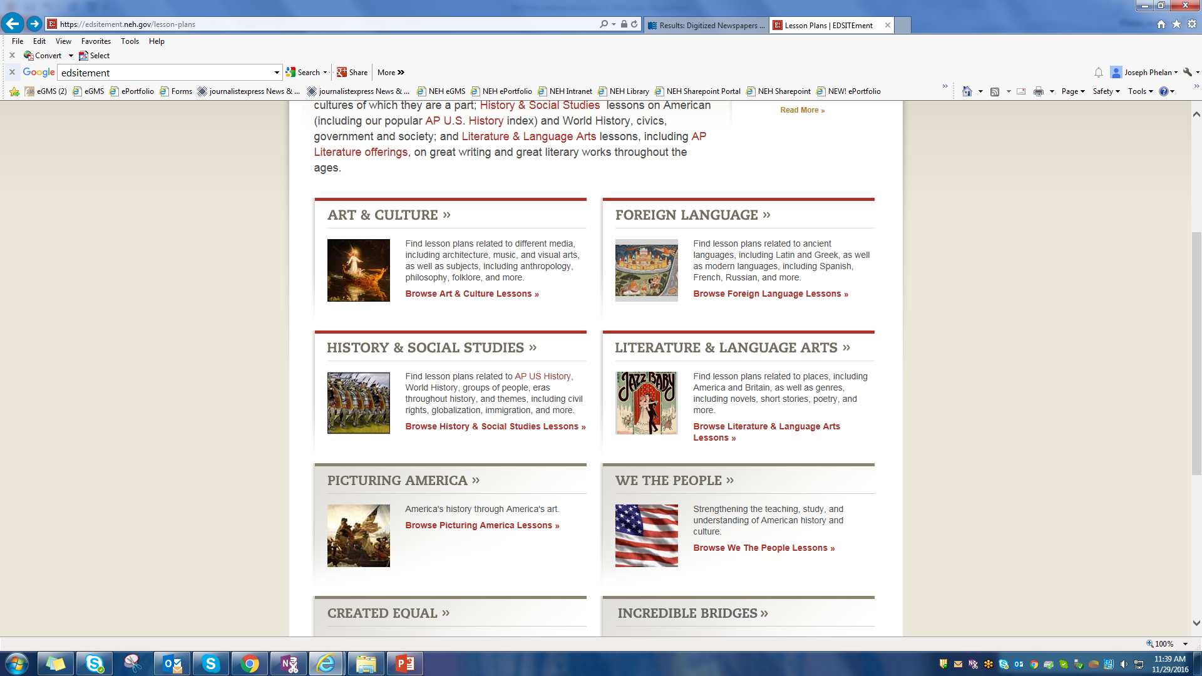

Slide 51
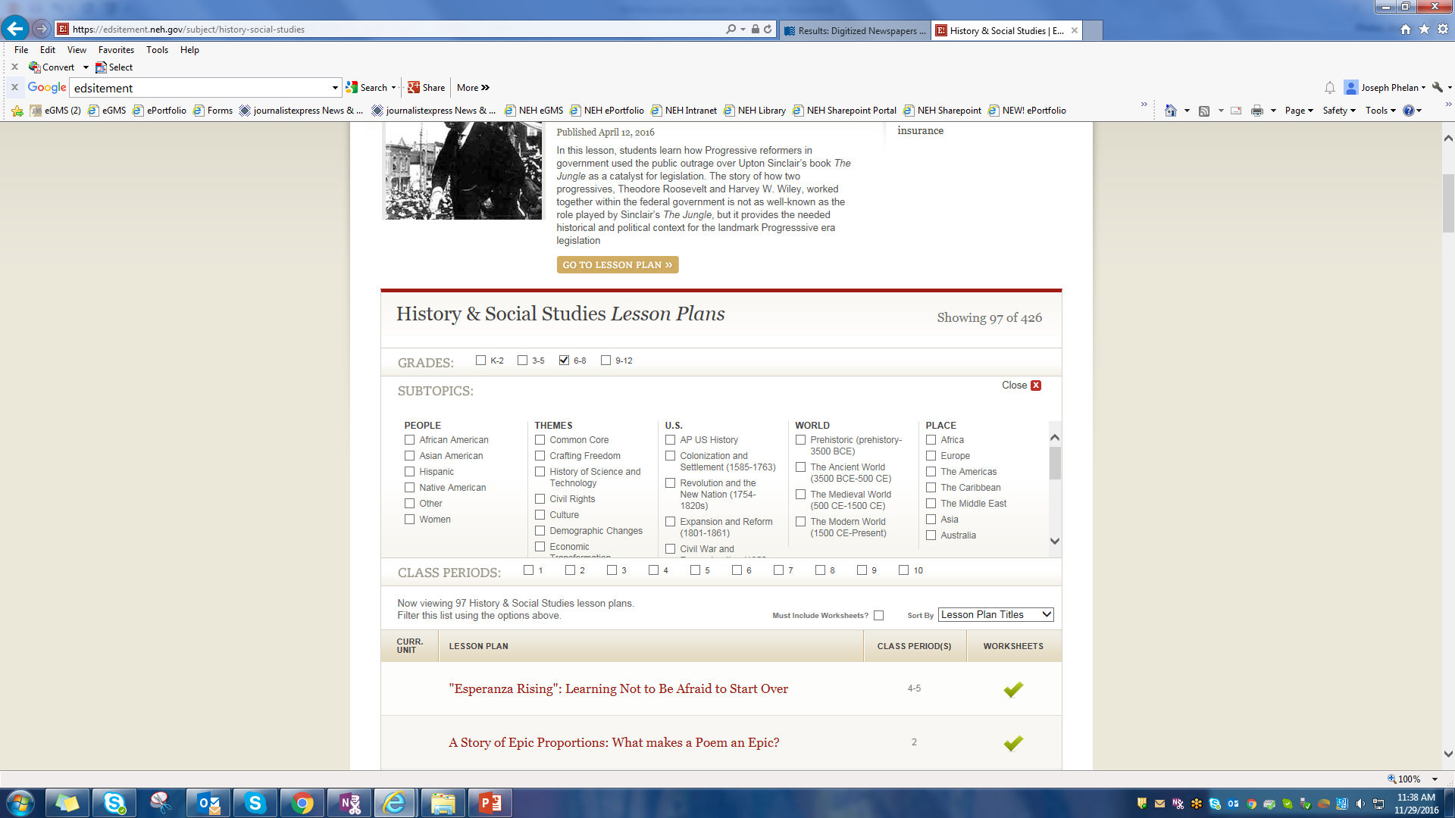

Slide 52
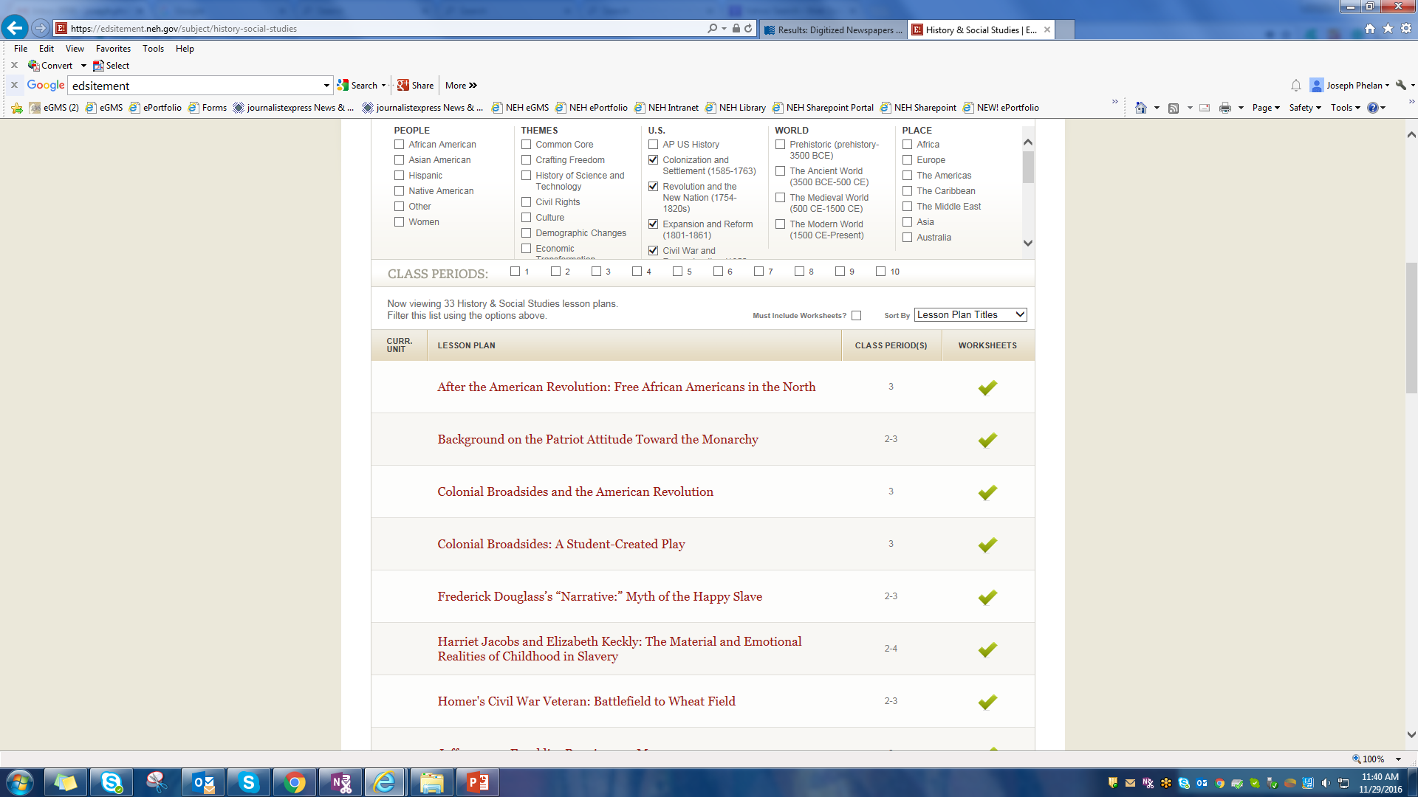

Slide 54
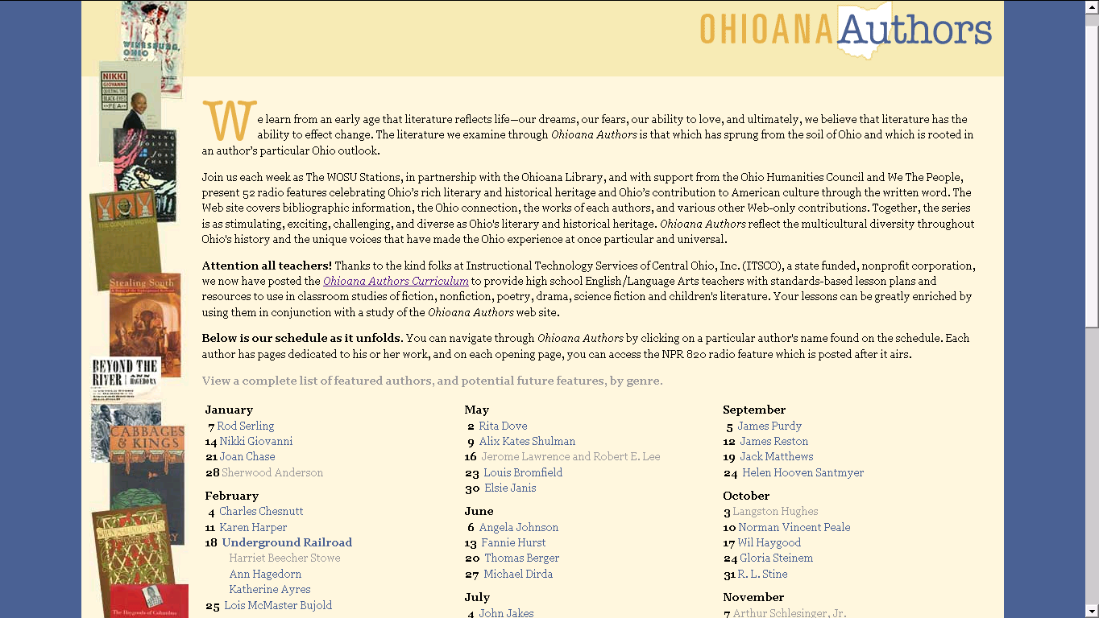

Slide 62
Poll Question 5.
How many of you are interested in exploring NEH’s opportunities for teachers and/or EDSITEment resources?

Slide 63
Visit EDSITEment!
http://edsitement.neh.gov/
Join us on FACEBOOK. TWITTER us!
Joe Phelan jphelan@neh.gov
Shelley NiTuama snituama@neh.gov

