Slide 1
Augmented Reality Writing Pieces that POP
Angela Maxwell
Beachwood City Schools
amm@beachwoodschools.org
@librarymax
http://bit.ly/wrtpop
Notes:
twitter

Slide 2
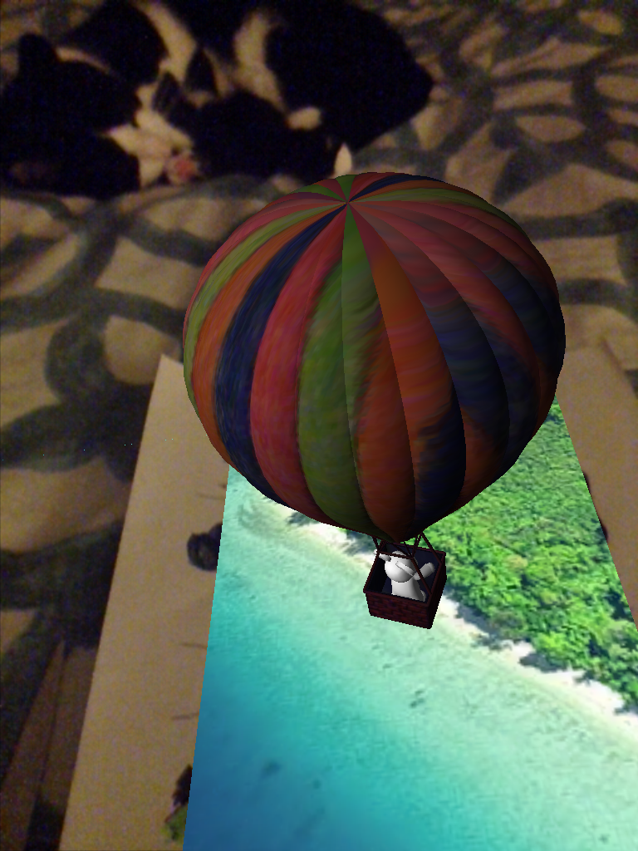
About Me
10 years in education
Mother of two boys
Technology Adventurer
Teacher, Curator, Creator
Ready to Learn!
http://bit.ly/wrtpop
Notes:
Who

Slide 3
Suggested App Downloads
http://bit.ly/wrtpop
Notes:
The Quiver and AR flashcards apps contain premade Augmented Reality Targets that a user scans. When scanned, 4D images, sounds, etc. appear. Daquir and Aurasma allow users to create their own AR experience.

Slide 4
What is Augmented Reality?
AR overlays images and sounds over images of the world (targets) as we know it.
http://bit.ly/wrtpop
Notes:
AR creates a 3D and sometimes 4D user experience through the lens of a tablet/smartphone.

Slide 5
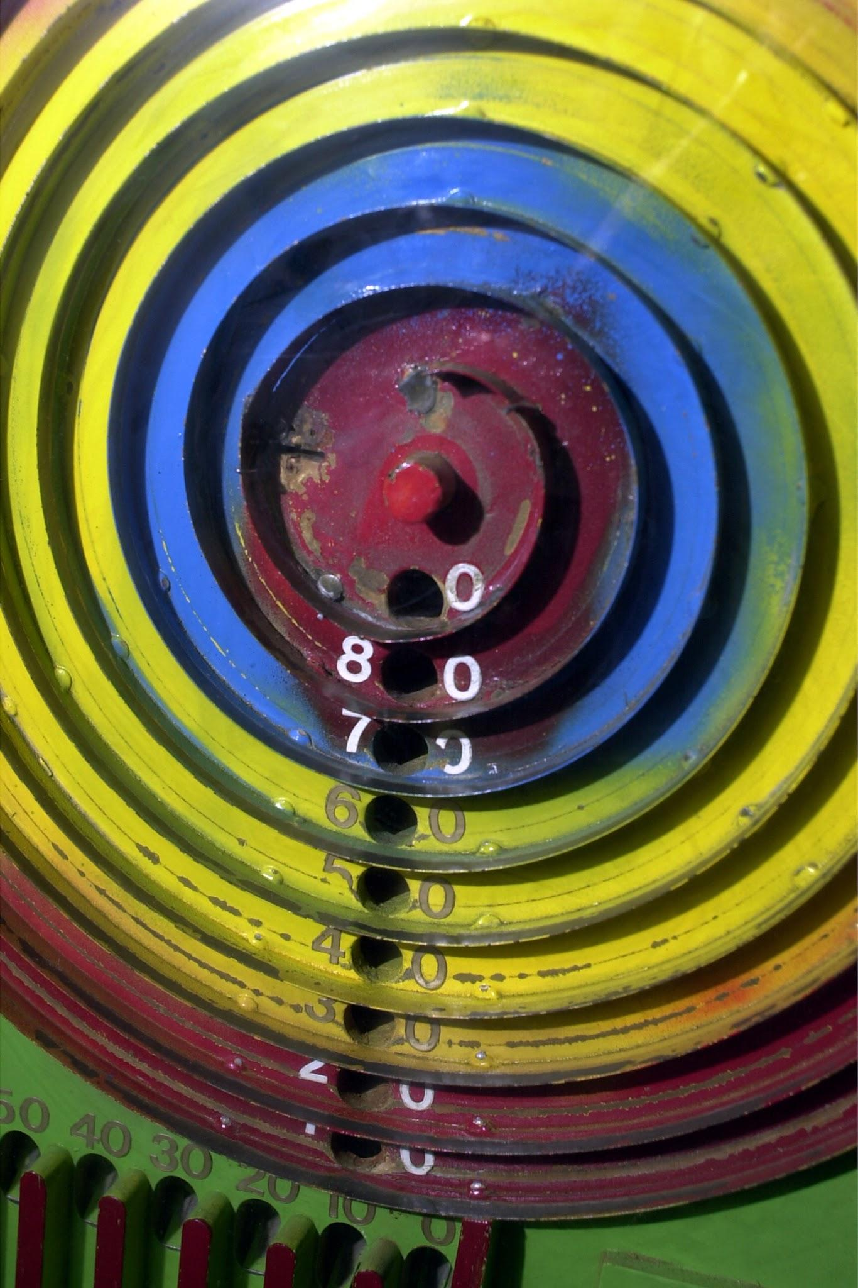
Targets
Specific uses of AR Apps as part of the writing process.
General Uses of AR Creation Tools to support any curricular area.
http://bit.ly/wrtpop

Slide 6
Materials
Printer
Tablets/ Smartphones
Coloring Supplies
Computers
http://bit.ly/wrtpop
Notes:
one tablet, any kind

Slide 7
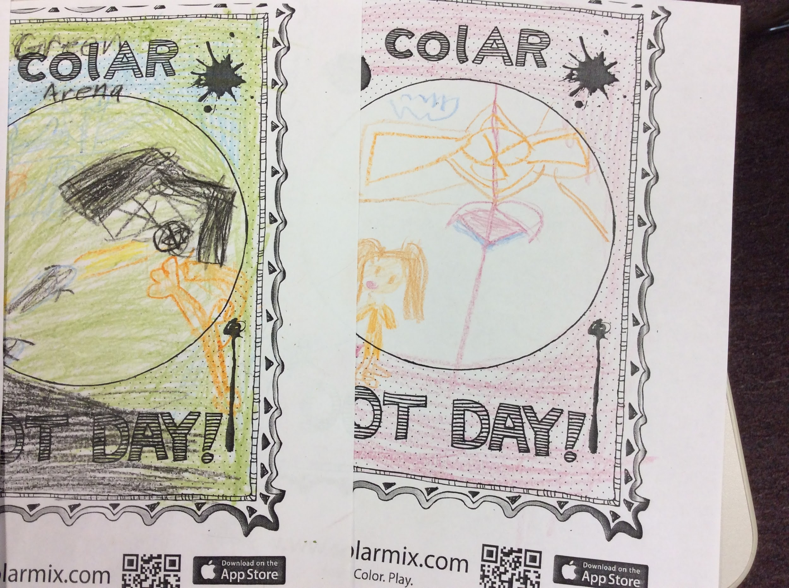
THe Dot
Check out the INFOhio Bookflix Version of The Dot
@librarymax
Notes:
3rd Grade Students read the story, The Dot by Peter Reynolds, design their own dot with colAR and then write a paragraph about their dot.

Slide 8
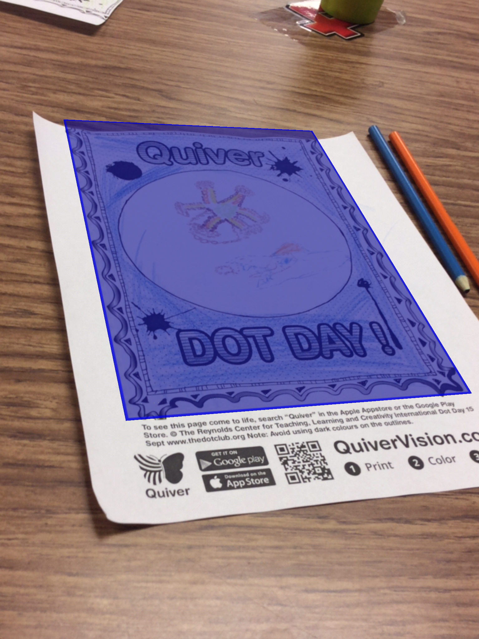
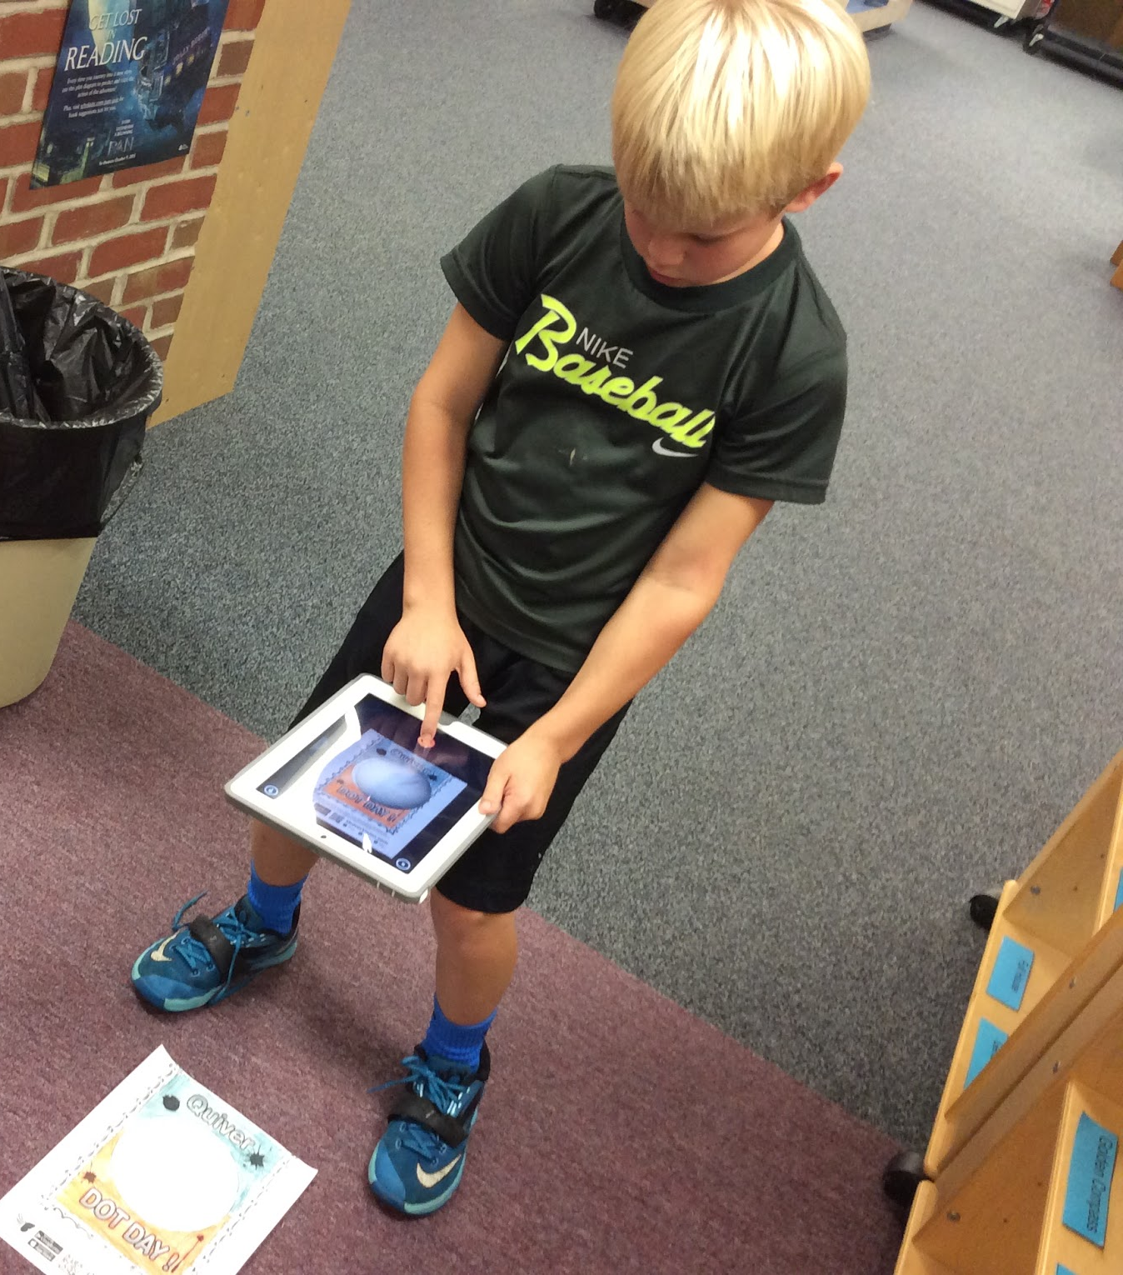

Slide 9
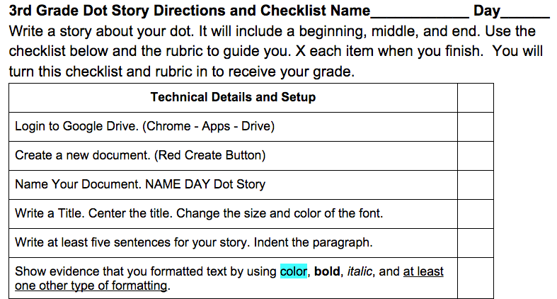
Dot Narrative Details
Rubric and Checklist
http://bit.ly/wrtpop
Notes:
students self asses incorporates 3rd grade ELA and technological literacy.

Slide 10
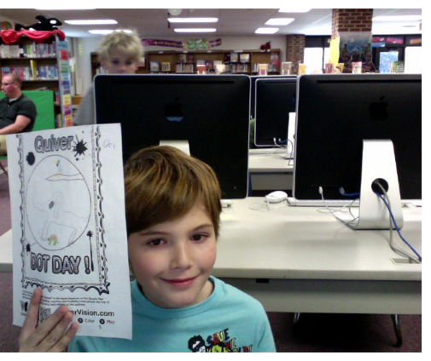
@librarymax

Slide 11
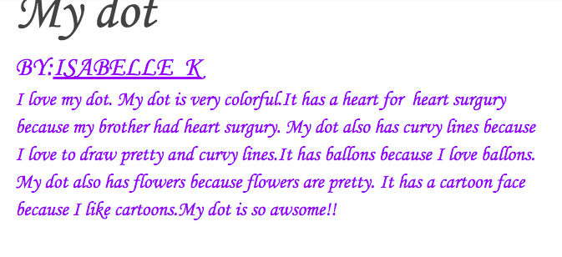
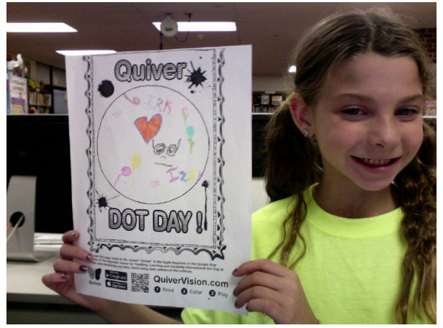
http://bit.ly/wrtpop

Slide 12
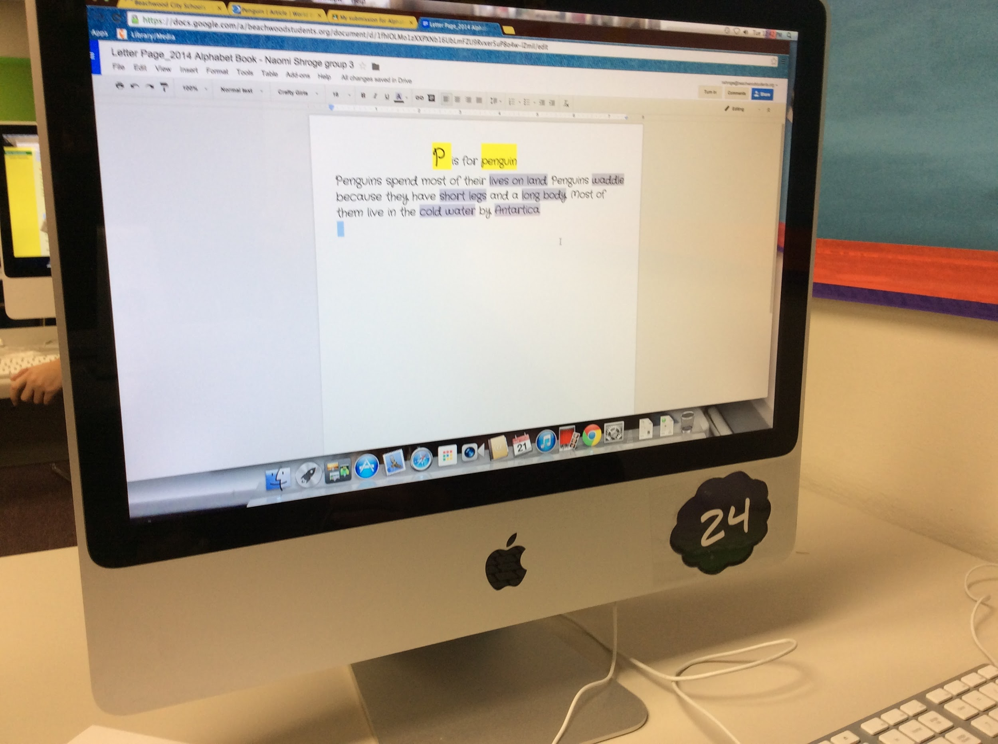
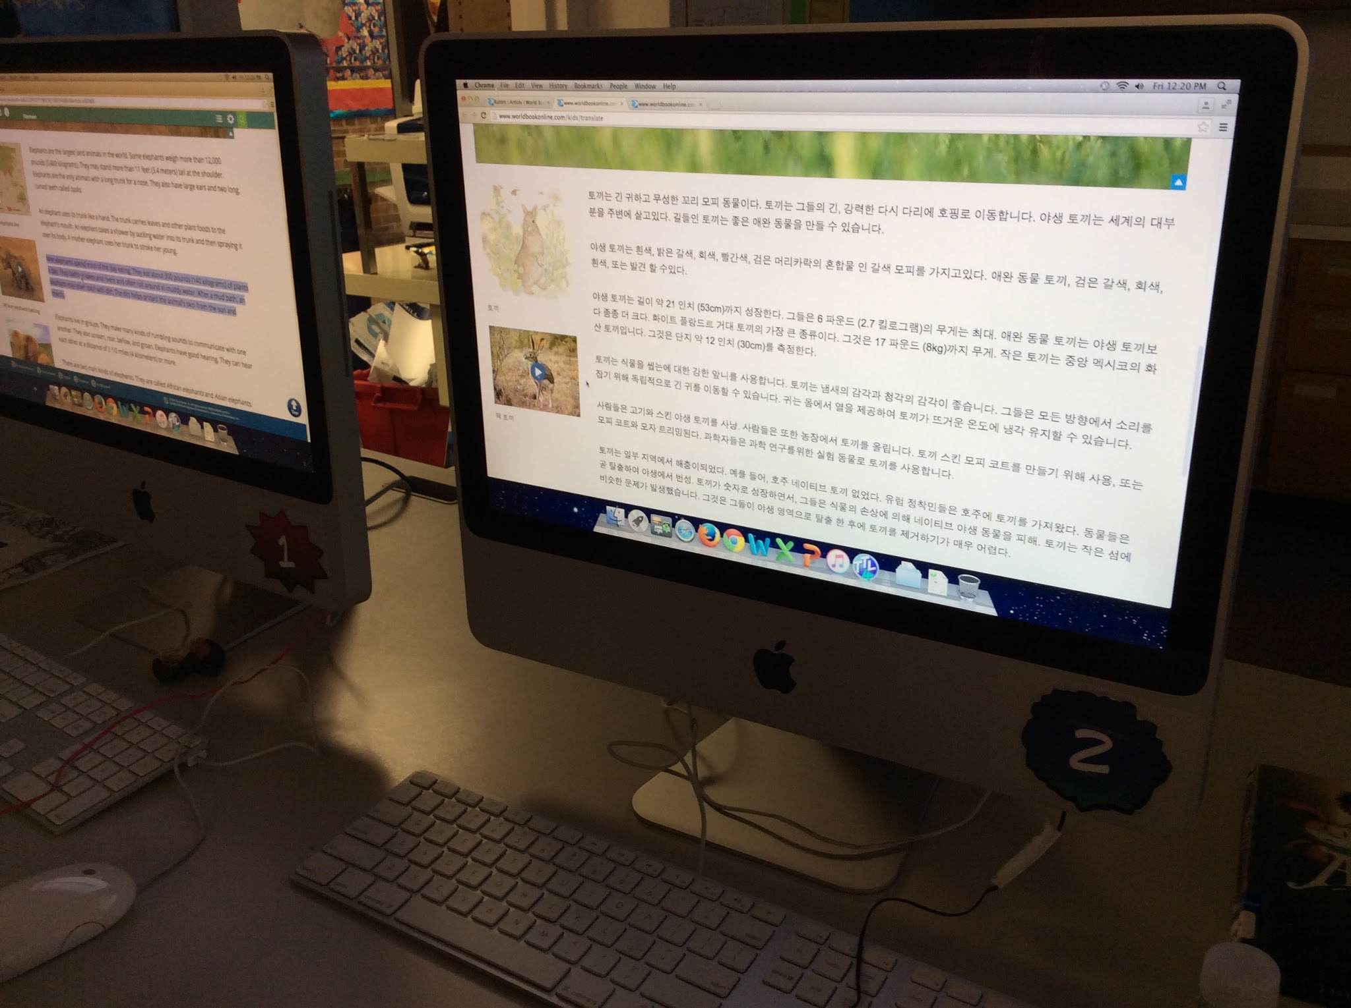
Animal Alphabet Book
See our finished products: http://issuu.com/librarymax
Notes:
4th Grade students use the AR Flashcards App to see an animal appear, research that animal, and design a complementing page with information and illustrations. All the pages are compiled into an Alphabet Book.

Slide 13
Resources
Flashcards
INFOhio World Book
Checklist
http://bit.ly/wrtpop
Notes:
AR flashcards App, beginning research skills with INFOhio.

Slide 14
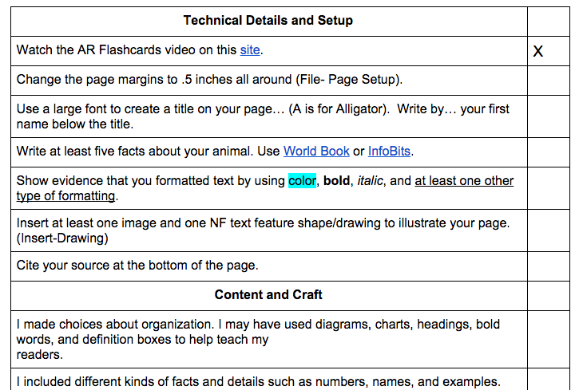

Slide 15
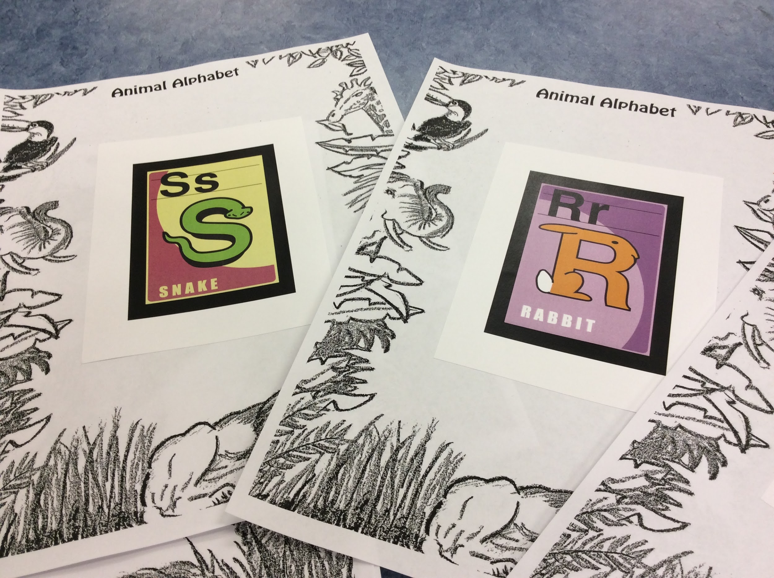
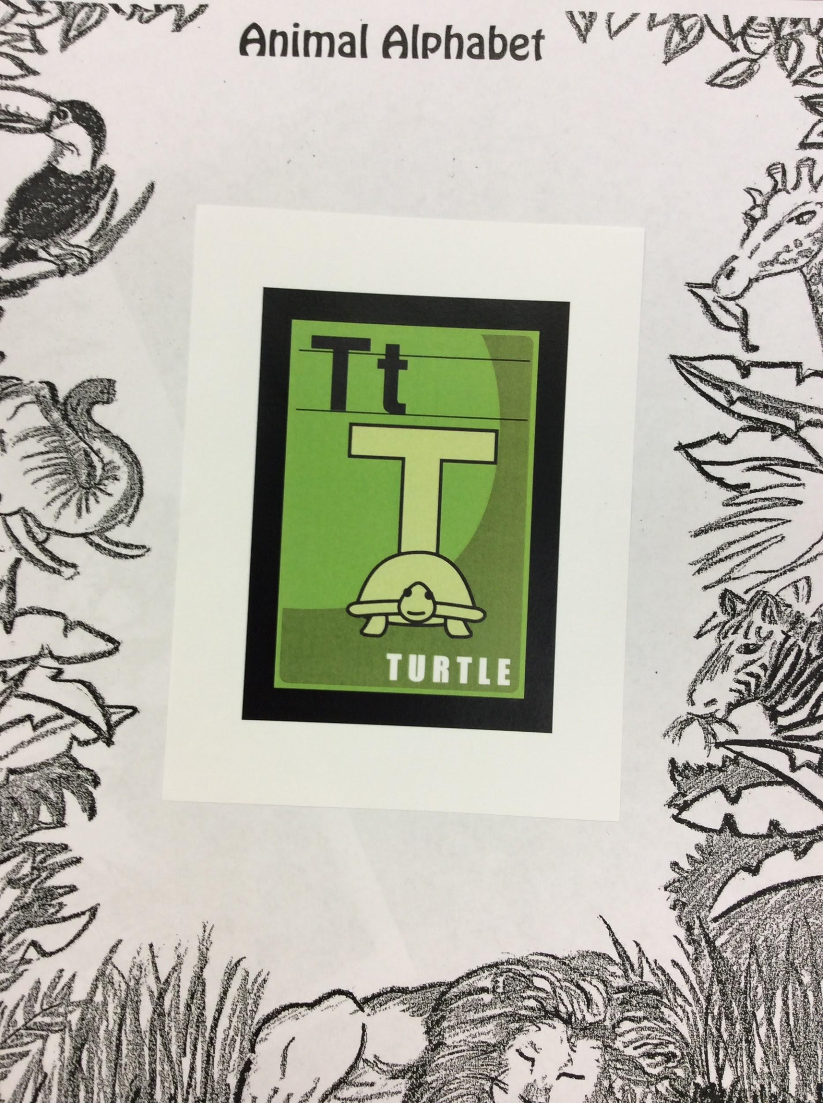
http://bit.ly/amaxreal
Notes:
Scan

Slide 16
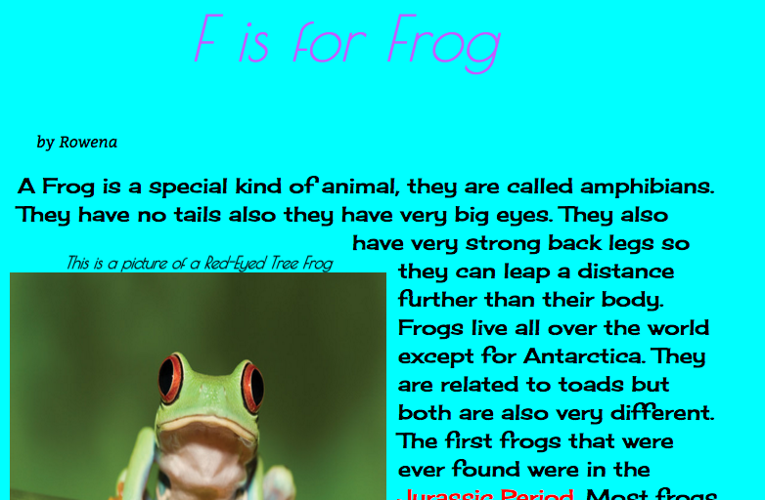
http://bit.ly/wrtpop
INFOhio Worldbook

Slide 17
Notes:
Scan

Slide 18
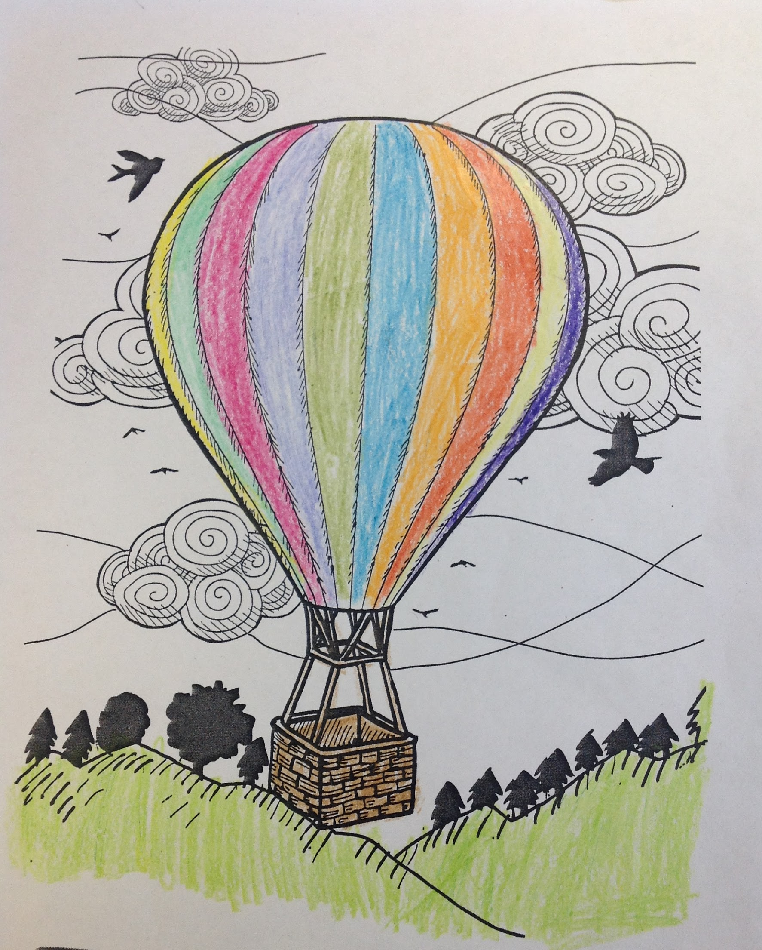
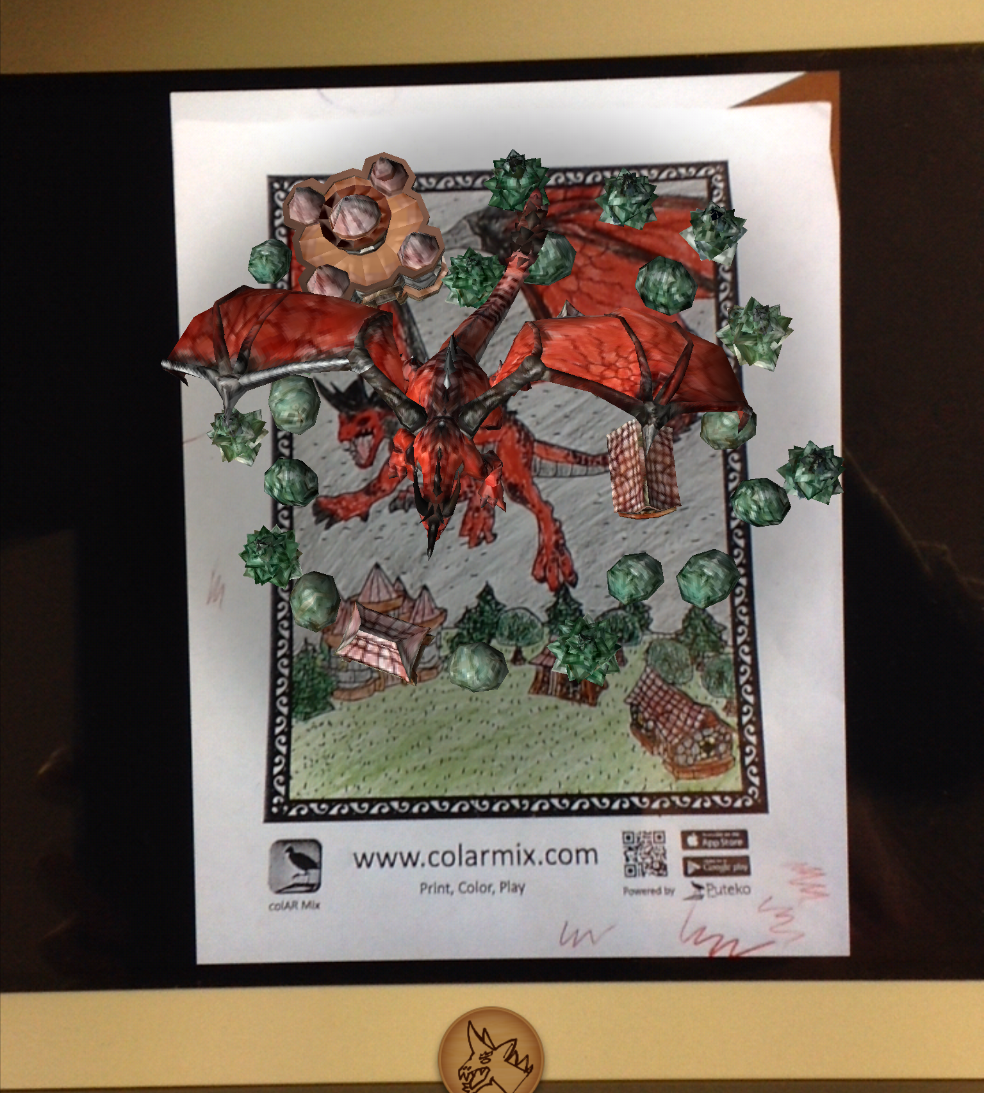
Poppin’ Picture Book
#appsmash
See our finished products: http://issuu.com/librarymax
Notes:
5th Grade students pick a series of AR illustrations and write a story to complement the illustrations using a presentation program.
#appsmash

Slide 19
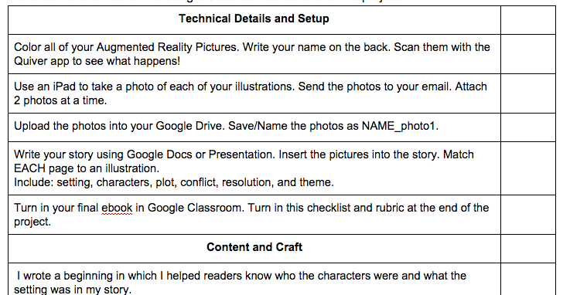

Slide 20
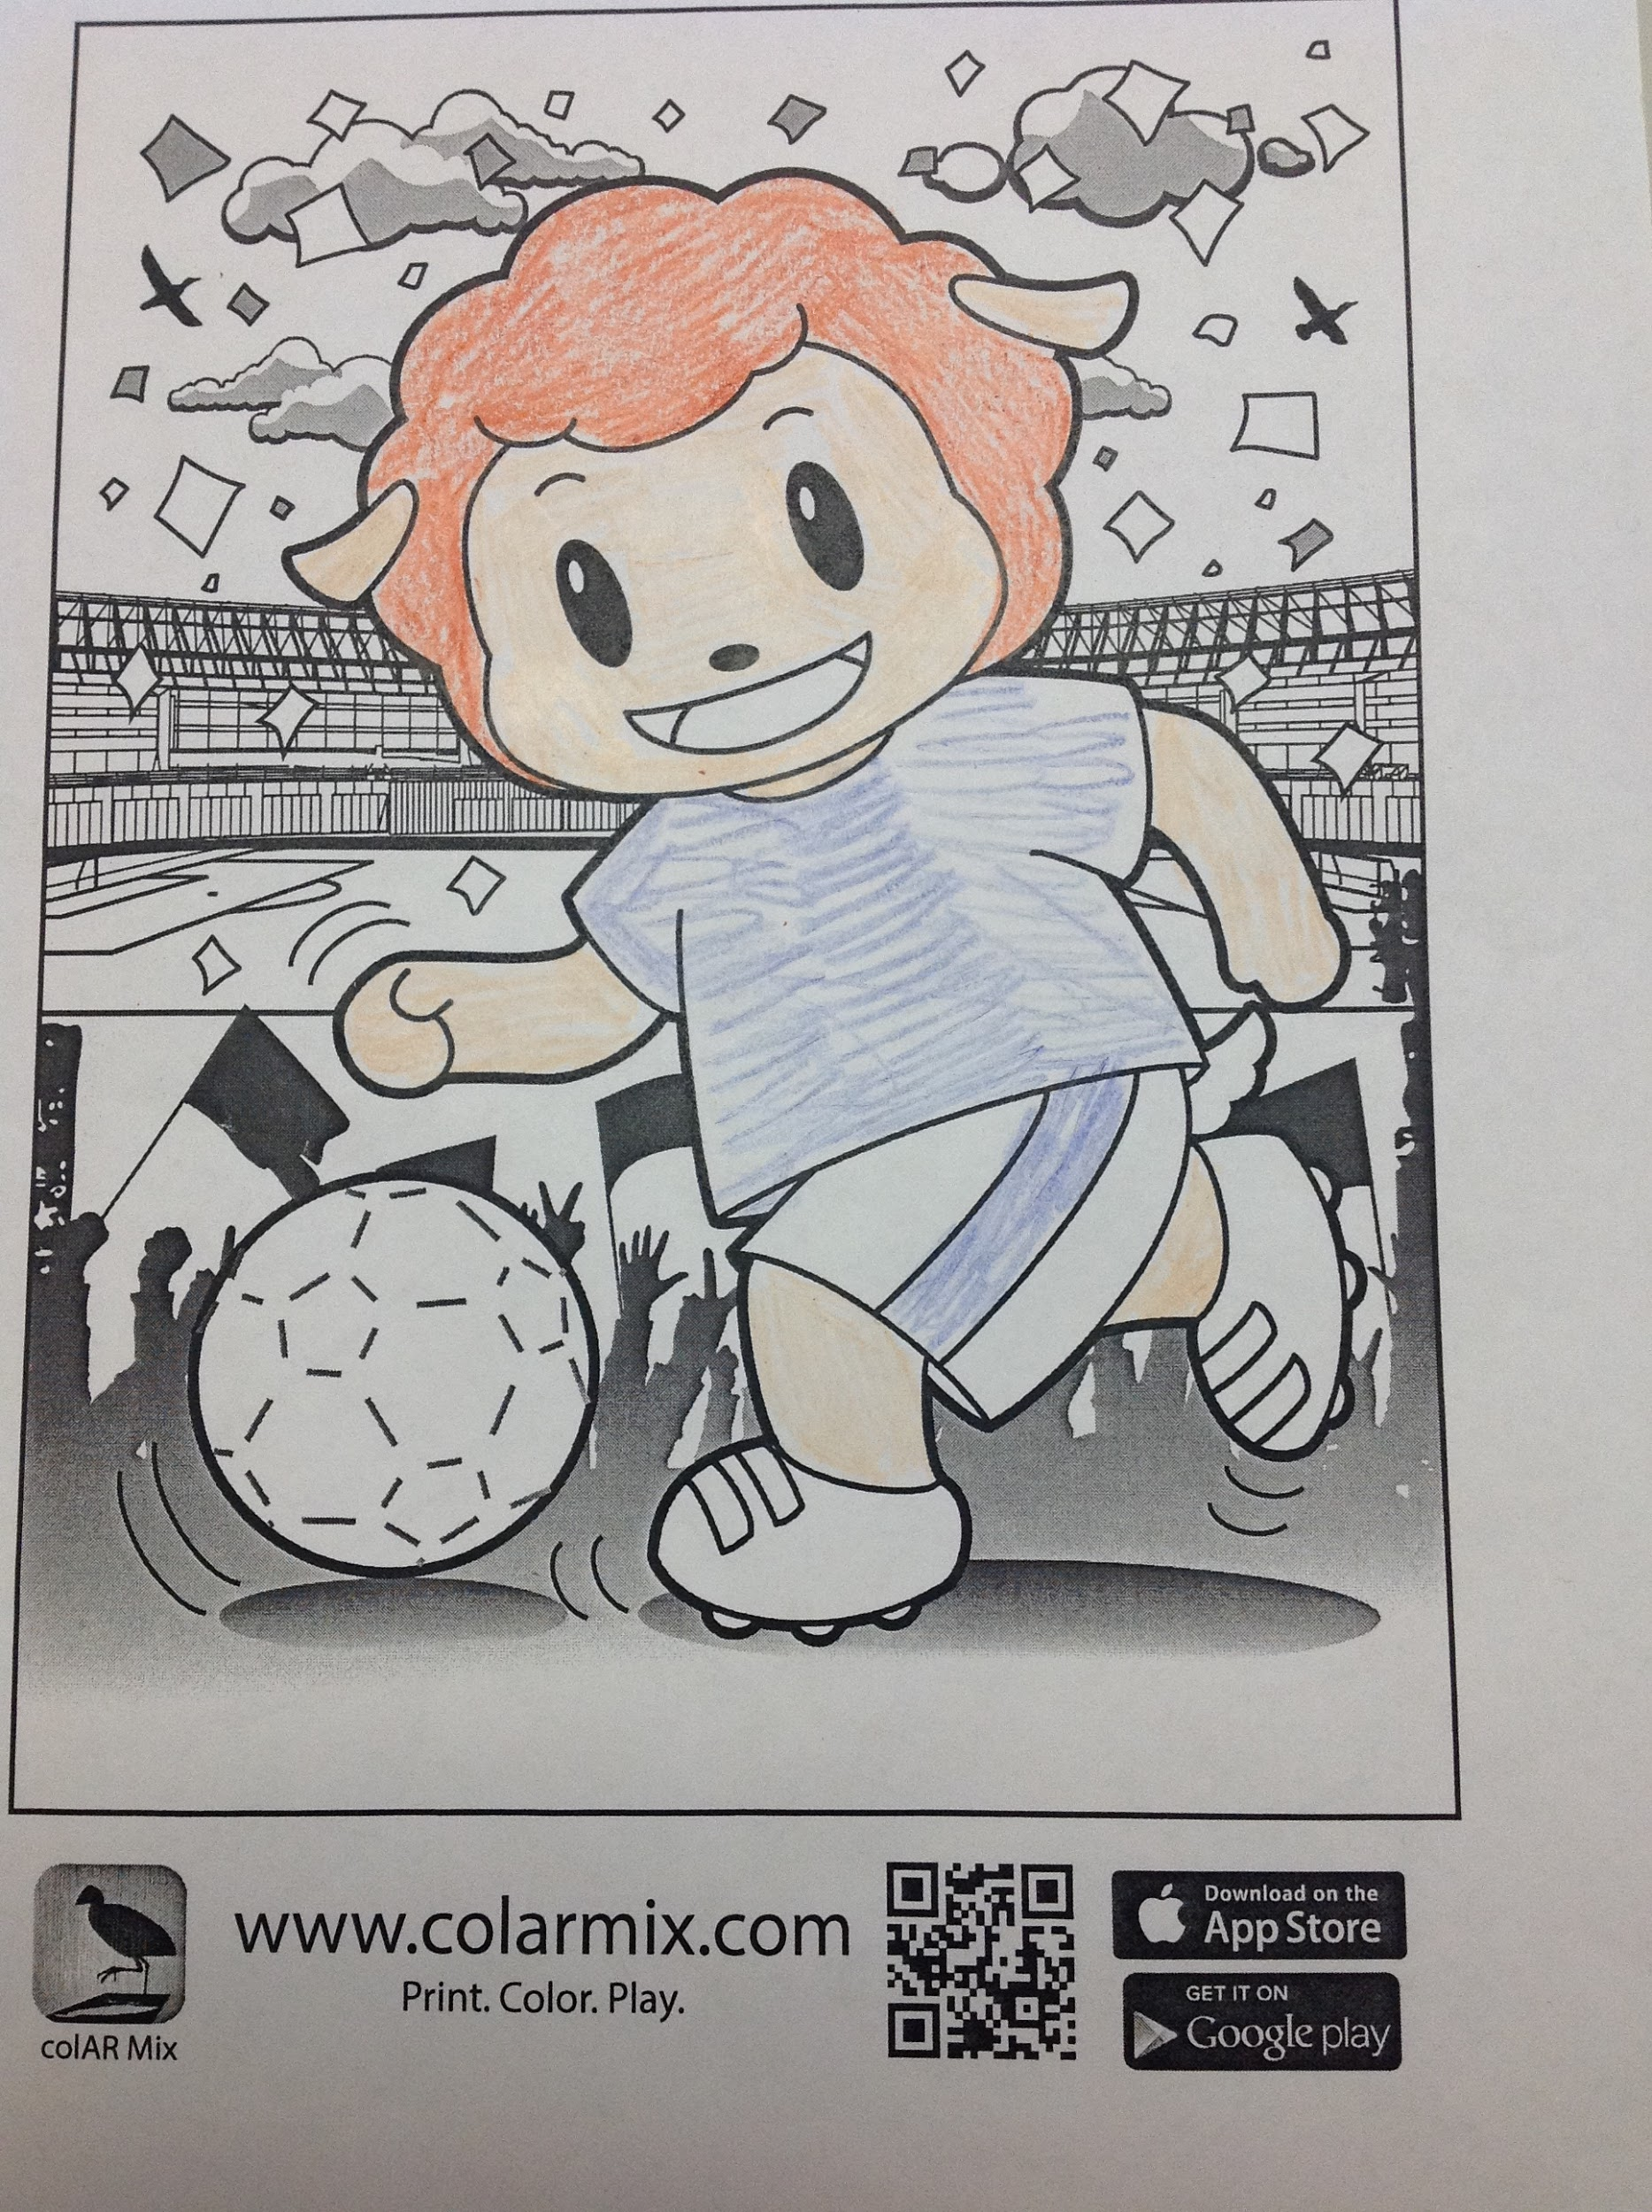
Poppin’ Picture Book Details
Choose 2-4 Quiver coloring pages.
Checklist and Rubric
http://bit.ly/wrtpop

Slide 21
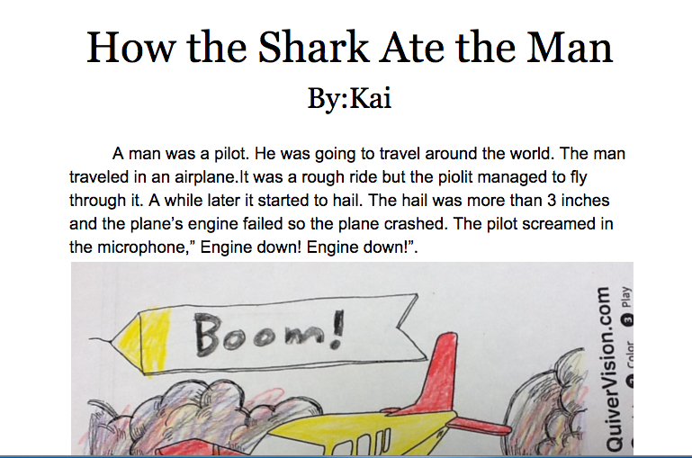
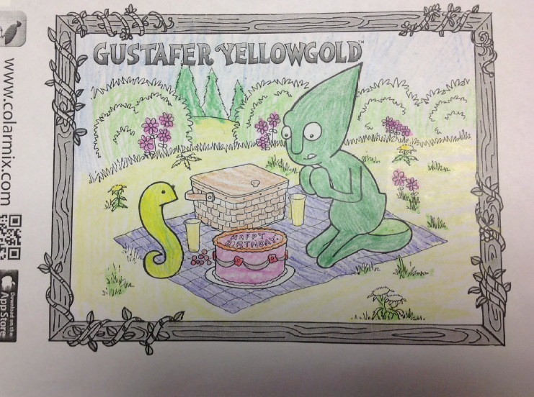
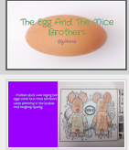
ColAR App Illustration
Google Doc
Google Presentation

Slide 22
Poppin’ Picture Book Examples
http://issuu.com/librarymax/docs/create_or_upload_your_poppin_pictur
http://issuu.com/librarymax/docs/createoruploadyourpoppinpicturebook/1
See our finished products: http://issuu.com/librarymax
http://bit.ly/wrtpop

Slide 23
How can Augmented Reality enhance your library programming?
http://bit.ly/wrtpop
Notes:
Think about marketing, student engagement, deeper

Slide 24
How might Augmented Reality lead to deeper learning?
http://bit.ly/wrtpop

Slide 25
How can Augmented Reality help us differentiate instruction?
http://bit.ly/wrtpop
Notes:
Think about content and process.

Slide 26
Ready to Move On?
Two Guys and Some iPads
Aurasma
Daqri
http://bit.ly/wrtpop

Slide 27
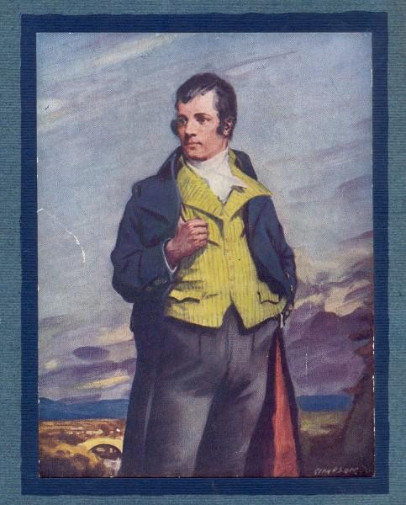
Notes:
channels, social media like platform, easy to keep private, great for elementary.

Slide 28
Library Orientation
http://bit.ly/wrtpop

Slide 29
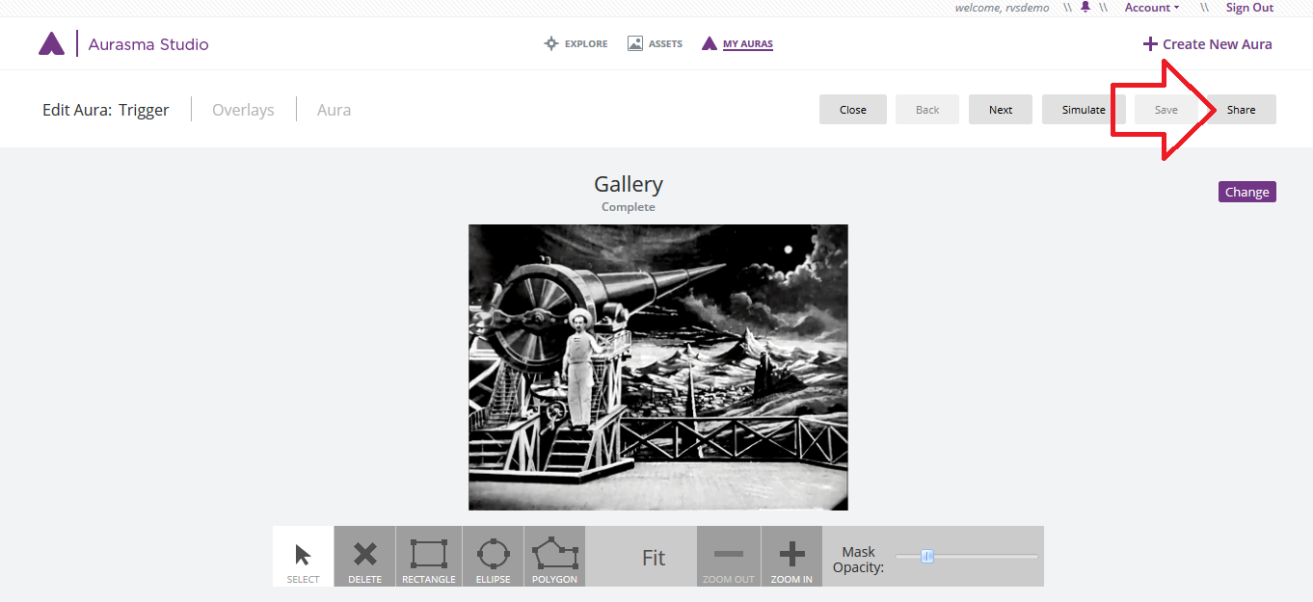
https://studio.aurasma.com/login
Notes:
Studio- more complex, for teachers

Slide 30
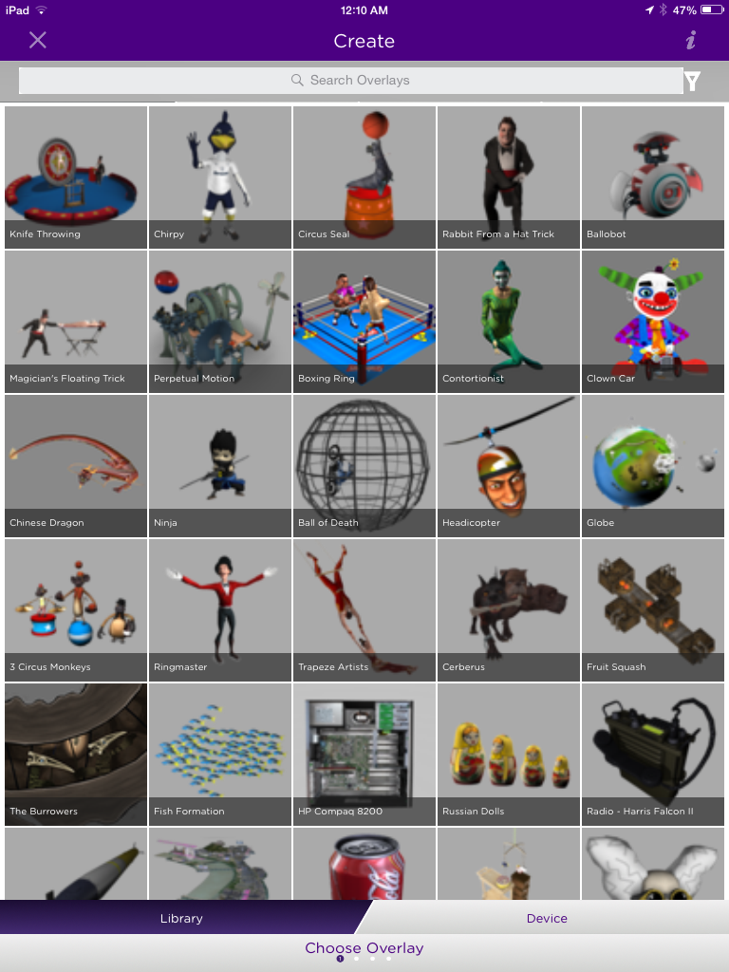
Notes:
students create in iPad app, class login, must follow a channel to scan an aura, safer

Slide 31
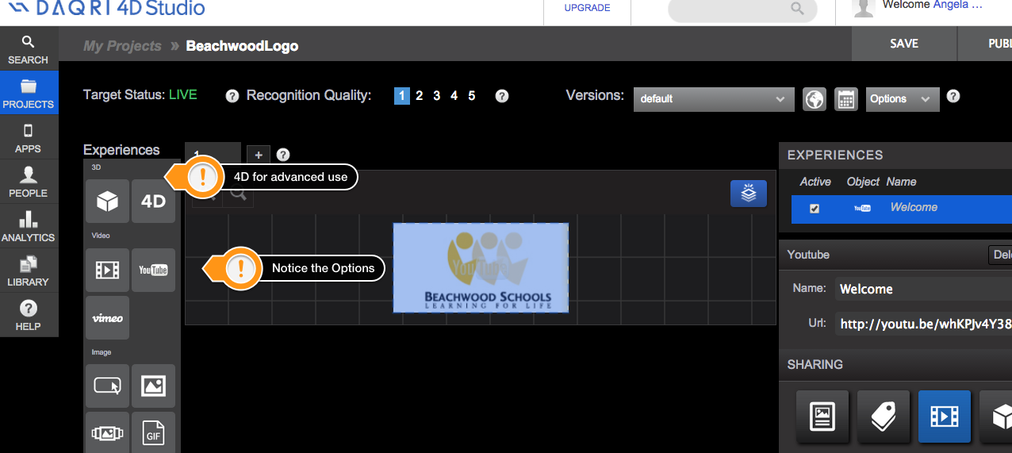
Notes:
more sophisticated 3D and 4D, teacher as creator, HS students

Slide 32
Scan with the Daqri App
Notes:
Old video, but illustrates how we can use Daquri to embed anything.

Slide 33
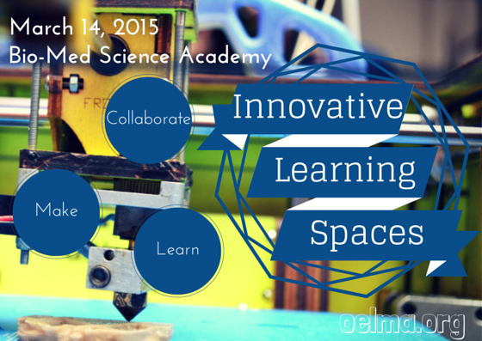
Scan with the Daqri App

Slide 34
Ideas?
http://bit.ly/wrtpop
@librarymax

