Slide 1
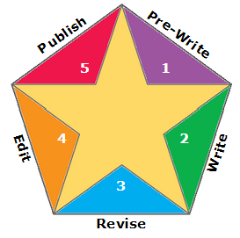
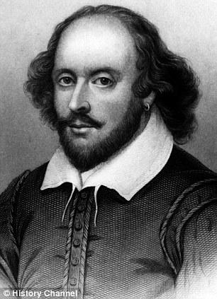
Using Technology
to Support the Writing Process
for Students at All Levels
This Presentation: goo.gl/jxPxZp
Resource List: goo.gl/LkO66Z
Presenter: Michael D. Roush
michaeldroush.org
michaeldroush@gmail.com
@mdroush

Slide 2
Why emphasize writing?
What happened to Carly? 2/16/15
VIDEO 1

Slide 3
writ·ing [rahy-ting]
definition?

Slide 4
Communication
Writing
Handwriting

Slide 5
Communication
Writing
Handwriting

Slide 6
What is “Writing”?
Thoughts
Ideas
Facts
Concepts
Observations
Conclusions
Compose…
&
Express...
Notes:
“Writing” is the ability or act of composing and expressing thoughts, ideas, facts, concepts, observations, conclusions, etc. in a fixed form. Handwriting on paper is ONE way to do this, but is certainly not the ONLY way to do this. It may not even be the BEST way to do this, and that is the divergence in thinking that can open the door to changing our “struggling writers” into “accomplished writers”. Focus on the process, not the mechanics of one form.

Slide 7
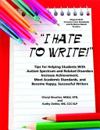
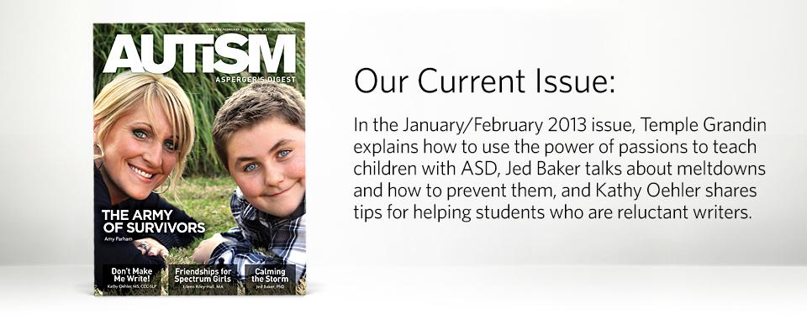
Barriers to Writing
Language “He has great ideas. However, when it’s time to write, he can’t think of anything to say!”
Organization “His writing is so disorganized. His paragraphs look like a laundry list of facts with no sense of order or sequence.”
Motor “He can’t get started. When I ask him to write, he just sits there.”
Sensory “Every time he’s asked to write something, he has a meltdown!”
http://autismdigest.com/write/
Notes:
Two struggling writers may not struggle for the same reason. It is important to try to understand why struggling students are struggling, so that appropriate scaffolds can be put in place.

Slide 8
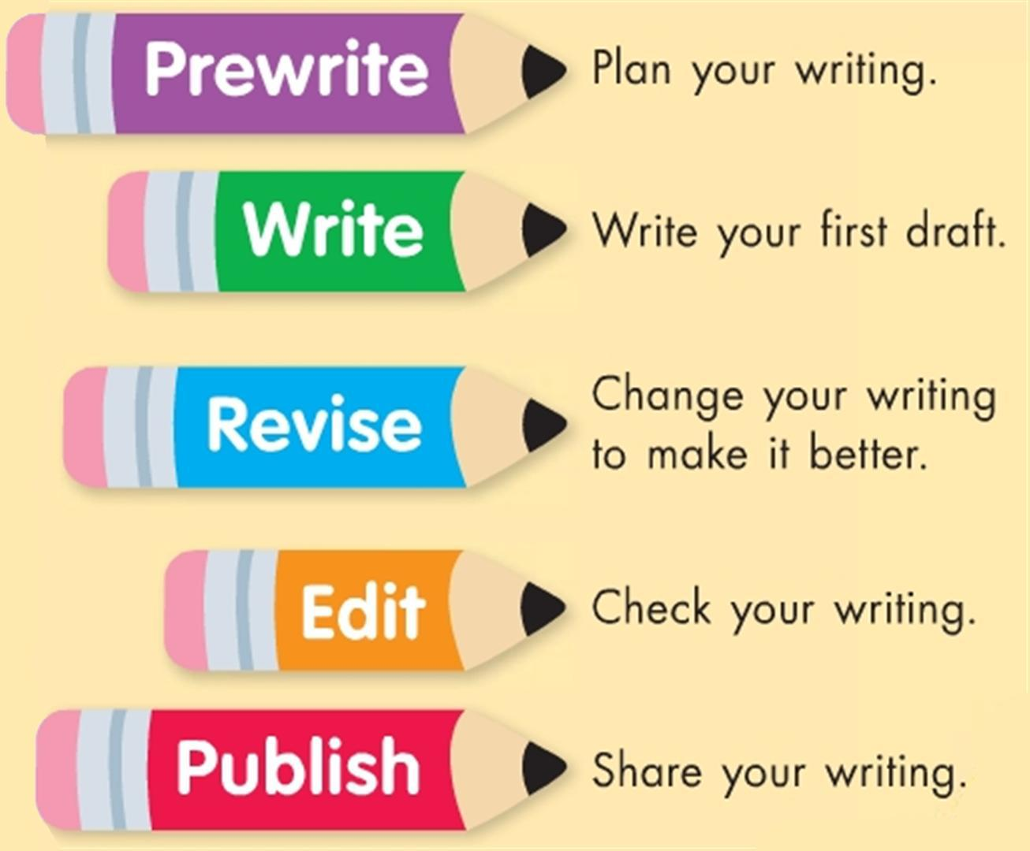

Slide 9
Research
Notes:
The first step in starting to write is usually not “starting to write”!
Google Docs Research Tool, Google Scholar, InstaGrok, TagGalaxy, VisuWords (http://www.visuwords.com/),

Slide 10
http://isearch.infohio.org
Research
Notes:
Google Docs Research Tool, Google Scholar, InstaGrok, TagGalaxy, VisuWords (http://www.visuwords.com/),

Slide 11
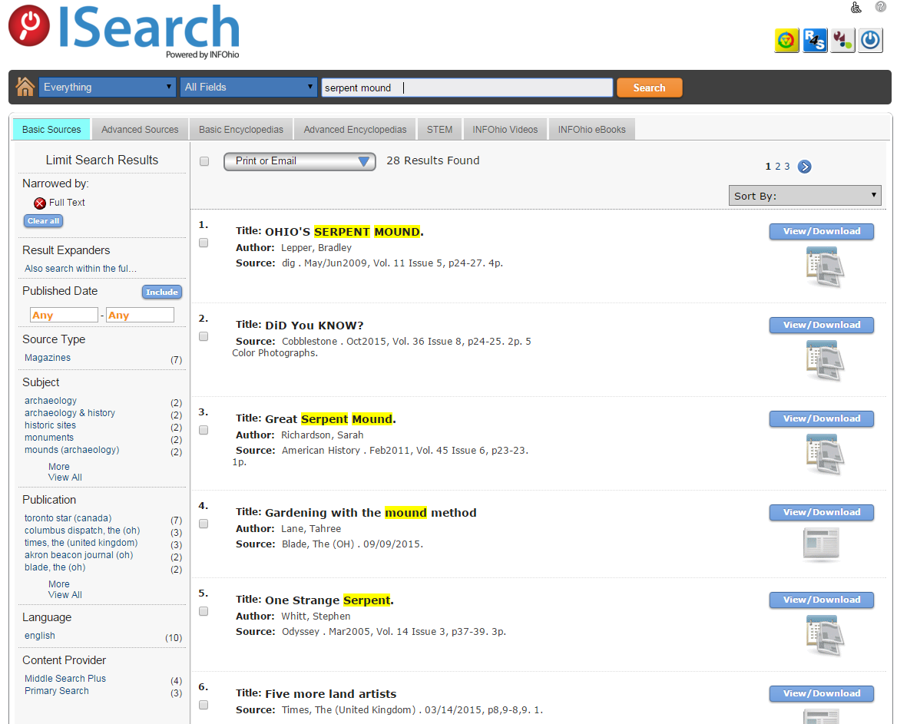
Research
Notes:
Google Docs Research Tool, Google Scholar, InstaGrok, TagGalaxy, VisuWords (http://www.visuwords.com/),

Slide 12
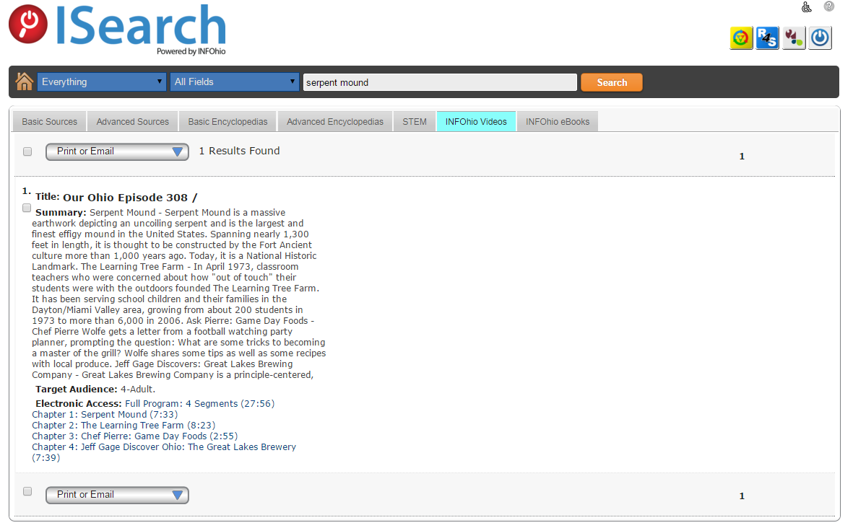
Research
Notes:
Google Docs Research Tool, Google Scholar, InstaGrok, TagGalaxy, VisuWords (http://www.visuwords.com/),

Slide 13
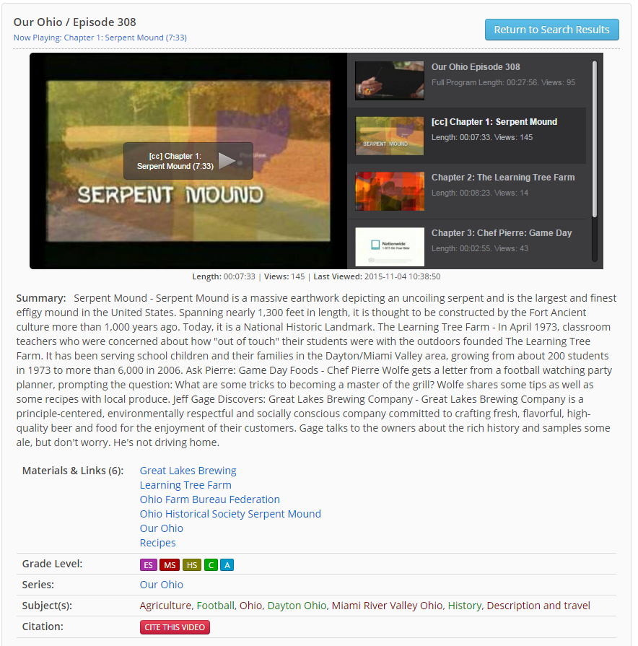
Research
Notes:
Google Docs Research Tool, Google Scholar, InstaGrok, TagGalaxy, VisuWords (http://www.visuwords.com/),

Slide 14
Organization
Notes:
Popplet, LucidChart, ReadWriteThink Org Tools (http://www.readwritethink.org/search/?resource_type=16&type=24),

Slide 15
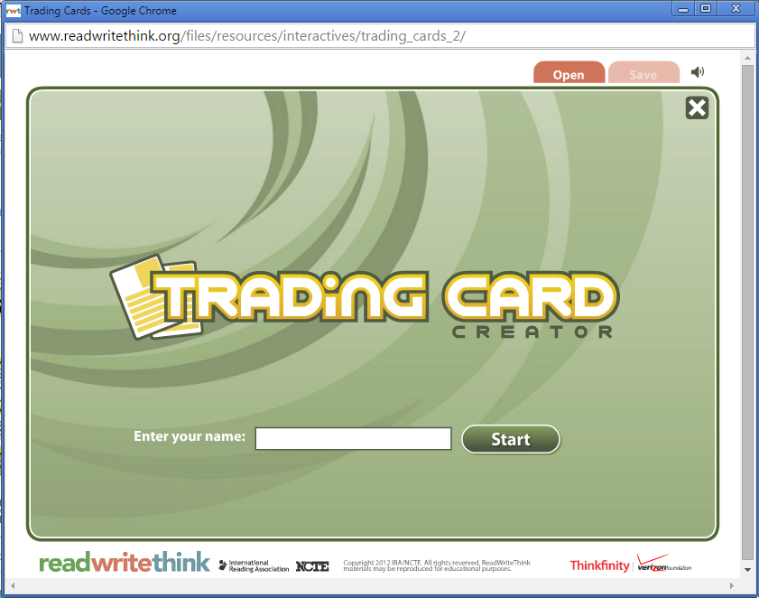
Organization
Notes:
ReadWriteThink Trading Card Generator: http://www.readwritethink.org/classroom-resources/student-interactives/trading-card-creator-30056.html

Slide 16
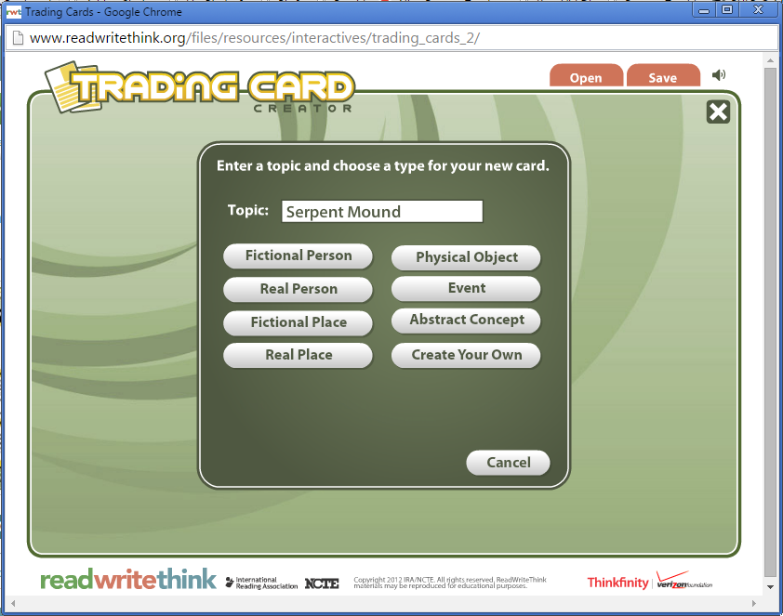
Organization
Notes:
ReadWriteThink Trading Card Generator: http://www.readwritethink.org/classroom-resources/student-interactives/trading-card-creator-30056.html

Slide 17
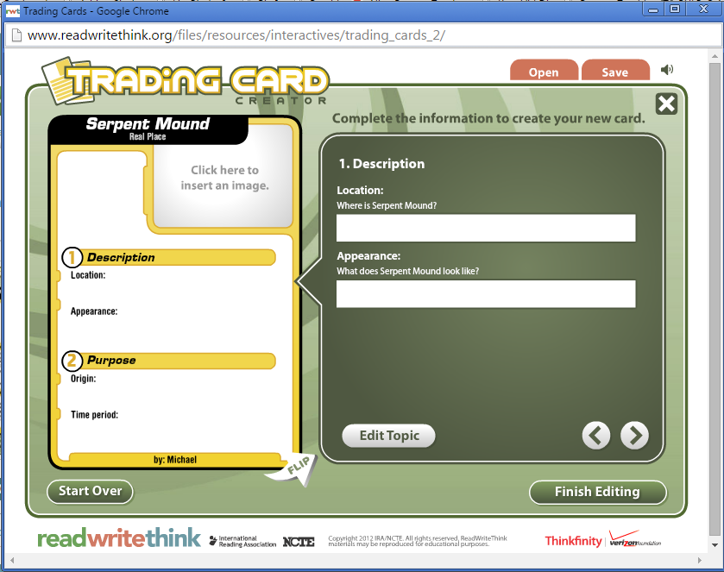
Organization
Notes:
ReadWriteThink Trading Card Generator: http://www.readwritethink.org/classroom-resources/student-interactives/trading-card-creator-30056.html

Slide 18
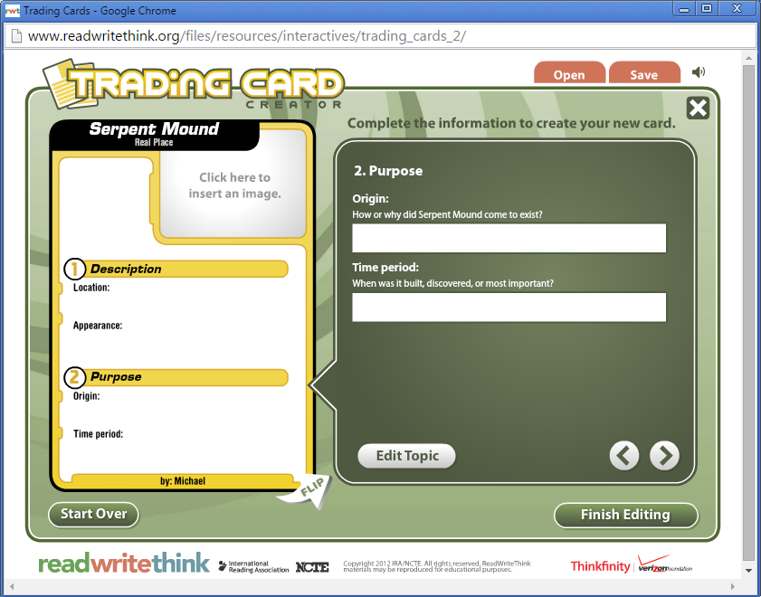
Organization
Notes:
ReadWriteThink Trading Card Generator: http://www.readwritethink.org/classroom-resources/student-interactives/trading-card-creator-30056.html

Slide 19
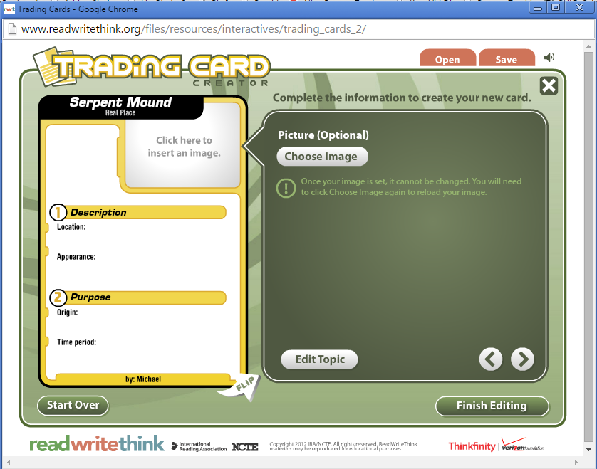
Organization
Notes:
ReadWriteThink Trading Card Generator: http://www.readwritethink.org/classroom-resources/student-interactives/trading-card-creator-30056.html

Slide 20
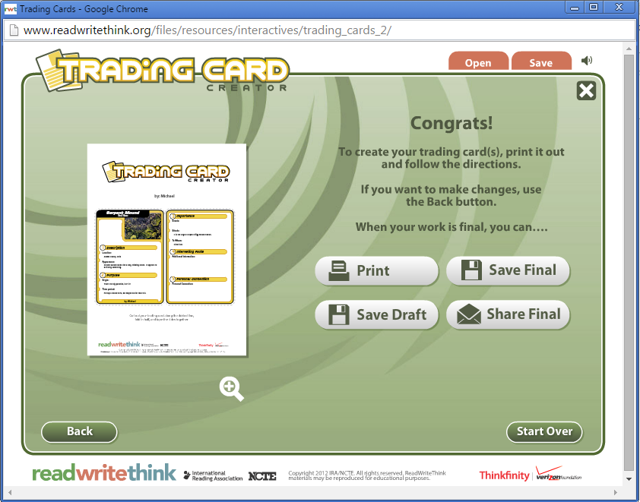
Organization
Notes:
ReadWriteThink Trading Card Generator: http://www.readwritethink.org/classroom-resources/student-interactives/trading-card-creator-30056.html

Slide 21
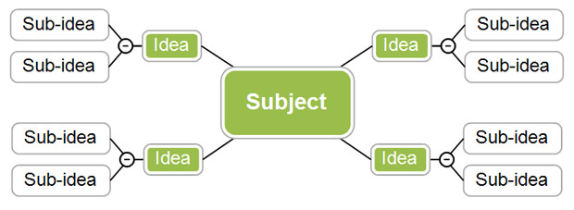
Graphic Organizers

Slide 22
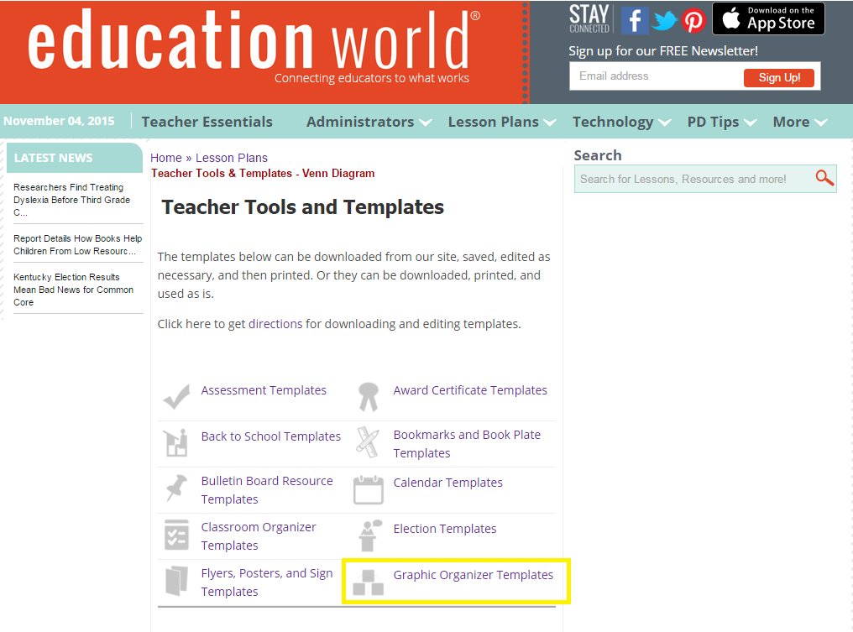
http://www.educationworld.com/tools_templates/
Graphic Organizers

Slide 23
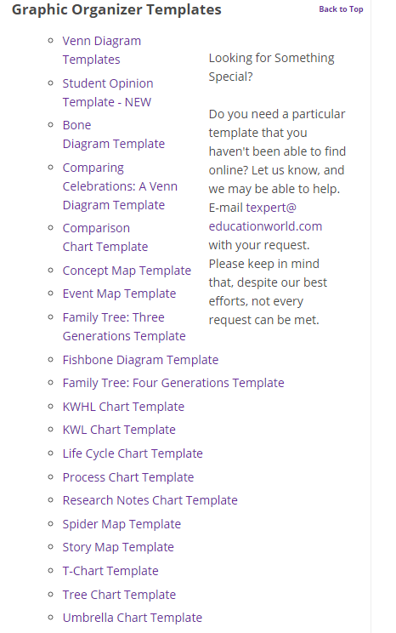
http://www.educationworld.com/tools_templates/
Graphic Organizers

Slide 24
“How do I get the stuff that is inside my head into a fixed format?”

Slide 25
Speech-to-Text

Slide 26
Speech-to-Text
Microsoft Speech Recognition [XP, Vista, 7, 8]
Mac OS X Dictation
Chrome Voice Recognition (from ctrlq.org)
DictaNote [Chrome App]
Chrome Speech Recognition API Demo
iOS
Settings → General → Keyboard → “Enable Dictation”
Notes:
I don’t have time to go into any specific one, but whether you are using Windows, Mac OS X, or Chrome, there is speech-to-text available for your system FOR FREE.

Slide 27
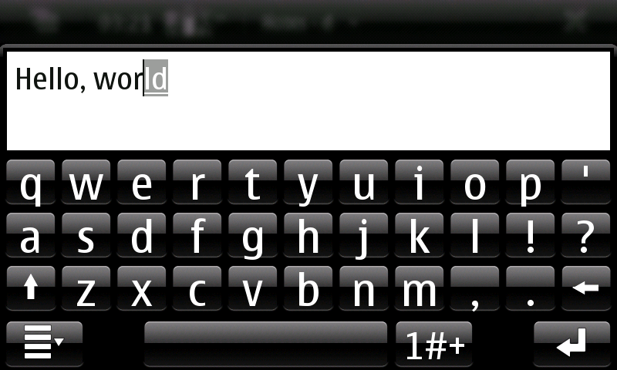
Word Prediction
Notes:
LetMeType,

Slide 28
Word Prediction
Resource List: goo.gl/LkO66Z
Notes:
LetMeType,

Slide 29
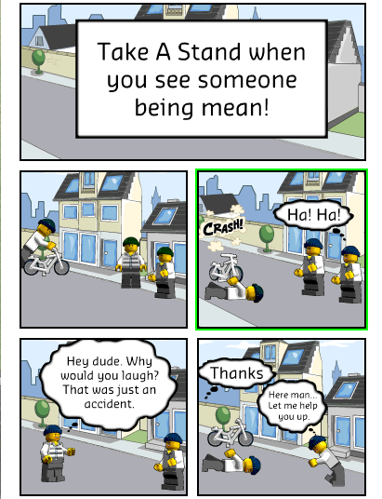
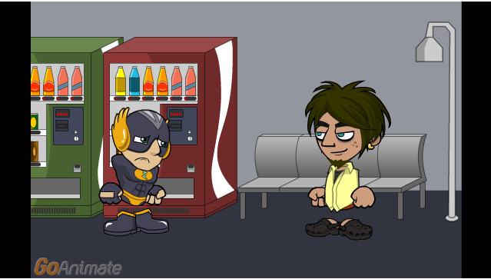
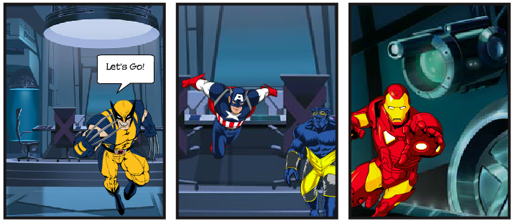
Alternate Formats
Notes:
LEGO Comic Creator, Marvel Super Hero Comic Creator, GoAnimate, StoryboardThat, PowToon, Voki

Slide 30
Alternate Formats
Notes:
This is LEGO City Comic Creator. No account is needed to start creating a comic. Can download as a PDF or print. “Save” and “Load” features seem not to work so well anymore.

Slide 31
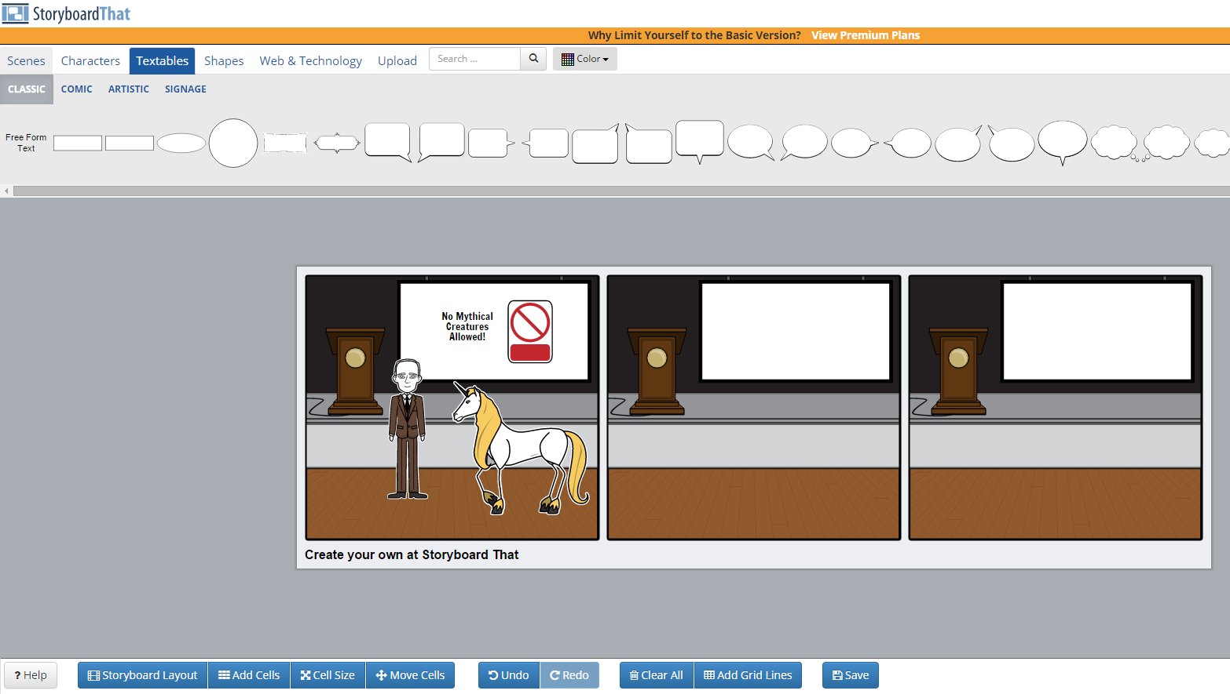
Alternate Formats
Notes:
This is “StoryboardThat”. Free accounts available. Can use your Google account as your login.

Slide 32
What’s the Difference?
vs.
Readability
Logic
Clarity
Grammar
Capitalization
Punctuation
Both may be done by self-review, peer-review, and/or technology assisted review!

Slide 33
“Does this make sense?”
“Am I saying what I wanted to say?”

Slide 34
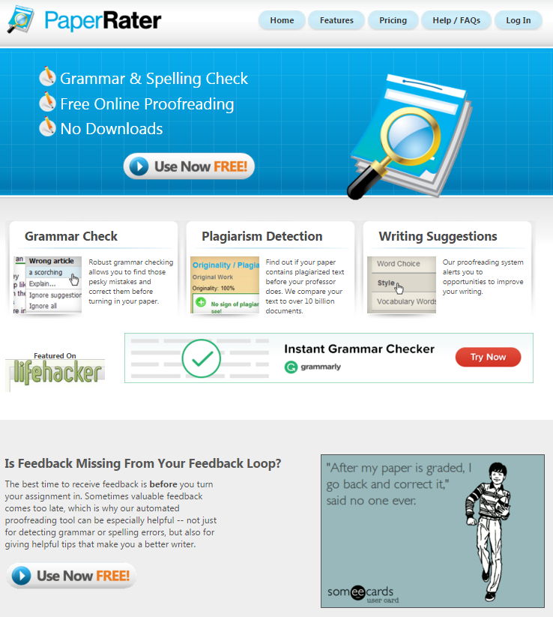
PaperRater.com
Use it yourself
OR
Have your students use it before they turn anything in!

Slide 35
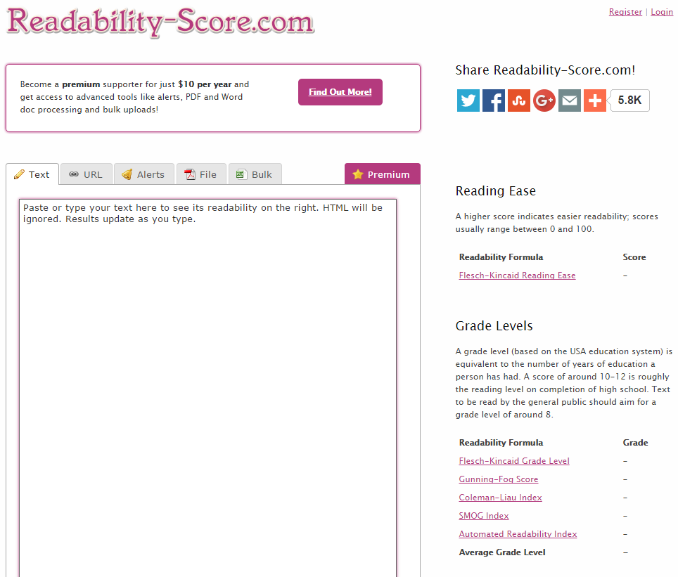
Notes:
Readability-score.com analyzes text for reading level. Use this to encourage students to write up to their level. It can also be a challenge to hvae students revise their writing so that it lowers the reading level without affecting the clarity.

Slide 36
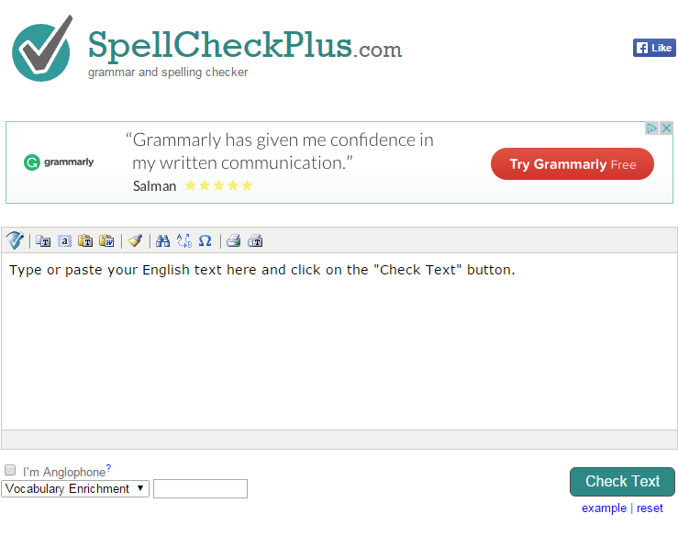
Notes:
SpellCheckPlus.com offers a simple spelling and grammar checker for any text you can paste into the text box.
Free version limit, 2000 characters. Checks word choice, word form, style, and spelling.

Slide 37
To grade… or not to grade! That is the question!
Notes:
If this is happening in my classroom, I haven’t graded anything yet, beyond checking for progress and completion of previous steps. And those grades (if any) have nothing to do with the final grade on this writing assignment.

Slide 38
“Publish”? Are you crazy?

Slide 39
good > good enough

Slide 40
Impact
authenticity
Relevance
Notes:
Publishing is where Impact is. Publishing is where authenticity is. Publishing is where relevance is.

Slide 41
Start your own “StoryCorps” project
“Q&A” from StoryCorps
12 year old Joshua Littman interviews his mother
VIDEO 2
Notes:
Publishing is where Impact is. Publishing is where authenticity is. Publishing is where relevance is.

Slide 42
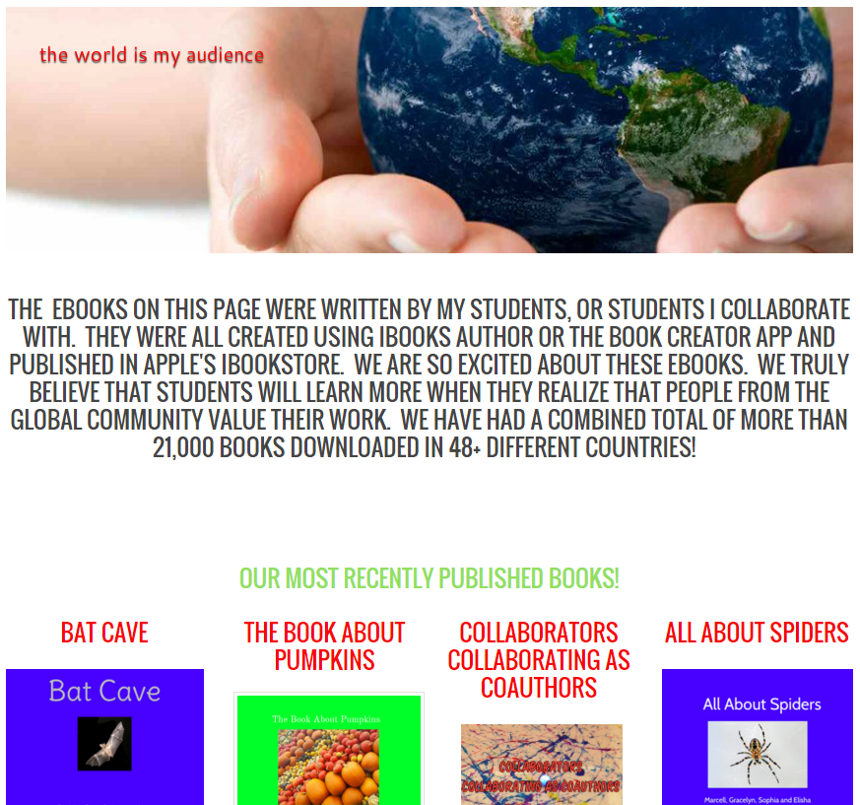
http://mrsmithtrt.weebly.com/class-ebooks.html
Notes:
Here’s an example. This was done with iBooks Author, and is available (for FREE) in the free iBooks app for iOS!

Slide 43
http://mrsmithtrt.weebly.com/class-ebooks.html
Notes:
Here’s an example. This was done with iBooks Author, and is available (for FREE) in the free iBooks app for iOS!

Slide 44
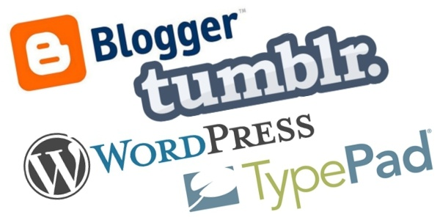
Do you Blog?

Slide 45
KidBlog.org
Notes:
Probably the EASIEST way for you and your students to get started. KidBlog.org
Free for you and up to 50 students. Automatically log in with your Google (Apps For Education) Account if you have one, or create a free account with your school e-mail address.

Slide 46
#IWishMyTeacherKnew
Notes:
If you want students to care more about their writing, they must be allowed to write about something they care about.
Story from CNN on April 20, 2015. Generating ideas really can be this simple.

Slide 47
Notes:
This is the granddaddy of self-publishing. You can create your own ACTUAL printed book here. Lots of options for sizes and “extent” of publishing (ISBN, etc.). You can market and sell your book through this site as well.

Slide 48
“To ISBN, or not to ISBN?”
Notes:
A word about ISBNs. Do you need one, or not? Are they expensive?
ISBN = International Standard Book Number
If you only distribute your book through a service like Lulu, then no, you don’t need an ISBN. If you want to sell your book through Amazon or something like that, then yes, you do need an ISBN. Not only that, but every different version of your book (paperback, hardback, ePUB, PDF, etc) must have its own unique ISBN. These can be pricey, but they open up new options for distribution and revenue-generating.
Who do you want to be the “publisher”? Does your school have its own “Publishing House”? If not, maybe it should!
Want to know more about ISBN’s? http://www.thebookdesigner.com/2010/03/isbn-for-self-publishers-answers-to-20-of-your-questions/

Slide 49
Notes:
Now, what can you do with this?
This year? Over the summer (to prepare)? Next year?
Team Planning Time!

Slide 50
Publish
Pre-Write
5
1
4
2
Edit
Write
3
Revise

Slide 51
Using Technology
to Support the Writing Process
for Students at All Levels
This Presentation: goo.gl/jxPxZp
Resource List: goo.gl/LkO66Z
Presenter: Michael D. Roush
michaeldroush.org
michaeldroush@gmail.com
@mdroush

