Slide 1
Writing and Researching Online with Google Drive
Ryan Novak, English Teacher
Kenston High School - Chagrin Falls, OH
@khs_novak bit.ly/infohionovak
ryan.novak@kenstonapps.org

Slide 3
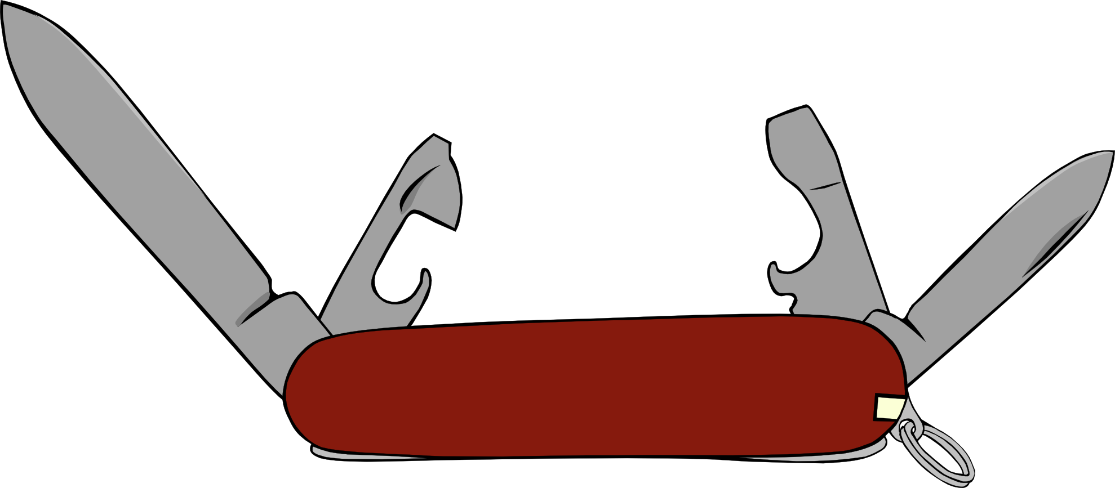
Use ONE resource to do
what used to take many.

Slide 4
Questions to ask
when using tech...
Does it solve a problem?
Does it help your students?
Does it save you time?

Slide 5
Complete the ENTIRE research process with Google Drive
Develop and submit research questions
Conduct research with reputable sources
Complete works cited entries
Create “note cards”
Organize ideas with graphic organizer
Draft, peer edit, and revise
Submit and assess
Return and revise
All while allowing the instructor to track progress and comment throughout!

Slide 6
SCIENTIFIC
METHOD
RESEARCH
PROCESS
WRITING
PROCESS
Ask a question
Question
Prewrite
Research
Research
Draft
Hypothesis
Organize
Revise
Test Hypothesis
Draft
Edit
Analyze data/
draw conclusion
Revise/Edit
Publish
Report results:
Was hypothesis correct?
Publish

Slide 7
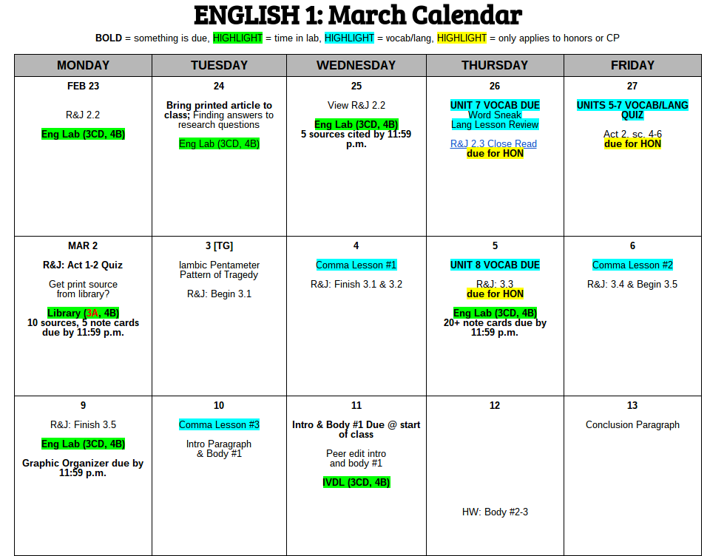
Google Calendar Stinks
Share Due Dates and Links in a Doc

Slide 8
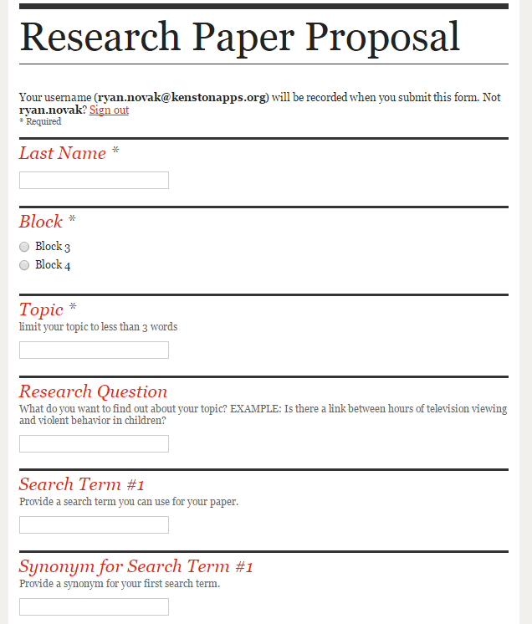
A Google form can be embedded on a website, posted on Google Classroom, or shared with students via email.
However you share it out to students, it is a great way to collect proposals (or any other data) from students.
Proposing Research Questions with Forms

Slide 9
Because of control over who has access to Google documents, a teacher or librarian/ media specialist can share links to databases and the usernames and passwords needed to access them easily and securely.
Sharing Links and PW to INFOhio Databases

Slide 10
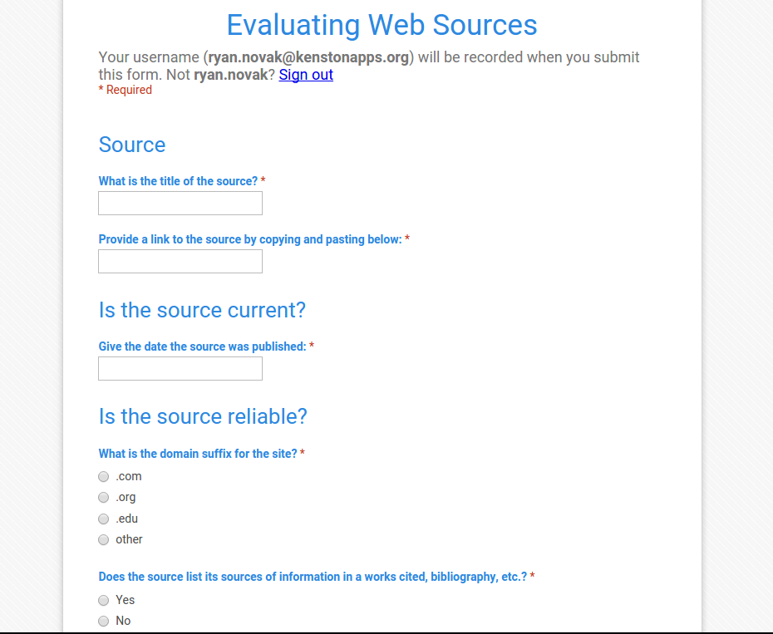
Using Forms to Approve Web Sources

Slide 11
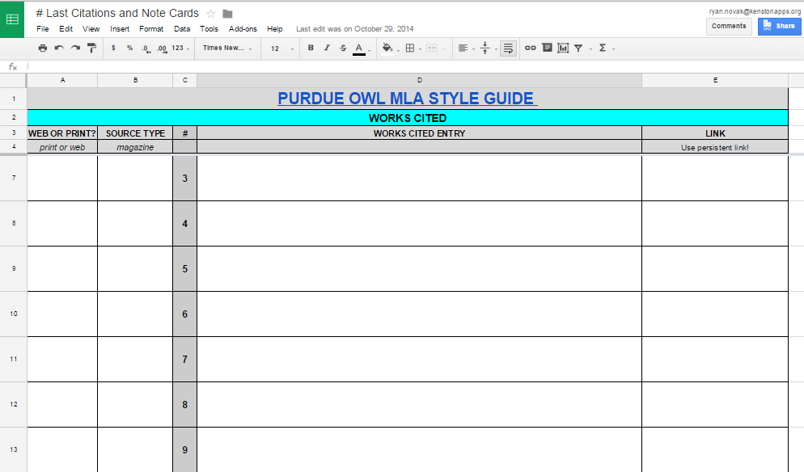
Sharing In-progress Works Cited...

Slide 12
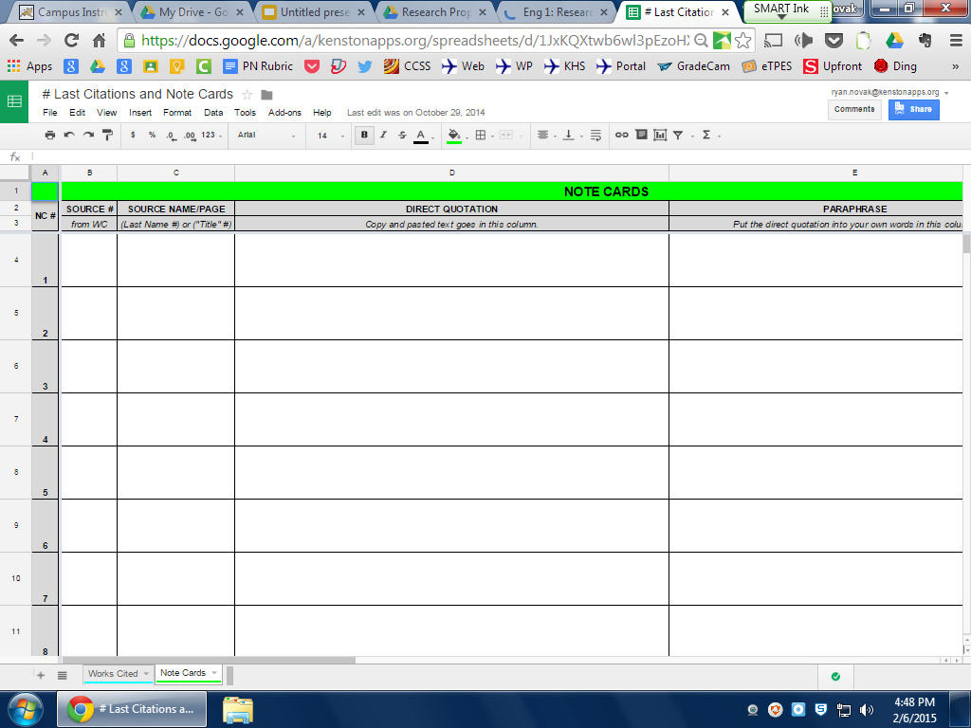
...and Note Cards

Slide 13
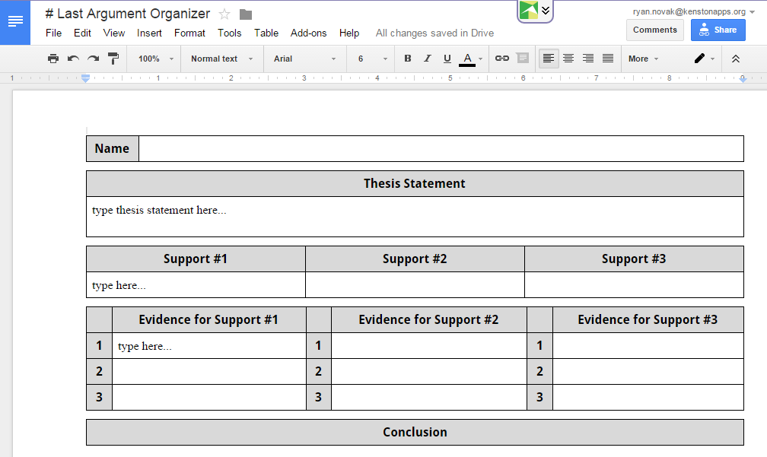
Providing Feedback During Prewriting & Planning

Slide 14
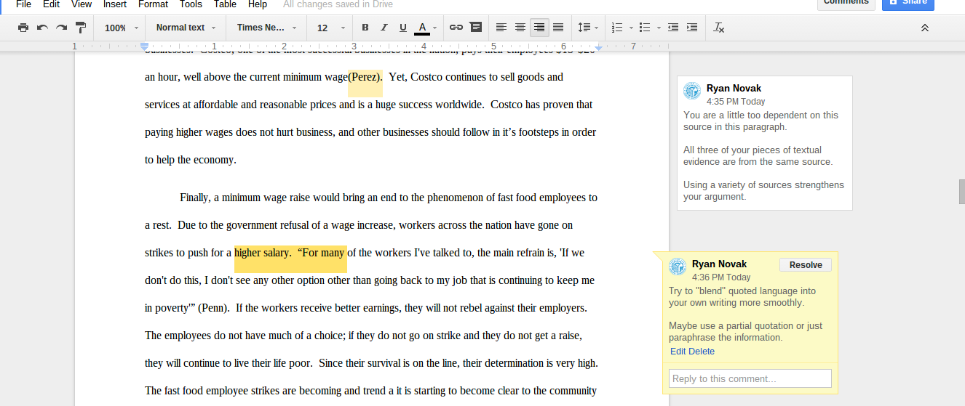
Direct a comment at someone, and he/she will receive an email notification: type “+” and email address (+ryan.novak@kenstonapps.org)
Teacher and Peer Comments During the Process

Slide 15
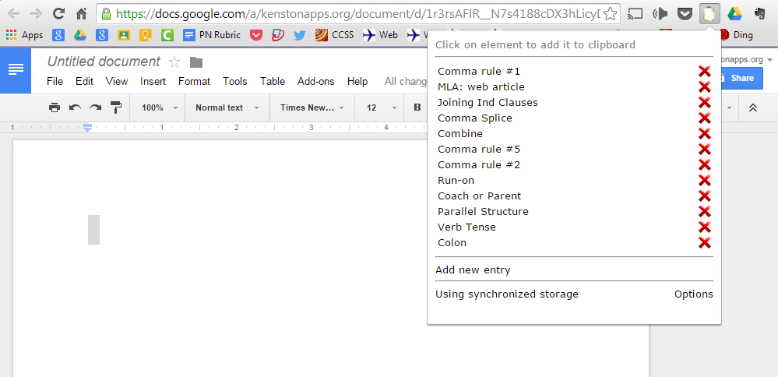
Canned Comments Using Permanent Clipboard

Slide 16
Feedback throughout the Entire Process

Slide 17
Advantages:
Extends the classroom beyond the class period.
Can’t get to a student’s question? Get to it during your planning period.
Students can collaborate and help each other even if they’re not together.
Can give feedback while work is in progress.
Much more productive than waiting until students have moved on to next assignment.
Unless you force them, students rarely, if ever, will revise a paper on their own.

Slide 18
What I’ve learned:
Understand that providing feedback online can save you time and help students, but only if you find a way for it to do so.
Comments are easily accessible, but students are not more likely to read them. Keep comments to a minimum and hold students accountable! Don’t write more than they did!

Slide 19
What’s Next...
INFOhio Bootcamp 2016??

Slide 20
CCSS.ELA-LITERACY.W.9-10.2.A
Introduce a topic; organize complex ideas, concepts, and information to make important connections and distinctions; include formatting (e.g., headings), graphics (e.g., figures, tables), and multimedia when useful to aiding comprehension.
CCSS.ELA-LITERACY.W.9-10.6
Use technology, including the Internet, to produce, publish, and update individual or shared writing products, taking advantage of technology's capacity to link to other information and to display information flexibly and dynamically.
FULLY Addressing Tech Expectations in the CCSS

Slide 21
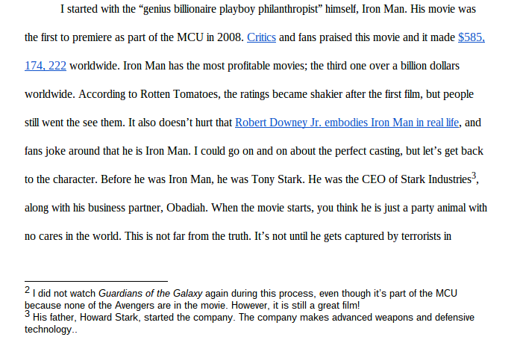
We all read Hyperlinked Texts Every Day
Do Students Write Any?

