Slide 1
Genealogy Gallery Walk:
Making Research Personal
Presented by: Jessica Klinker
Created in Collaboration with:
Shelly Mann, Laura Garber,
Frank Bonfiglio,
Sarah Waugh, and Anne Gill
Franklin Heights High School
South-Western City Schools
Notes:
Hi, My name is Jessica Klinker. I am the Head Librarian at Franklin Heights High School in South-Western City School District, located here in Columbus. Although they couldn’t be here for this presentation, the team of English 11 Teachers I worked with on this project were all equally invested in the planning, creation, and implementation of this project. I am very grateful that they welcome me into collaboration with them, so that we can ensure research skills are embedded into the work in their classrooms.

Slide 2
Our Research Philosophy: Grounded in Inquiry
Kuhlthau (2013)
Notes:
To give you a little background about our collaboration team, the English 11 teachers and I decided last year that we really wanted to try approaching research through the lens of Guided Inquiry. We believe strongly in this approach, because it incorporates more student choice and motivates students to dig deeper into topics that interest them. We have also found that it encourages students to try new things and develop more of the “HOW” skills, as opposed to just content-skills, skills such as creating more vibrant presentations, practicing interviewing skills, and understanding that there are many different types of research, beyond searching the Internet or a database.

Slide 3
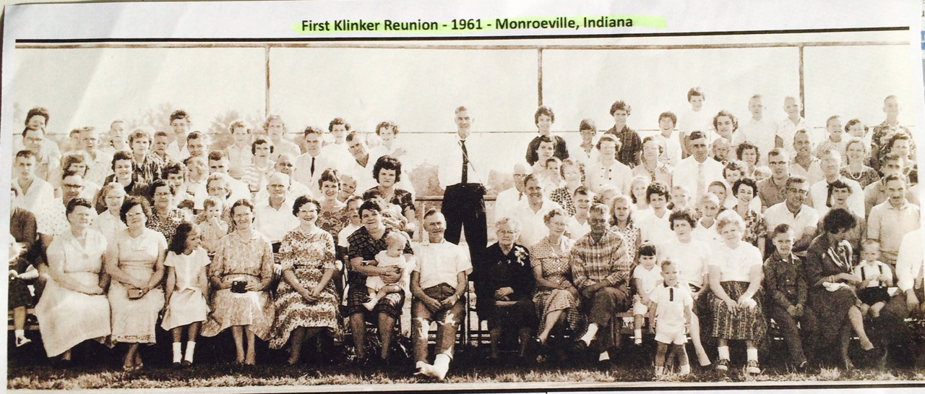
Genealogy Project
Essential Questions
Where do I come from?
How does my family background impact who I am?
Notes:
One of the teachers on the English team experienced a death in the family this past Fall and, during the process of preparing for the memorial, discovered some family documents that shed new light and detail into her family’s history. This prompted her to pose that question to our team and to our students. Our team jumped on it, because we recognized that many of our students come from different backgrounds, including several who have immigrated within the last generation, and that many students haven’t previously had the opportunity to explore their personal histories. We also believed this topic would open up opportunities for the students to practice a different set of research skills and tools, such as using primary source research, developing interview skills, and exploring new databases, such as Ancestry.
To develop our project, the teachers and I did our own research. We used the ALA webinar by Leslie Preddy and Suzanne Walker, The R.O.A.D. I Travel: A Program Model for School Libraries, in which they detailed the collaborative genealogy project they did with their 8th grade students and the State Library of Indiana. We also consulted with the Genealogy Department at the Columbus Metropolitan Library.

Slide 4
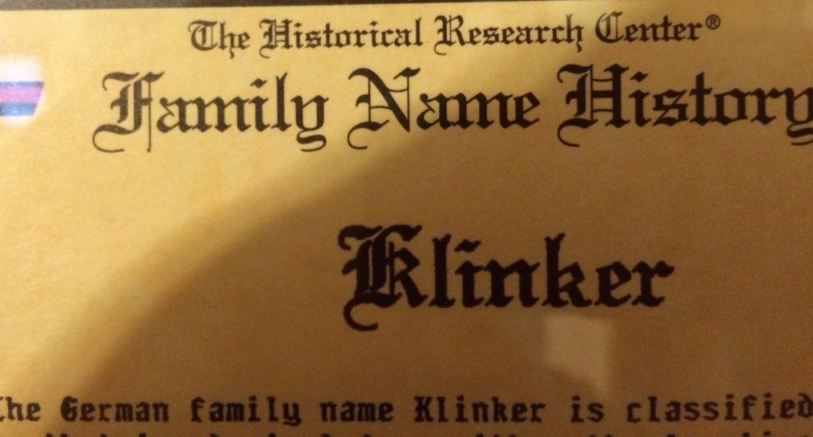
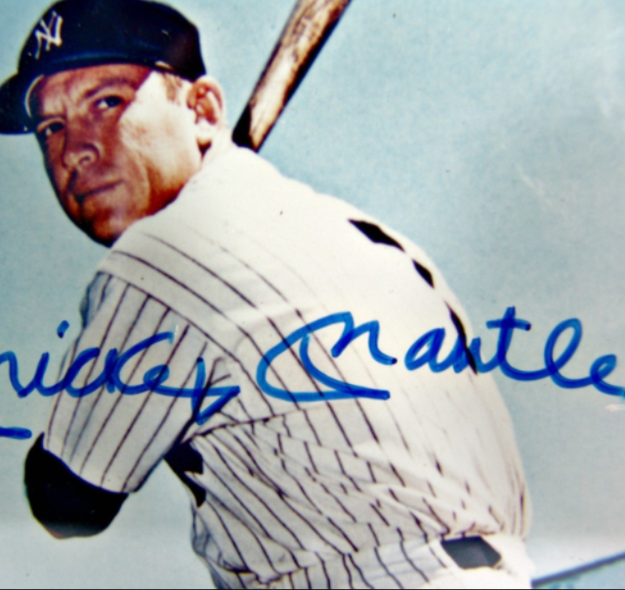
Project Hook:
Artifact and Surname
Student on our baseball team’s family artifact: Signed Mickey Mantle picture passed down from grandfather, to father, to him.
Favorite sources for histories on surnames:
http://www.ancestry.com/learn/facts
http://www.surnamedb.com/
Notes:
The first assignment we gave students was to find a family artifact and find out what the history of their surname. This was a good hook activity, because it asked many students to start that conversation about what is important in their families, what types of items can be considered artifacts, and thinking about how names are passed down and changed over time.
There were some students who had a hard time locating their surnames in these databases, so we reached out to the genealogy department at the public library for help on some of them. On the ones that still weren’t available, we encouraged students to look at mother’s maiden name or their own first names, to explore the meaning of those names.

Slide 5
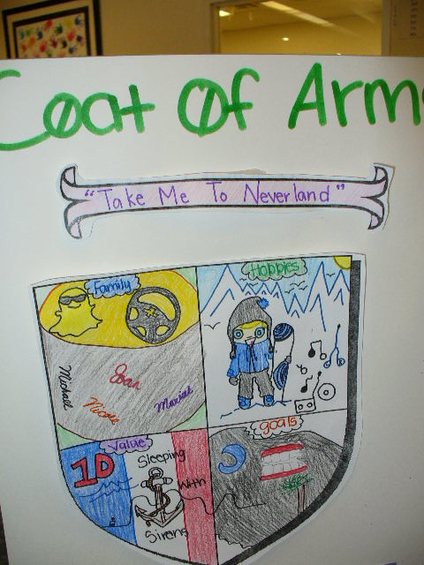
Personal Coat of Arms
Notes:
All of the teachers on our team like to emphasize different means of expression, so we wanted to ensure that we were incorporating some opportunities for visual learners and artistic students to shine during this project also. So, inspired by a family plaque hanging at my grandparents, which including the Klinker surname history and a Klinker Coat of Arms, our team designed an assignment for this project in which students designed their own personal coat of arms.
In addition to tying in different means of expression, this activity was also good towards the beginning of the project for helping students connect what we were researching with their personal interests and values.

Slide 6
The Day You Were Born
Notes:
One piece of The R.O.A.D I Traveled project that Leslie Preddy and her team did was asking students to use microfiche at the Indiana State Library to look up newspaper articles from the day they were born to see what was going on in the world. We were hoping to replicate that experience for our students by arranging a field trip to the downtown public library, but they were undergoing construction and weren’t able to accommodate a group our size. However, we were still able to have students look up world events that happened on the day or month they were born by using our research databases. We guided them to EBSCO and to our Gale database, Student Resources in Context. One of the benefits of this type of assignment was that, even though the students were familiar with both of these databases from previous research projects, this gave me the chance to highlight the Advanced Search features, specifically showing them how they could limit the results to materials published in a specific date range.
So, for the research portion of this assignment, they completed a simple chart one thing in a few major categories: weather, entertainment, world news, sports, and one other of their choice with a citation of where they found their information.
Then, the English teachers asked them to write a narrative story about the day they were born, incorporating some of the facts they had uncovered.
So, what you might be noticing is, with the genealogy project, in particular, we have several mini-projects that all fit within the umbrella of our overarching theme. We have found that students as well as we, as teachers, have a lot more persistence when the pieces are chunked. It also allows us to focus on different aspects of research skills along the way. When the teachers are doing several of these types of units throughout the year, it creates an ideal situation for research to be embedded into the classroom assignments and practiced consistently. As a librarian on a flexible schedule, I’m relying on teachers to invite me into their classes to give me access and opportunity to teach research skills and resources, so what I used to get a lot was: “We are starting a research project on X. Can you come in one day next week and tell the students how to do research?” I usually come up with something, because I never pass up an opportunity to work with the students, but what I’m thinking is “No, Research Skills CANNOT be taught in a day!” With projects like the Genealogy project, the teachers were calling me in every other week or so to teach a new skill specific to the assignment – in this case, advanced searching in databases.

Slide 7
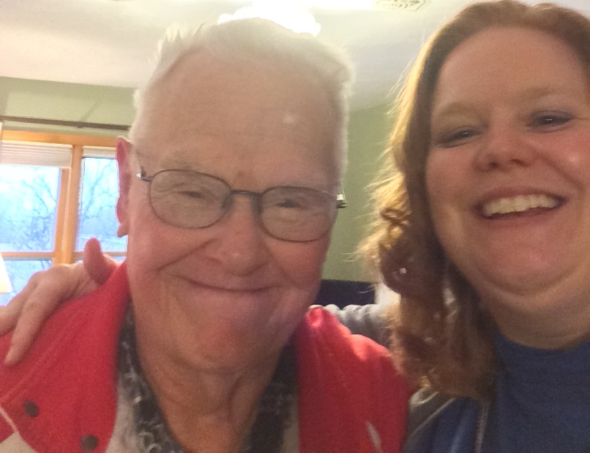
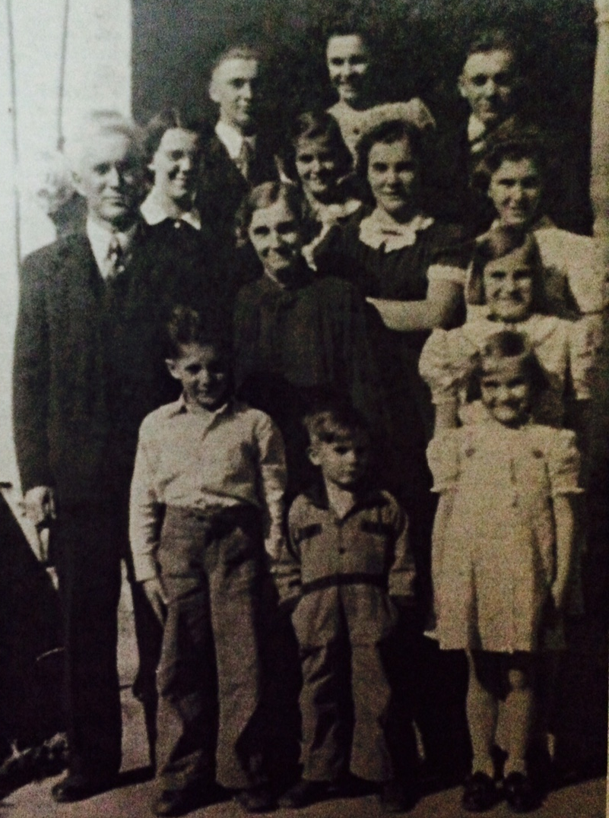
Elder Interview
Notes:
The next assignment the students worked on was an Elder Interview. We liked that this assignment incorporated interview skills and highlighted that doing research doesn’t always mean consulting databases or reading books. The students could choose any elder and do either a phone or in-person interview. We provided a list of suggested questions from which the students could choose. When they were finished interviewing their elder, the students wrote a short reflection paper detailing what they learned.

Slide 8
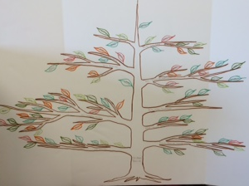
Family Tree
Notes:
When people think of genealogy research, most people think about their family tree, so, at this point in the project, we wanted students to create their own family tree. Each person’s family is different, with some students being adopted and some keeping in touch with one side more than the other, so, for this assignment, we wanted to focus on process instead of requiring a specific product. We had students begin with what they already knew and had them use a free online family tree maker called www.familyecho.com to start building a tree. Then, they had to use at least two different resources to build on to what they already knew. Most of them used the Ancestry database in INFOhio and family interviews. We also encouraged them to be created in how they represented their family tree for their final product.
After we finished presenting this to the students, our teaching team also had a discussion that next time, we’d also like to inspire students to think outside the traditional mindset of “family tree” and inspire them to also consider different formats to represent their family…for example, possibly: a family quilt, a family garden, or some other image that might show how their family is related. Giving students options and inspiring them to think creatively about how they use and present the information they have collected during research has proven to be a very important component of making research personal for the students and encouraging them to take pride and ownership over their work.

Slide 9
Autobiography Photo Story
Notes:
One of the final pieces students were asked to create to bring together all of the components of their research was an autobiography photo story. For this project, students were asked to use personal photos to illustrate 4 different events from their life. Throughout this projects, students had been investigating family history and family stories. For this piece, it is bringing it back to relating to them personally…encouraging them to think about artifacts (photos and objects) and how those items help them tell their personal story.

Slide 10
Parallel Assignment:
Self-Selected Reading Biography
Notes:
The teaching team that I work with believes strongly in providing “model texts” for the students. For this project, they required students to read a biography or autobiography of their own choice which they would read as a parallel assignment to the research pieces they were doing for the genealogy project. The goal here was to provide students model of how other people told their stories and how family histories shaped the lives of people the students considered role models.
There was a lot of student choice embedded in this assignment, as well, in that students selected their book and then could select any 4 out of 16 choices representing creative and expository writing, visual representations, and miscellaneous expressions demonstrating what they learned from their reading.

Slide 11
Students’ Final Reflections and
Self-Selected Pieces
GoAnimate video describing Coat of Arms
Family Recipes Books
Letters to their future selves.
Portfolio of artwork that represents personal interests
Slide show describing the most important people in their life.
Playlist of music that represents their family
Video slideshows of family pictures
Notes:
Once the students had completed all of these pieces, we moved into the final reflection mode, in which they look back over everything they had created and learned. They were asked to write a final reflection tying together everything they learned and then create something that reflected what they learned. We called this final creation their self-selected piece. They were allowed to take it any direction they were inspired to go: one student used family recipes to help tell about different people and memories in his family, one create a musical playlist that represented some important moments in family history, and several students were inspired to create family photo videos with musical backgrounds.

Slide 12
Gallery Walk Presentations
Notes:
To celebrate their research, we set up a Gallery Walk in the school library where students displayed their visual presentations. On their visual presentations, students were asked to revise at least 5 of their favorite pieces from the whole genealogy project to revise and compile into a visual display. We had it set up in the library all day and invited parents, teachers, and other classes to come and view the displays.
All visitors were asked to participate in the gallery walk by using post-it notes to provide notes of affirmation to the students. We also had a scavenger hunt/search activity available for visitors that had questions like: Which was your favorite Coat of Arms? Family Tree? Who had the most siblings? Etc.
The students were proud of their work and some other students and teachers were inspired to try similar projects in the future.

Slide 13
A Model for Future Research
Why does it matter for students on a personal level?
What are they called to DO with what they learn in their research?
How is this unique?
Notes:
So, that was how Franklin Heights approached genealogy research, but I hope to emphasize our teaching team has come to realize that it isn’t so much the content of the research that matters, but rather our approach. In our Genealogy project and our other inquiry-driven research projects, we are pushing students to find personal connections to the content in order to make it meaningful and relevant. Then, we are emphatic that students must be asked to DO something with what they have learned, beyond writing a research paper or even doing a PowerPoint presentation for the class. Students must be challenged to synthesize their new knowledge and then use it in way that is meaningful for them: Are they going to create something new, such as composing a piece of music? Are they going to develop websites or PSA campaigns on issues that matter? Even a playlist of music that demonstrates their family relationships. Also, how is this research and learning unique? In the age of Google, we need to push ourselves as educators to create situations in which students must use research in unique ways and to move beyond simple information-gathering. It would be pretty much impossible for students to complete their Genealogy project using Google alone.
Students will still be demonstrating all of the required elements of high-quality research, but they will be doing so in ways that require higher-level thinking and are much more motivating that writing a traditional research paper.

Slide 14
Works Cited
Kuhlthau, Carol Collier. "Inquiry Inspires Original Research." School Library Monthly 30.2 (2013): 5. MasterFILE Premier. Web. 26 Apr. 2015.
Preddy, Leslie and Suzanne Walker, The R.O.A.D I Travel: A Program Model for School Libraries. Online webinar. ALA. 8 Oct. 2014. Web. 12 Apr. 2015. http://ala.adobeconnect.com/p2h0s99i2ye/

Slide 15
Thank You
Jessica Klinker
jessica.klinker@swcsd.us
@klinkereads

