Slide 1
Five Years in the Future:
Maximizing Trends to Meet Your Students' Needs
Miguel Figueroa
INFOhio
Boot Camp
August 2, 2016

Slide 2
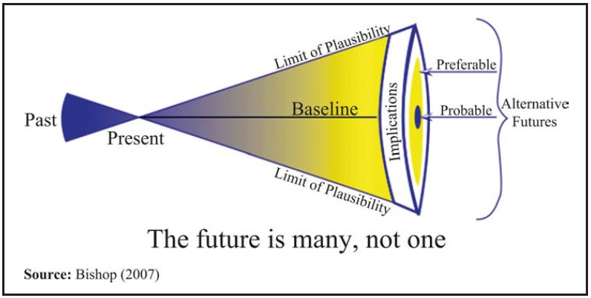

Slide 3
“Foresight is thinking ahead to
how trends, issues, and develop-
ments that can be observed in
the present are likely to shape
alternative futures
What are the key forces that
are shaping the future?
What might be their possible outcomes?
What implications could they have for the learning and actions that must happen in the present?”
Marsha Lynne Rhea. Anticipate the World You Want: Learning for Alternative Futures. Scarecrow Education: Lanham, Maryland. 2005. p. 21

Slide 4
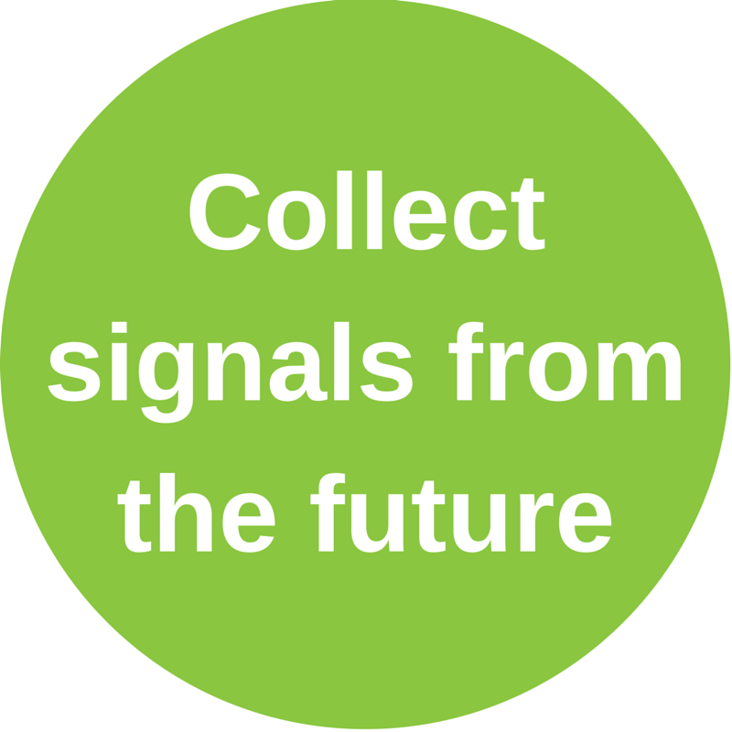
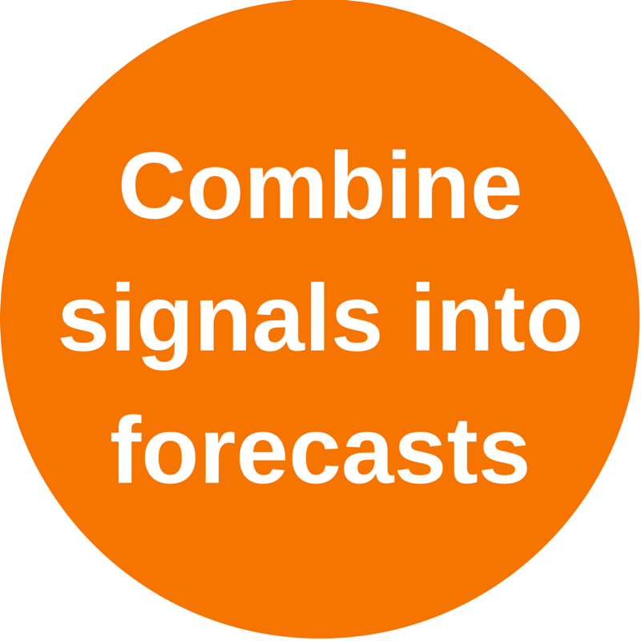
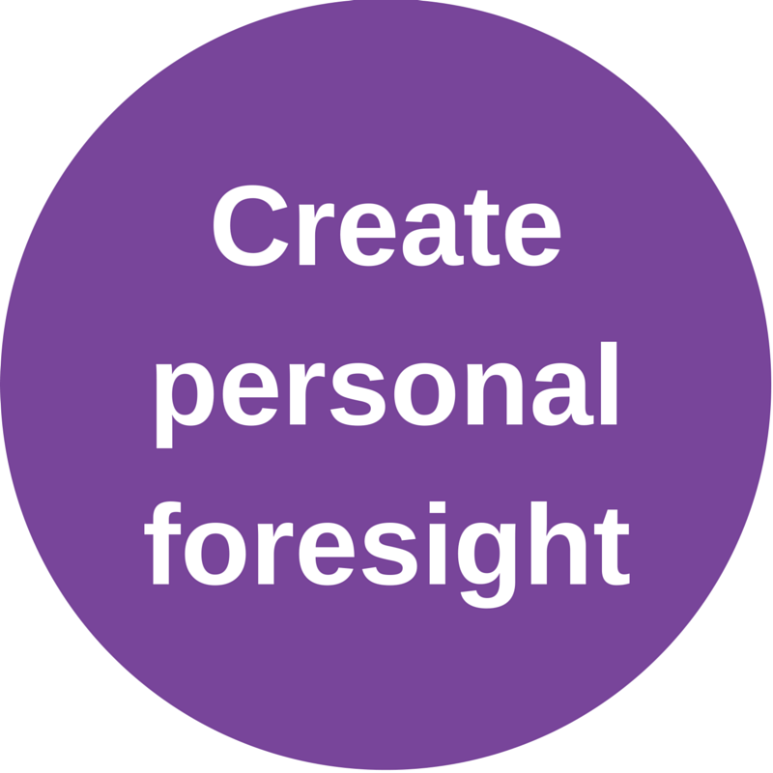
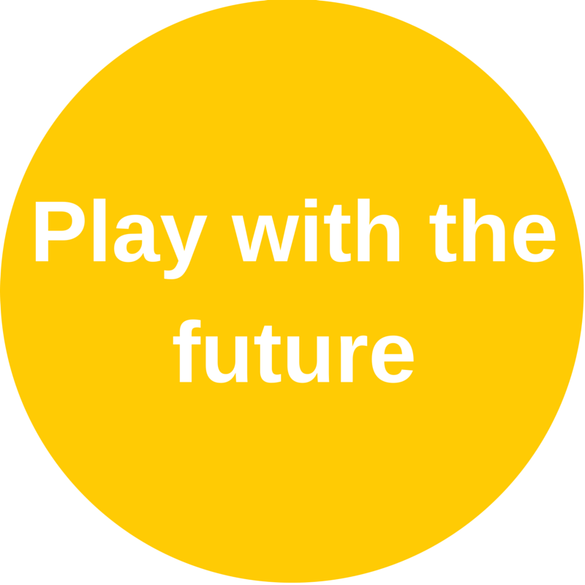
4 Steps From
Jane McGonigal

Slide 5
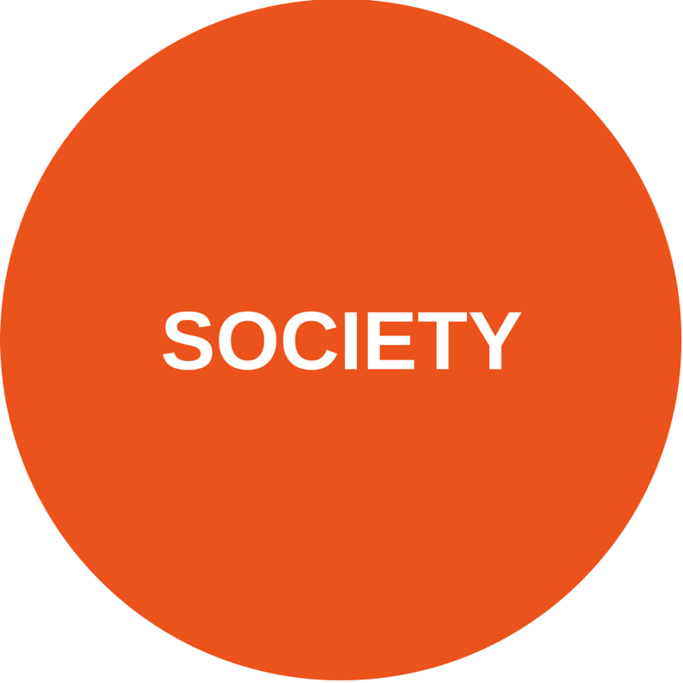
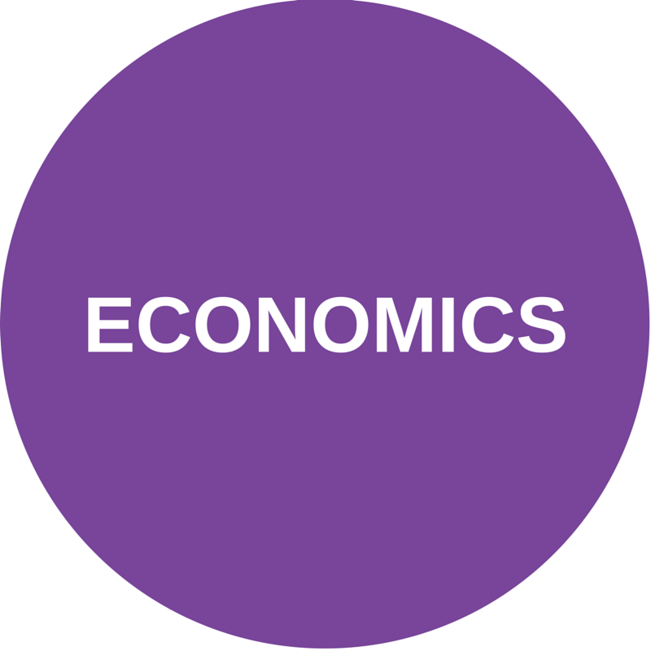
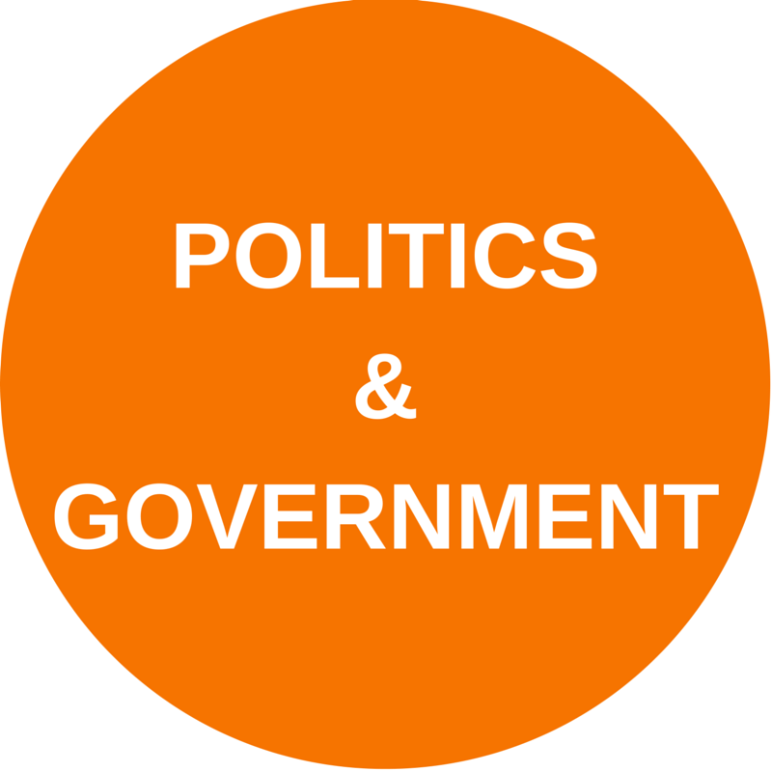

Slide 6
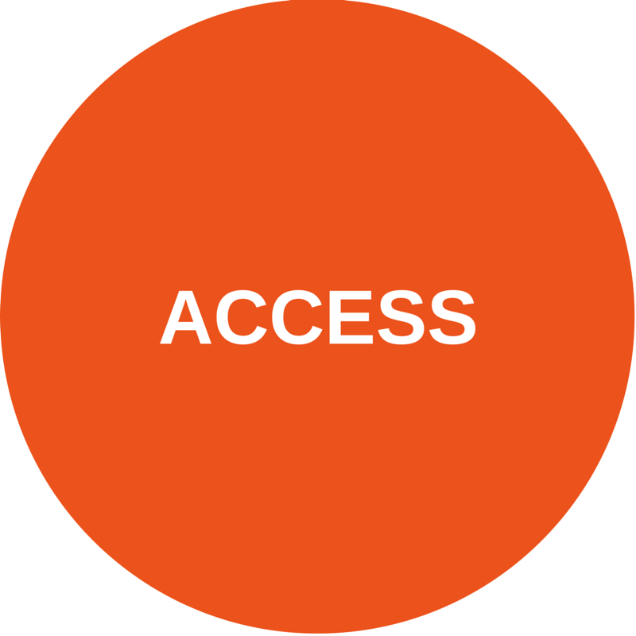
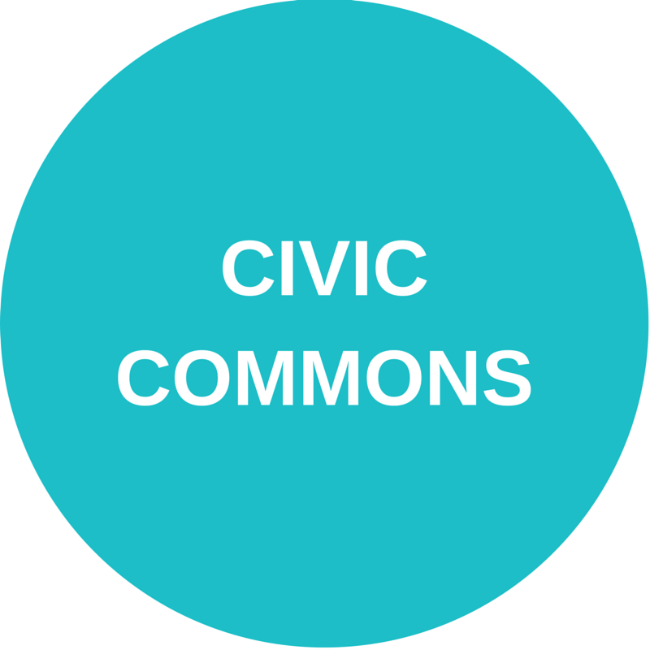
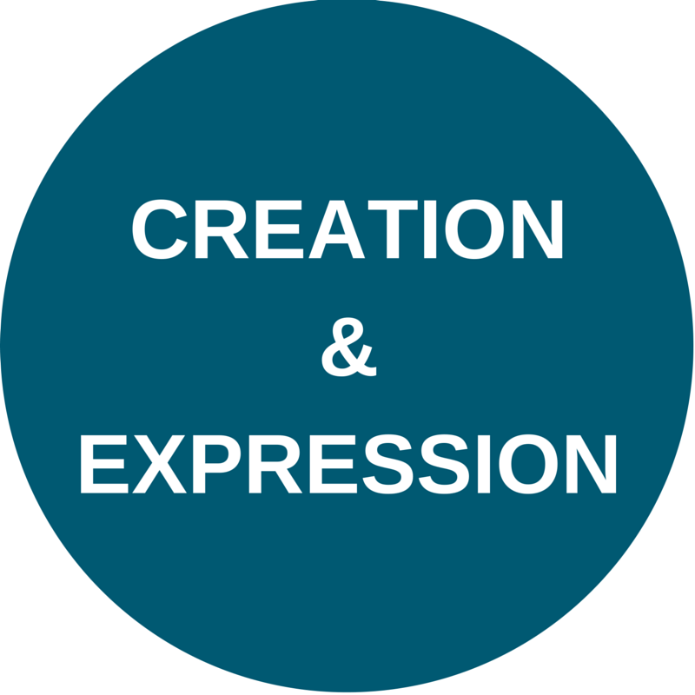
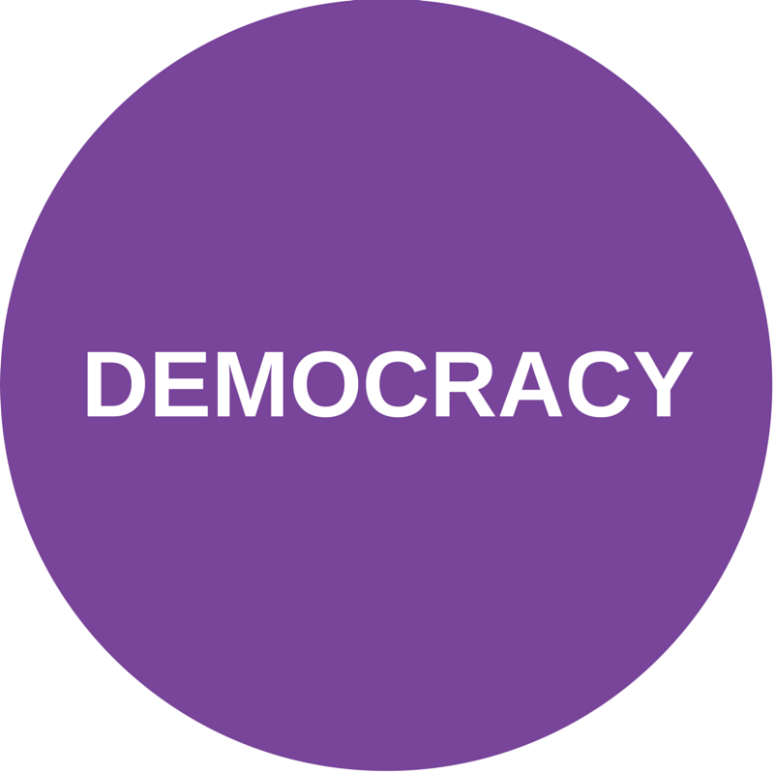
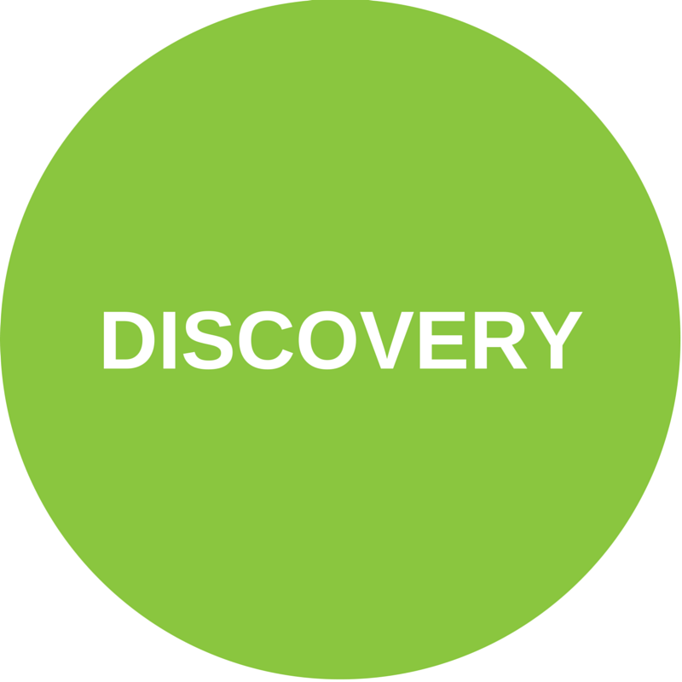
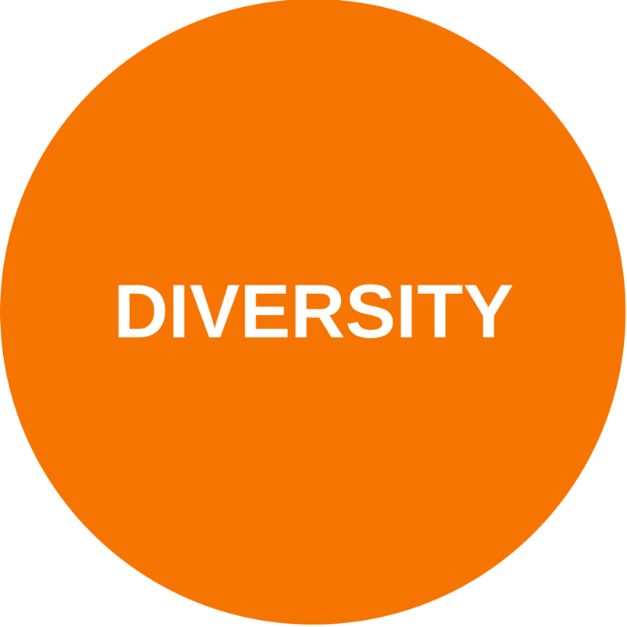
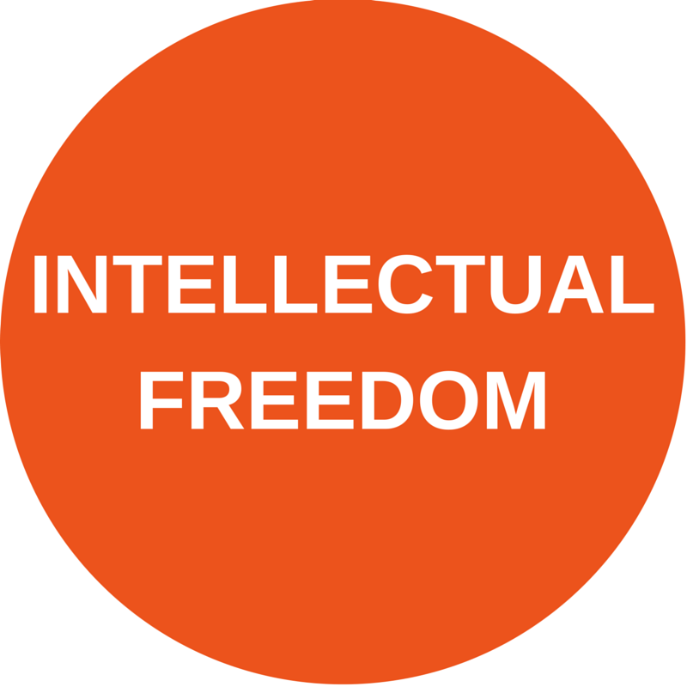
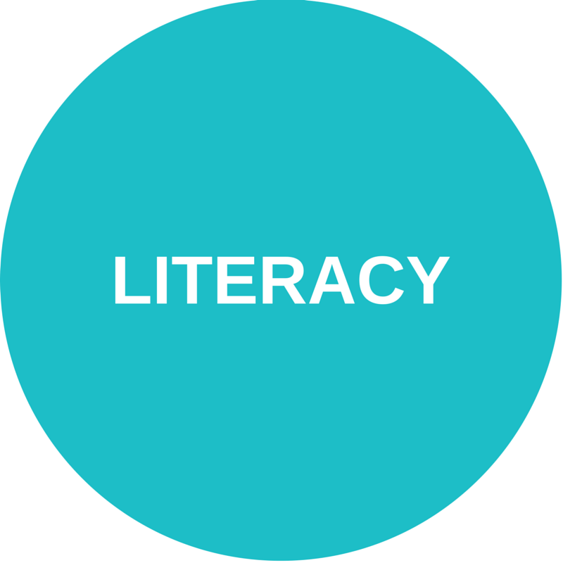
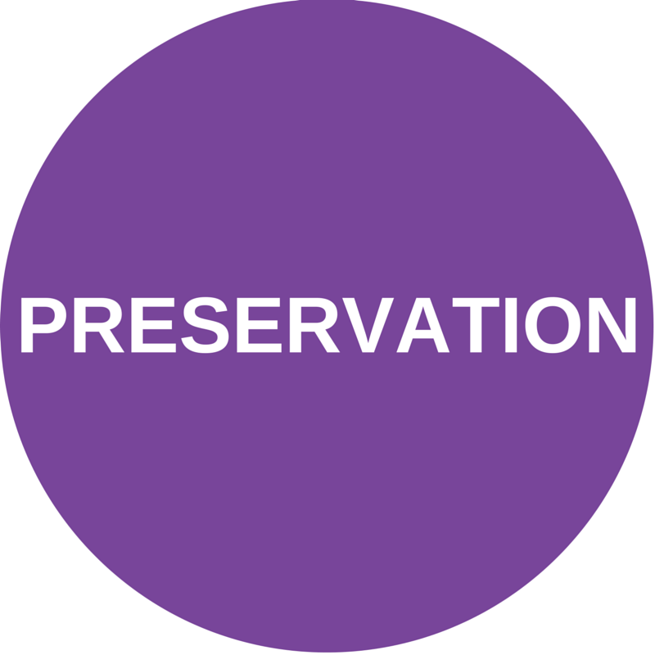
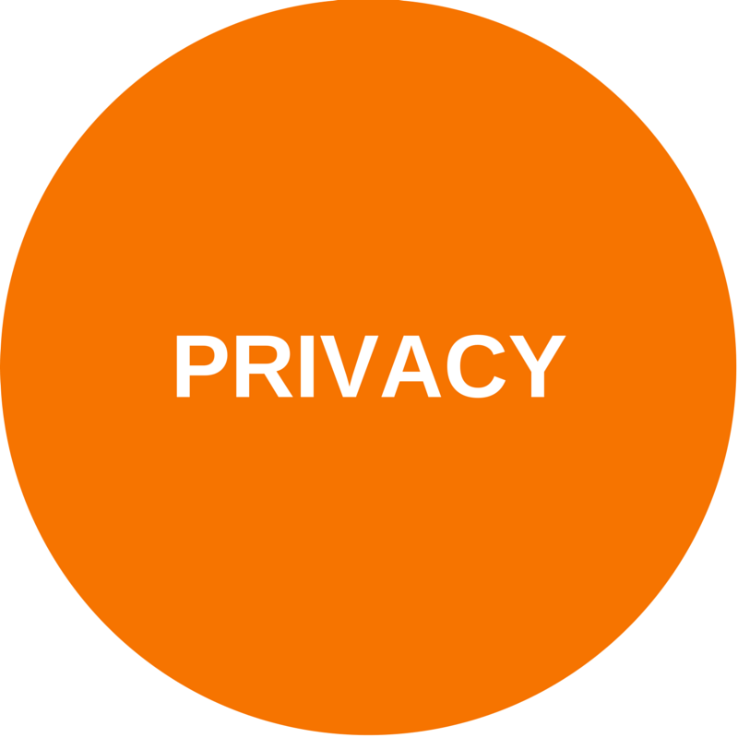
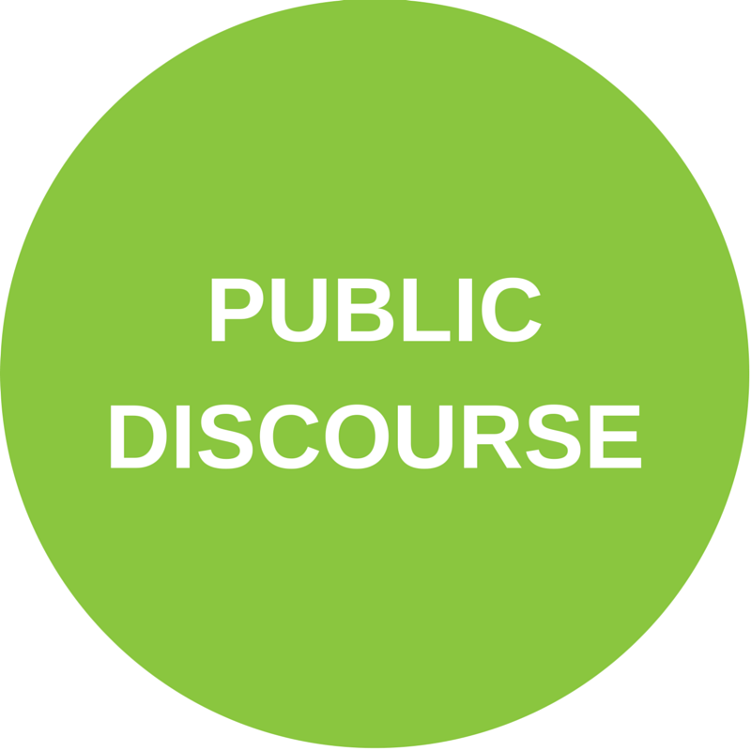
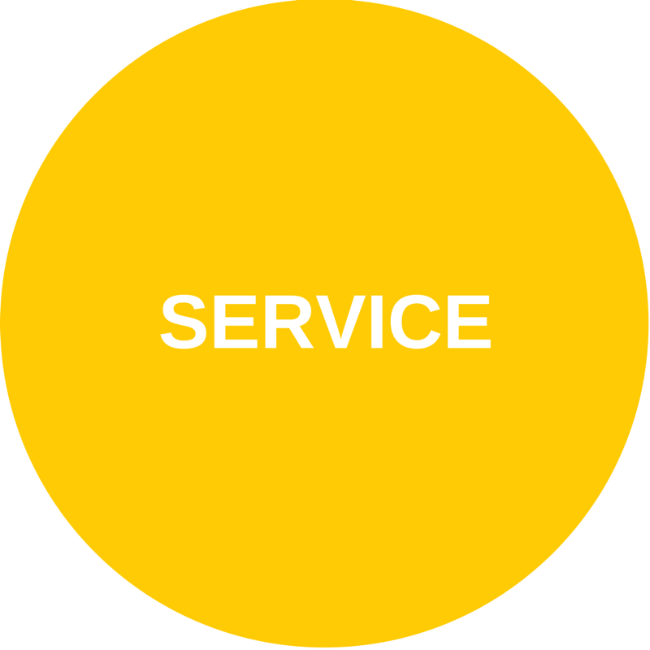

Slide 7
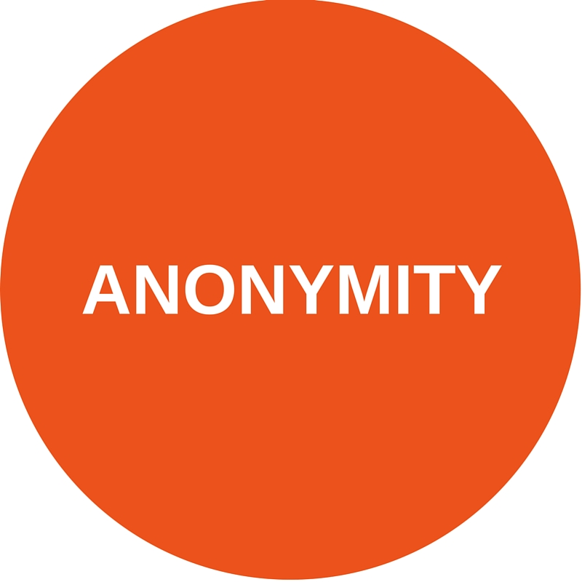
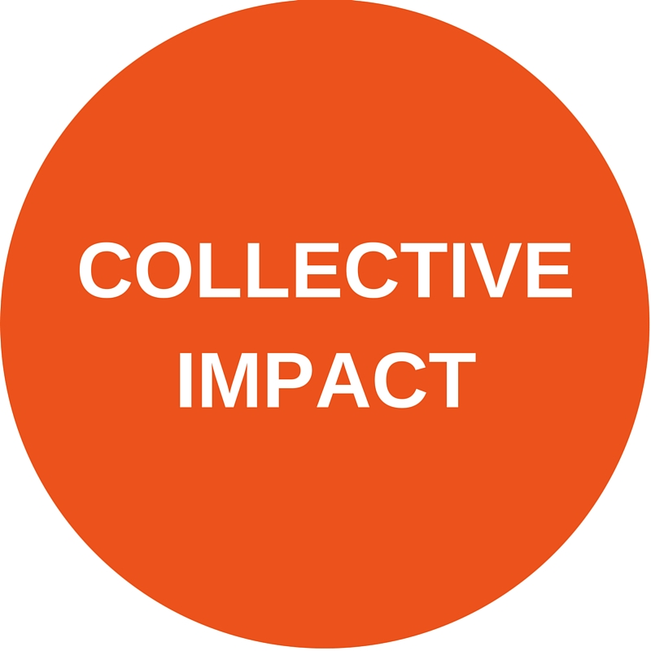
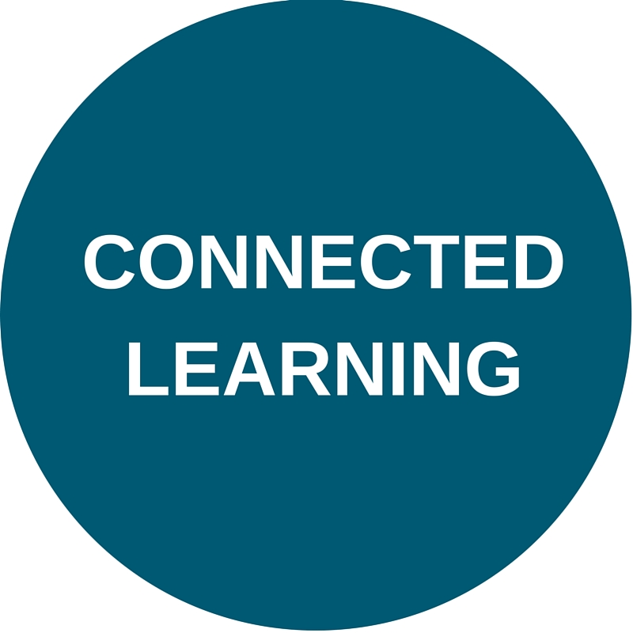
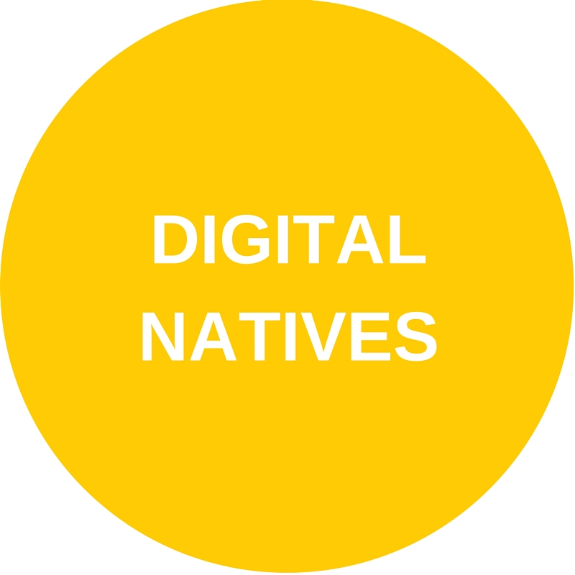
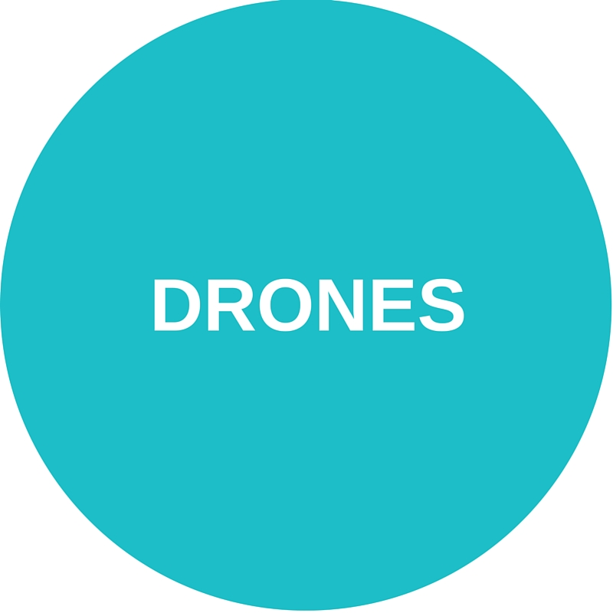
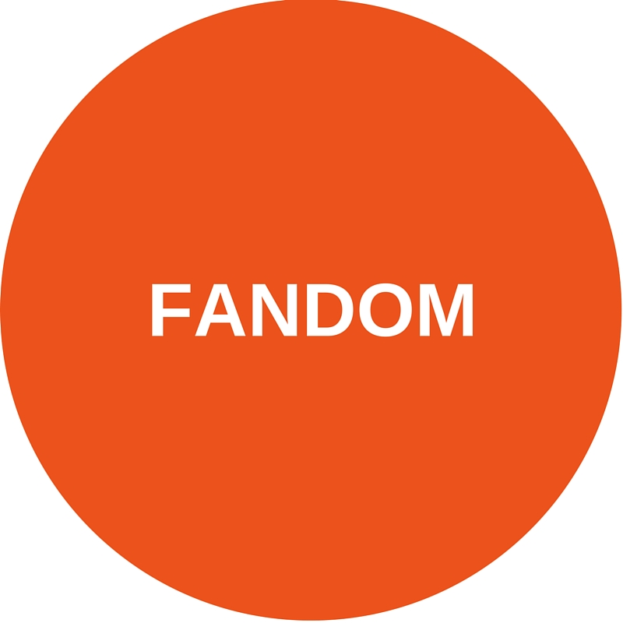
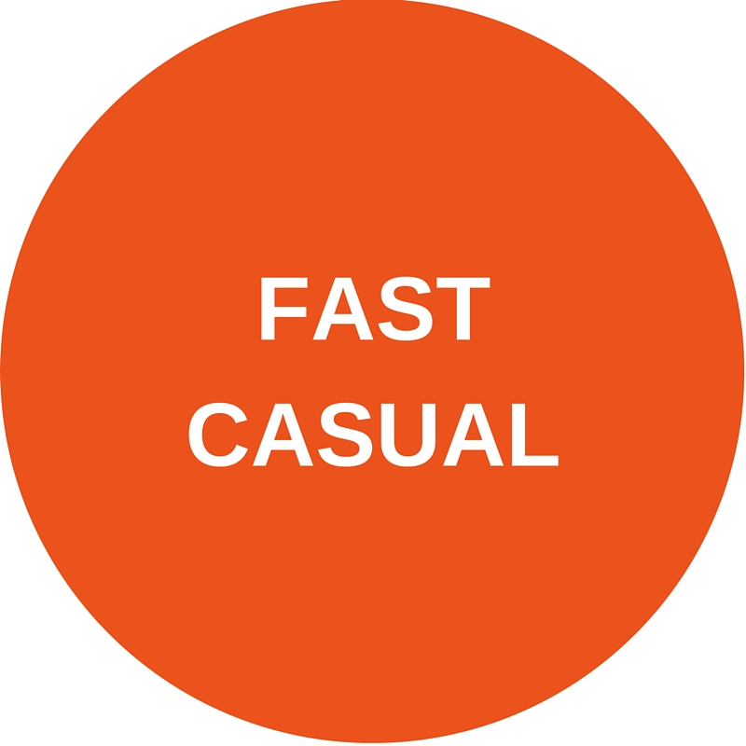
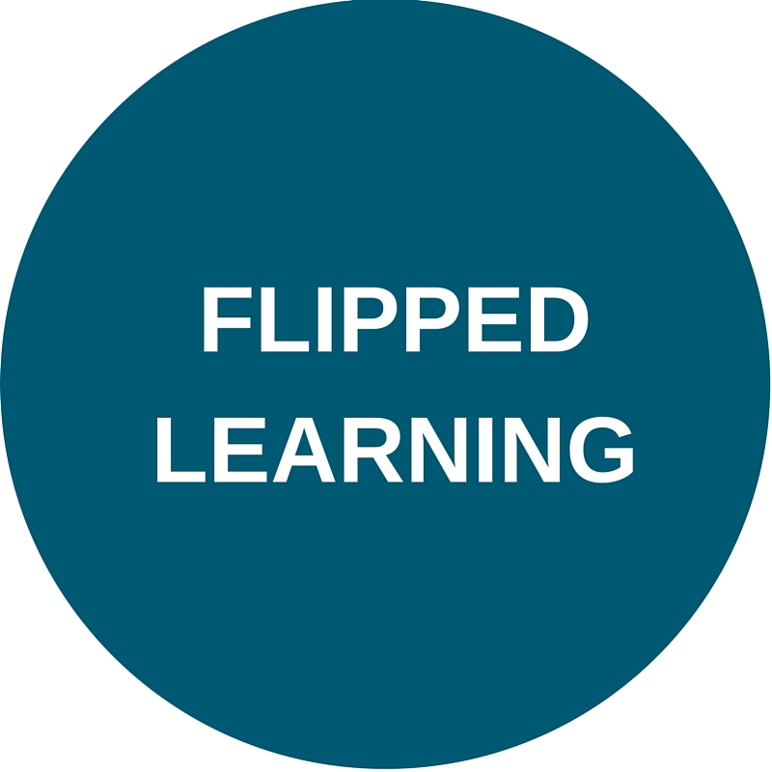
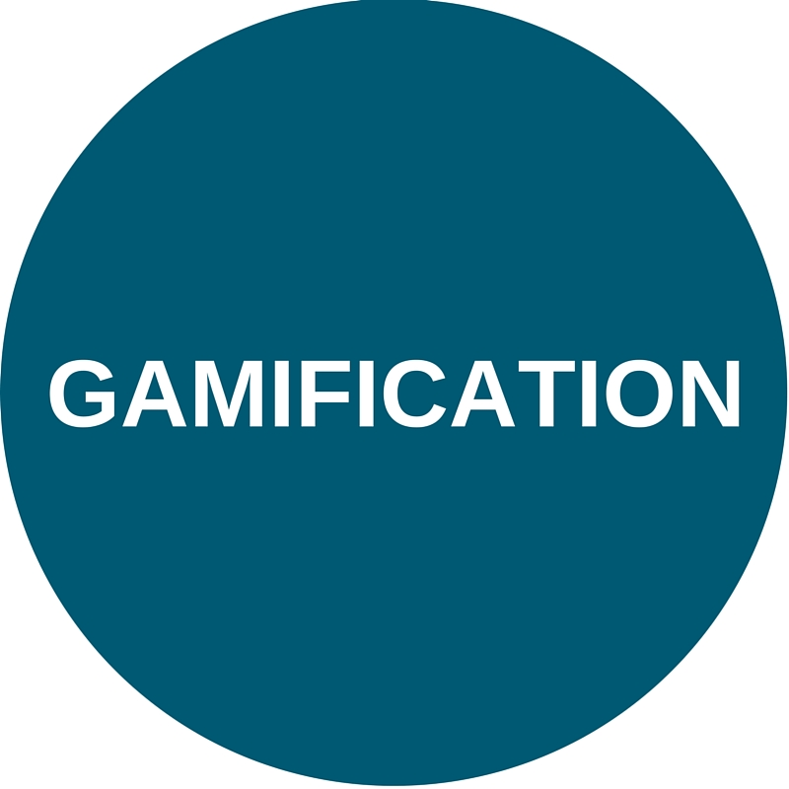
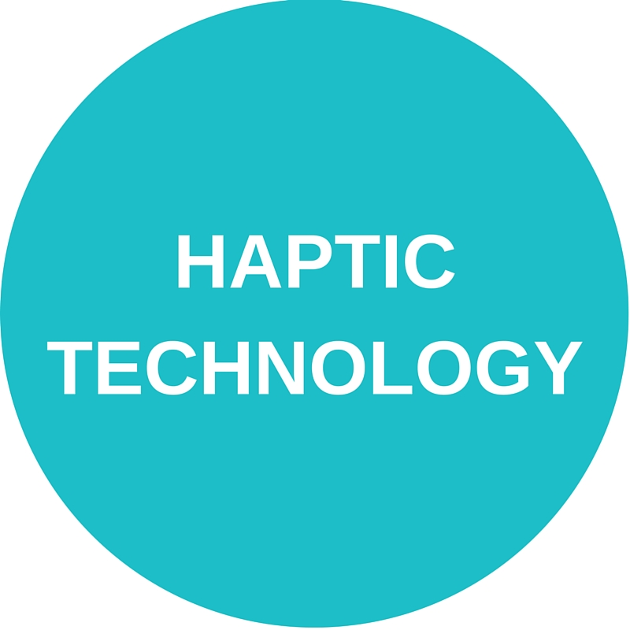
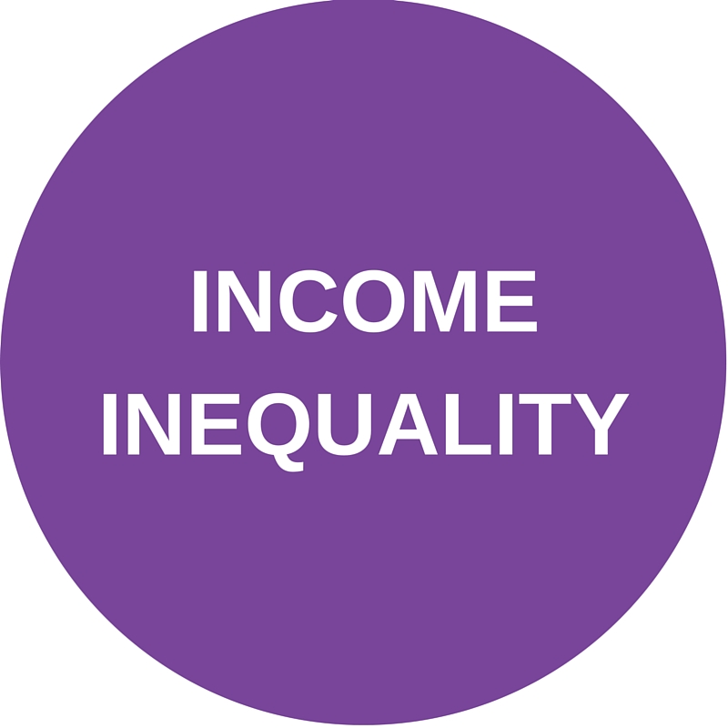
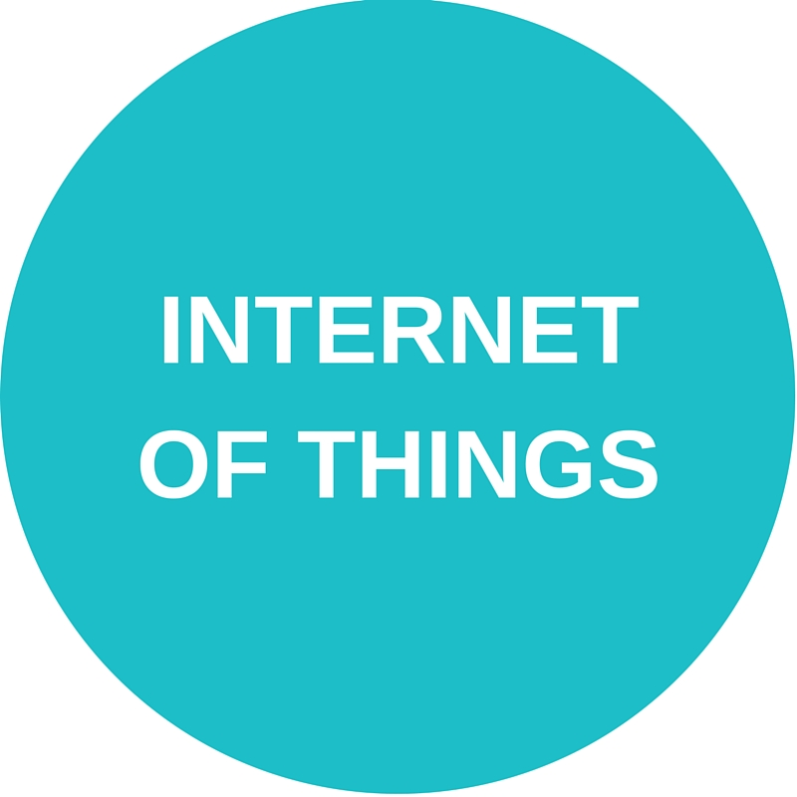
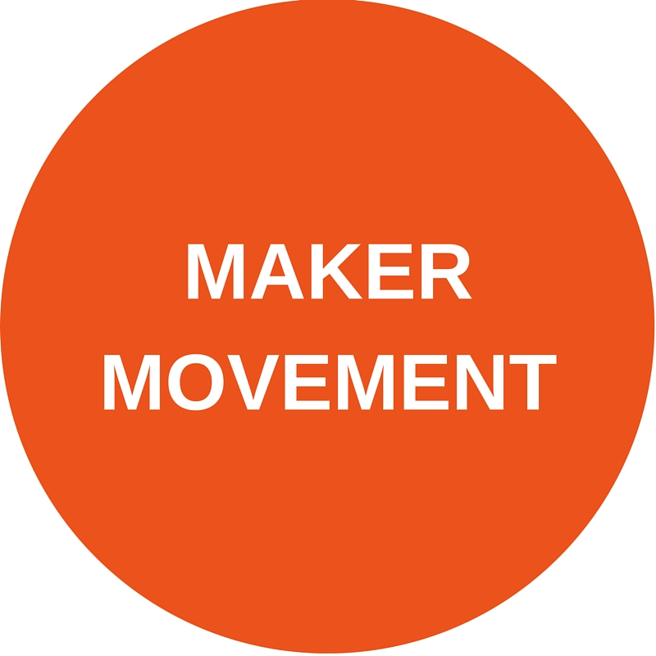
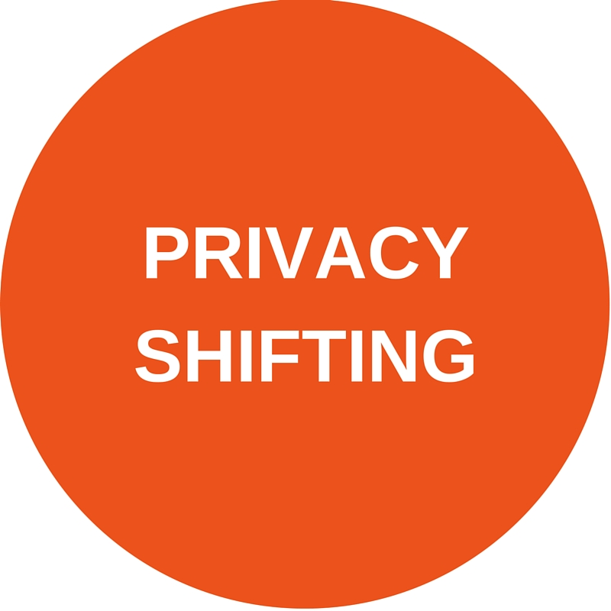
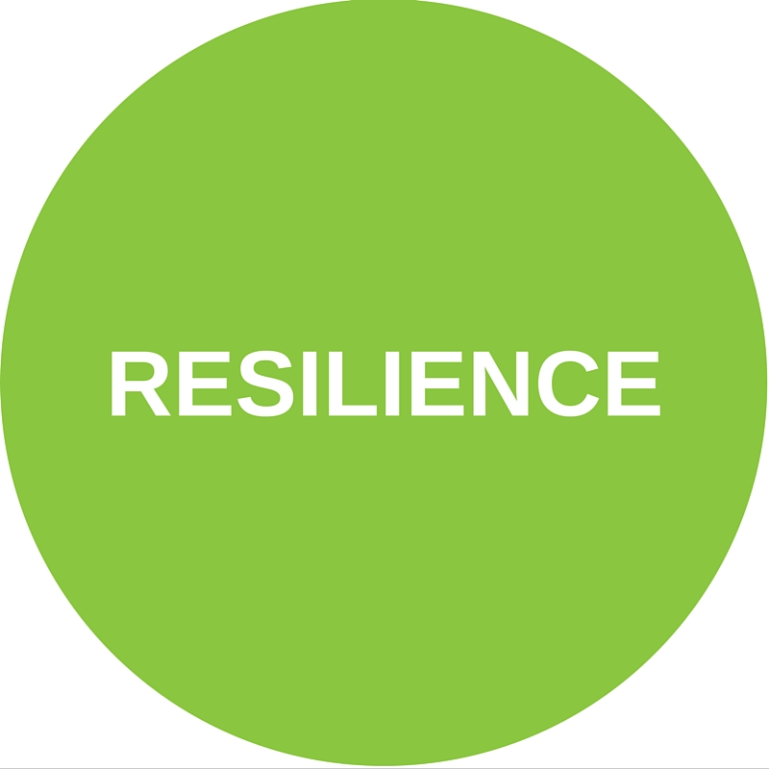
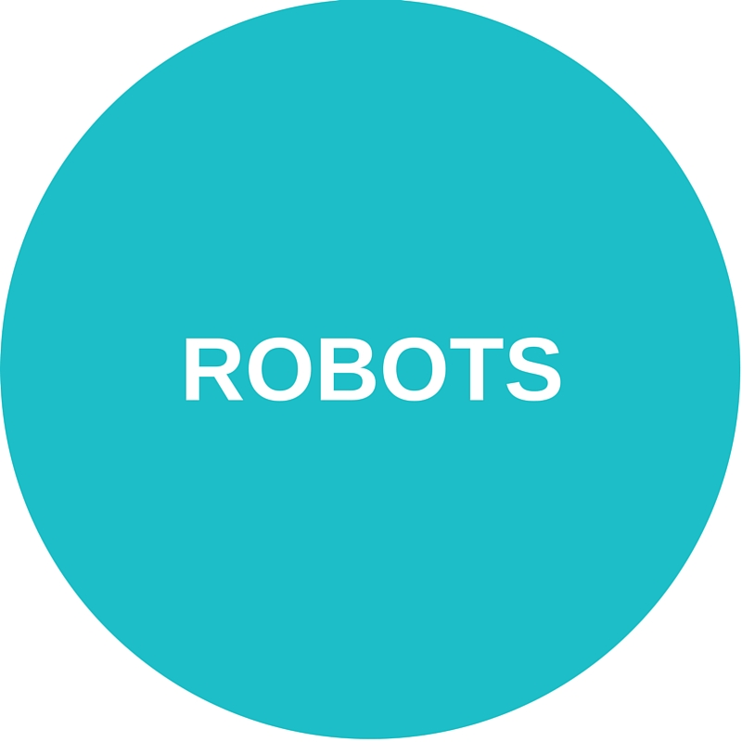
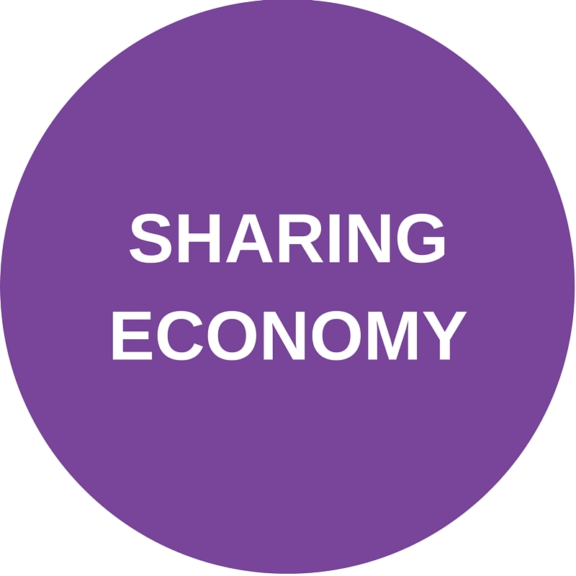

Slide 8
Fandom refers to a community of people who are passionate about something, whether it’s a film, a band, a television show, a book, or a sports team. [1] The growing availability of media and social networks have provided individuals more opportunities to discover content and then more easily find groups of like-minded people with whom they can share and exchange proof of their fandom (discussions, writing, art, etc.).
How It’s Developing
For many, the idea of fandom may be most readily associated with the television series Star Trek and the Trekkies who led letter-writing campaigns to extend the series and attended conventions where they met the actors and creators of the series. Fandom, however, might find even earlier origins in the Lisztomania frenzy over the pianist Franz Liszt, the fans of the Sherlock Holmes detective stories, die-hard sports fans, or even the music fandoms of Sinatra, Elvis, or the Beatles.
Why It Matters
As cultural institutions that preserve and provide access to books, video, music, and an increasing array of media, fandoms may be obvious partners in promoting literacy, engagement with culture, and media creation.
Fandom increasingly assumes active creation – writing, recording, drawing, remixing, role-playing – rather than just passive consumption of media. [13] This could make it an important space for libraries to design programming and …
Notes and Resources
[1] “The Geek Grandpa: Leonard Nimoy’s Pivotal Role in the Rise of Fandom.” Lynn Zubernis. Raw Story. March 5, 2015. Available from http://www.rawstory.com/2015/03/the-geek-grandpa-leonard-nimoys-pivotal-...
[2] “A Beginner's Guide to Fandom.” Aja Romano. The Daily Dot. August 7, 2012 (Updated July 2, 2015). Available from http://www.dailydot.com/culture/beginners-guide-fandom-fanworks/

Slide 9
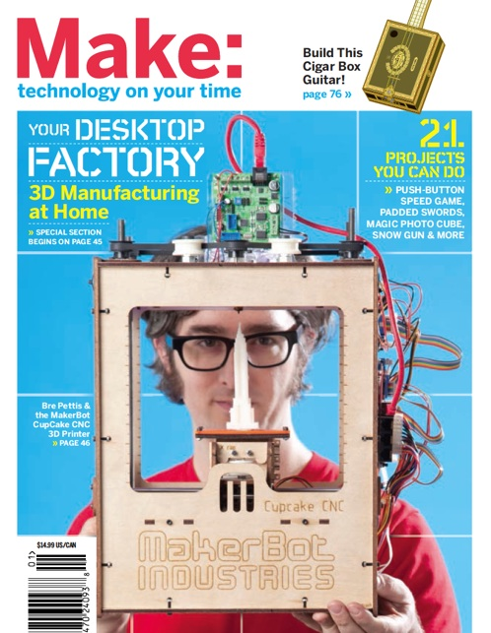
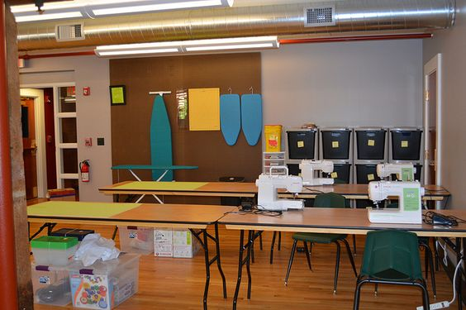
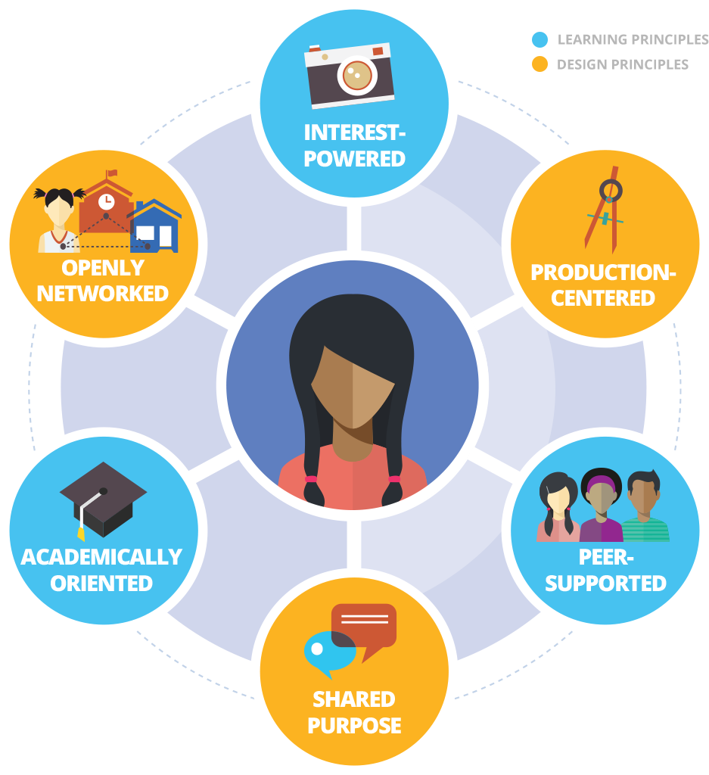
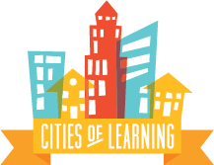
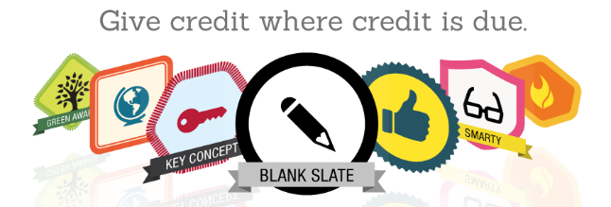
Images (top to bottom; left to right): Make:, Fayetteville Free Library; Connected Learning Alliance, LRNG; Credly

Slide 10
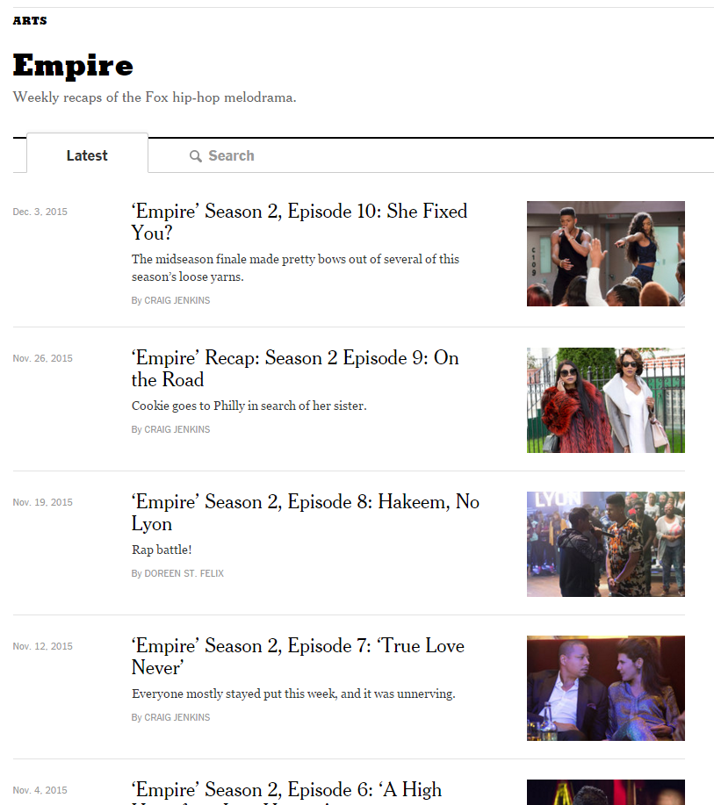
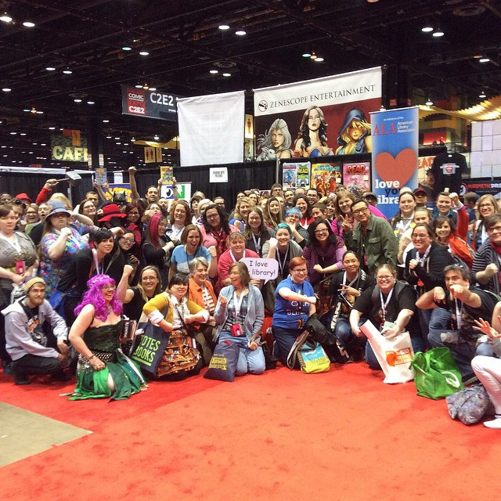
Images (top to bottom; left to right): The New York Times; American Library Association, FanFest

Slide 11
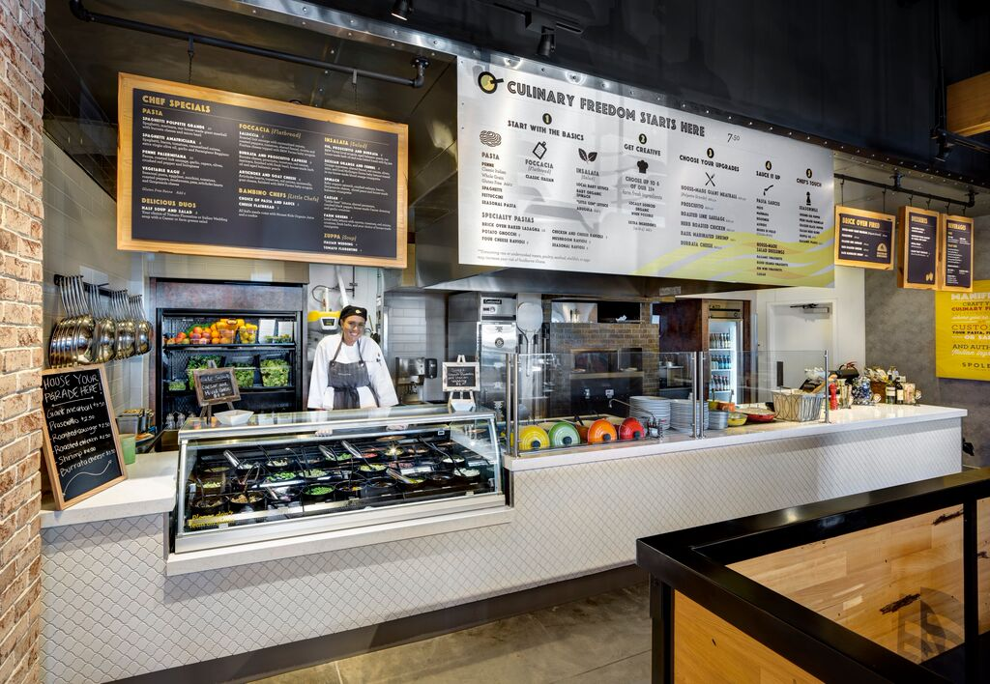
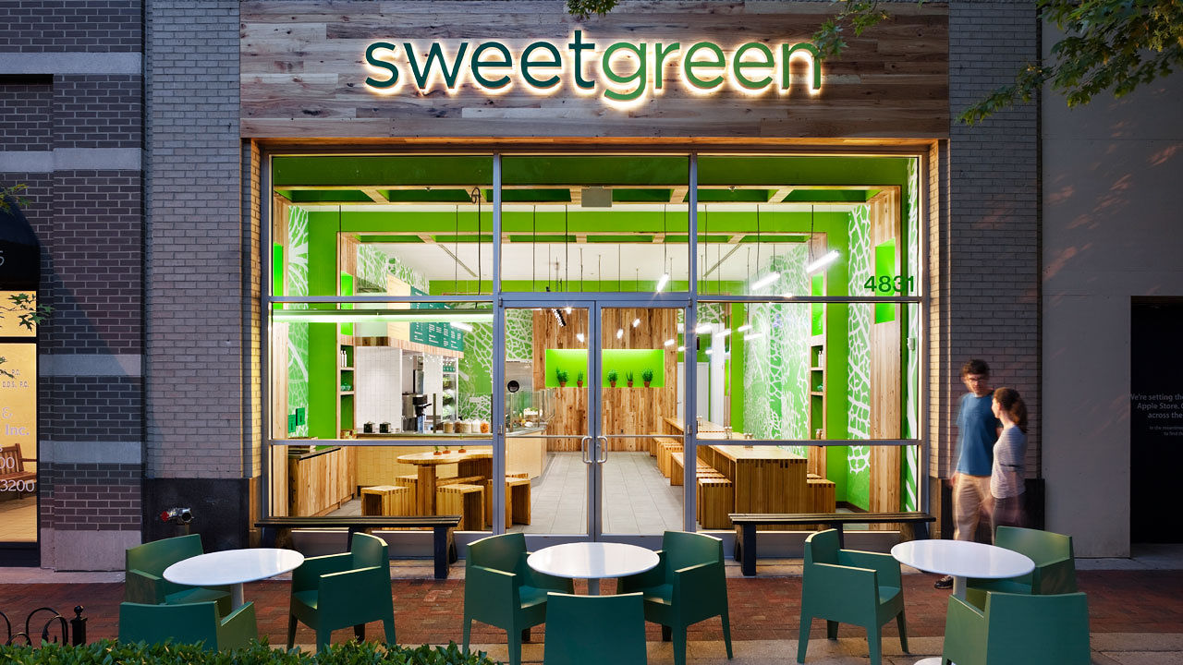
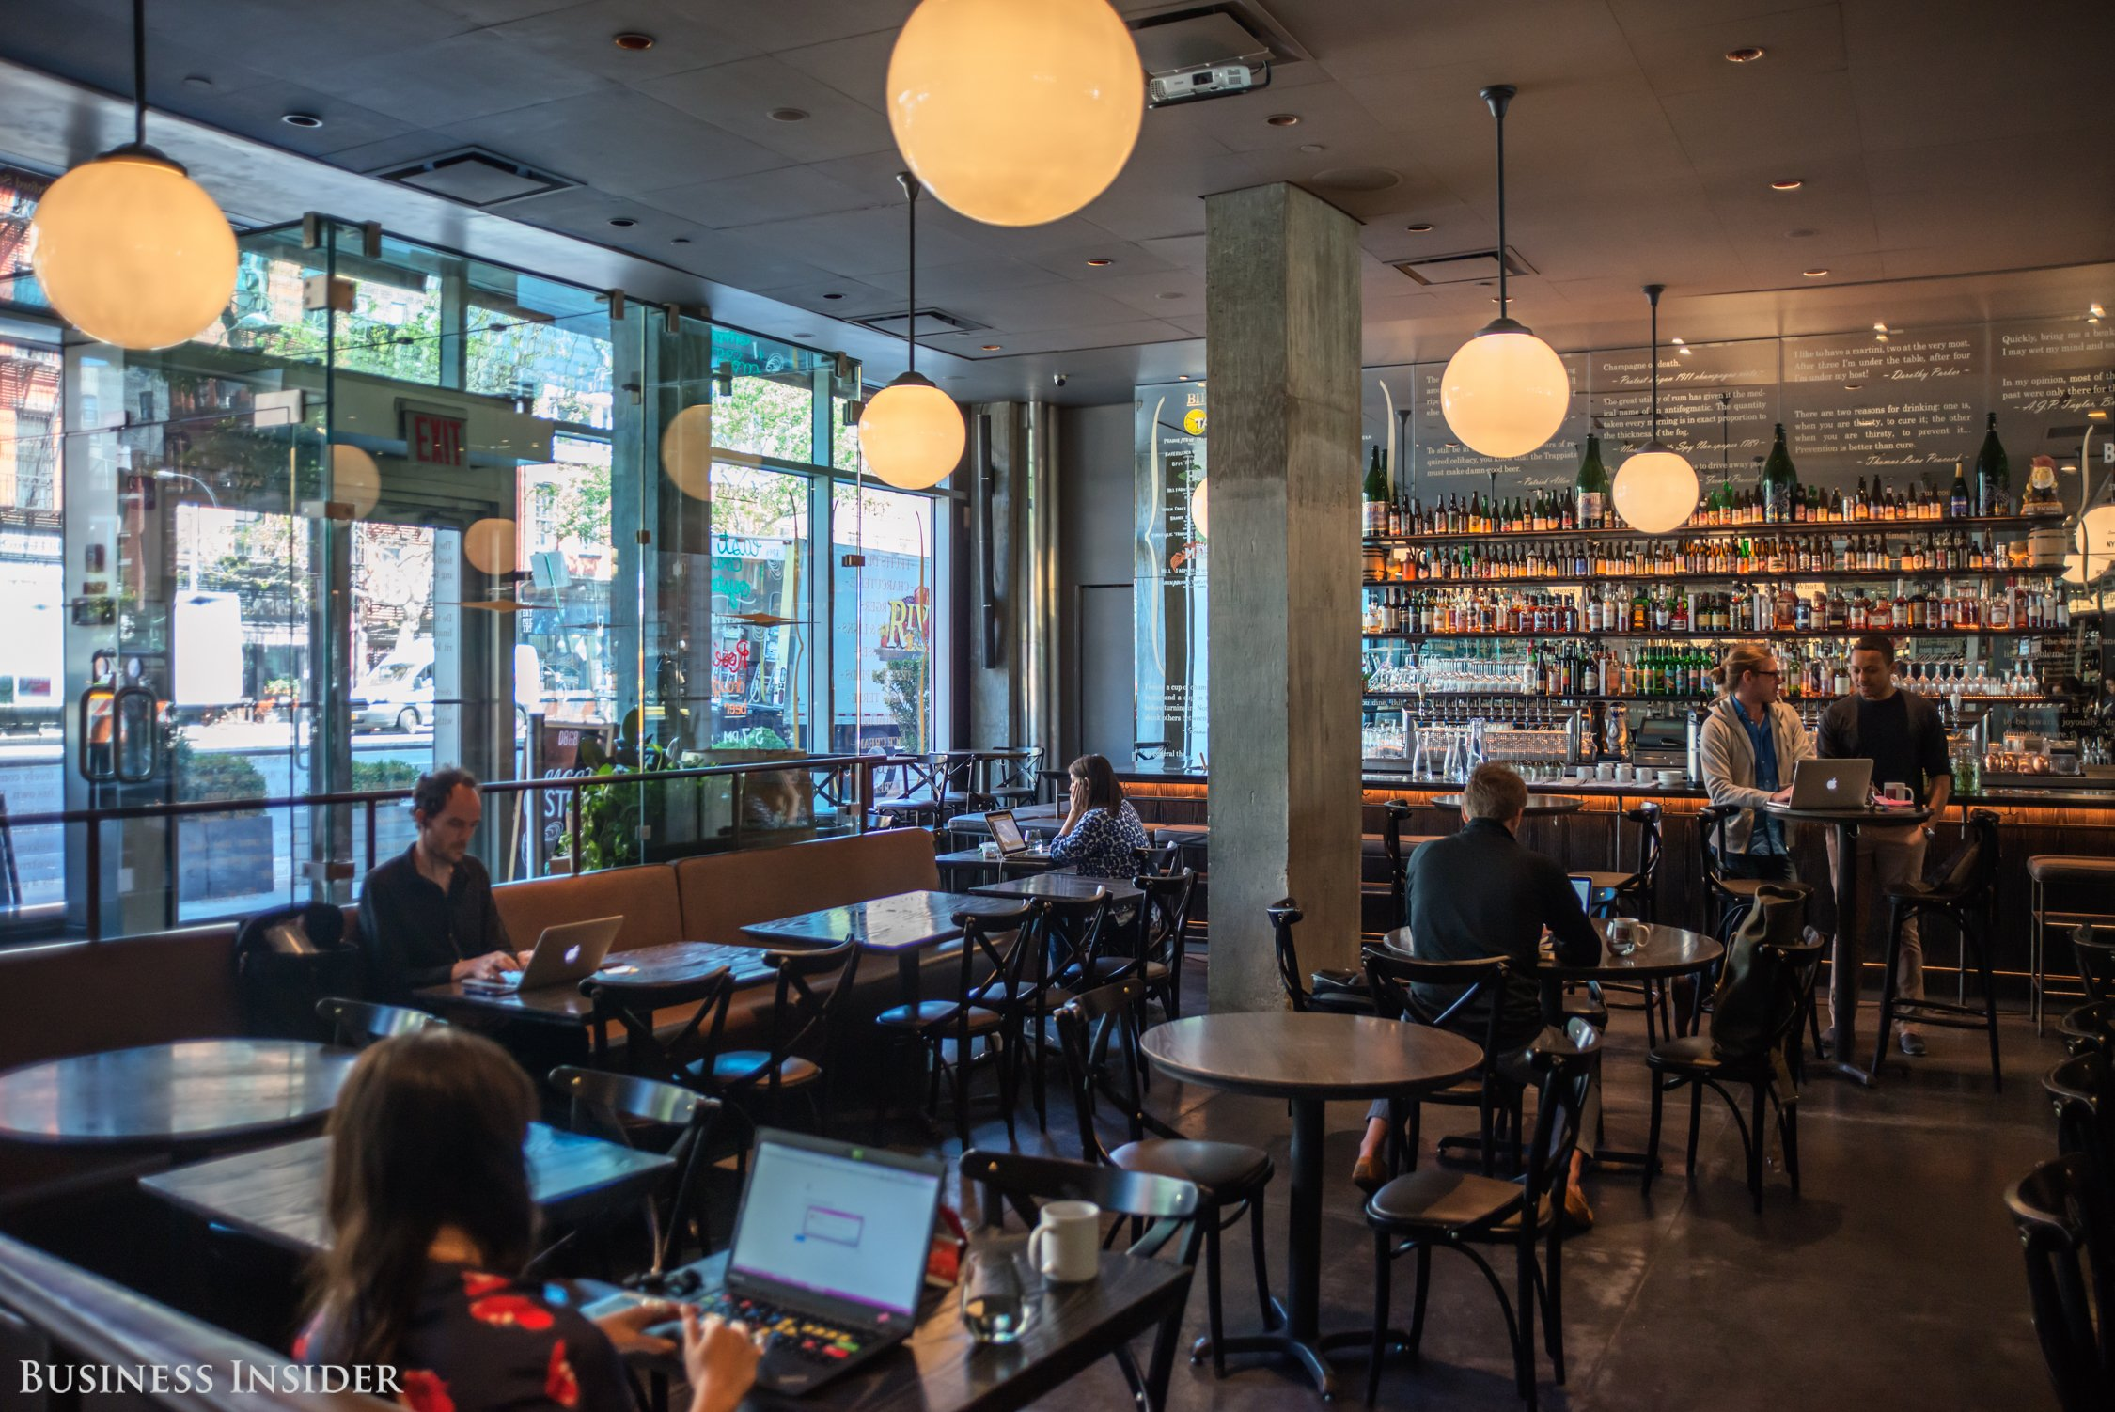
Images (top to bottom; left to right): Fast Casual, sweetgreen; Business Insider (Hollis Johnson)

Slide 12
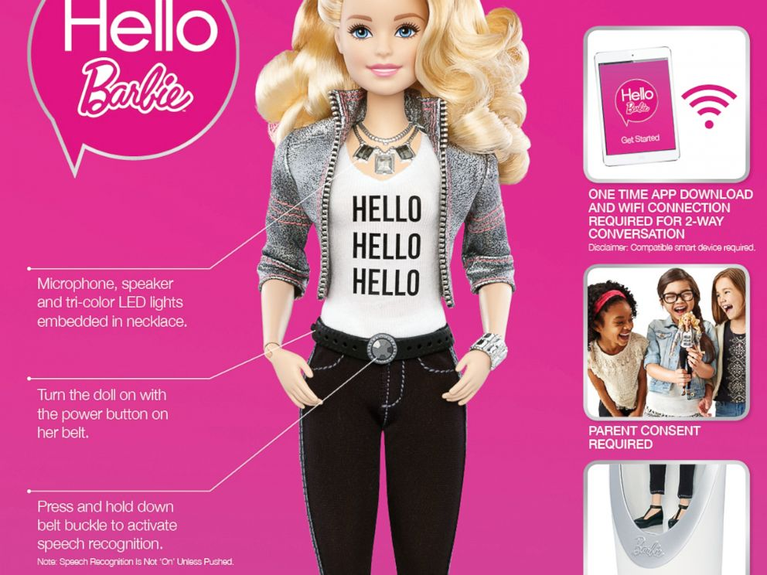
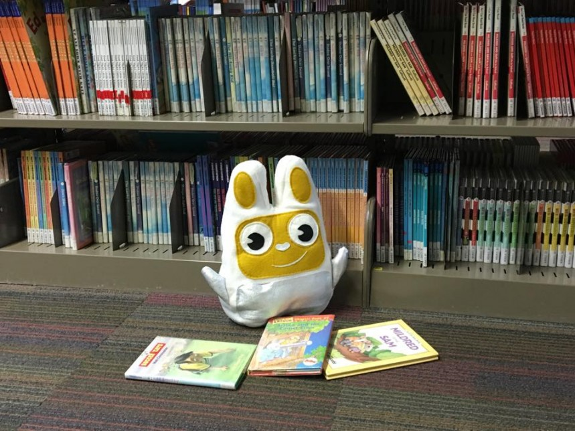
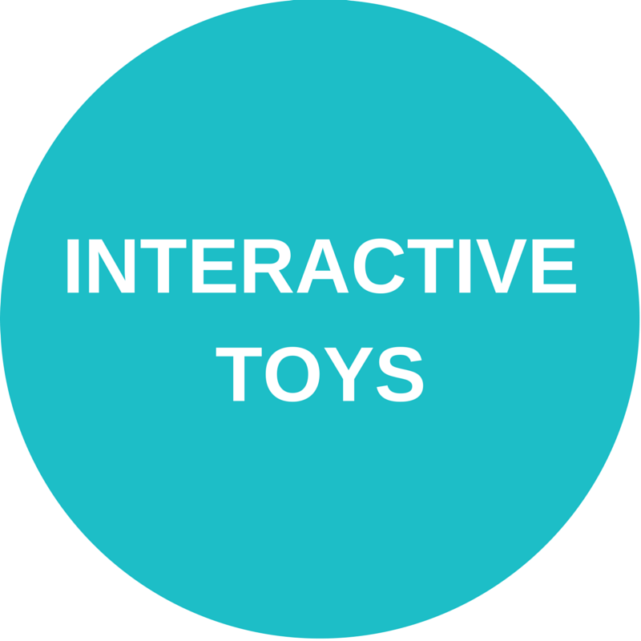
Images (top to bottom; left to right): Mattel, Povi; Samsung Mobile UK

Slide 13
Images (top to bottom; left to right): Digital Detox, Kunihiko Morinaga/ANREALAGE; OFF Pocket

Slide 14
Images (top to bottom; left to right): Disney on Broadway; Mattel; The New York Times, Creative Review

Slide 16
We have to become collaborators
for the future
Respect and integrate know-
ledge and practice across
multiple disciplines into greater
understanding and performance
Generate new thinking that leaps over present problems and limitations
Unify individual perspectives and strengths into collective intelligence
Marsha Lynne Rhea. Anticipate the World You Want: Learning for Alternative Futures. Scarecrow Education: Lanham, Maryland. 2005. p. 67

Slide 17
Miguel Figueroa
Center for the Future of Libraries
American Library Association
mfigueroa@ala.org
www.ala.org/libraryofthefuture

Slide 18
Group Activity
Open Five Chat Windows
Fandom
Fast Casual
Interactive Toys
Unplugged
Virtual Reality
Comment on how you see these trends shaping the library of the future

