Slide 1
Getting the most from LOCAL searching
Notes:
Intro –
Me – librarian since 2005, 30+ years as an educator Full time library media specialist at Elder High School in Cincinnati. My second year there about to begin. All boys, 860 students.
Why I love Isearch
Fewer clicks – more likely to use quality resources
Customizable makes it work for my goals
Possibility for additional resources to be added in the future
Today’s Goals
Know how Isearch works
Know how to set up a Book River
Have some ideas about how to use Isearch in your school

Slide 2
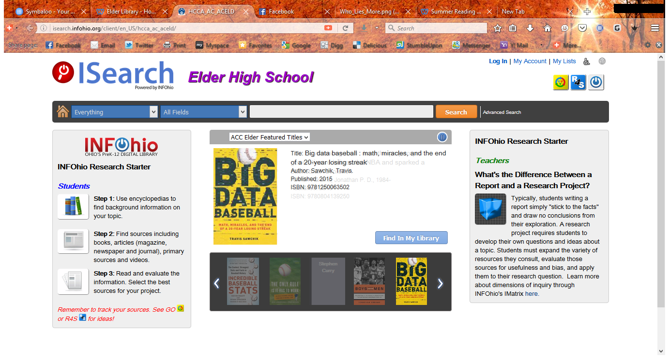
My favorite feature – the Book River. You can go straight to a featured title.
Log in just as you always have
Notes:
Log in – keeping lists
A couple of cautions, hopes for the future of Isearch
Email and printing lists made with Isearch do not include call numbers – an Ebsco issue
Lists can only include library materials. Research Resources cannot be added to same list as library materials. You can print/email entries from your search results in Isearch
(Here we go to Isearch live to explore the Book River)
Choose a book from the River and click Find in My Library. Note features of display – same as regular catalog, except if you are in habit of promoting the rating system (under all content) you cannot access it from Book River/Isearch
Now click on Research Resources – voila – results from both Basic and Advanced sources, and all the functionality of the Ebsco databases
Now, how do you create this book river? (Back to Slideshow screen shot)

Slide 3
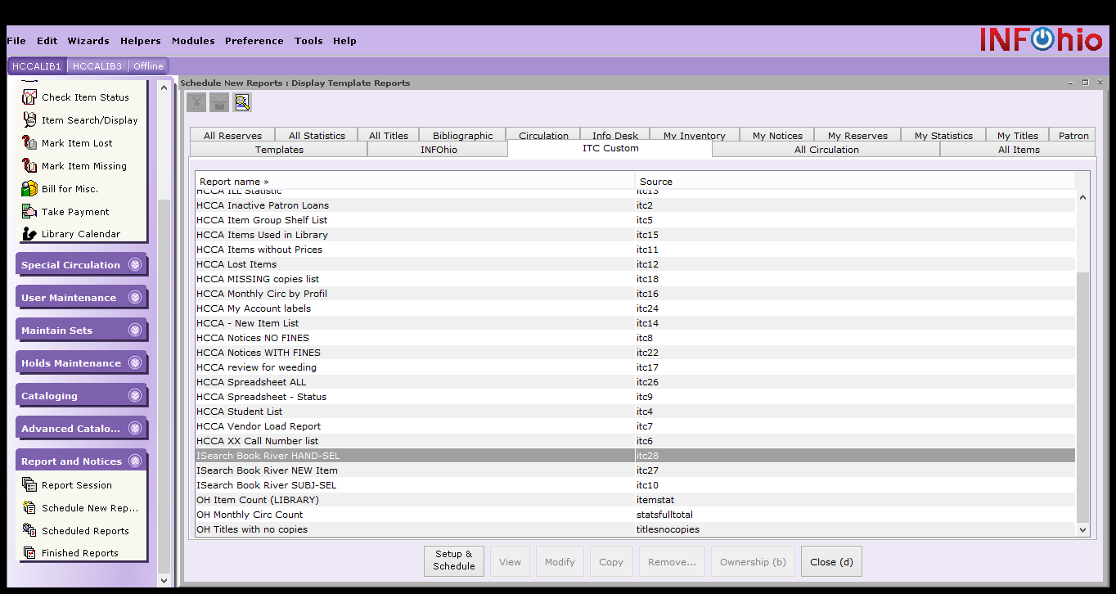
Creating a book river
Notes:
Creating the Book River
There are 3 basic types available
New
Hand Selected
Subject Selected
ITC custom is where you find the template. Materials on InfOhio reference the InfoDesk tab, but ours for HCC are found under ITC Custom -- Go live to this on my computer and show how each can be modified

Slide 4
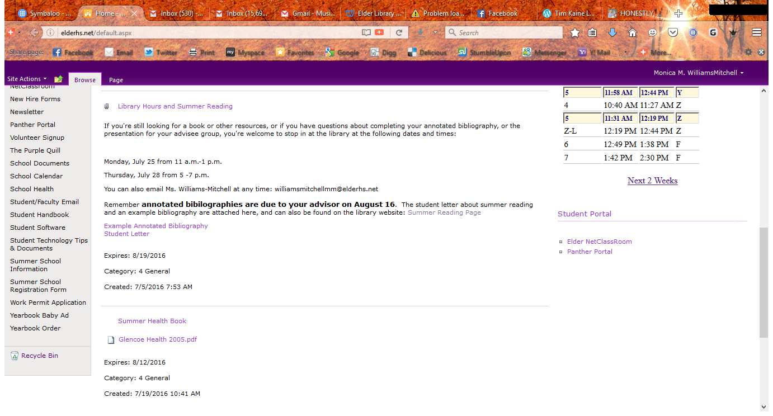
Notes:
Promoting Isearch Local
On our intranet – links
In classes when they come in – have found students pretty receptive to this. They like the idea of finding “all” the info in one place. Emphasizing the added value features helps.

Slide 5
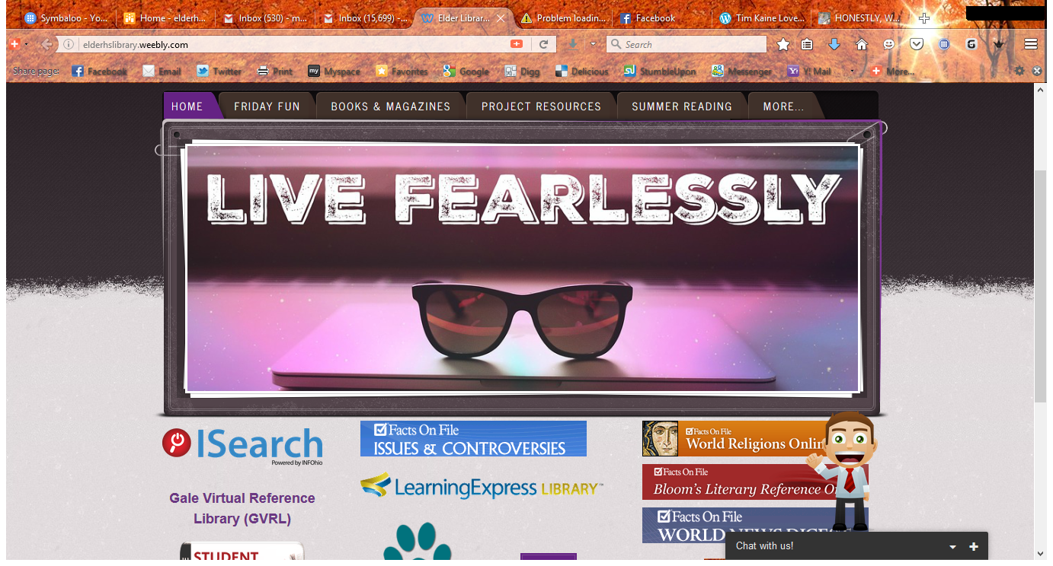
Notes:
Promoting use of Isearch with faculty and students
My crazy looking page – It’s my fearless entry into web creation.
I link to this at least once a week with announcements, emails, etc. Not all are promoting Isearch, but many encourage its use.
Faculty inservice demo
Faculty meeting demo
Our Friday Fun link drives the most traffic to our site, but once there, it’s very easy to get to other things.
We have picked up tweeting, and also have announcements on the video board in the cafeteria and the one in the library.
My plans in the fall include creating an Isearch badge for our mobile computing class., and this fall I can have all the freshman students use it when they come for orientation.
Our summer reading program encourages its use as well.

Slide 6
