Slide 1
Don’t Become a Library Zombie
Use Your ILS to Survive
The Genrefication Process
Notes:
Introduce yourself. School librarian and HCCA provider. Both sides of the process. Used Destiny.

Slide 2
SURVIVAL TIP #1
PLAN WITH THE
END IN MIND
These strategies will save you
time and frustration.

Slide 3
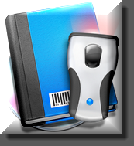
DON’T TOUCH A BOOK MORE
OFTEN THAN NECESSARY
If you are changing spine labels, consider counting this as inventory. Left- over labels and unedited call #s = missing books.
If you aren’t changing spine labels, apply genre stickers or translucent colored labels as you sort!

Slide 4
Work With Vendors to Get
What You Need
Customized cataloging for MARC records, call numbers, spine labels & genre labels is often possible.

Slide 5
SURVIVAL TIP #2
LEAVE SIGNPOSTS
Students must know where to find a book in its new genrefied location.
Notes:
Leaving signposts for your students is the most important step in the genrefication process. You will have handled your books a million times in the last few months and their new organization will seem obvious to you. No so for your students. They will need explicit direction in order to begin using their library in its new configuration. This can easily be accomplished by editing the copy record of each title in your database so that the information appearing in the Online Public Access Catalog or OPAC includes the new location of the book they select.

Slide 6
What are my options?
#1 ADD A GENRE PREFIX TO THE
CURRENT CALL NUMBER
#2 CHANGE THE CALL NUMBER PREFIX TO REFLECT THE NEW GENRE
#3 ADD THE GENRE TO THE CALL NUMBER TO INDICATE LOCATION
PROS
No need to redo spine labels.
Easy to know where to search library for title.
CONS
Need a way to indicate location on book to help shelvers (colored labels & signs?)
Notes:
All of these methods can be done globally but you will need to scan each title in a genre in order for this to happen. I’ve found that using a using a wireless laptop and handheld scanner at the shelves is the most efficient method. It’s probably the same process that most of you use to complete your inventory. As a matter of fact, I actually skipped doing inventory the year that I genrefied. Since I opted to replace spine labels it was easy to identify books in the database that didn’t receive new call numbers. I simply marked them all missing and deleted them.
The first two options require new spine labels. It can be helpful, but not necessary, to apply translucent spine label covers for quick shelving reference and to help your students ID the various genres quickly.
The third option can be accomplished without applying new spine labels, but some indication of shelving location will be necessary. You can use either a genre sticker or a translucent colored label from vendors like Demco or Highsmith.
Whatever you decide, go with what will be most useful to your students.

Slide 7
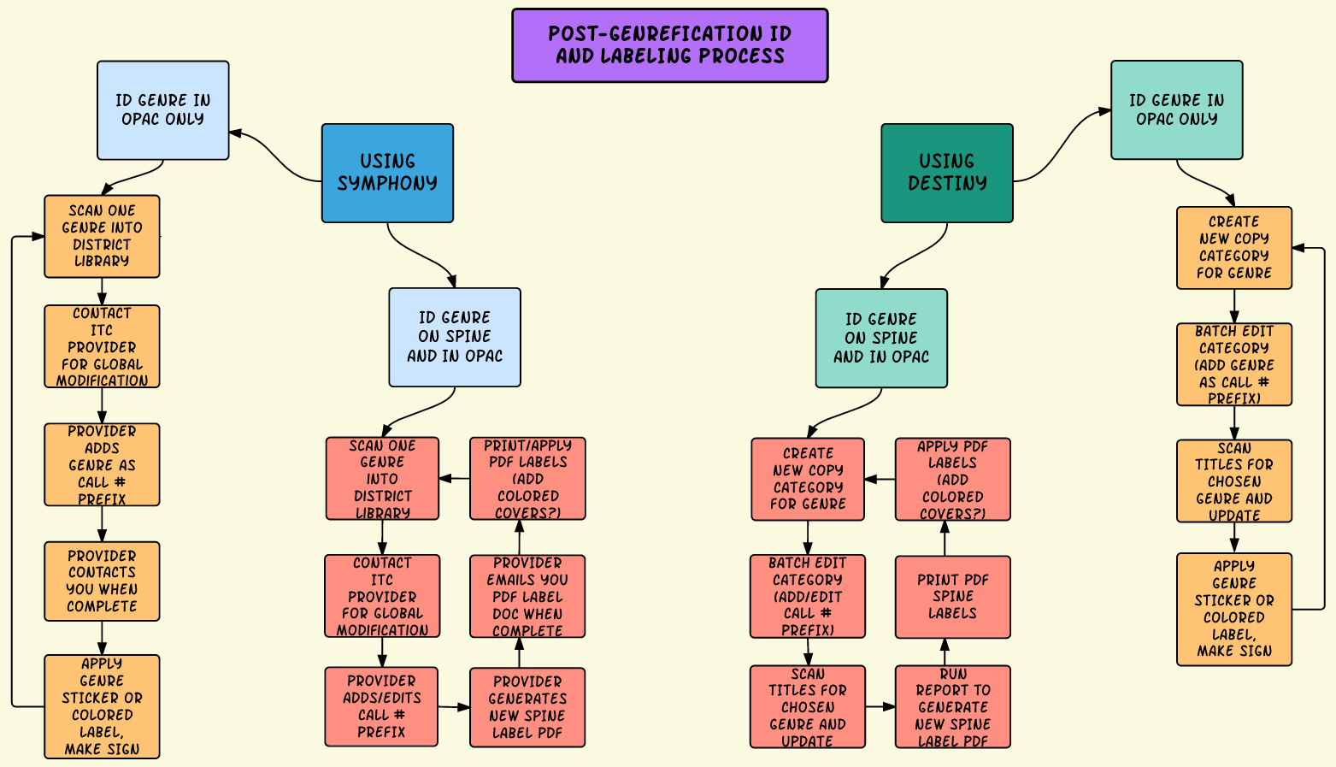
How do I create these signposts?
Google Doc of Image Available Here

Slide 8
SURVIVAL TIP #3
LET YOUR ITC PROVIDER DO THE HEAVY LIFTING
Sirsi/Dynix Symphony

Slide 9
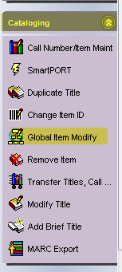
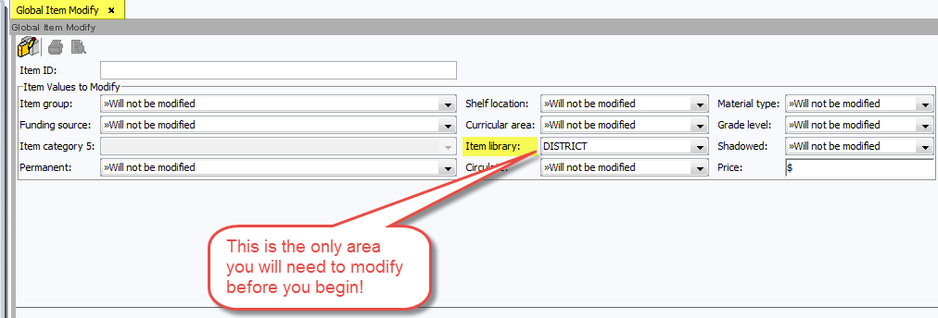
Prep Copies for New/Edited Prefix
Set Global Item Modify wizard to change items’
library location to DISTRICT.

Slide 10
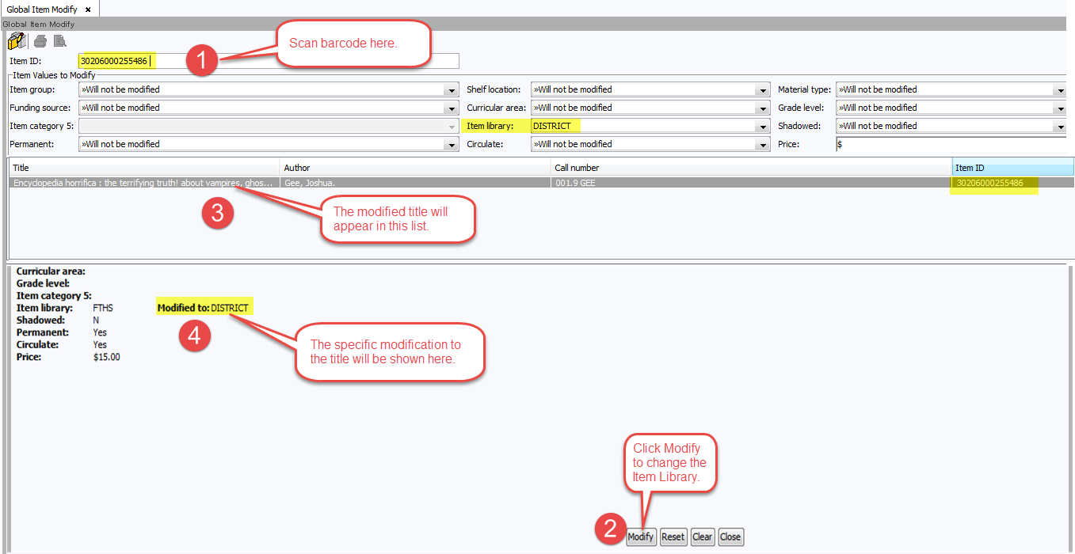
Move Copies to DISTRICT
Scan copies for one genre to remove them from your building library. Contact your ITC Provider.

Slide 11
Let the magic happen!
Your ITC Provider will run a script on the server that will magically update all of the copies moved to the DISTRICT library with the new/modified call number prefix and then they will move the copies back to your library.
They can also:
eMail a shelf list of the titles in the new genre.
eMail a PDF of your new spine labels for you to print and apply.

Slide 12
SURVIVAL TIP #4
USE ILS TOOLS TO
UPDATE YOUR COPIES
Follett Destiny

Slide 13
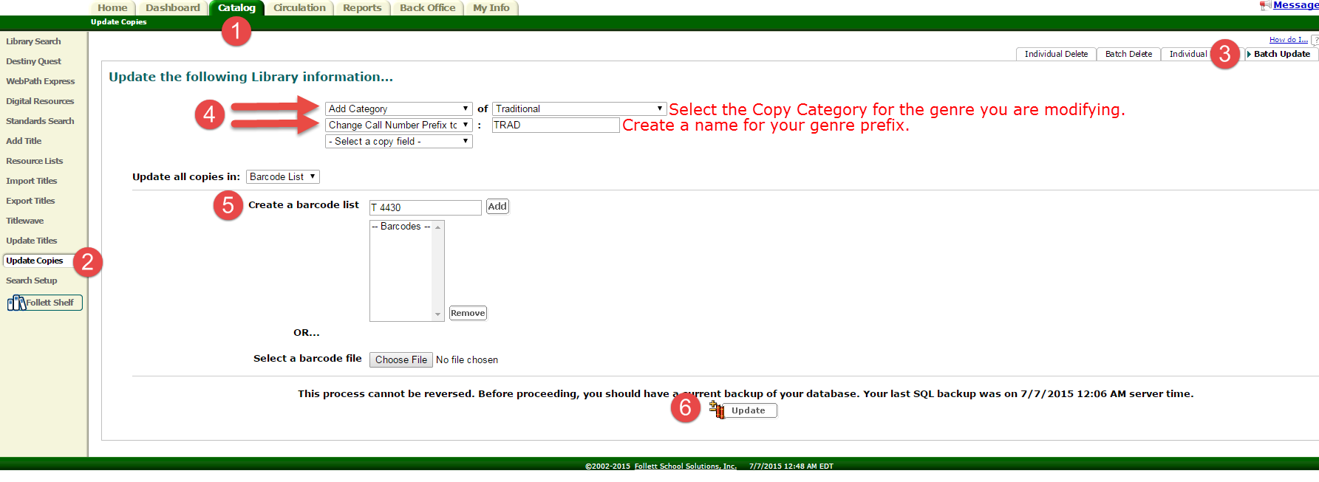
Batch Edit Titles for a Specified Genre
Notes:
Be sure to check your copy category to see that it is not Restricted from student searches. This is a great way for kids to locate titles they are most interested in.

Slide 14
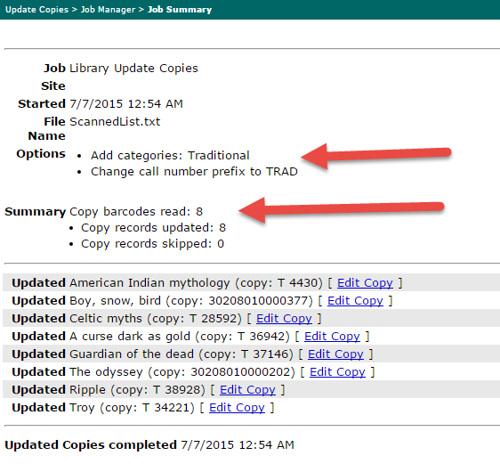
Check Your Results
Use the Edit Copy links to make additional changes.

Slide 15
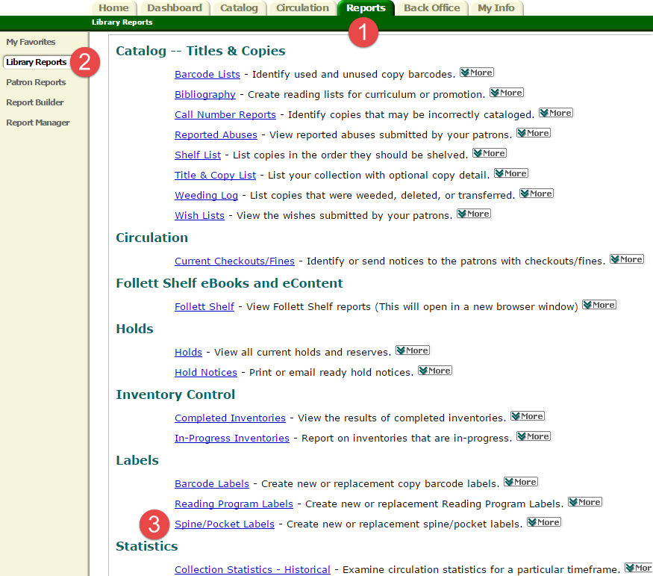
Generate New Spine Labels

Slide 16
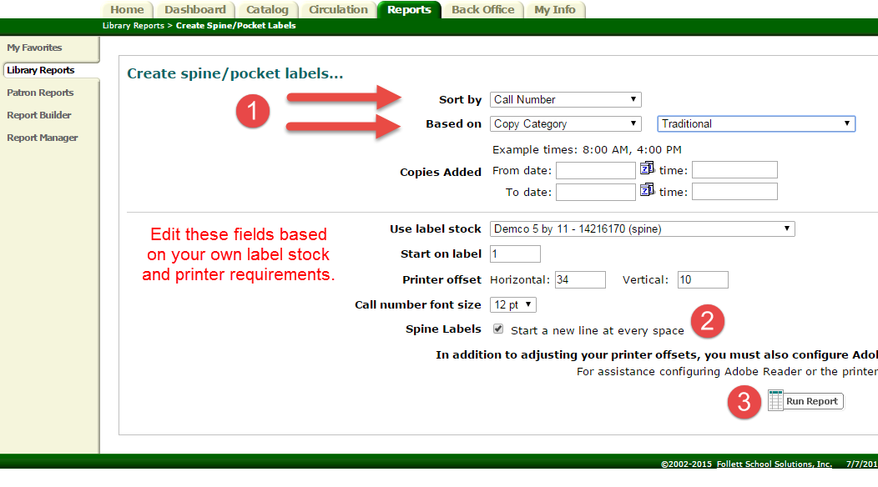
See how helpful those
Copy Categories can be?

Slide 17
Print Your New Genre Labels
This even works with nonfiction titles in the genre!

Slide 18
SURVIVAL TIP #5
MAINTAIN YOUR COLLECTION
Use every tool in your arsenal to increase your chances of survival.

Slide 19
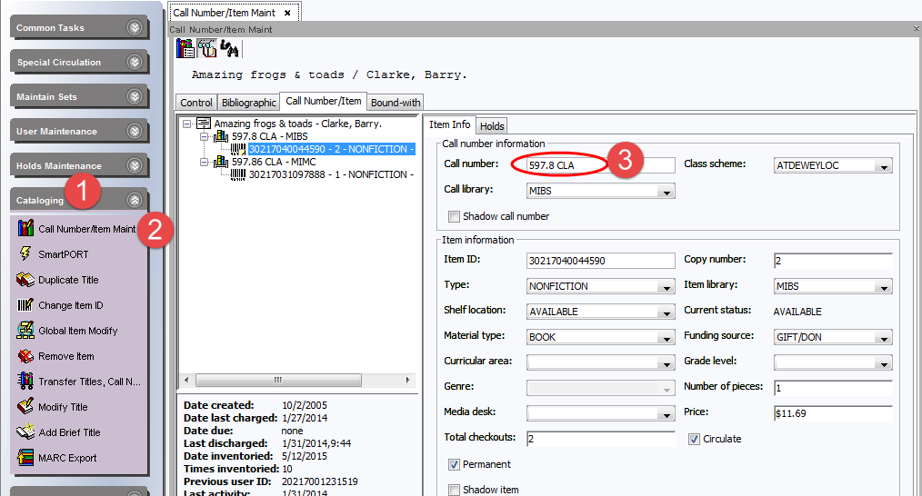
Symphony Users Can Modify Copies

Slide 20
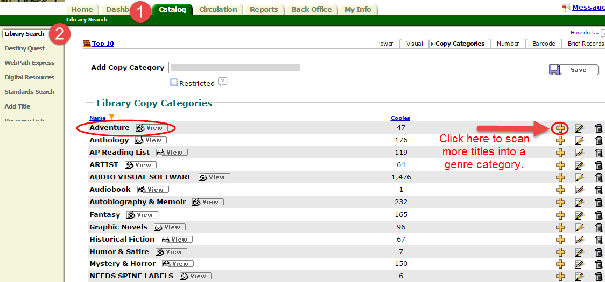
Destiny users can add
copies to a Copy Category
This works great if vendor has customized your call #!

Slide 21
Or they can batch edit titles for new books of a single genre and print spine labels.
Same process as before!

Slide 22
SURVIVAL TIP #6
STICK WITH YOUR FRIENDS
You’d be amazed how helpful & careful middle and high school students can be if you are willing to share the work!

Slide 23
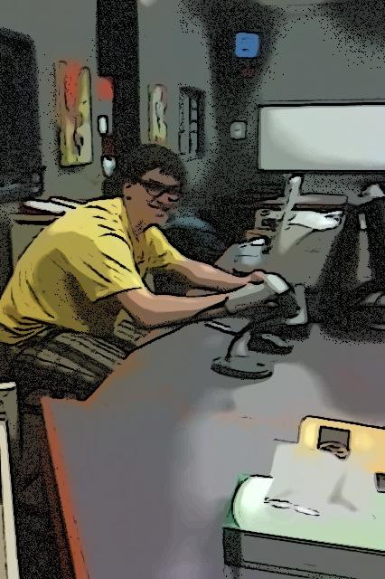
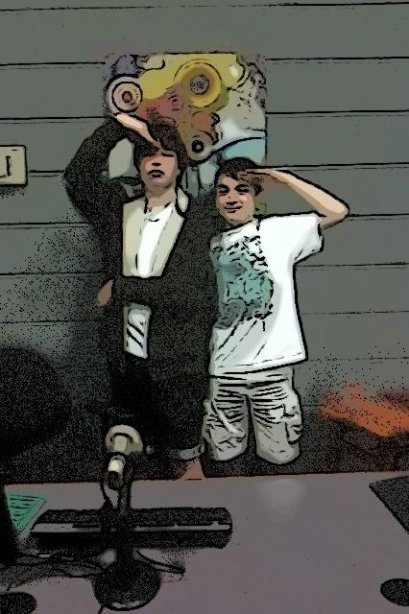

Slide 24
If you can survive genrefication,
then you are ready for any emergency…
Even a zombie apocalypse!

