Slide 1
Improving Writing Across the Curriculum
Marcia Barnhart
Marcia Barnhart Educational Consulting LLC

Slide 2
Survey Questions #1
Your position
Elementary teacher
High school teacher
Librarian/Media Specialist
Assistant/Principal/Superintendent
Curriculum director
Other

Slide 3
Survey Question #2
Does your district/building have a program for writing across the content areas?
Yes
No
Does not apply to me

Slide 4
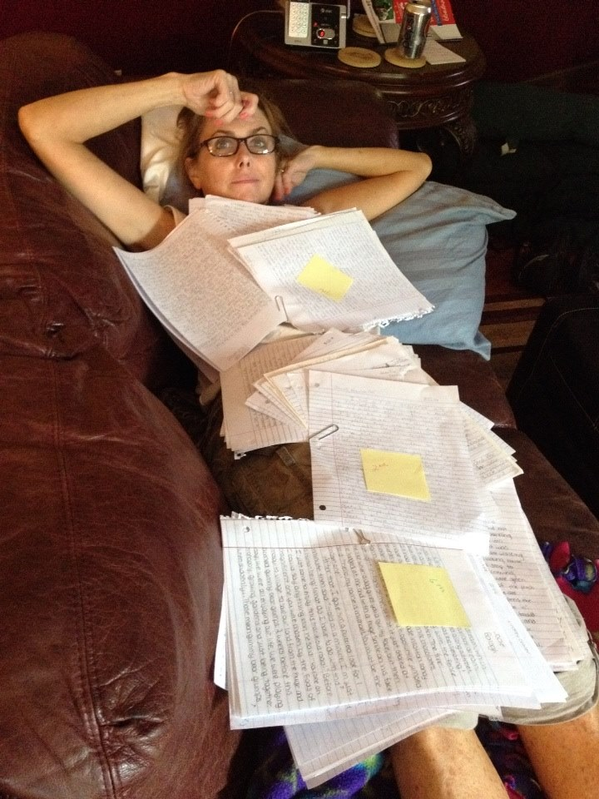
“I am so happy to be
back in school so I have something
to do with my time
on the weekends,”
said no English teacher ever.

Slide 5
Seriously now…..
To significantly impact writing ability for all students, two choices:
Reduce class size to 10-12 and give English language arts teachers an additional period for grading writing.
Make all teachers responsible for writing instruction.

Slide 6
Writing: How Important?
“There are no silver bullets in education. But…non-fiction writing is about as close as you can get to a single strategy that has significant effects in nearly every area of curriculum.”
Doug Reeves
Notes:
How many of you find that writing helps you learn? IN college and today, it is my single most-relied upon strategy to help me learn. Reading the material is not enough. I have to write about it (take notes, etc.) but then if I talk about what I have read and written with someone else, it cements the learning.

Slide 7
Writing: How important?
“If we could institute only one change to make students more college ready, it should be to increase the amount and quality of writing students are expected to produce.”
David Conley
College Knowledge

Slide 8
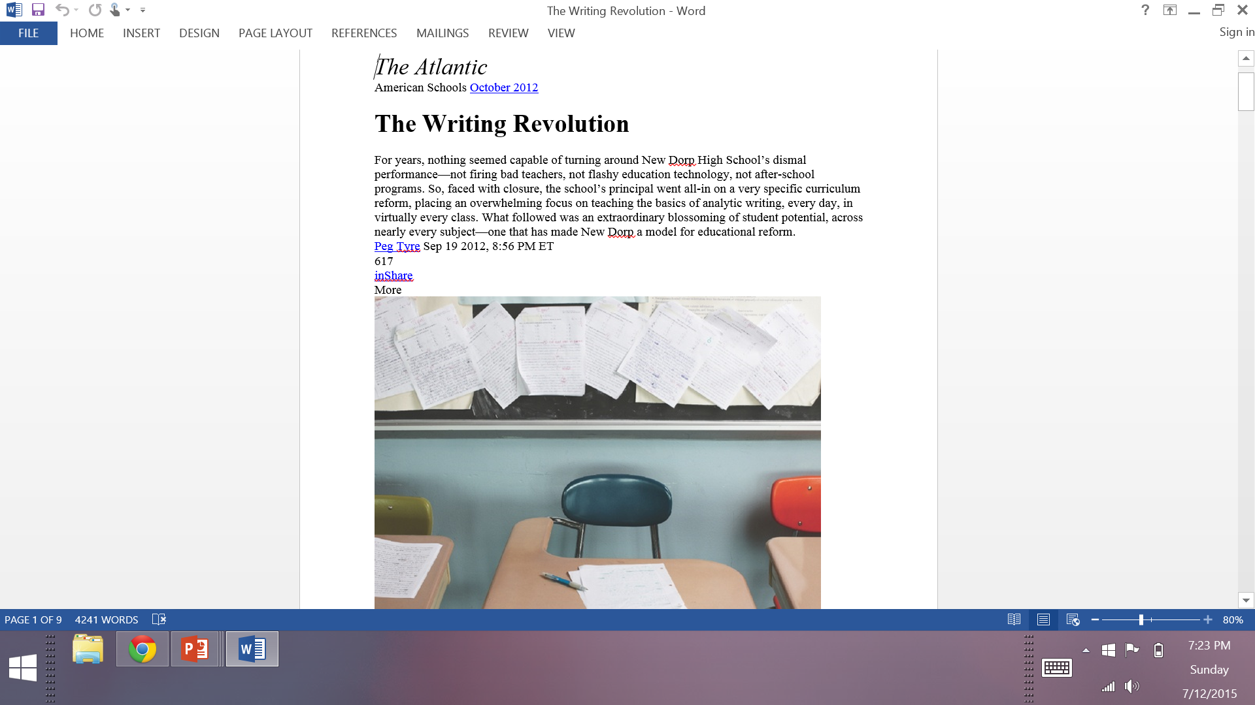
http://www.theatlantic.com/magazine/archive/2012/10/the-writing-revolution/309090/

Slide 9
Basic Literacy Model
Notes:
Step 1: Engage with complex text (Discuss concept of complex text and how CCSS defines it)
Step 2: Extract and employ evidence (What might this look like in action? Students writing about text, talking about the text with each other, presenting information from the text.)
Step 3: Ultimate goal of education is to build knowledge. Effective literacy practices will increase knowledge building in all content areas.
9

Slide 10
Mike Schmoker Focus: Elevating the Essentials to Radically Improve Student Learning
Notes:
The foundation of this training and the Literacy Standards. How would you rate these skills in terms of relevance to college and career readiness?
10

Slide 11
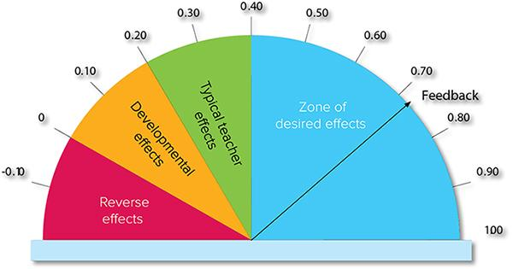
Use the Literacy Model to move the dial on student achievement
Notes:
Literacy practices across content areas must become the norm in school culture. How can the use of literacy practices support the school’s goal to increase student achievement? This is our focus this morning. Move the dial concept from John Hattie’s work in Visible Learning.
11

Slide 12
New Standards Demand
Students in all content areas be able to
Read complex texts
Write effective explanations and arguments
Conduct research
Present findings

Slide 13
Notes:
You can skip this section if the pre-assessment determines that they know a lot about the Literacy Standards
13

Slide 14
The document is organized into three main sections
Standards for English Language Arts Grades K – 5 pp. 9-33 | Standards for English Language Arts Grades 6 – 12 pp.34-58 | Standards for Literacy in History/Social Studies, Science and Technical Subjects Grades 6 – 12 pp. 59-66
Notes:
K-5 “A single K–5 section lists standards for reading, writing, speaking, listening, and language across the curriculum, reflecting the fact that most or all of the instruction students in these grades receive comes from one teacher”
6-12 “Grades 6–12 are covered in two content area–specific sections, the first for the English language arts teacher and the second for teachers of history/social studies, science, and technical subjects”
14

Slide 15
What are the Literacy Standards?
Standards for reading and writing in
Science
Social Studies
History
Other Technical Subjects*
Notes:
Other Technical Subjects? Art? Music? Yes, basically all subjects in which students are required to read and write
15

Slide 16
What does “Other Technical Subjects” mean?
A course devoted to a practical study, such as engineering, technology, design, business, or other workforce-related subject; a technical aspect of a wider field of study, such as art or music. (CCSS Glossary)

Slide 17
To what grade levels do the Literacy Standards apply?
Grades 6 - 12
Notes:
This division is predicated on the assumption that K-5 teachers teach reading and writing skills in all content areas. Does this happen in your building?
17

Slide 18
Organization of the Literacy Standards
Literacy Standards
Reading History/Social Studies p. 61 | Reading Science and Technical Subjects p. 62 | Writing History/Social Studies, Science and Technical Subjects p. 64-66

Slide 19
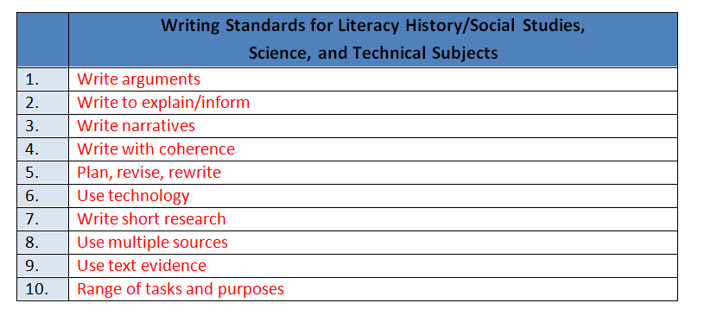
Notes:
Answers should include these words. Now that you have examined the literacy standards, can you see how they apply to your content area grades 6-12? For K-5, did you get a deeper understanding of your standards? How aligned is your instruction to these standards?
19

Slide 20
Survey Question #3
3. Rate your depth of knowledge with regard to Ohio’s Learning Standards for Writing.
I don’t know anything about them.
I have some knowledge of them.
I know them fairly well.
I could teach them to others.

Slide 21
What are the 3 modes of writing as specified in Ohio’s Learning Standards for ELA/Literacy?
Arguments
Informative/Explanatory
Narratives

Slide 22
Balance of Student Writing
Notes:
Explain that the Common Core State Standards require that the balance of writing students are asked to do parallels the balance assessed on the National Assessment of Educational Progress (NAEP).
For instance, the facilitator might say,
“The Common Core State Standards ask students to write an increasing proportion of arguments and informational reports from sources as they progress through the grades. Consequently, less classroom time is spent in later grades on personal writing that asks students to detail personal experiences or opinions. The balance of types of writing students are asked to do should parallel the balance assessed on the National Assessment of Educational Progress (NAEP).
So, by the time students are in high school, analytical writing (writing to argue and explain) has increased from 65% to 80% of their writing experience. We recognize, of course, that these forms of writing are not strictly independent; for example, arguments and explanations often include narrative elements, and both informing and arguing rely on using information or evidence drawn from texts.”

Slide 23
Writing Standard #1
English Language Arts | History , Social Studies, Science and Technical Subjects
6-8:Write arguments to support claims with clear reasons and relevant evidence 9-12:Write arguments to support claims in an analysis of substantive topics or texts, using valid reasoning and relevant and sufficient evidence | Write arguments focused on discipline-specific content.
What does it mean to “write an argument”?

Slide 24
Persuasion vs. Argument
Persuasion | Argument
Appeals to the credibility, character, or authority of the writer (speaker) Appeals to the audience’s self-interest and sense of identity Relies on emotional appeals Evokes emotions | Convinces the audience because of the perceived merit and reasonableness of the claims and proofs offered rather than evoking emotions. Requires evidence
Notes:
We often confuse persuasion and argument.

Slide 25
Logical argument vs. persuasive writing
Both argument and persuasion have as their goal persuading people to believe something is true or change their beliefs or behavior.
Persuasion relies on persuasive strategies.
Appeals to audience’s self interest, sense of identity, emotions, credibility or authority of the writer, etc.
Argument relies on logic and evidence.
Convinces audience because of the perceived merit and reasonableness of the claims and proofs offered
Notes:
Explain that there is a fine but important distinction between logical argument and persuasive writing, even though persuasion is the goal of each. The distinction lies in the appeal each makes: Persuasion may rely on persuasive techniques such as appealing to self interest or emotion. Argument, on the other hand, always relies on a logical case that persuades by convincing the reader of the merits of the claims and proofs.
For instance, the facilitator might say,
“In Oregon, we have used the term persuasive mode to describe what in the Standards is called argument. The change in terminology is helpful in distinguishing the salient characteristic that elevates argument: logic.
For instance, when asked to write a short paper “persuading a parent” to do something, we have all seen instances when one or more students will resort to flattery, bargaining, even pleading – which may in fact be very persuasive at home, but certainly does not represent progress toward -- or understanding of -- the ability to write a reasoned, logical argument that is required to be college and career ready.”

Slide 26
www.ldc.org
Literacy Design Collaborative
…a fresh approach to incorporating literacy
into middle and high school content areas
Notes:
LDC is a national community of educators providing a teacher-designed and research-proven framework, online tools, and resources for creating literacy-rich assignments and courses across content areas.

Slide 27
The Basic Format
After researching _____(informational texts) on ___________(content), write __________(essay or substitute) that argues your position on __________ (content). Support your position with evidence from your research. L2 Be sure to acknowledge competing views. L3 Give examples from past or current events or issues to illustrate and clarify your position.
Notes:
This is the basic format. If you have not printed the entire Guidebook 1.0 and LDC Template Task Collection, you need to print at least pages 1-5 of the Template Task Collection for each participant.

Slide 29
The Basic Format with Essential Question
[Insert Question] After reading __________(literature or informational texts), write_________ (essay or substitute) that addresses the question and support your position with evidence from the text(s). L2 Be sure to acknowledge competing views. L3 Give examples from past or current events or issues to illustrate and clarify your position.
Notes:
This is the second of the two basic formats: After researching (reading) (previous slide) and the essential question format.

Slide 34
Writing Standard #2
English Language Arts | History , Social Studies, Science and Technical Subjects
6-8: Write informative/explanatory texts to examine a topic and convey ideas, concepts, and information through the selection, organization, and analysis of relevant content. 9-12:Write informative/explanatory texts to examine and convey complex ideas, concepts, and information clearly and accurately through the effective selection, organization, and analysis of content | Write informative/explanatory texts, including the narration of historical events, scientific procedures/experiments, or technical processes

Slide 35
8 shifts in English Language Arts
Increase in informational text
Attention to levels of text complexity
Increase in literary nonfiction
Using the close reading process
Writing to sources
Marshalling arguments
Increase in research
Focus on academic vocabulary

Slide 36
Writing to Sources
What does this shift mean for educators?
The majority of the questions developed for the text must be text-dependent.
What is the difference between text-based and text-dependent?

Slide 37
Text-Dependent Questions...
Can only be answered with evidence from the text.
Can be literal (checking for understanding) but must also involve analysis, synthesis, evaluation.
Focus on word, sentence, and paragraph, as well as larger ideas, themes, or events.
Focus on difficult portions of text in order to enhance reading proficiency.
Include prompts for writing and discussion questions.
Notes:
TDQ’s should not require background knowledge (stores of background knowledge can be added to by collecting the evidence from the text to further build knowledge, or can be tapped into to make meaning of the text.)
Questions that involve analysis, synthesis, evaluation actually point towards the most difficult parts of text. Literal question do not.
TDQ’s will drive the CCSS in the classroom if questions are asked about words, sentences, paragraphs, big ideas, themes, relationships, etc.
TDQ’s are an opportunity to address the academic (tier two) vocabulary and syntax that are features of complex text – the features that make text difficult for students.
This means that good questions actually make students stronger and more capable readers.

Slide 38
Non-Examples and Examples
Not Text-Dependent
Text-Dependent
In “Casey at the Bat,” Casey strikes out. Describe a time when you failed at something.
In “Letter from a Birmingham Jail,” Dr. King discusses nonviolent protest. Discuss, in writing, a time when you wanted to fight against something that you felt was unfair.
In “The Gettysburg Address” Lincoln says the nation is dedicated to the proposition that all men are created equal. Why is equality an important value to promote?
What makes Casey’s experiences at bat humorous?
What can you infer from King’s letter about the letter that he received?
“The Gettysburg Address” mentions the year 1776. According to Lincoln’s speech, why is this year significant to the events described in the speech?
Notes:
Text-dependent questions require students to pay attention to the text at hand and to draw evidence from that text.
What does this look like in the classroom?
Teachers insist that classroom experiences stay deeply connected to the text on the page and that students develop habits for making evidentiary argument both in conversation, as well as in writing, to assess comprehension of a text.
Students have rich and rigorous conversations and develop writing that is dependent on a common text.

Slide 39
PARCC Grade 7 Question
You have read three texts describing Amelia Earhart. All three include the claim that Earhart was a brave, courageous person. The three texts are:
“Biography of Amelia Earhart”
“Earhart's Final Resting Place Believed Found”
“Amelia Earhart’s Life and Disappearance”
Consider the argument each author uses to demonstrate Earhart’s bravery.
Write an essay that analyzes the strength of the arguments about Earhart’s bravery in at least two of the texts. Remember to use textual evidence to support your ideas.
Notes:
Allow viewers to read question.
Aligns to the standards and reflects good practice.
Specific CCSS alignment to:
RI.7.1 (use of evidence); RI.7.8 (evaluate claims in a text); RI.7.9 (comparison of authors’ presentation); RI.7.10 (complex texts).
W.7.2 (writing to inform and explain); W.7.4 (writing coherently); W.7.7 (conduct short research projects); W.7.8 (gather relevant information from multiple sources); W.7.9 (drawing evidence from texts).
L.7.1-3 (grammar and conventions).
Measures the ability to compare and synthesize ideas across multiple texts and the ability to analyze the strength of various arguments.
Asks students to write to sources rather than write to a de-contextualized prompt.
Focuses on students rigorously citing evidence for their answer.
Requires students to delve deeply into multiple texts to gather evidence to analyze a given claim, simulating the research process.
Requires students to demonstrate they can apply the knowledge of language and conventions when writing.

Slide 40
Engaging the Adolescent Learner by Douglas Fisher and Nancy Frey

Slide 41
8 shifts in English Language Arts
Increase in informational text
Attention to levels of text complexity
Increase in literary nonfiction
Using the close reading process
Writing to sources
Marshalling arguments
Increase in research
Focus on academic vocabulary

Slide 42
Writing Standard 7
English Language Arts | History, Social Studies, Science and Technical Subjects
Conduct short as well as more sustained research projects to answer a question (including a self-generated question) or solve a problem; narrow or broaden the inquiry when appropriate; synthesize multiple sources on the subject, demonstrating understanding of the subject under investigation. | Conduct short as well as more sustained research projects to answer a question (including a self-generated question) or solve a problem; narrow or broaden the inquiry when appropriate; synthesize multiple sources on the subject, demonstrating understanding of the subject under investigation.

Slide 43
Research the Shift Buster
Informational text
Complex text
Close reading
Writing arguments/explanations
Academic vocabulary
Citing evidence
Misconception: Research must be a big project and is best suited for a once-a-year situation.
Notes:
By including more research, teachers are addressing all the shifts.

Slide 44
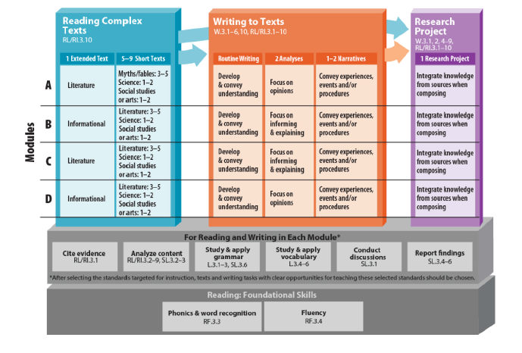
PARCC Content Model Framework

Slide 45
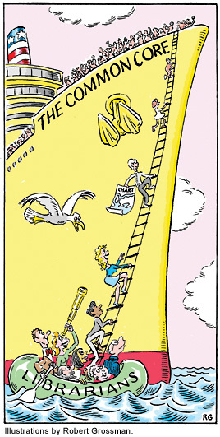
Librarians as Literacy Lifesavers
Notes:
From School Library Journal, April 2012
Article “All Aboard!: Implementing Common Core Offers School Librarians an Opportunity to Take the Lead” by Rebecca Hill
Here come ocean liner behemoth….the Common Core. Many teachers will feel lost in knowing how to implement them . But librarians are here for the rescue with their knowledge of inquiry and informational literacy.

Slide 46
Basic Literacy Model
Engage with complex text
Extract and employ evidence
Build knowledge

Slide 47
Step 1: Engage with text
Text=video, PPT, textbook, magazine articles, newspaper articles, literature
Scaffold reading of text:
Chunk it and respond (quick writes)
You read it to them
They read with a partner
They answer text-dependent questions
Use close reading process
Accountable talk discussions

Slide 49
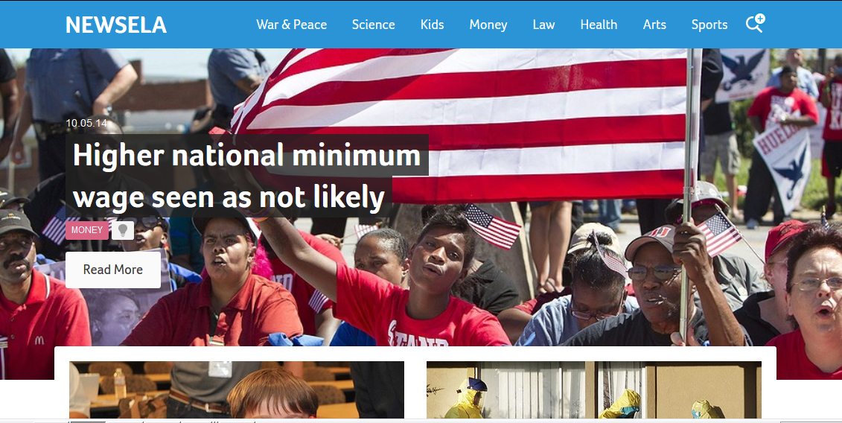
www.newsela.com

Slide 50
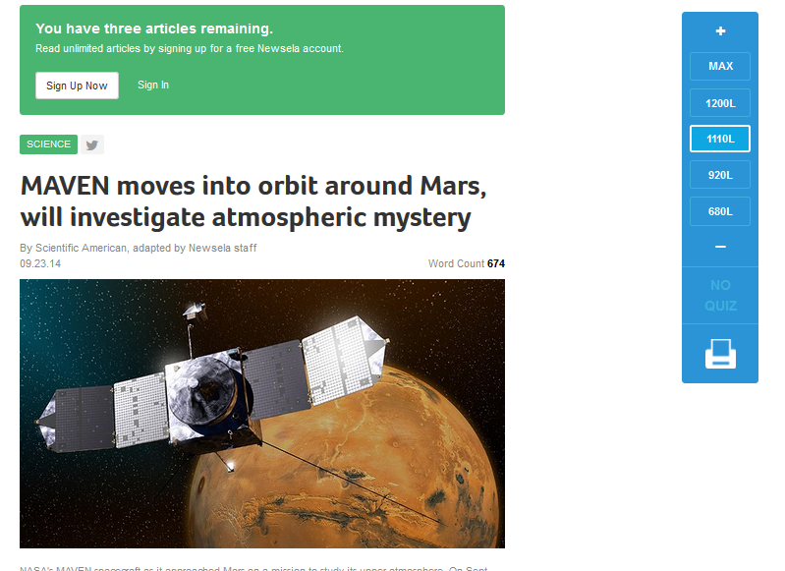

Slide 51
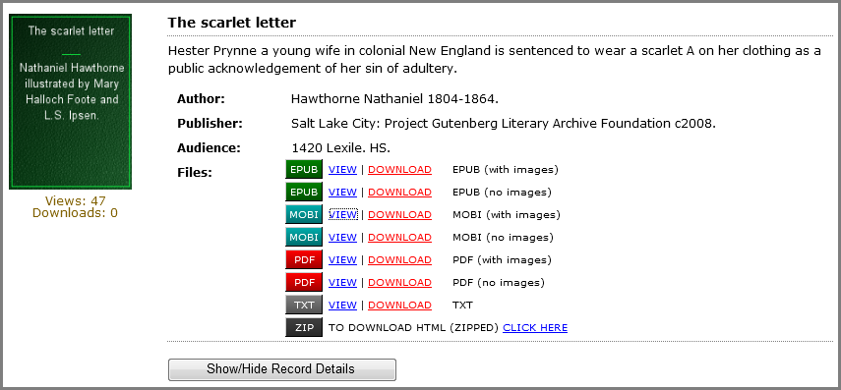
INFOhio eBook Collection
600+ classic audio and e-books titles.
Search by grade level/Lexile.
Download in multiple formats through
and INFOhio schools online library catalogs
Contact: central@infohio.org for more information.
Notes:
INFOhio eBook Collection 1) The INFOhio eBook Collection contains titles available for online viewing or download to electronic devices. This collection includes 600-plus e-book public-domain titles from Project Gutenberg and 69 audio books from ThoughtAudio. These classic literature authors and titles were selected from school recommended and required reading lists, and ODE exemplar titles.
2) The eBook Collection can be searched either through the INFOhio online catalog (CAT) or the Discovery Portal.
Students, teachers and parents have unlimited access 24/7 from home or school. Titles have been cataloged for complete search capabilities including authority control subject headings and grade levels. Titles have Lexile, content and summary information, when available.
3) Books can be viewed on the computer screen or downloaded in multiple e-book formats (mobi, epub, pdf, html, mp3). E-reader devices and apps provide added features (i.e., electronic bookmarking, note taking, dictionary access, etc.)
The list of titles included in the eBook Collection, sorted by Title or sorted by Author, is updated daily.
INFOhio provides help in searching and downloading eBook Collection titles. Contact INFOhio for more information.

Slide 52
Thinking Like a Historian http://sheg.stanford.edu

Slide 53
The Stanford Site
73 lessons in the U.S. curriculum
31 lessons of the world curriculum
5 lessons in the introduction to historical unit
http://sheg.stanford.edu/rlh
To hear students talk about Thinking Like a Historian.

Slide 54
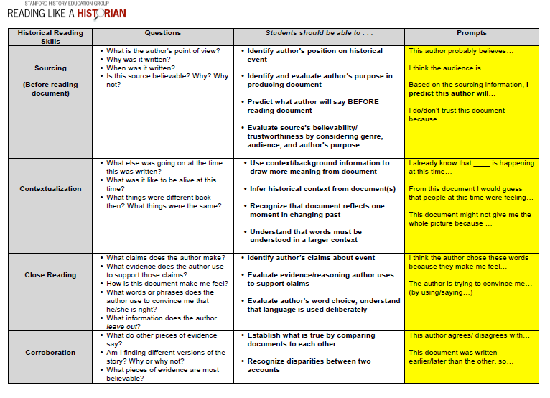
Notes:
1. Explain how the steps of the Reading like a Historian Approach (sourcing, contextualization, and close reading) help frame and facilitate student learning and deeper understanding of primary and secondary source documents.
2. Reflect on the methods and strategies that would be (or are) most effective for implementing the Reading Like a Historian approach in your classroom.

Slide 55
Step 2: Extract and employ evidence
Writing assignment or culminating task
Argument or explanation
Requires them to synthesize information from one or more sources on the topic
Engage them in the writing process and other best practices
Share and explain rubrics before they begin
Share exemplar examples of final product before they begin

Slide 56
Writing to Learn
Examples:
journals
free writes
vocabulary journals
topic analyses
diagrams and charts
note taking
graphic organizers
Key: Encourage students to write about what they are thinking and learning.

Slide 57
Purpose of WTL
Not all writing to learn activities must be graded.
Offer feedback and comments but do not feel compelled to grade spelling, punctuation, etc. on every piece of writing.
Purpose to
promote active learning
encourage discussion
engage all students
encourage thinking
These less formal writing assignments may be expanded into more formal writing tasks.

Slide 58
Graphic Organizers
Provide visual representation of facts and concepts and their relationships helping students to:
Organize ideas
Represent abstract ideas more concretely
Illustrate the relationships among facts and concepts
Store and recall information
Notes:
Graphic Organizers can be used for note taking, summarizing or as an assessment

Slide 59
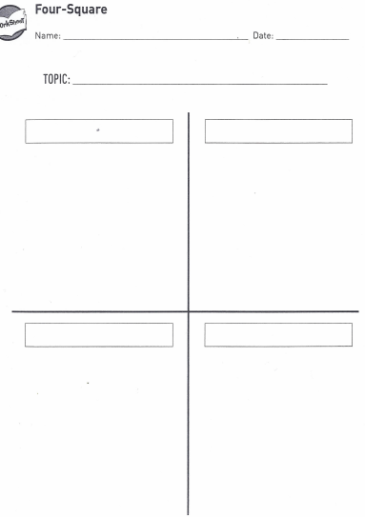
Summarize Note Taking
Notes:
Four Square is an organizer that can be used individually, in small groups or whole class. The page is divided into 4 squares with each one representing a topic or key concept. It can be used to take notes about each concept. If a line is drawn across the bottom then an overall summary can be written. Likewise, Four Square can be adapted to three topics or concepts.

Slide 60
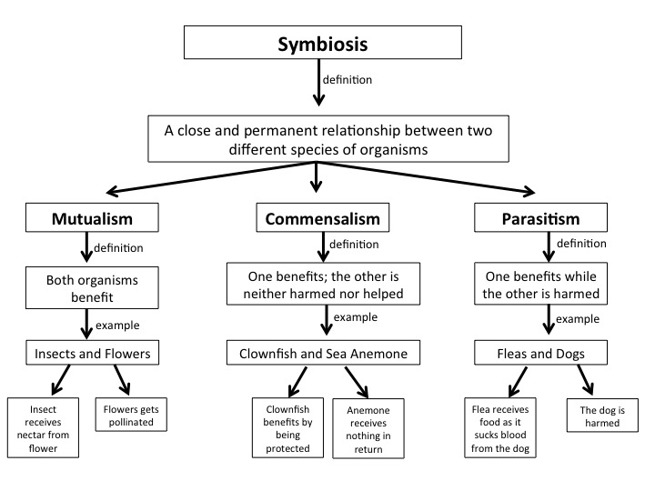

Slide 61
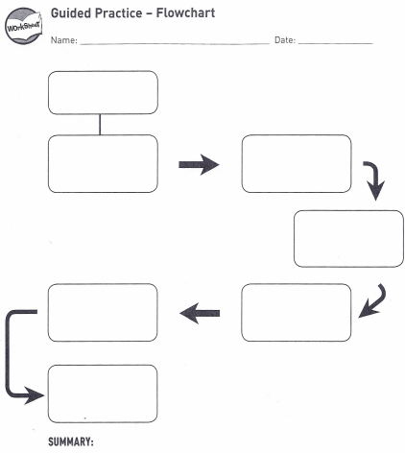
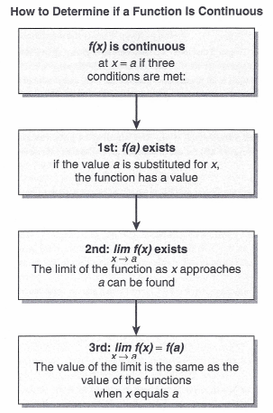
Flow Charts - Create one for the integer rules
Notes:
Flow charts are great tools for summarizing a process or procedure. If students create the flow chart based upon their learning they organize their thinking, leading to more likely recall and also create a tool that can be used to reinforce that learning in the application of those concepts or procedures.

Slide 62
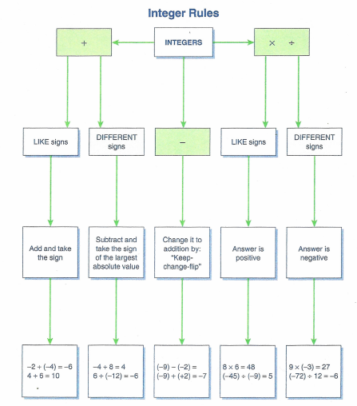
Notes:
Here is an example of a flow chart on how to combine signed numbers. Students would benefit most from experiencing “operating” on signed numbers with a variety of tools: chips, number lines then creating a flow chart that would synthesize what they have observed.

Slide 63
Vocabulary Concept Map
Notes:
Since nouns play such a significant role in understanding text, students need a mechanism that allows them to visualize and internalize word meanings. A vocabulary concept map does this. There are several forms with the key characteristics that students list examples and non-examples, many times including a picture along with characteristics or elements. If a definition is included, it is in the student’s own words. Looking up and writing down a dictionary definition has little to no long term benefit. As students learn more about a term, concept or topic, they can modify the concept map.

Slide 64
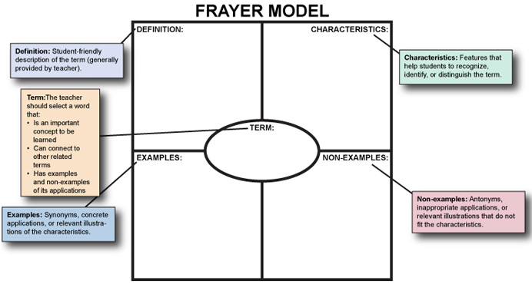

Slide 65
Notes:
This is a second vocabulary concept map. It is often referred to as the Frayer Model. I like to have students draw a picture or a model as one of the examples.

Slide 66
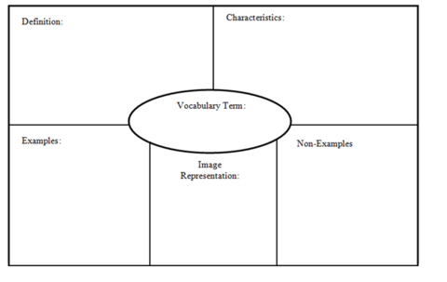

Slide 67
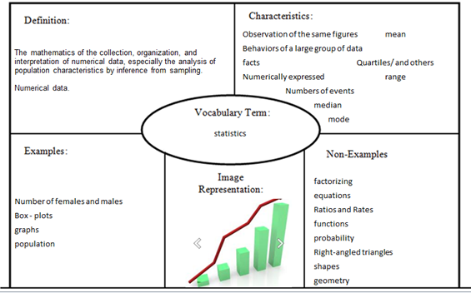

Slide 68
Reflection is not a luxury; it is a necessity!
Thinking and talking about experiences not only helps to make sense of the past, but also changes the likelihood of subsequent remembering.
Daniel Schacter
The Seven Sins of Memory
Notes:
Reflection – learned habit
Brain literally lights up during reflection
Promotes social experience
Evaluation is a part of the reflective process; valuing something worth reflection involves emotion
As students write about thinking, they learn what they know and do not know. When they explain their thinking to others and listen to others’ thinking they confirm ideas and pick up new ones. Students learn more from other students. Encourage active thinking from your students at all times.

Slide 69
http://mikeschmoker.com/write-more.html

Slide 70
Write More, Grade Less
Traditional grading practices = overly time-consuming, may have negative impact
Overload- too many errors; students ignore
Infrequent writing assignments
Delay – don’t return for weeks
There is a better way…Mike Schomoker

Slide 71
https://www.noredink.com/

Slide 72
Resources
Appendix B of Common Core Standards
Sample Performance Tasks for every grade level and across content areas. (text dependent questions)
http://www.corestandards.org/assets/Appendix_B.pdf

Slide 73
Appendix B Grades 6-8

Slide 74
Appendix B Grades 9-10

Slide 75
Appendix C
Grade level writing exemplars for each of the three modes of writing.
http://www.corestandards.org/assets/Appendix_C.pdf

Slide 76
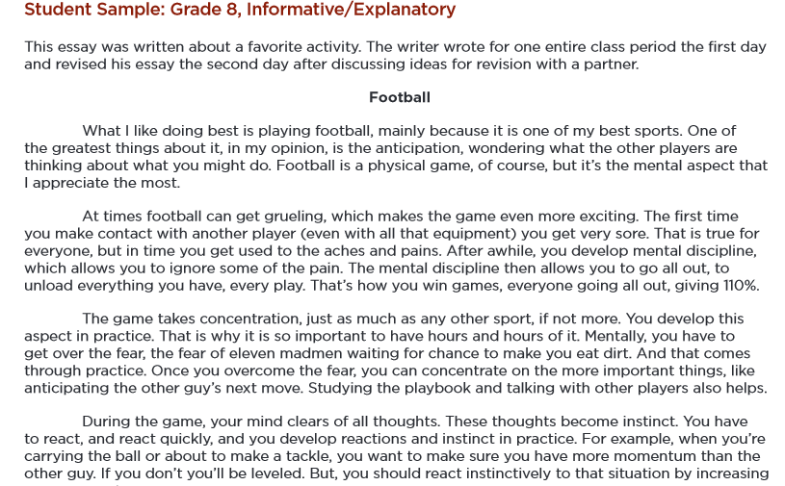

Slide 77
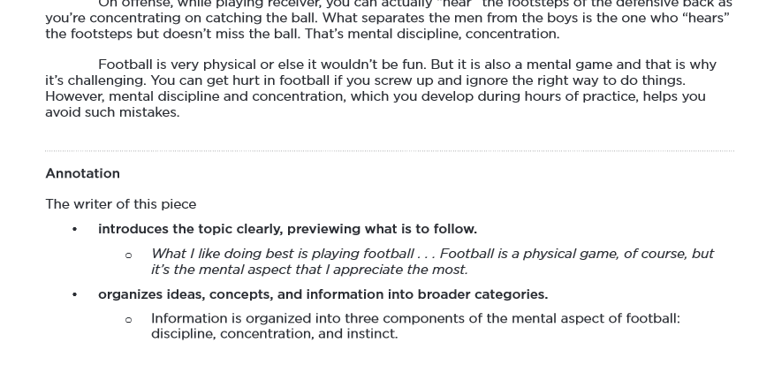
Each writing sample is following by an annotation
which explain the strengths of the writing.

Slide 79
Achieve the Core Website
http://achievethecore.org/dashboard/300/search/1/1/0/1/2/3/4/5/6/7/8/9/10/11/12/page/507

Slide 80
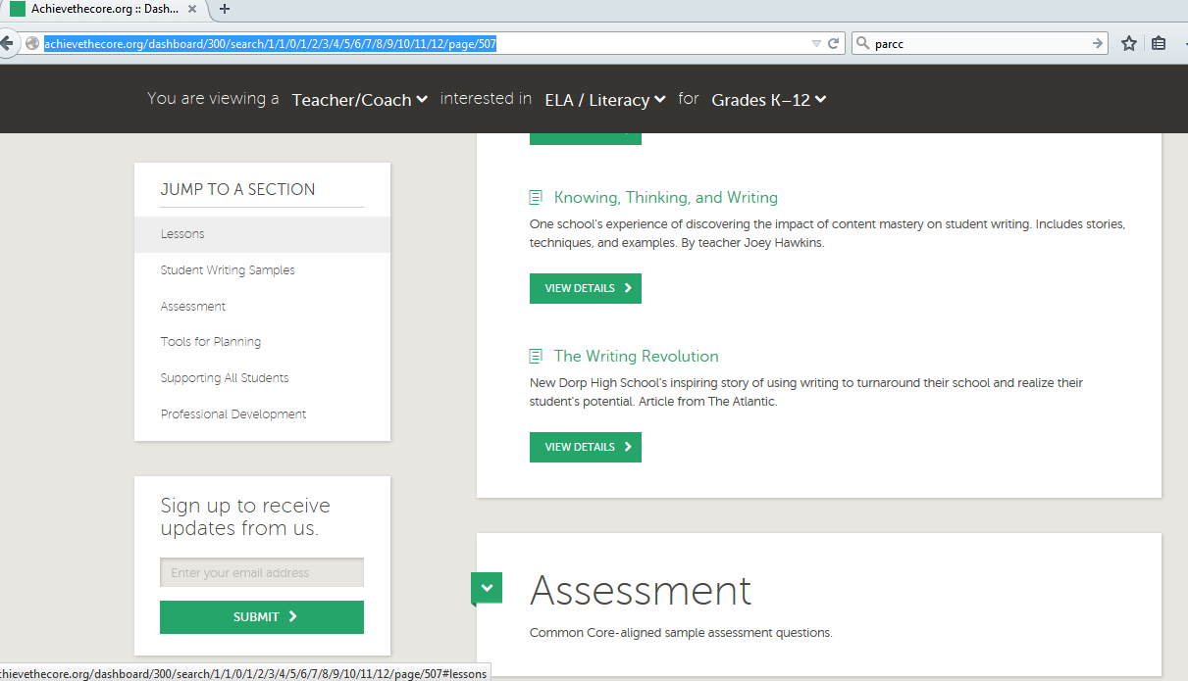

Slide 81
Review
Students should be:
Writing arguments
Responding to text-dependent questions
Doing more research writing
Writing in all content areas
Engage in student-led discussions

Slide 82
Thank you!
mbarnhart@teacher2teacher.us

