Slide 1
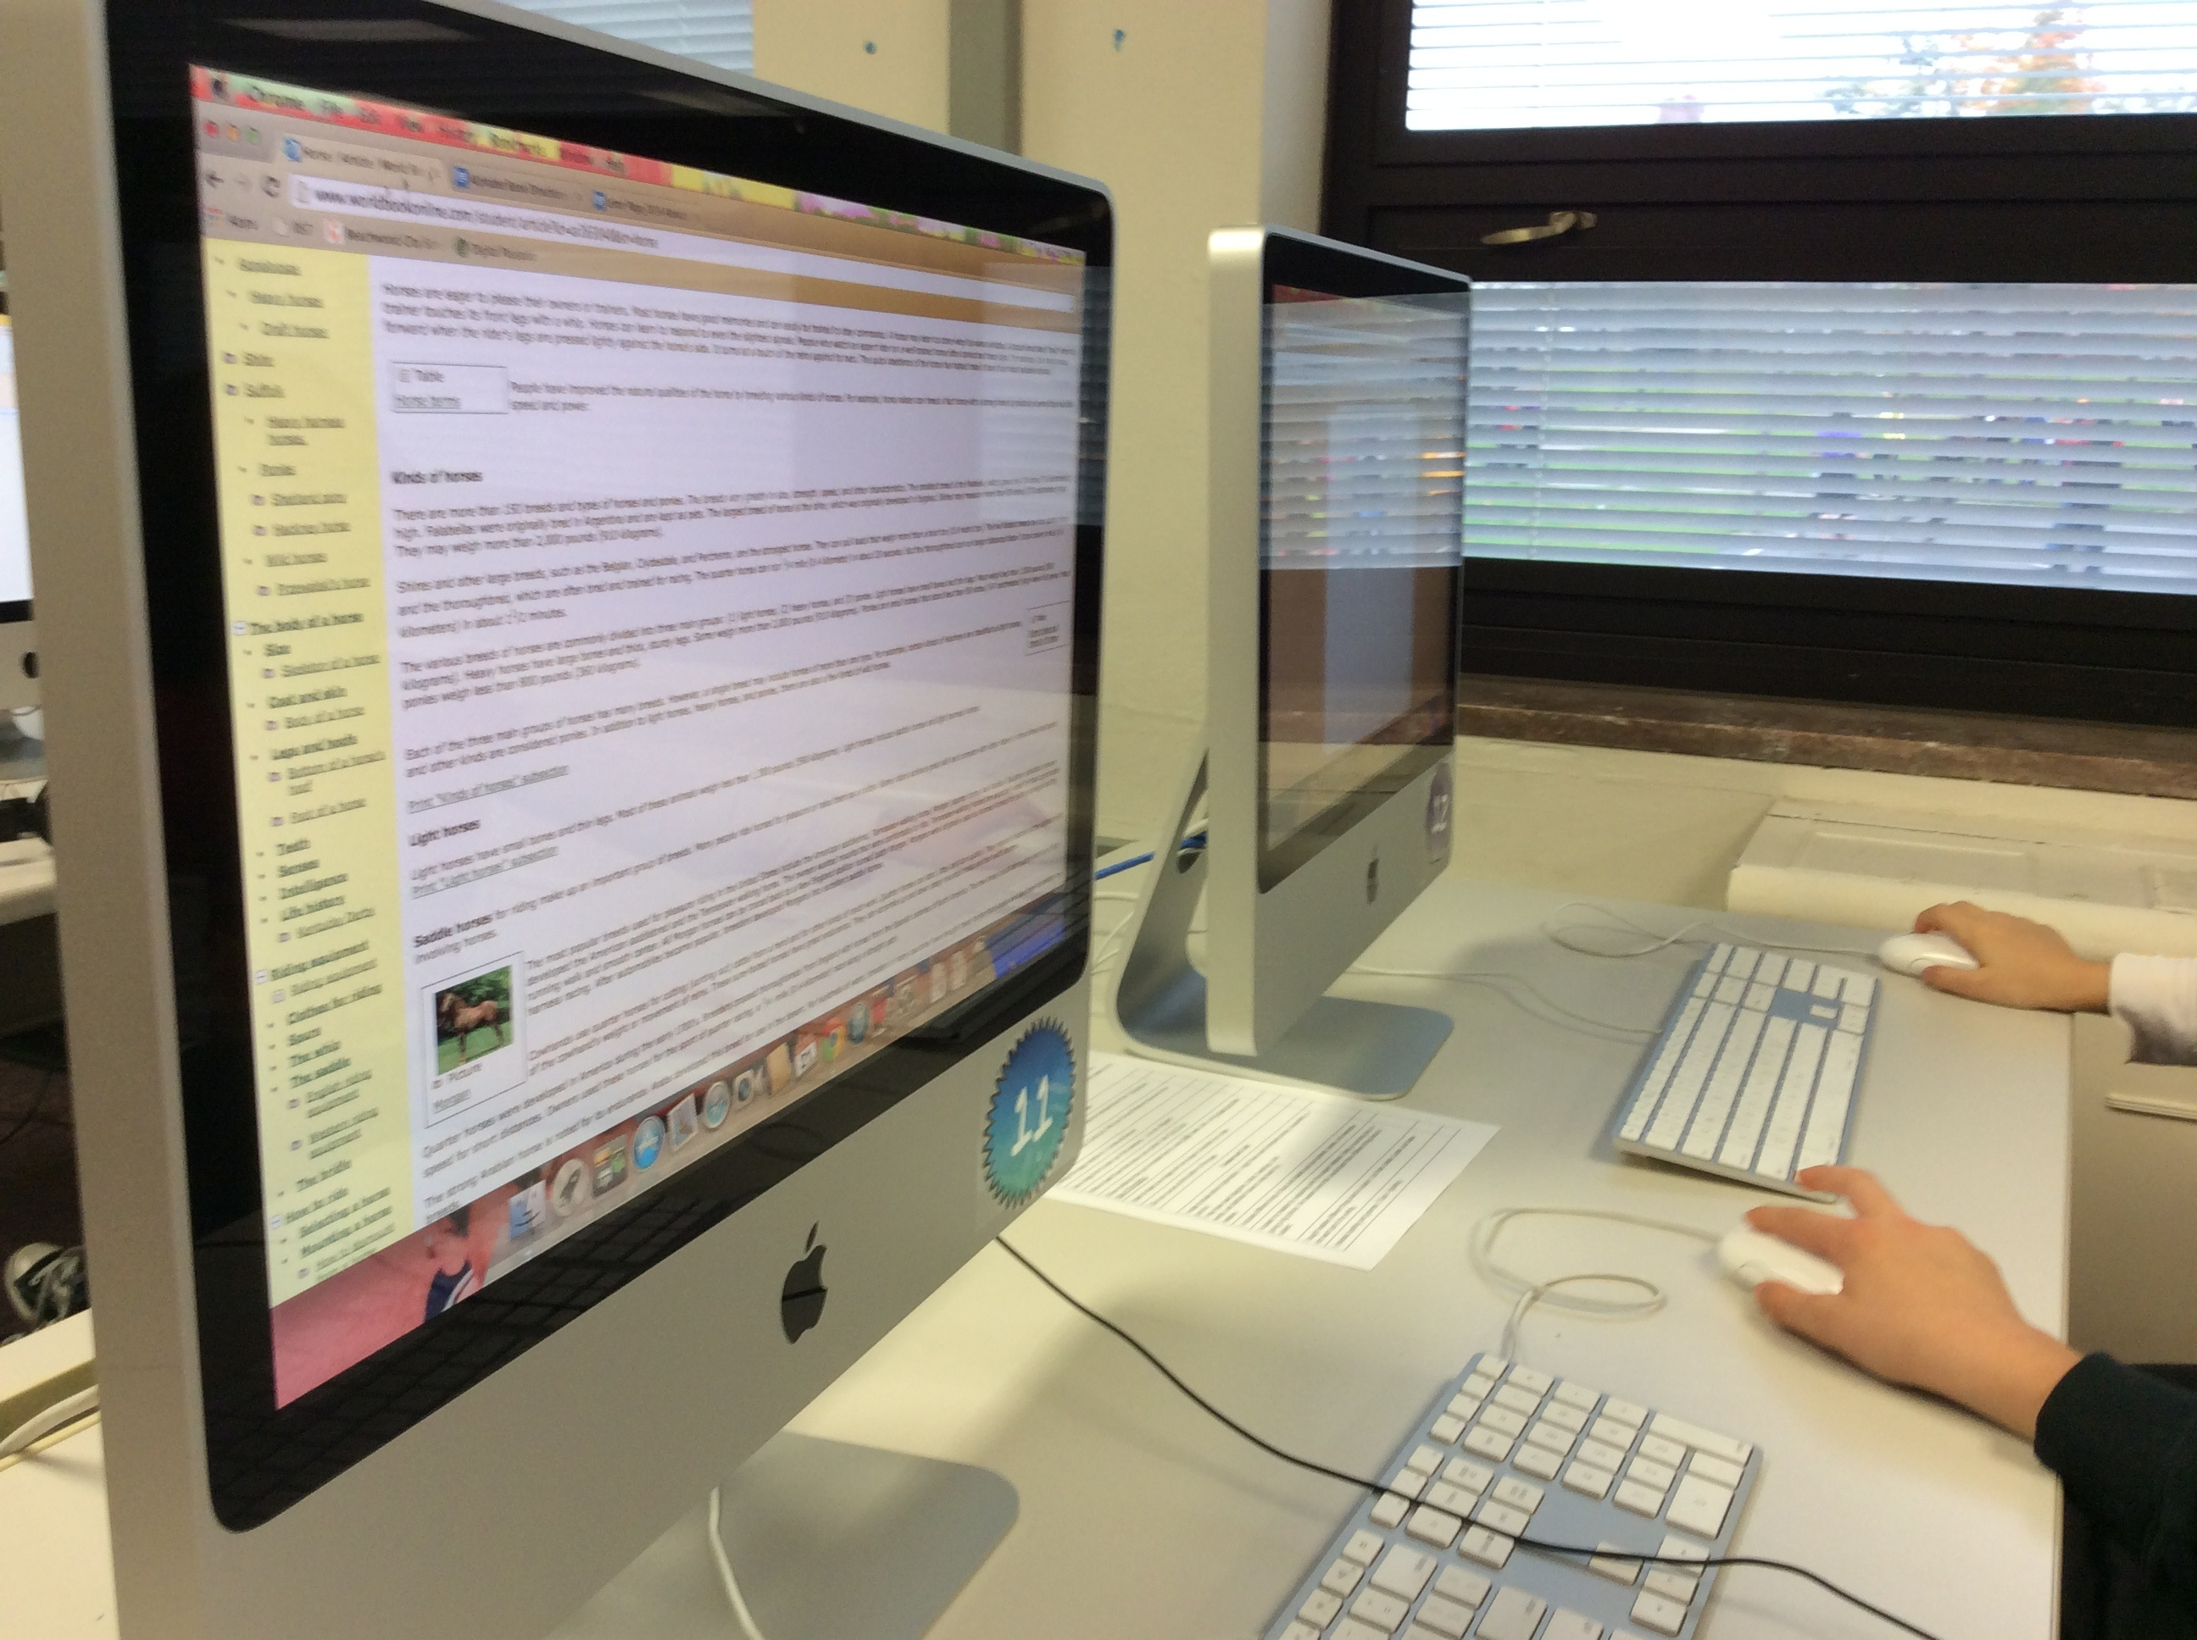
Multimedia Research Presentations
Angela Maxwell
amm@beachwoodschools.org
@librarymax
They’re Elementary!
Notes:
Hello everyone, I’m Angela Maxwell a school librarian in Beachwood Ohio, a northeastern suburb of Cleveland. I work in one of our elementary buildings with students in grades 3-5. I teach on a partially fixed schedule, so I see students as a special and have mornings to run the library, coach staff, and collaborate. I am going to take you through four successful research projects I have been a part of or designed, that can be adapted to almost any grade level or content area.

Slide 2
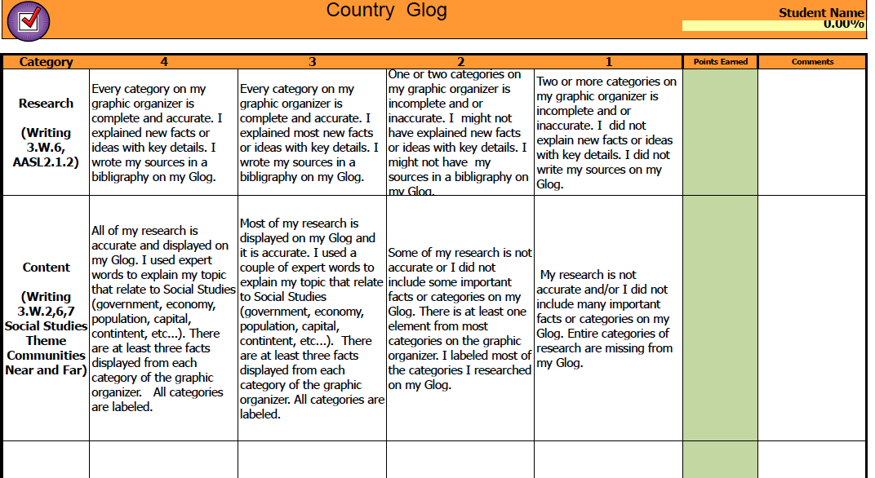
Third Grade Country Glog
Notes:
First we have the third grade Country Glog. This project aligns to social studies standards and can be adapted to other third grade topics such as communities, branches of government. What you are seeing is part of a rubric I created as part of a rubric template using Microsoft excel. It will actually calculate students’ scores.

Slide 3
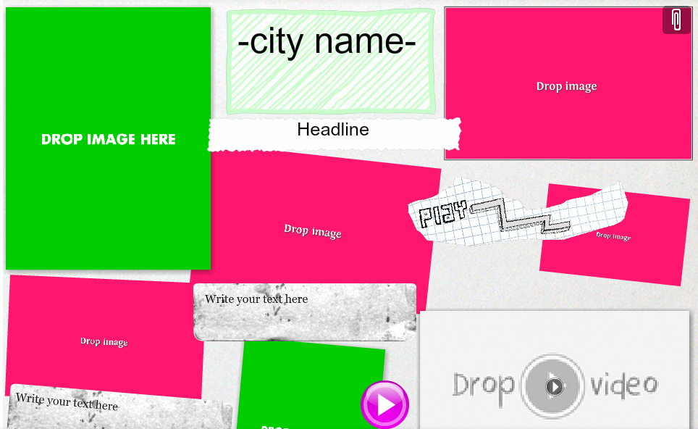
Notes:
To start the projects, students were sent home a letter by their social studies teacher to research their countries of origin or choose a country of interest to their family. Then, I went into social studies classes to review research resources. In particular we used Culture Grams and World Book Kids from INFOhio. Students were given at least four categories to research and completed a graphic organizer before starting the Glog. Each category had four details.

Slide 4
Notes:
Then, in my fixed schedule classes, we created the interactive online poster or Glog. Here’s an example of student work that incorporates images and graphics.

Slide 5
Notes:
Students embedded YouTube videos to support their information. Students can search YouTube within Glogster Edu but to avoid inappropriate videos, I had them search in their Chrome browser with a YouTube Safe Search setting turned on. Other videos could be included as links.

Slide 6
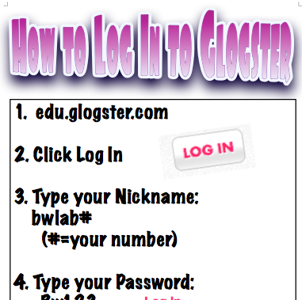
Notes:
We used a Glogster Edu teacher account that costs around $40.00 for 20 students to access. There is also a free version that will give you ten accounts. It is a Chrome App and now available as an iPad app.

Slide 7
Fourth Grade Historical Detective
Notes:
The next project is one that I currently do in my fixed classes to support both the 4th social studies curriculum’s emphasis on a primary versus secondary source, teach about reliable sources, and introduce presentation tools- specifically Google Classroom. When you click on the link you will be taken to my presentation

Slide 8
Notes:
I introduce the project with the slideshow that starts out like this. Then, I present seven mysteries. This year I created a Google Form for the kids to choose their top 2 choices of the mystery they wanted to solve and posted it to our Google Classroom page. Then I assigned kids the mysteries. This keeps presentations interesting. I will develop even more mysteries for next year. Here’s what one of the mysteries looks like: I will share my screen with you https://docs.google.com/presentation/d/1PeapQO3xg5FzLnPi_oGP6Toe_rechhvNjvlifpUD3SM/edit?pli=1#slide=id.g265902f0e_00
I use the Library of Congress Teaching with Primary sources a lot. http://www.loc.gov/teachers/tps/

Slide 9
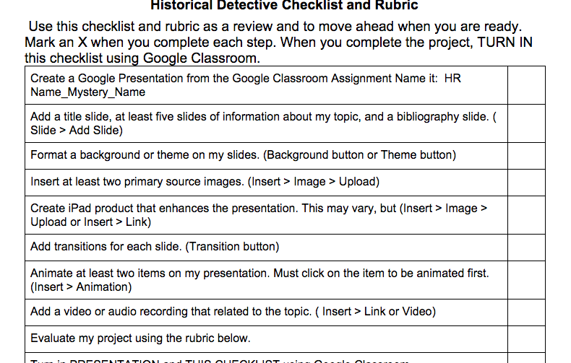
Notes:
Because this is a project I do in my media class, students use an online checklist in a Google Doc while they work through the project, and submit everything electronically. They also self assess using this checklist and rubric. http://www.loc.gov/teachers/tps/ into chat window.

Slide 10
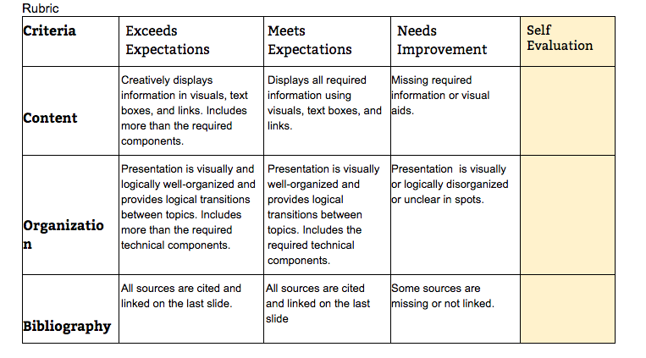
Notes:
We usually have a day set aside for presentations. You might notice that the rubric is focused on presentation and organization skills because it is a project I do in my fixed schedule media class and I’m evaluating those skills in this project. It’s a target skill I’m focusing on while teaching many other skills and it’s manageable when you are doing it with 100+ students. If this was a project in a social studies or ELA collaboration, I would update this rubric.

Slide 11
Notes:
Here are some examples of student work. Students decide how they will format their presentation, and reveal their mystery person to the class. You’ll notice that this one has an embedded Tonntastic video that the student created.

Slide 12
Notes:
Do you know who this is? In this student’s presentation he used animation effects to reveal the face of Sally Ride.

Slide 13
Notes:
This is a primary source picture of one of our mystery people as a child.

Slide 14
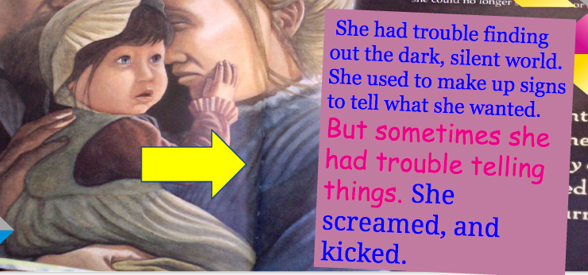
Notes:
This student took photos of a picture book about Helen Keller and used them as her background in Google Presentation. To evaluate student’s work, they self evaluate, peer evaluate using comments and I evaluate. Go back to slide 10.

Slide 15
Fifth Grade Animated Food Webs
Notes:
On to another use of Google Presentation, animating food webs. This project was a collaborative effort between our Science Coach, Michelle Leizman, Melanie Musulin, a 5th grade science teacher, and myself. We discussed ideas, and I created a template for students and for teachers using Google Presentation. The directions for students were actually put right into the template notes. Because we used Google Classroom, this was easy to do. It also let the teacher differentiate easily.

Slide 16
Notes:
One thing students needed to do was to place their animal in a food chain template or create their own version. Incidentally, it was good preparation for online assessments (yuck!).

Slide 17
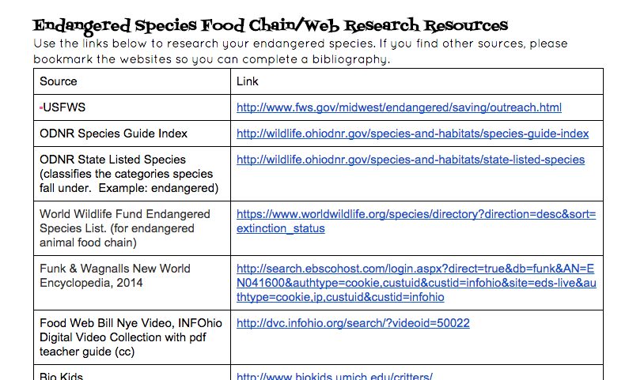
Notes:
I created this Google Doc of web research resources for the students and another similar document for the teachers as a resource for

Slide 18
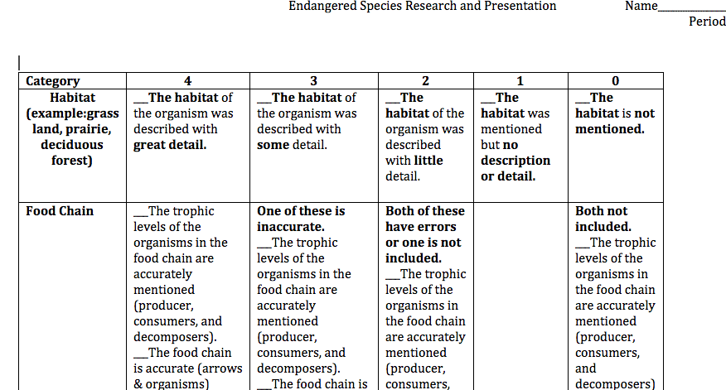
Notes:
We focused on 5th grade science standards and used this rubric as a guide for students.

Slide 19
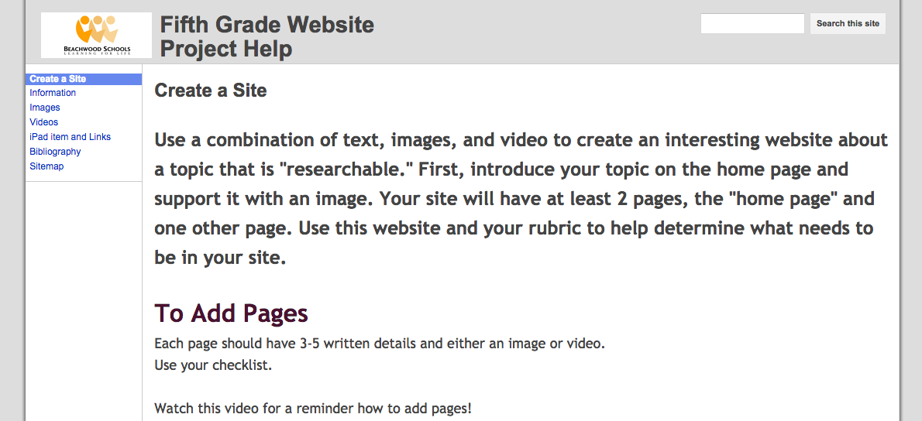
Fifth Grade Website
Notes:
On to my favorite culminating project, the 5th grade research website. Fifth graders start by doing an INFOhio webhttps://drive.google.com/file/d/0B270Vss4v8FNOW5XOWxqV19SR2c/view?usp=sharing minilesson

Slide 20
Fifth Grade Website Template
Notes:
Differentiation, fifth grade template, used for all

Slide 21
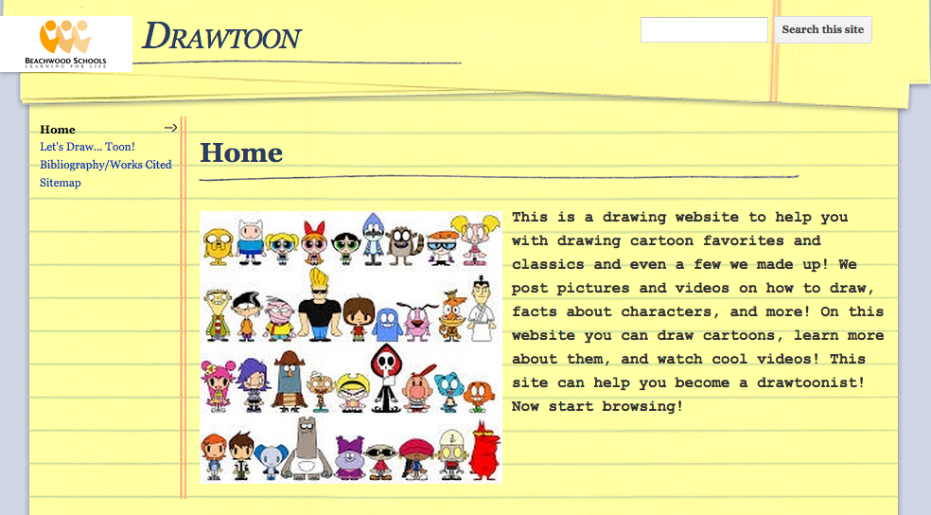
Notes:
Introduction, requirements

Slide 22
Notes:
Images to support, use of INFOhio reliable source, https://youtu.be/SfFuoLRPc74 video 1:22 in or https://youtu.be/3w1lg5P6yWc Elmo interview

Slide 23
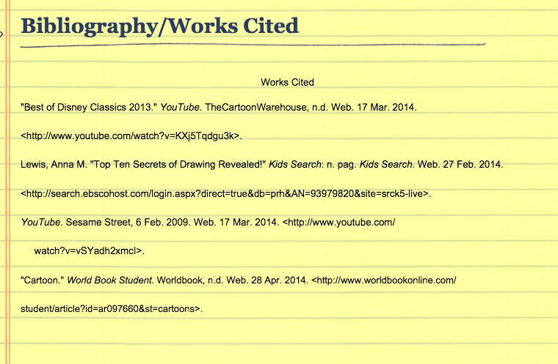

Slide 24
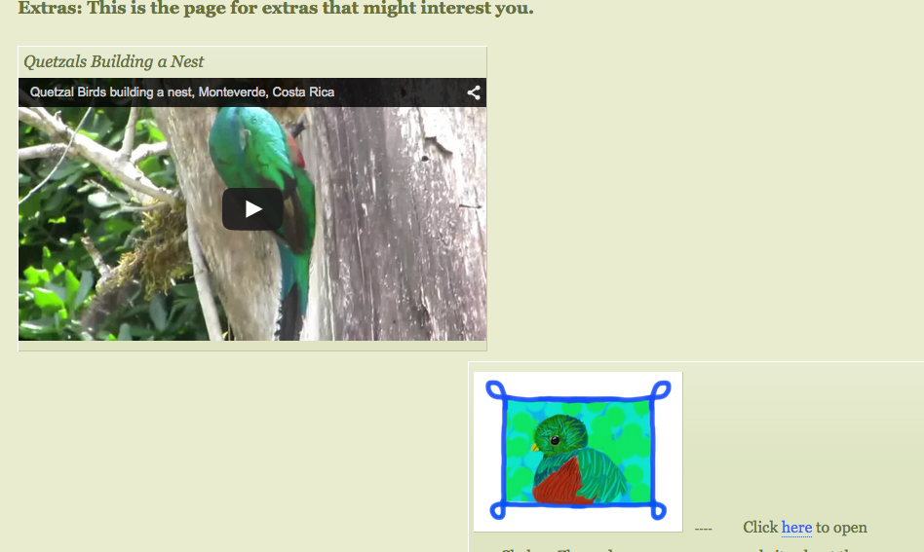
Notes:
Video and iPad item

Slide 25
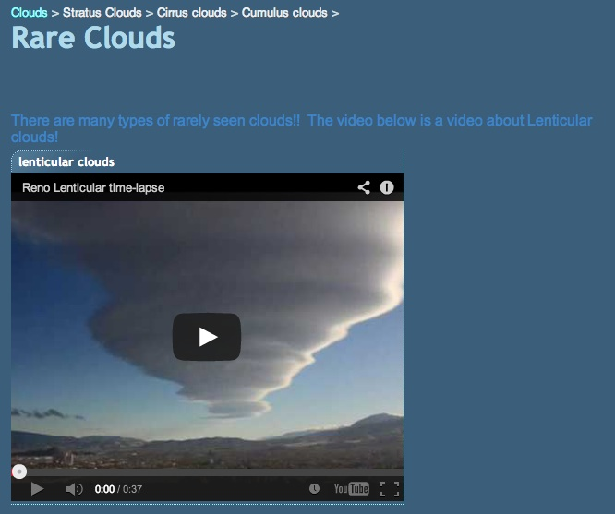
Notes:
In depth

Slide 27
Multimedia Research Presentations
Angela Maxwell
amm@beachwoodschools.org
@librarymax
They’re Elementary!

